Slide 1

Mission
Supporting Undocumented Students
Rights, Responsibilities, and Resources
Flex Day Presentation
Cañada College – January 10, 2020

Slide 2
Today’s Agenda
Welcome and Introductions
Group pre-quiz
Rights and benefits
Test your knowledge
Resources
Next Steps

Slide 3
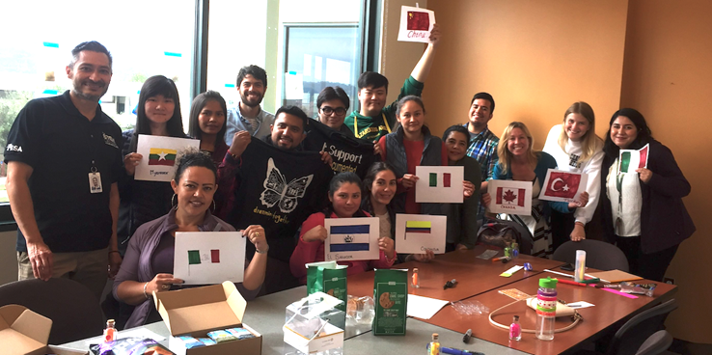
Why Are We Here?

Slide 4
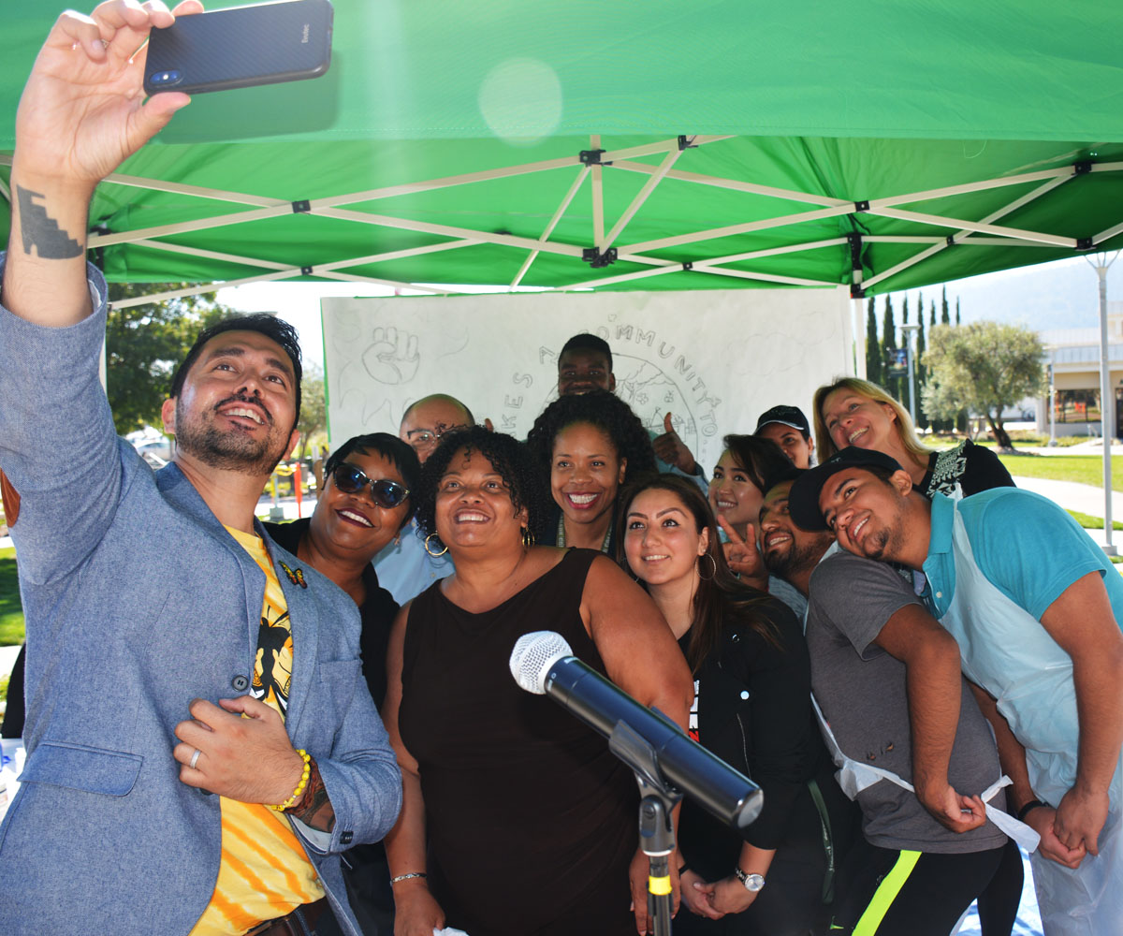
Learning Outcomes
Developing Professional Responsibility
Incorporating Equity Minded Language
Identifying Resources

Slide 5
Group Pre-Quiz
Which is the equity-minded term to use and why: Undocumented immigrant or illegal immigrant?
How might being part of a mixed status family impact a student?
Name 2 specific ways that our campus offers support for immigrant students of any status:
What should you do if approached by ICE on campus about a student?

Slide 6
Rights and Benefits
Instructions:
  Read the Rights and Benefits boxes closely
  Match the statuses to the cards.
  Cards
    U.S. Citizens
    Permanent Residents
    Student Visa Holders
    Undocumented Immigrants with DACA
    Undocumented Immigrants

Slide 7
Rights and Benefits - U.S. Citizens
Permission to work
  On campus only
Eligibility for federal financial aid
Eligibility for State Financial Aid
Free, public K-12 education
Authorization to be in the U.S.
  Permanently
  Not subject to protentional detention and/or deportation
Can leave the U.S and Return
  Without time restrictions
Can leave the U.S and Return
  Without time restrictions
Can petition certain family members to immigrate
  Including immediate relatives without much delay
Eligibility for public assistance
  Without waiting periods
Can vote in U.S. elections and serve on juries
Eligibility to Study Abroad Program

Slide 8
Rights and Benefits – Permanent Residents
Permission to work
Eligibility for federal financial aid
Eligibility for State Financial Aid
Free, public K-12 education
Authorization to be in the U.S.
  Permanently
Eligibility to Study Abroad Program
Can leave the U.S and Return
  Without time restrictions
Can petition certain family members to immigrate
  Including immediate relatives without much delay
Eligibility for public assistance
  Without waiting periods
Not subject to protentional detention and/or deportation
Permission to work on campus only
Can vote in U.S. elections
and serve on juries

Slide 9
Rights and Benefits – Student Visa Holders
Permission to work
  On campus only
Authorization to be in the U.S.
Can leave the U.S and Return
Eligibility for federal financial aid
Eligibility for State Financial Aid
Free, public K-12 education
  Permanently
  Not subject to protentional detention and/or deportation
  Without time restrictions
Can petition certain family members to immigrate
  Including immediate relatives without much delay
Eligibility for public assistance
  Without waiting periods
Can vote in U.S. elections and serve on juries
Eligibility to Study Abroad Program

Slide 10
Rights and Benefits
– Undocumented Immigrants with DACA
Eligibility for State Financial Aid
Free, public K-12 education
Not subject to protentional detention and/or deportation
Permission to work
  On campus only
Eligibility for federal financial aid
Authorization to be in the U.S.
  Permanently
Can leave the U.S and Return
  Without time restrictions
Can petition certain family members to immigrate
  Including immediate relatives without much delay
Eligibility for public assistance
  Without waiting periods
Can vote in U.S. elections and serve on juries
Eligibility to Study Abroad Program

Slide 11
Rights and Benefits – Undocumented Immigrants
Eligibility for State Financial Aid (AB540 & SB68 only)
Free, public K-12 education
Permission to work
  On campus only
Eligibility for federal financial aid
Authorization to be in the U.S.
  Permanently
  Not subject to protentional detention and/or deportation
Can leave the U.S and Return
  Without time restrictions
Can petition certain family members to immigrate
  Including immediate relatives without much delay
Eligibility for public assistance
  Without waiting periods
Can vote in U.S. elections and serve on juries
Eligibility to Study Abroad Program

Slide 12
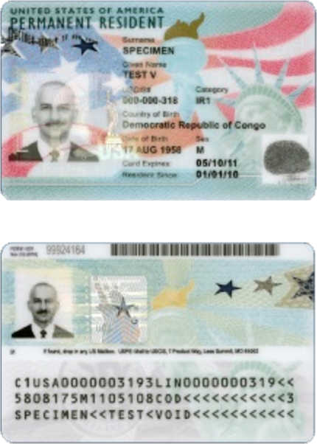
Immigration 101
Different types of immigration status
  US Citizen
  Lawful permanent resident (aka “green card”)
  Non-immigrant status
    International student
    H1 work visa
  No status
    Visa overstay or never had status
Pathways for immigration status
  Through family or work
  Humanitarian basis
  (asylum, victim of crime, DV or
  trafficking, special pathways for minors)

Slide 13
Unauthorized Practice of Law
Against the law
Criminal
In California, it is illegal and a crime to provide legal advice if you are not a licensed attorney.
CA Business & Professions Code sections 6125 & 6126

Slide 14
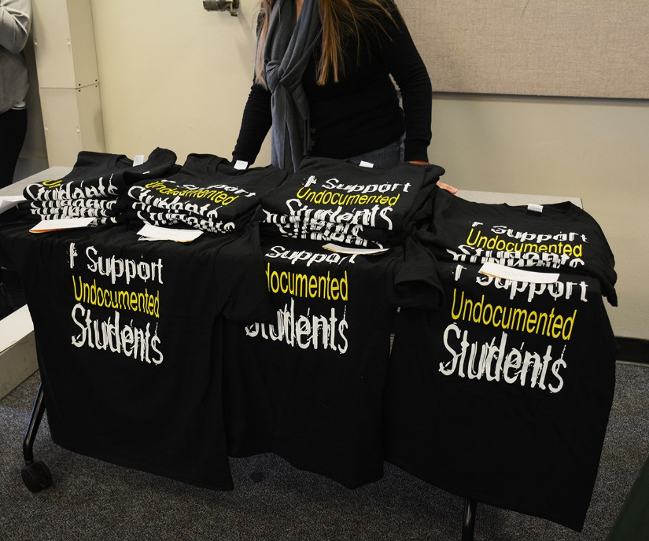
Remember
Undocumented individuals have rights
  Workplace
  School (e.g., FERPA)
  Due process
Free and confidential legal consultation

Slide 15
Testing Our Knowledge - Scenarios
A professor/counselor/mentor notices that an amazing student’s work is slipping, and the student is disengaged in class, so they approach the student and inquire about what is going on. It comes out that the student’s parents are undocumented and are in the process of being deported. The parents were the primary source of financial support for them and their two younger siblings, who are in elementary school and middle school respectively. The student is now responsible for their siblings and is receiving minimal financial support from their parents. The student expresses concern about failing their current classes, and no longer being able to take classes full time. This would mean losing access to their financial aid and eligibility in EOPS.

Slide 16
Testing Our Knowledge - Scenarios
  What could the professor/counselor say or refer them to,
  to support them?
  How might the circumstances of this situation play out
  in your own service area?
  What could you do to support a student like this?

Slide 17
Testing Our Knowledge - Scenarios
A student goes to a student service office on campus to get necessary information about X. The program staff asks her if she is an international or AB540 student. Although she is undocumented, she is not an AB540 student and feels scared to reveal this information, so she says she is an international student. Therefore, the staff person gives her information based on the student being an international student (with those rights and benefits). As a result, the student does not get accurate information about X that applies to her situation.

Slide 18
Testing Our Knowledge - Scenarios
What could the staff person have done differently to ensure that this student received the information she needed?
Are there any ways that your service area may be alienating or not sufficiently serving undocumented students?
How can your service area ensure that all students feel welcomed and have access to as many resources as possible?

Slide 19
Dream Center Resources and Services
  The Cañada College DREAM Center is a resource center & safe space for undocumented students, community members & allies.
  Services include:
  Assistance with AB 540, DREAM Act, DACA & scholarship applications
  Connect Dreamers to appropriate resources and services
  – SparkPoint, Financial Aid, PCC
  Free Legal Clinic – 207 clients served 242 times
  Professional development including information workshops for students and staff to understand challenges and resources.
  Daily News & Immigration Policy Updates

Slide 20
Dreamers Club
Accomplishments
Event Participation
  ESL Event
  Club Rush
  Latinx Celebration
  Undocumented Student Week of Action
Increased Membership
  Classroom Visits
T-Shirt Design
Goals
Search for Scholarships
Create a New Logo
Website Update
Create Community Events
More Classroom Visits

Slide 21
Next Steps
Visit the Dream Center: Bldg 9-219B
  Stop by and say “Hi” to Saúl
Attend Dreamers Task Force Meeting
  Thursday, January 23rd, 3pm - 4:30pm, Bldg 3-117
Legal Clinic: Spring 2020 Schedule
  Wednesday, 10am-1pm, Bldg 9-219B
Attend our next Flex Day workshop!

Slide 22
Reach out to us!
Saúl Miranda - Dream Center
Program Services Coordinator
650 – 306 – 3466
mirandas@smccd.edu
Julie Carey
Professor – ESL
careyj@smccd.edu
Alison Field
Professor – History
fieldsa@smccd.edu
Nimsi Garcia
Program Services Coordinator
garcian@smccd.edu
Adolfo Leiva
Director – SparkPoint
leivaa@smccd.edu
Kiran Malavade
Professor – English
malavadek@smccd.edu
Yesenia Mercado
Financial Coach
mercadoy@smccd.edu
Yolanda Valenzuela
Professor – English/Reading
valenzuelay@smccd.edu
Ariela Villalpando
Program Services Coordinator
villalpandoa@smccd.edu
https://canadacollege.edu/dreamers/index.php

