Slide 2
Canada College is committed to the health and safety of its students, faculty and staff and to maintaining a safe environment.

Slide 3
Cañada has established a CARES Team Canada Assessment, Response and Evaluation of Students to provide assistance to anyone on campus.

Slide 4
The CARES Team serves as the centralized, coordinated group for discussion and action regarding students exhibiting behaviors which are of concern.

Slide 5
Chaired by - Vice President, Student Services (VPSS)
Counselor, Personal Counseling Center
Academic Counselor
Director, Disability Resource Center
Dean of Counseling
Public Safety Representative
VPSS Executive Assistant

Slide 6
Faculty and Staff Role
Each member of the Cañada community has a responsibility to help students succeed. Early prevention and intervention is key to this goal.
Often, a faculty or staff person is in a position to offer the first helping hand to a student as well as recognize at risk students or those becoming at risk.
Each of us has our own comfort level but a flow of information to the CARES team is very important.
Remember, do the best you can and let our team assist you and the student.
The most important thing is that you do something.

Slide 7
When to Submit a Report
A student might directly confide his or her concerns to you
You might infer that he or she is in distress by observing the student's behavior.
Marked change in student’s appearance, academics or attendance
Personal safety concern for you or other students/threatening words or actions
A student's behavior indicates acute personal distress that needs intervention
Disruptive or disturbing behavior, signs of alcohol or drug intoxication
Writings that convey clear intentions to harm self or others

Slide 8
Talking with a Student
If the student is exhibiting bizarre or disturbing behavior or is intimidating you or others, contact Public Safety 650-738-7000 immediately.
If the situation is less severe, you think the student might be open to discussing their concerns with you, and you are comfortable and willing to do this:
Let the student know that you've noticed that he or she has been having difficulty lately.
Give specific examples, such as "You've been crying," or "You're no longer participating in class."
Ask if the student would like to talk with you about it.
Respond to those students who disclose their personal concerns to you by:

Slide 9
Measure of Mental Health- Related Risk: The “D” Scale:
Distressed Behaviors: Nervous or anxious, sad, crying, or depressed, inability to concentrate, spaced-out or disheveled appearance, angry, under the influence, excessive demand for reassurance/support, expressing suicidal thoughts
Suggested actions:
•Talk with student privately or confidentially
•Register concern
•Inform student about available assistance
•Submit a CARES Report
•Whenever a student expresses suicidal thoughts, take them seriously and get help immediately by walking them to PCC or calling Public Safety at 650-738-7000

Slide 10
Disruptive Behaviors: Causing disruption in or outside of classroom, inappropriately focusing attention on self, irrational or inappropriate, unrelated or bizarre comments, verbally abusive, defiant, exhibitionist
Suggested Actions:
•Always protect personal safety
•Protect safety of others, if possible
•If appropriate:
•Speak with student privately and confidentially
•Show concern/acknowledge feelings
•Set limits for acceptable behavior
•Submit a CARES Report
•If discussion with student seems inappropriate, dangerous, or ineffective, request student leave class and contact Public Safety immediately at 650-738-7000 .

Slide 11
Dangerous Behaviors: Danger to self or others, acting out and appears to be potentially violent, violent behavior toward self or others, threatening to harm or kill self or others
Suggested actions:
Always protect personal safety
Protect safety of others if possible
Immediately call 911
If you feel safe, buy time by talking calmly and with concern until help arrives.

Slide 12
Students can write a CARES Report
Student are also encouraged to write reports
Students come in contact with other students who are distressed, disruptive or dangerous.
Students often see and hear behaviors we do not, especially on social media

Slide 13
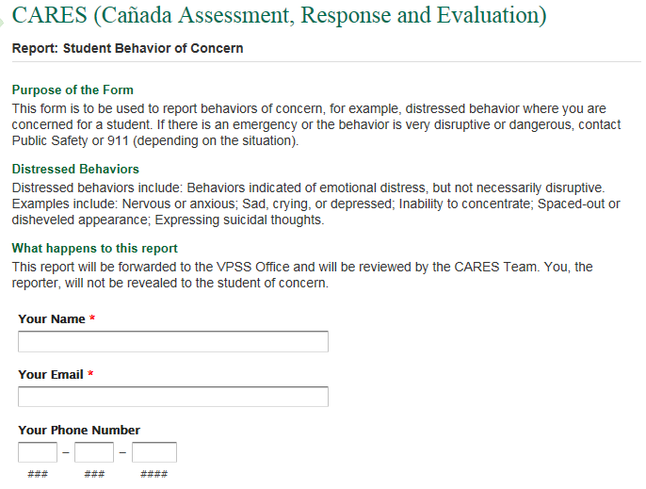
Fill out the form online

Slide 14
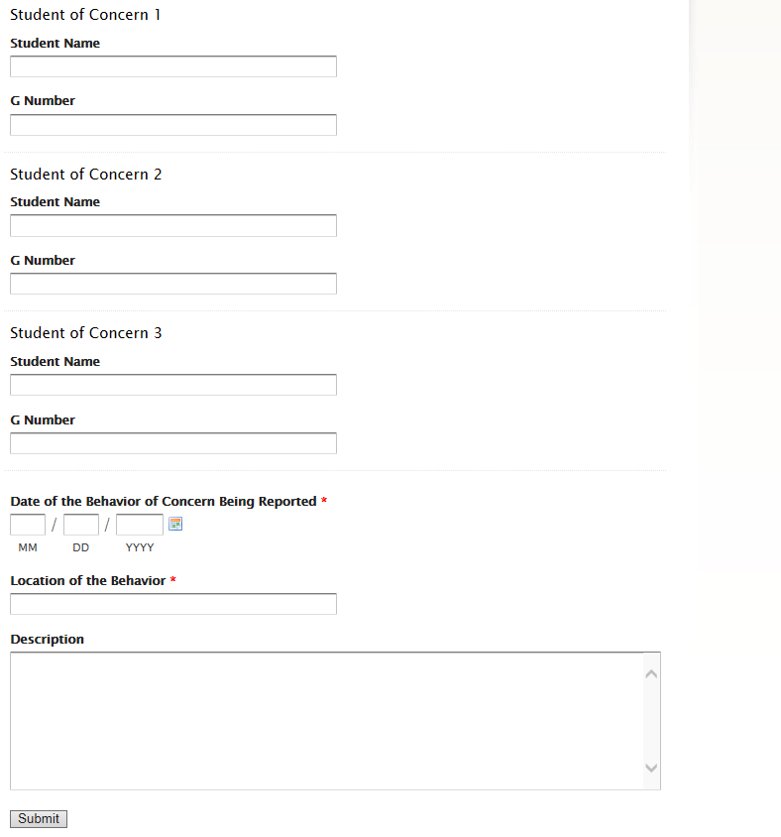

Slide 15
Follow up email
Faculty and staff will receive an email letting them know that CARES is working on the case

Slide 16
Questions?

