Slide 1
The Impact of ePortfolios
What does current research show are the impacts of requiring students to construct ePortfolios?
What can we learn from this at Cañada?
Jeanne Gross and Carol Rhodes
February 27, 2015
Academic Senate Governing Council

Slide 2
Examples of ePortfolio at Cañada
ILO Assessment:
Portfolio Pilot Project Assessment Report 2012-2013
Portfolio Evaluation for ILO Assessment 2013-2014
PLO Assessment: Engineering, Biological Sciences, ESL, ASCC
Student sample
ESL 400/LIBR 100 Academic Scholarship and Success Learning Community:
Student sample 1
Student sample 2
Student sample 3
ALLIES Digital Literacy Project, led by Kathy Haven: 7 faculty trained, 100+ low level ESL students created ePortfolios:
Student sample 1
Student sample 2

Slide 3
Connect to Learning (C2L) -- Fipse-funded project
The Making Connections National Resource Cnter, La Guardia Community College
24 institutions established ePortfolio projects in national community of practice
Questions posed:
What difference can ePortfolios make?
What does it take for ePortfolios to make a difference?
Findings reported What Difference Can ePortfolio Make? Eyon, Gambino & Török:
ePortfolio initiatives advance student success
Making student learning visible, ePortfolio initiatives support reflection, social pedagogy, and deep learning
ePortfolio initiatives catalyze learning-centered institutional change

Slide 4
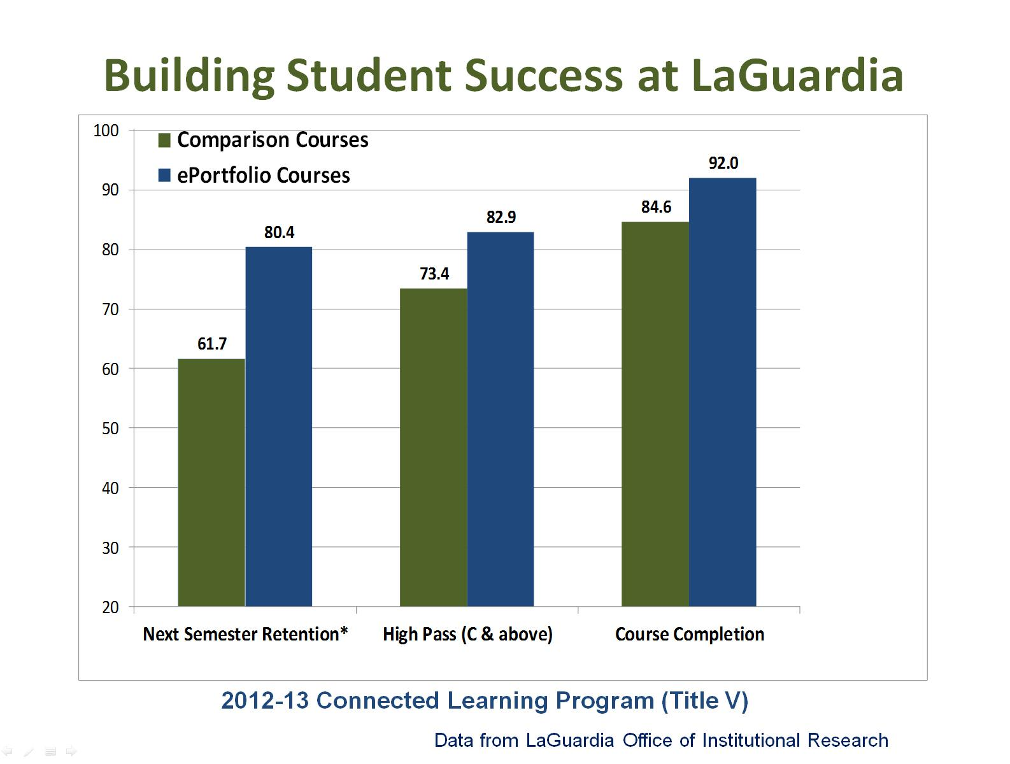
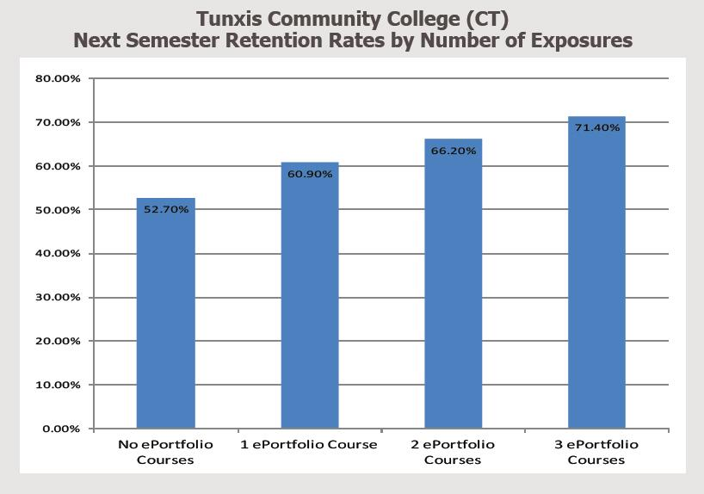
ePortfolio Initiatives Advance Student Success
From La Guardia, students in ePortfolio-intensive courses are more likely to pass their courses and return the next semester, and at Tunxis that Students with multiple ePortfolio courses demonstrate higher retention rates

Slide 5
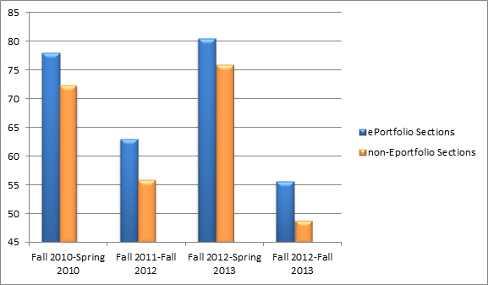
ePortfolio Initiatives Advance Student Success
Tunxis Community College, Connecticut, Developmental English data:
San Francisco State University: Data shows that retention and graduation rates for Metro Academy, high-risk students are higher than university-wide averages
 | Metro Academy 1St year ePortfolio | All SFSU First Year
1 Yr Retention rate | 90.0% | 79.3%
2 Yr Retention rate | 79% | 60%
4 Yr Graduation rate | 24.6% | 14.9%

Slide 6
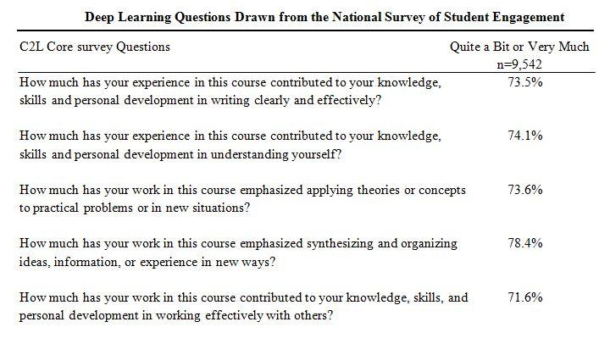
ePortfolio Initiatives Support Reflection and Deep Learning
Survey of 9,542 students in the 24 participating institutions indicated significant student perception of deep learning in courses using ePortfolios:
Data shows that students are more likely to engage in deep, integrative learning when faculty and other students look at the portfolio and comment. Dr. Helen Chin, Stanford, analyzed Core Survey data from C2L, found strong correlation between high levels of feedback and deeper ePortfolio impact. 85.4% of the students who reported high levels of peer feedback Agreed or Strongly Agreed with the statement “Using ePortfolio has allowed me to be more aware of my growth and development as a learner.” Students who received low levels of peer feedback was 30.6%.
Crossing Borders: A Narrative of Social Pedagogy

Slide 7
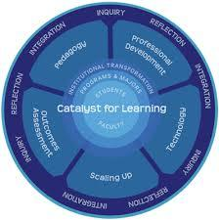
ePortfolio initiatives catalyze
learning-centered institutional change
C2L research suggests that sustained, effective ePortfolio initiatives build vibrant programs with work in five interlocking sections:
Professional Development
Pedagogy
Technology
Outcomes Assessment
Scaling Up

Slide 8
Support at Cañada
CIETL Coordinator, Carol Rhodes, other ePortfolio faculty members
Online Resources:
ePortfolio page
video tutorials, instructor guides
Learning Center:
Supervising staff
Classroom presentations; developing ePortfolios, Jonathan MacSwain
Trained tutors
Library:
Faculty Display, ePortfolio resources
Valeria Estrada, Librarian

Slide 9
Discussion/Planning

