Slide 1
Board of Governors Fee Waiver
SMCCCD
Loss of eligibility
regulatory changes
Staff Training
March 14, 2016
Margie Carrington

Slide 2
Loss of Fee Waiver
September 27, 2012: SB 1456 Student Success Act of 2012
  New law will help students complete educational goals
  Begins implementation of Student Success Task Force recommendations 2.2 (mandated services), 3.2 (BOG Fee Waiver conditions), and 8.2 (Student Support Initiative)
  January 2014: Final Board of Governors Fee Waiver regulations adopted
  Section 58621 of subchapter 7 of chapter 9 of division 6 of title 5 of the California Code of Regulations is added

Slide 3
Key Provisions
  The student becomes ineligible for the BOGFW if placed on academic or progress probation, as defined in section 55031(a) or (b), or a combination for two consecutive primary terms
  Fall and spring semesters for colleges on a semester system
  Fall, winter, and spring quarters for colleges on a quarter system
  Terms are considered consecutive on the basis of the student’s enrollment so long as the break in the student’s enrollment does not exceed one primary term – recent guidance from CCCCO to go back up to 4 terms
  Loss of eligibility shall become effective at the first registration opportunity AFTER such determination is made
  Loss of BOGFW eligibility shall not occur prior to the fall 2016 term
  Excludes Foster Youth (up to age 24) – expires on January 1, 2017

Slide 4
Implementing Regulations
Districts required to begin notifications to students following the spring 2015 term
Notice of future BOGFW eligibility risk to ALL at-risk students
Not just current BOGFW at-risk students
Required within 30 days from the end of the term - ongoing
Districts must ensure that the requirements of this section are fully operational for registration for the fall 2016 term
Includes information in board policies, catalogs, websites, etc.
Each community college district shall establish written procedures to appeal the loss of the BOGFW

Slide 5
Notification
Dear SMCCCD Student,
This email is to alert you that you are currently failing to meet the minimum academic progress standards at one or more of the three colleges within the San Mateo County Community College District (Cañada College, College of San Mateo and Skyline College) and are at risk of losing future Board of Governors’ Fee waiver (BOGFW) eligibility.
The most recent assessment of your academic standing was made after final grades were processed at the end of the spring 2015 semester. The minimum academic and progress standards are defined as a 2.0 cumulative GPA and a 50% completion rate for all attempted units within the SMCCCD.
Recent changes made to Title 5 of the California Education Code by SB 1456 Student Success Act of 2012 state that beginning in Fall 2016, a student who fails to meet the minimum academic and progress standards of the institution for two consecutive semesters (fall and spring semesters, excludes summer) is at risk of losing eligibility for the Board of Governors’ Fee Waiver (BOGFW). If you currently do not receive the BOGFW, you are still at risk of losing future eligibility until you regain good academic progress standing.
To learn more about this recent change and the steps you can take now to improve your academic progress standing, please see http://smccd.edu/faprobation/.
The SMCCCD Colleges have a wide variety of support services and programs to help you successfully achieve your educational goals. You are strongly encouraged to take advantage of them.
Sincerely,
The SMCCCD Colleges

Slide 6
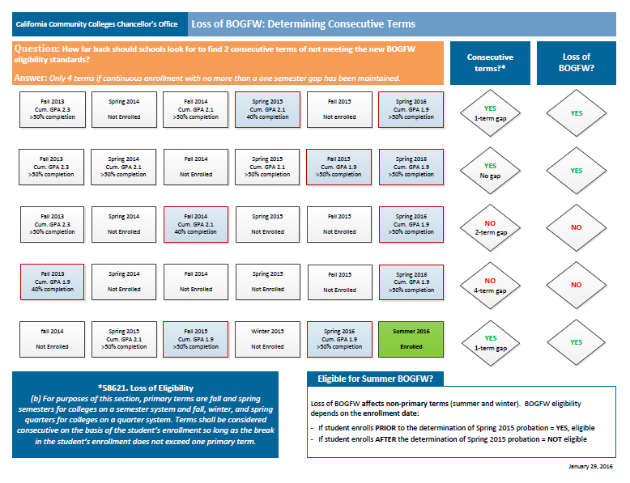
Determining Consecutive Terms

Slide 7
Appeals
  Extenuating circumstances
  Verified cases of accidents, illnesses
  Documented changes in student’s economic situation
  Evidence the student was unable to obtain essential support services
  Factors associated with Veterans, CalWORKs, EOPS, and DSPS status
  Student with a disability applied for, but did not receive reasonable accommodation in a timely manner
  Significant academic improvement in term (2.0 GPA/50% Completion)
    Optional to approve or grant automatic appeal
    A student who successfully appeals the loss of enrollment priority shall also have BOGFW eligibility restored (ONE APPEAL PROCESS)

Slide 8
SMCCCD Status/Process
  Common Appeal Form
  Local Committee
  SMCCCD Resource Page
  http://smccd.edu/faprobation
  Needs update
  Link Appeal Form
  CALBFA/CALBSTU Banner Releases late April/Install June
  FA TV Get SAP
  Loss of Enrollment Priority & BOGFW Modules

Slide 9
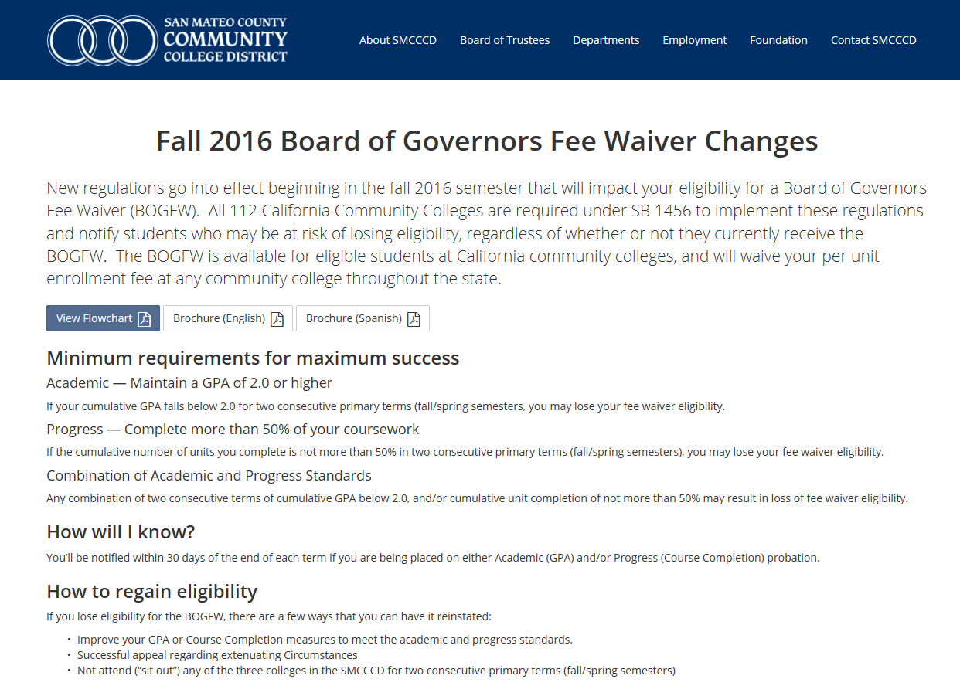
SMCCCD Resource Page

