Slide 1
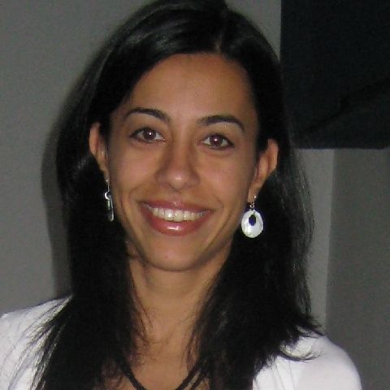




ASGC Taskforce on
Course Enrollment Maximum
Ana Miladinova
Athletics, Library, Learning Center
Hyla Lacefield
Business, Design & Workforce
Katie Schertle
Humanities & Social Sciences
Dani Behonick
Science & Technology

Slide 3

First Steps
CEM terminology
information collection

Slide 4
CEM Terminology!

Slide 5

Course Enrollment Maximums
set by dean
based on physical/regulatory limitations
  facilities (seating, room size)
  equipment
  fire safety
  other regulations
information stored in Banner
Physical Cap
Notes:
“this is the number of students that the physical limitations of the class will allow

Slide 6

Course Enrollment Maximums
set by faculty, in consultation w/ deans & approved by Curriculum Committee
based on pedagogy
  mode of instruction
  methods of assessment
  number of levels in classroom
  safety issues (e.g. physical activity courses)
information stored in ?
Pedagogical Cap

Slide 7
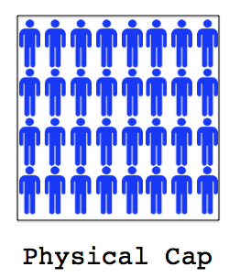

Course Enrollment Maximums
BLAH 100
Notes:
right now, we have only physical caps for our courses

Slide 8
Information Collection

Slide 9
http://curriculum.fullcoll.edu/PDFs/Class%20Size%20Resource%20Document.pdf

Slide 10
Feedback
would these metrics meet your needs?
if not, what would you change?

Slide 11
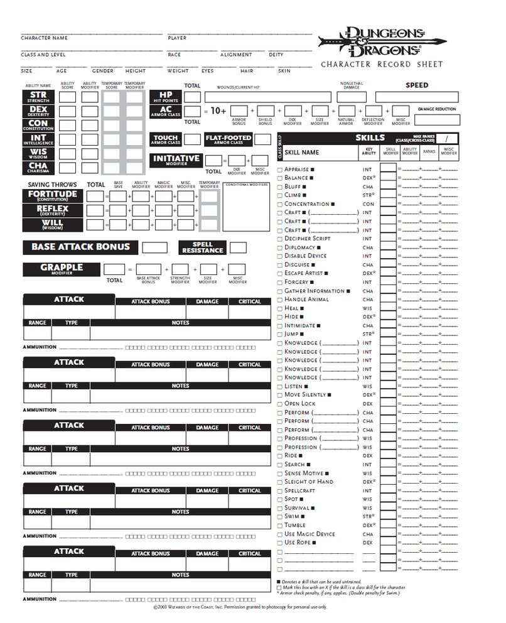

Slide 12
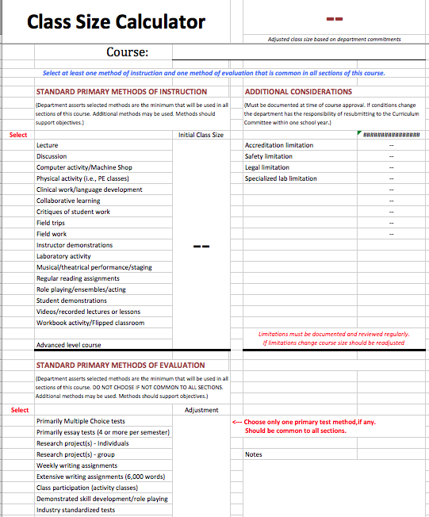
Notes:
demo actual calculator here!

Slide 13
Feedback
would this tool meet your needs?
if not, why/what would you change?

