Slide 1

Guided Pathways at Cañada College

Slide 2
Decline of Hope Upon Entering CC’s
81% of entering community college students indicate they want to earn a bachelor's degree or higher
33% of entering students actually transfer to a four-year institution within six years
Of those transferring, 42% earn a bachelors degree.
14% of the entire cohort of entering community college students earns a bachelor's degree within six years
Horn & Skomsvold, 2011; Jenkins & Fink, 2016
Of first-time college students who enrolled in a community college in the fall of 2009, 38.1% earned a credential from a two- or four-year institution within six years
National Student Clearinghouse Research Center, Shapiro & Dundar, 2015
Developmental Course Pathways are long and often result in dropout before students reach gateway courses.

Slide 3
Guided Pathways at Cañada College
Completion Crisis
  Students experiencing developmental education dropout at high rates before getting to gateway courses.
  Students aren’t finishing on time.
  Students are incurring higher debt.
  Students are taking excess credits.
Students Need
  Strong guided support.
  Less optional opportunities.
  Integrated career exploration throughout student lifecycle.
  Opportunities to explore majors, programs, degrees, and certificates

Slide 4
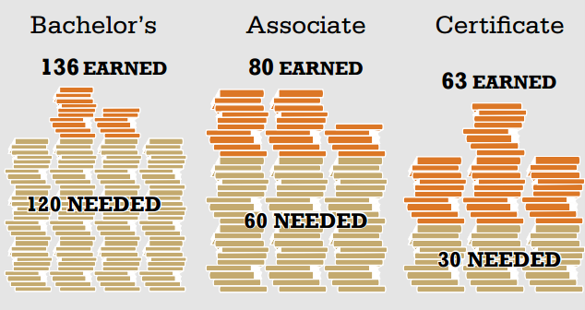
Excess Credits

Slide 5
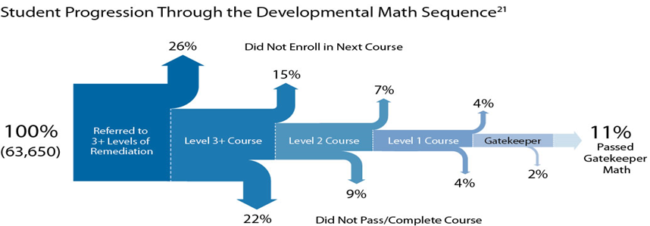
Development Education Pathways
Federal BPS (Beginning Postsecondary Students) data from 2009 indicate 68% of students beginning at public two-year colleges in 2003–2004 took one or more remedial courses in the six years after their initial college enrollment.
At four-year public colleges, it was 40 percent.
Chen & Simone, 2016

Slide 6
Excess Credits Impact
Student Learning
  Degree and Transfer
    Students are surprised to find that courses taken do not count towards credentials (Nodine et al 2012)
  Completion
    Students are not able to complete upon transfer because of loss of financial aid (Federal Aggregate Student Loan Limit=Associates +Bachelors)
Student Resources
  Time
    Longer time to complete increases cost of attendance (school and living expenses)
  Money
    Additional credits Cost Students additional $8 billion
    Cost to government $11B, potential federal student loan changes

Slide 7
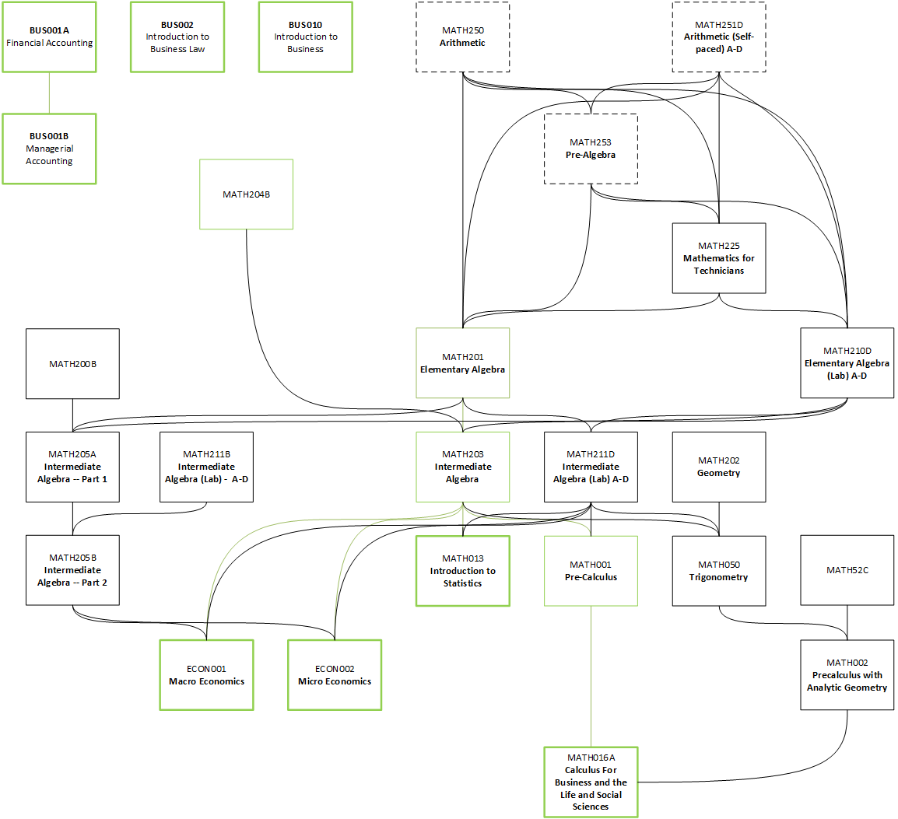
Typical CA CC Pathway

Slide 8
Student Voice about Choices
More than 50% Concerned about making a mistake when choosing classes (Moore & Shulock, 2014)
42% don’t have enough information about requirements (Rosenbaum et al, 2006)
Surprised to find that courses taken do not count towards credentials (Nodine et al 2012)

Slide 9
What are Guided Pathways?
Guided Exploration for Un/Decided Students
  Clustering of Programs of Study into Meta Majors
  Clearly Delineated Program Requirements (Default Sequences)
Improved Placement and Developmental Sequence
Integrated and Proactive Student Supports

Slide 10
What will Cañada do through June of 2019?
Coordinating oversight by Guided Pathways Steering Committee that will undertake three potential areas of inquiry and exploration utilizing $515,000 of resources over five years.
A work-plan must be submitted by March 31.
The plan can be flexible.
Additional dollars may be available through district support.
Three part plan:
  Curricular Exploration
  Business Process Analysis and Integrated Supports
  Student Voices and Focus Groups
From March through June 2018
  Form sub-committees
  Identify Leads and Release
  Formalize each plan

Slide 11
What will Cañada do through June of 2019?
#1
Curricular Exploration
A careful deliberate process that will undertake:
Reading and review of best practice including reading circles and communities of practice.
Data dives relevant to our own student data.
Developing a research and data portal.
Visits to other CA colleges that are undertaking this process.
Guest speakers to guide our College on their college process.
Outcomes
Awareness of the work we need to do.
Awareness of our student data.
The tentative exploration of Cañada Meta Majors

Slide 12
What will Cañada do through June of 2019?
#2
Business Process Analysis for Integrated Support
A careful deliberate process that will undertake:
Review of best practices in integration
Assessment and inventory of our own integrations.
Training for staff in Lean/Six Sigma
Mapping exercises of workflow for each services team.
Visits to other CA Colleges.
Consultation of best practice around integration and service.
Outcomes
Awareness of potential integration
Staff awareness of workflow and stopgaps for students.
Ability to inform resource request process.

Slide 13
What will Cañada do through June of 2019?
#3
Student Voices and Focus Groups
A careful deliberate process that will undertake:
Assessment of students that need to be included.
Assessment of process for focus groups.
Development of tolls/materials to include students as researchers in the process.
Utilization of research-based best practices to inform focus groups.
Development of two cycles of focus group research to inform campus.
Development of visual tools to convey student voices
Outcomes
Awareness of all student concerns related to GP
Capturing voices qualitatively
Ability to use data to inform larger GP process.

Slide 14
Honor the Past. Transform the Future.
CanadaCollege.edu/50

