Slide 1

Professional Development in the SMCCCD
Presentation to Academic Senates
Skyline College 5/2/2019 – Cañada College 5/9/2019 – CSM 5/14/2019
Paul Rueckhaus, AFT president / Leigh Anne Shaw, DAS president

Slide 2
Timeline
2018 – District Senate was told that campuses were not accessing their professional development funding – significant totals were being rolled over from year to year. Local senates discussed and illuminated concerns.
December 2018 – a joint study session by AFT and DAS was held wherein faculty reviewed the PD processes at each campus and developed a list of concerns they wished to see addressed.
March 2019 – DAS and AFT developed a proposal for ultimate negotiation; began process of sharing at local campuses and getting feedback

Slide 3
Types of professional development

Slide 4
Proposed use for Article 13 funds
✓
✓
✗
✗
✓

Slide 5
Proposed activities NOT appropriate for Article 13 funding
Implementation of State Mandates and Campus Initiatives | Training on Software and data management programs | Participatory governance
Campus redesign Guided pathways/ metamajors General Education Redesign Learning Communities Basic Skills and similar initiatives (e.g., acceleration) Dual Enrollment initiatives Adult Ed. Initiatives Promise scholars | Canvas (See MOU for teaching in Distance Ed.) Student Management System (e.g., Salesforce) TracDat SPOL Banner AdAstra WebSmart Curricunet Any software program essential to the management of a classroom, department or program. | Any activities related to state or regional meetings of mandatory governance committees (e.g., Academic Senate, Curriculum Committee). Any training having to do with program and institutional assessment, reporting and tracking; accreditation; or other administrative processes that faculty may carry out.

Slide 6
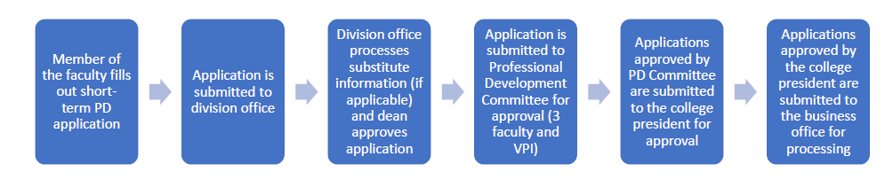
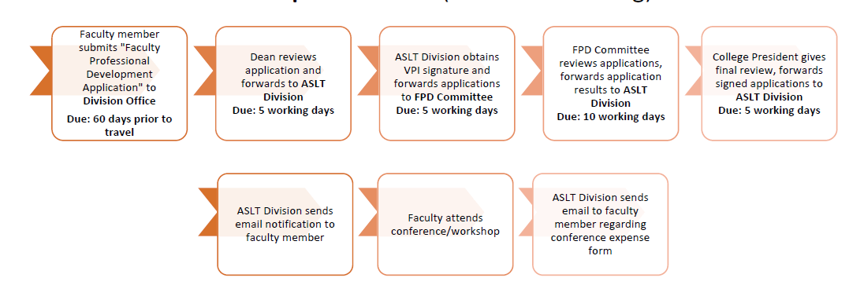
CSM PD Process
Sky PD Process

Slide 7
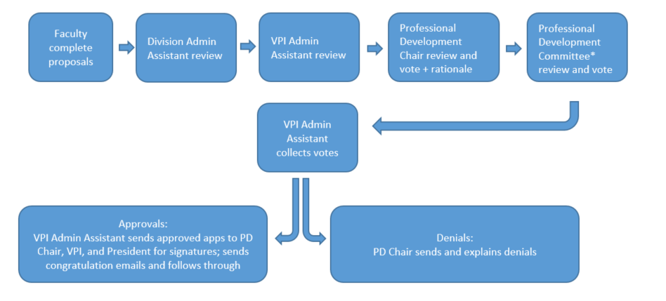
CSM PD Process
Cañ PD Process

Slide 8
Negotiations Update
Proposed by AFT: An increase from 1% to 2% to cover sabbaticals and long-term (Note: both CSM and Can have exhausted PD funding for the remainder of the year until the allocation in October 2019.) Rejected by District.
Proposed by SMCCCD: A change to the composition of PD committees at each campus to 3 Senate appointees and 3 administrative appointees.

Slide 9

Discussion

Slide 10

Thank You

