Slide 1


Slide 2
What is accreditation?
Accreditation is a voluntary system of self-regulation developed to evaluate overall educational quality and institutional effectiveness.
Accreditation is a regular self-evaluation of how well we are living up to the standards set by the Accrediting Commission for Community & Junior Colleges (ACCJC).
An independent, external team of our peers (from other colleges) reviews our self-evaluation and visits our campus to determine if we are meeting the standards.

Slide 3
Where are we in the process?
The review process includes four steps:
An internal self-evaluation – DONE!
An external evaluation by a team of peer reviewers (September 30 - October 3, 2019)
Commission review and accreditation action (January, 2020)
An institutional response to recommendations for improvement (2020)

Slide 4
Mission
Cañada College provides our community with a learning-centered environment, ensuring that all students have equitable opportunities to achieve their transfer, career education, and lifelong learning educational goals. The College cultivates in its students the ability to think critically and creatively, communicate effectively, reason quantitatively, and understand and appreciate different points of view within a diverse community.
Vision
Cañada College is committed to being a preeminent institution of learning, renowned for its quality of academic life, its diverse culture and practice of personal support and development, extraordinary student success, and its dynamic, innovative programs that prepare students for the university, the modern workplace, and the global community.

Slide 5
Students
6,700

Slide 6
Students
6,700
The Community

Slide 7
Students
6,700
Faculty
220
The Community

Slide 8
Students
6,700
Staff
94
Faculty
220
The Community

Slide 9
Students
6,700
Staff
94
Faculty
220
Administrators
24
The Community

Slide 10
Students
6,700
Staff
94
Faculty
220
Administrators
24
The Community

Slide 11
Participatory Governance
How the College sets priorities and makes decisions

Slide 12


Slide 13
Students Faculty Staff Administrators

Slide 14
Students Faculty Staff Administrators
Working Together for Student Success!

Slide 15
Staff
Faculty
Students
Administrators

Slide 16

Participatory Governance Structure
As of 11.7.18
SMCCD Board of Trustees
Chancellor
President
PBC
Staff
Faculty
Students
Admini-strators
ASCC
(students)
Academic Senate (faculty)
ClassifiedSenate (staff)
Cabinet
(VPs, all Deans, Marketing)
Staff
Faculty
Students
Administrators
Staff
Faculty
Students
Administrators
Staff
Faculty
Students
Administrators
APC
IPC
SSPC
Key:
= recommendations
= decisions
Programs
Program Review, Resource Requests, Staffing Requests
Deans
College Mission

Slide 17
Committee Reporting Structure
As of June 25, 2019
President
Academic Committee for Equity and Success (ACES)
Strategic Enrollment Management Committee
Report to the Planning & Budgeting Council (PBC)
PBC
Staff
Faclty
Studnts
Admin
ASCC
(students)
Academic Senate (faculty)
ClassifiedSenate (staff)
Curriculum Committee
Subcommittee of the Academic Senate
Staff
Faculty
Students
Administrators
Staff
Faculty
Students
Administrators
Staff
Faculty
Students
Administrators
APC
IPC
SSPC
Environmental Sustainability Committee
Professional Learning Committee
Safety Committee
Report to the Administrative Planning Council (APC)
Distance Education Advisory Committee
Honors Transfer Program Committee
Technology Committee
Report to the Instructional Planning Council (IPC)

Slide 18
Accreditation Standards
Standard I: Mission, Academic Quality and Institutional Effectiveness and Integrity
Standard II: Student Learning Programs and Support Services
Standard III: Resources
Standard IV: Leadership and Governance

Slide 19
Planning & Budgeting
How the College aligns its resources with its priorities and mission

Slide 20
Program Review
PURPOSE: Program review is the process through which constituencies on a campus take stock of their successes and shortcomings and seek to identify ways in which they can meet their goals more effectively.
A candid self-evaluation supported by evidence
Guides internal decision making
Provides external accountability (accreditation)
Connects program review with the college mission, planning, and budgeting
Faculty and Student Service Programs describes and documents what they do and why they do it
Instructional Program Review is faculty led: at Cañada the Academic Senate delegates process of peer review of program reviews to IPC
SSPC facilitates the peer review of student services program reviews
APC facilitates the peer review of administrative program reviews

Slide 21
August
November
December
February
March
April
May
October
September
January
Program Review Timeline
Oct. 30 – Nov. 1 Position Justification Presentations
Divisions provide information about prior‐ year grant‐funded positions
December 1
Validation concludes; PRIE & Budget Office provide information and rubric to PBC for prioritization
Dec - January
President announces approved positions
(contingent on funding)
Mid-April
Budget Office notifies Programs of approved requests funded for following year
August 1
Data Packets Available;
TracDat Open
Late Jan – Early Feb
IPC Program Review Presentations
Aug – Oct. 10
Departments conduct reviews
Deans provide feedback
Feb - April
VPA presents budget scenarios to PBC
November
IPC, SSPC, APC & PBC give Peer Review feedback in joint meeting
October
Cabinet reviews resource requests
November
Academic Senate prioritizes faculty position requests
October 21
DUE
Programs submit complete program reviews and all resource requests
November 8
Deans, VPs and President submit prioritized Division or Department resource requests
December 5
PBC prioritizes requests and presents President with prioritized list.
Mid-January
VPA presents 3-year revenue and expense projections to PBC
Mid-February
VPA returns to PBC with funding proposal
Late March
VPA & Deans discuss budget augmentation requests
Early June
VPA authorizes Divisions to make purchases
August Flex Day
Workshops
Approved by PBC on February 6, 2019

Slide 22


Slide 23
Canada Ed. Master Plan Goals:
Student Completion/Success
To provide educational and student services programs that help students meet their unique academic goals; minimize logistical and financial barriers to success; and highlight inclusivity, diversity and equity.
Community Connections
To build and strengthen collaborative relationships and partnerships that support the needs of, reflect and enrich our diverse and vibrant local community.
Organizational Development
To invest institutional resources on the structures, processes and practices that focus on a diverse student and staff population, promote excellence, equity, inclusion and transformative learning.

Slide 24
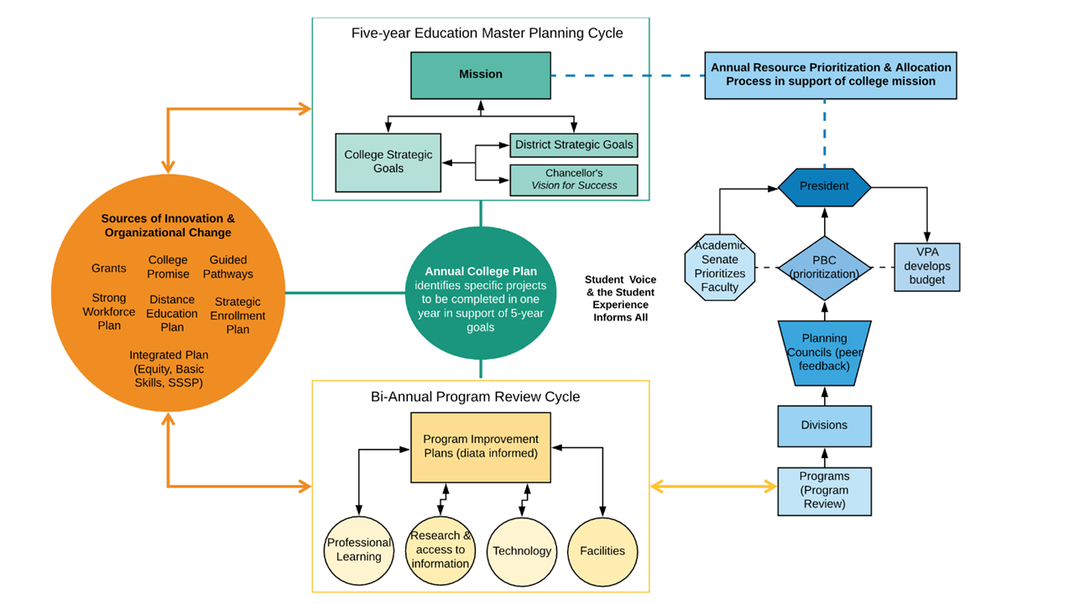

Slide 25
Cañada College Planning Calendar
Year: 2017 2018 2019 2020 2021 2022 2023 2024 2025 2026 2027
ISER 2019
Mid-Term Report
ISER 2026
ACCJC Annual, Mid-term, and ISER Report Cycle
5-year Education Master Plan Cycle
5-year Education Master Plan Cycle
Annual Plan
Annual Plan
Annual Plan
Annual Plan
Annual Plan
Annual Plan
Annual Plan
Annual Plan
Annual Plan
Annual Plan
Distance Education Plan
Facilities Master Plan
Guided Pathways Plan
Professional Learning Plan
Research Plan
Strategic Enrollment Plan
Strong Workforce Plan
Student Equity Plan
Sustainability Plan
Technology Plan

Slide 26
Measuring Effectiveness
How the College knows if it’s achieving its goals

Slide 27
Institution-set Standards: student achievement

Slide 28
Institution-set Standards: programmatic achievement

Slide 29
Institution-set Standards: operational metrics

Slide 30
What to expect when the ACCJC visiting team comes
Team Welcome event on Monday, Sept, 30 – faculty, administrators, classified staff, students, and board members (especially the college leaders and those closely involved with the ISER)
Team will use 6-111 as their office/home base during the visit (private)
The team will ask questions and will want to talk with various college constituents.
  Visits with college committee/council meetings, classrooms (on campus and online), and facilities.
  Meetings will be requested ahead of time and throughout the process.
  Requests for additional information will be made before, during, and after the visit.
If there are any concerns during the visit, the team will discuss them during the exit interview/meeting on Thursday, October 3. Everyone is encouraged to attend.

Slide 31
Getting ready for the visit
Informational Forum with Stephanie Droker, Senior Vice President of ACCJC, on September 11th at noon to engage with all of us and help us prepare for the visit.
Quick Reference Guide
All info found on college accreditation website:
Read the ISER!

Slide 32
During the visit: Open Forums
Welcome and Introductions
Monday, September 30: 10:00 – 11:00 a.m.
Building 8
Open Forum with the Team Chair, Dr. Flamer
Wednesday, October 2: 1:00 – 2:00 p.m.
Building 6, Room 101/102
Exit Interview
Thursday, October 3: 11:00 a.m. -12:00 p.m.
Building 6, Room 101/102

