Slide 1
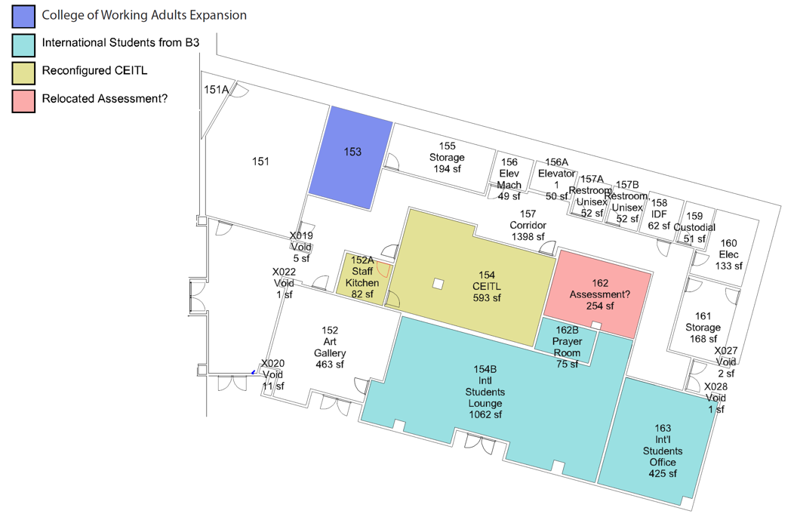
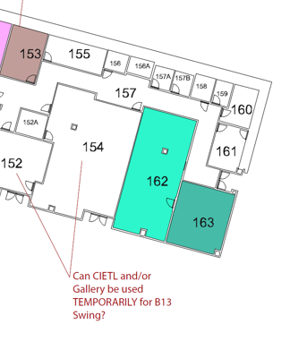

B9 Reconfig Project September 24, 2019
B9 Reconfig Project
May 8, 2020

