Slide 1
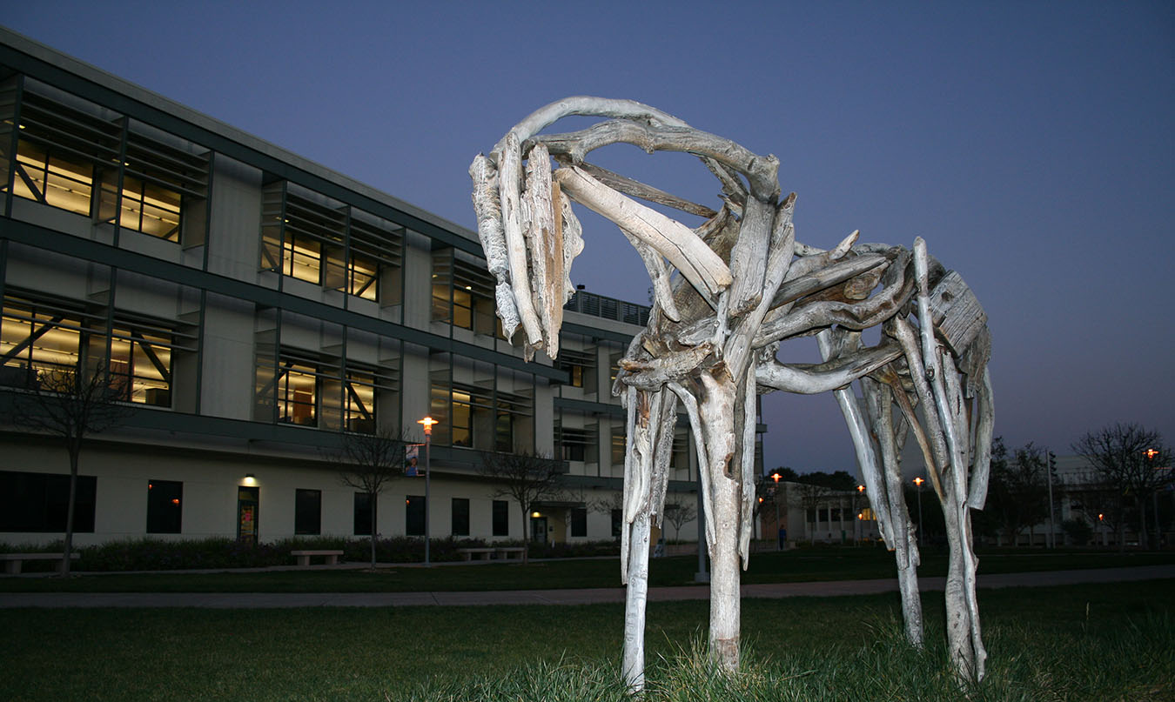
SEM Outreach
Academic Senate December 10, 2020
Prepared by the Office of Planning, Research & Institutional Effectiveness, Outreach, High School Transition/Dual Enrollment and Marketing

Slide 2
Marketing & Outreach Collaboration

Slide 3
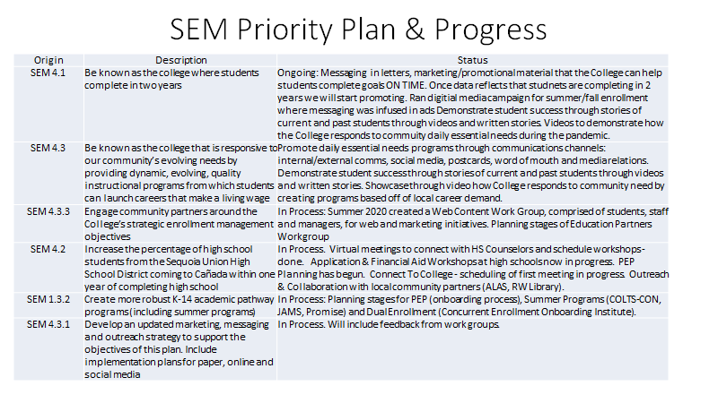
SEM Priority Plan & Progress

Slide 4
SEM Priority Plan & Progress
Leadership Retreat | Strengthen dual enrollment & early college opportunities (SEM 1.3.1) | Ongoing: Messaging in emails, Informational Workshops for Parents and Students and HS counselors, marketing/promotional materials about getting an early college start, and obtain college credit while in high school. Collecting data to support anti-racist framework and supporting underpresentative students in participating in dual enrollment. Hold HS & Community Partners Forum to share updates about enrollment, virtual campus resources and anti-racist framework. Updated Concurrent Website. In Process: Create Videos to promote Early College Opportunities (Middle COllege, Dual Enrollment), update High School Website. Streamlime enrollment process- formstack to eliminate barriers.Working with Adult Schools and HS to offer dual enrollment (CBOT, Engenerring, ECE, Career Classes)
Leadership Retreat | Strengthen communication with and engagement of parents (especially in E. Palo Alto, N. Fair Oaks) | Hosted HS & Community Partners Forum, presentations with nonprofits and HS partners, application workshops, College 101, Dual Enrollment, College Fairs. In Process: Newsletter to share information with our community partners, organizing a virtual Connect to College
Leadership Retreat | Rely more on the student perspective in all marketing and communications (esp. BIPOC students) and provide all materials in English, Spanish and other languages critical to our community | In Process/Ongoing: Spanish Translation Taskforce Summer 2020: translated all Admissions, Counseling/Matriculation, Financial Aid forms, outreach to material, student tutorials, updated /enespanol page. Will continue translating important enrollment, outreach and community information. Also looking into translating other languages critical to our community. Share marketing material with a series of student groups including Web Content Group, Outreach, ASCC, etc
Leadership Retreat | Publish all materials in English, Spanish and other languages critical to our community | In Process/Ongoing: Spanish Translation Taskforce Summer 2020: translated all Admissions, Counseling/Matriculation, Financial Aid forms, outreach to material, student tutorials, updated /enespanol page. Will continue translating important enrollment, outreach and community information. Also looking into translating other languages critical to our community.

Slide 5
Areas Of Current Focus To Reach Underserved Communities
East Palo Alto (EPA Academy & KIPP Valiant Middle School)
Redwood High School
Undocu-Community (Half Moon Bay - ALAS)
Dual Enrollment
Promise Scholars Program
Cañada presence in downtown Menlo Park & Redwood City
STEM Center
Athletics

Slide 6
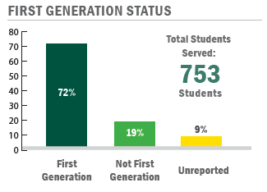
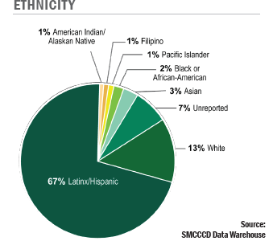
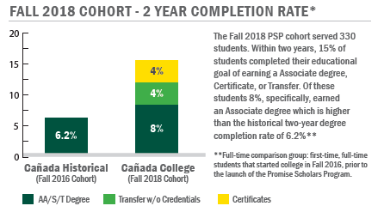
Promise Scholars Program Metrics

Slide 7
Dual Enrollment- Prioritizing Equity
Access to Early College Access is NOT EQUITABLE​
Disparities in student access- Black and Latinx student​
Students coming from a home with college-educated parents are overrepresented
Shifting the Narrative:
Create a College Going Culture
Less time to a college degree. ...
Be college-ready. ...
Finish requirements first. ...
Figure out your future. ...
Current Initiatives:
Engineering Pathway 4) Enrollment Process
College Career Classes 5) Student Support Programs
Adult School Programming 6) Outreach/Marketing

Slide 8
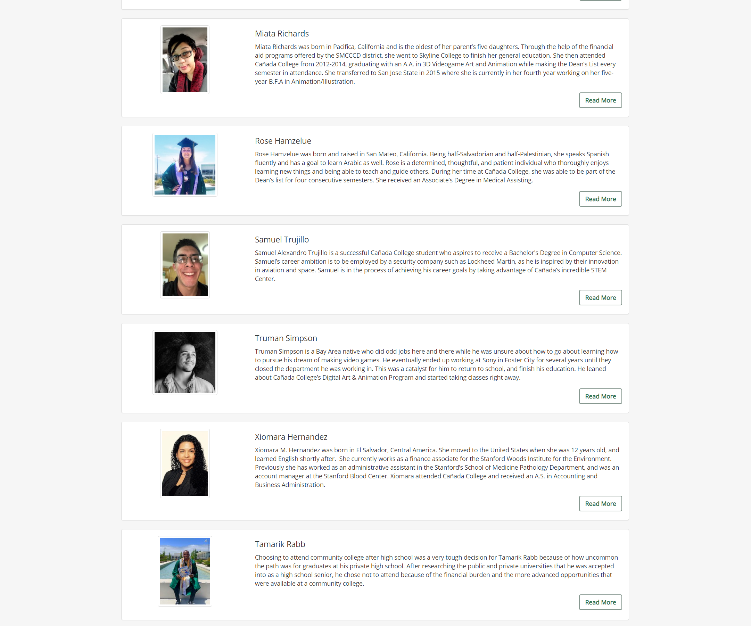
Demonstrating Student Success
Prospective students seeing themselves in our students

Slide 9
Marketing

Slide 10
Marketing
Social Media Advertising on Facebook & Instagram
Streaming Video on YouTube
Streaming Radio on Spotify
Direct Mailing Postcards
Messages in English & Spanish

Slide 11
Marketing

Slide 12
Service Area By Race/Ethnicity Majority

Slide 13
Our Communities
Native Hawaiian and Other Pacific Islander, Not Hispanic or Latinx, 1.2%
San Mateo County
Two or more races, Not Hispanic
or Latinx, 3.8%
Hispanic or Latinx, 24.0%
Asian, Not Hispanic or Latinx, 29.7%
American Indian and Alaska Native, Not Hispanic or Latinx, 0.2%
White, Not Hispanic or Latinx, 38.4%
Black, Not Hispanic or Latinx, 2.1%
Source: U.S. Census Bureau and American Community Survey; 1 year estimate for 2019; Statistical Atlas

Slide 14
Cañada College Demographics Fall 2019
Sources: Students – District data warehouse; Employees – CCCCO Data Mart; Community – U.S. Census American Community Survey, 1-year estimate

Slide 15
College Employees By Major Race/Ethnicity (#)
Source: CCCCO Data Mart

Slide 16
Cañada College Students Fall 2019
Fall 2019
Asian | 827
Black, Non-Hispanic or Latinx | 164
Filipino | 262
Hispanic or Latinx | 2,713
Two or more races | 287
Pacific Islander | 81
Unknown | 565
White Non-Hispanic or Latinx | 1,316

Slide 17
Support for an Umoja Program at Cañada

Slide 18
Thank you

