Slide 1
Reassigned Time Process & Decisions
Academic Senate | February 5, 2026
IPC Co-Chairs: Dr. David Eck and Dr. Chialin Hsieh

Slide 2
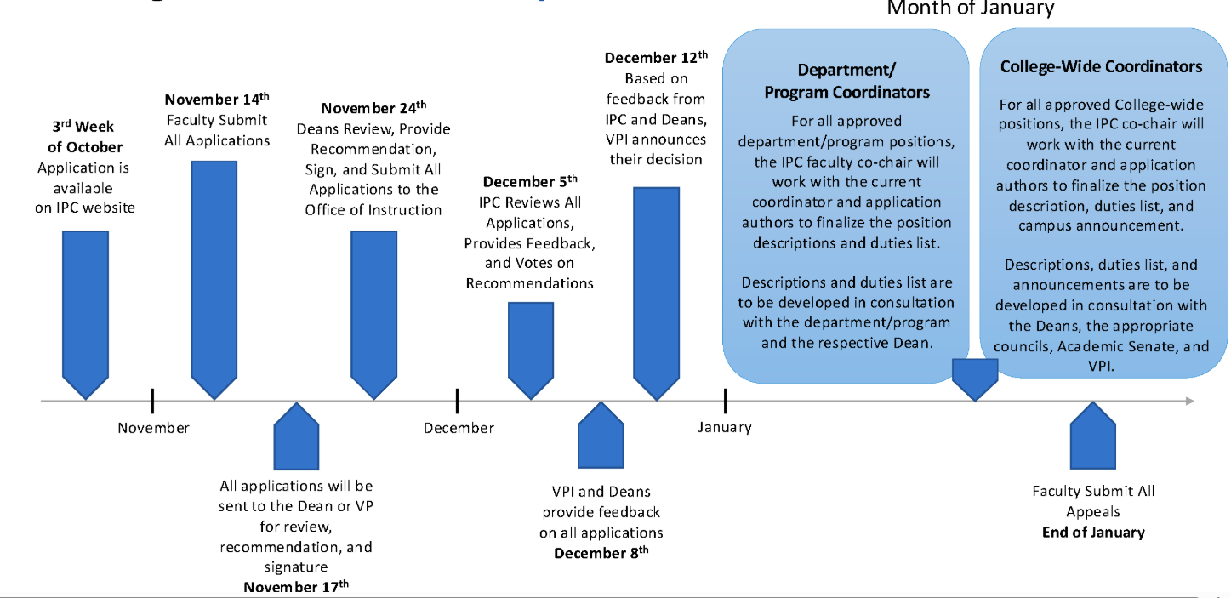
Reassigned Time Position Request: Process Overview
https://canadacollege.edu/ipc/reassignment-process.php
Notes:
David

Slide 3
IPC Reviews: Evaluation, Feedback, and Recommendations
IPC provided written feedback forms before the meeting
IPC reviewed all reassigned time requests
IPC discussed
IPC voted on recommendations
IPC Meeting Agenda December 5, 2025 https://canadacollege.edu/ipc/2526_files/ipc-agenda-12-05-2025.pdf
Notes:
David

Slide 4
Decisions Inputs and Review Criteria
IPC
Rating information
December 5 meeting: Deliberation
Deans’ feedback
Review for overlap with AFT Appendix D Duties
Final recommendations published on IPC website:
IPC website > Reassigned Time > Positions Past & Present > Fall 2025
Decisions listed in the rightmost column
Reassigned Time Appeal Process
IPC webpage > Reassigned Time > Appeal Process
Notes:
Chialin
My analyses: including IPC, Deans, and D1 Duty

Slide 5
Questions?

