Slide 1
Leadership Retreat 2026

Slide 2
What is it?
As part of Cañada College's annual planning cycle, student, faculty, and classified staff leaders and administrators convene for a Leadership Retreat during the summer in anticipation of the following academic year. Participants represent all of the major constituency groups that are part of the College's participatory governance framework. One of the outcomes of the Retreat is the development of the College's annual strategic plan (Educational Master Plan priority projects) for the following academic year.

Slide 3
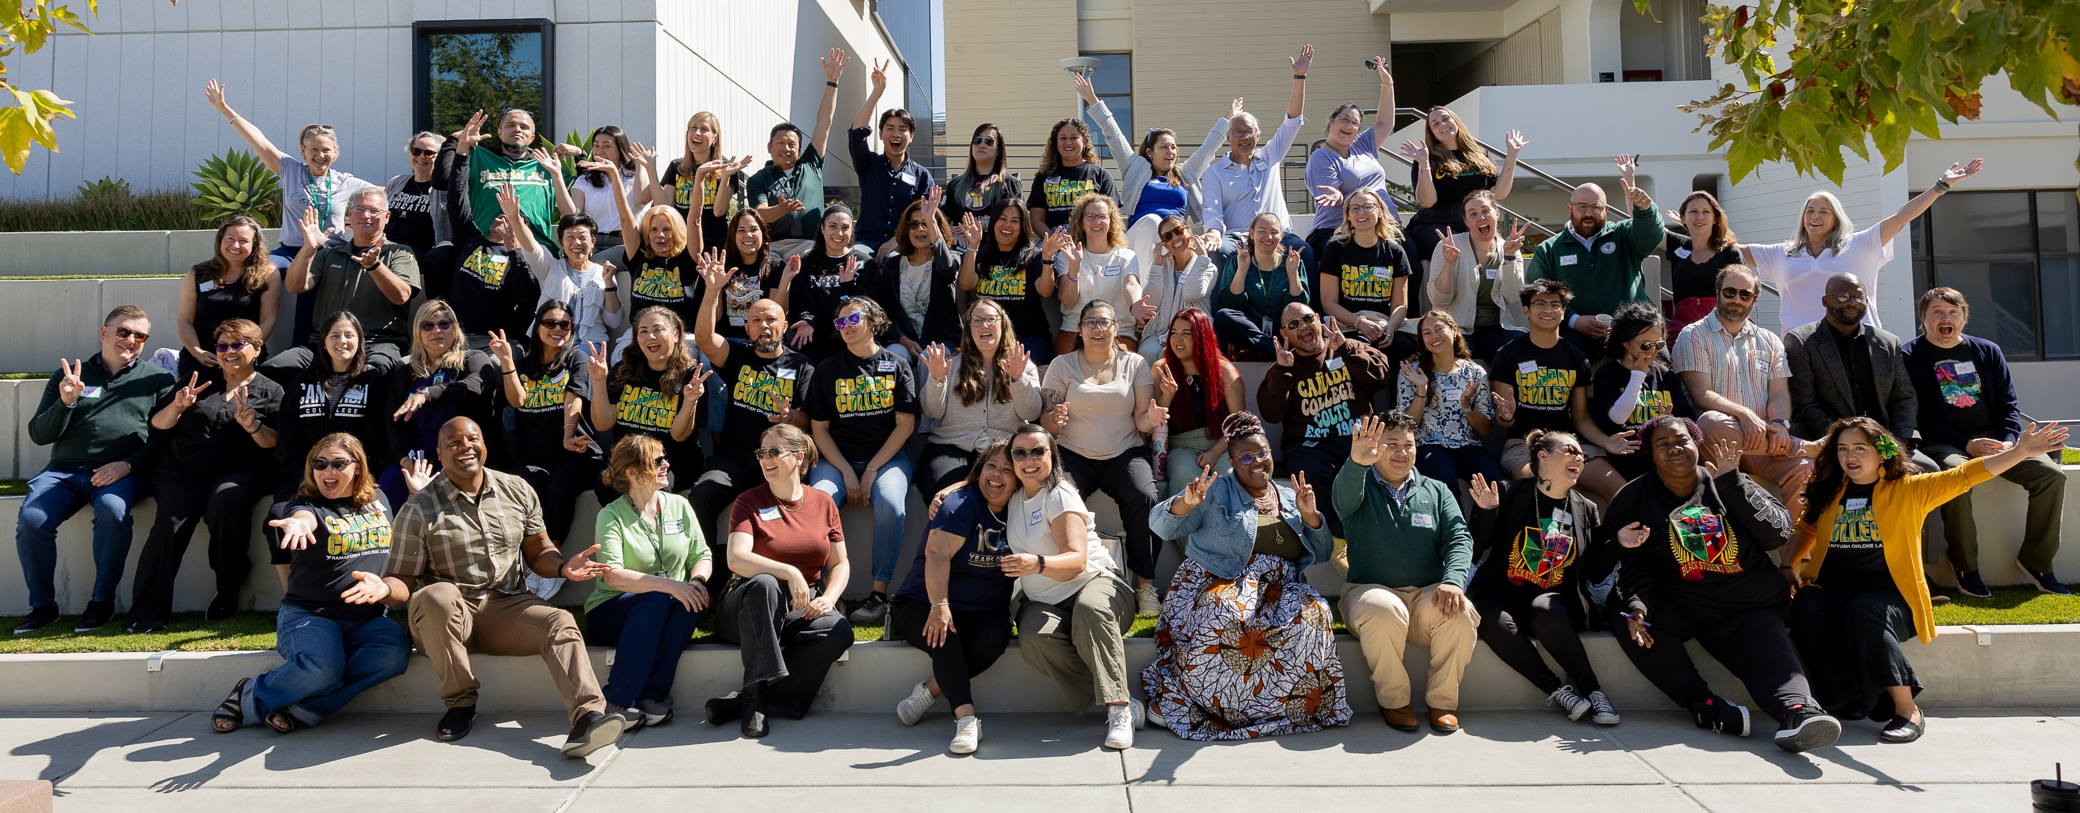
2026 Leadership Retreat
60+ students, faculty, classified staff and administrators participated
8 breakout sessions focused on “inquiry topics” for 2026-27 to help prepare or “plan to plan” for our new Educational Strategic Plan that starts Fall 2028.
Check Leadership Retreat website for more info

Slide 4
General Questions These Groups will be Investigating
Review current best practices
Gather campus input
Identify gaps
What are we doing now?
What are other college's doing?
Share out to participatory governance groups and collection feedback
Actionable recommendations

Slide 5
Inquiry Groups
Artificial Intelligence
  Instructional
  Student services (prof. devt with the tools)
  Operations
Work-based learning
  Embedding career exploration in more aspects of academic pathways
Intentionally strengthening enrollment
  Shifting demographics of our community – how can we best serve these changing educational needs?
  Community partnerships – are there other opportunities we could pursue?
Mental Health
  Understanding the emerging needs of students
  Exploring potential changes in teaching & learning strategies
Notes:
Manuel

Slide 6
Inquiry Groups cont.
Accessibility
  Making instructional and business processes accessible
Reimagining the Performing Arts Center with the community in mind – launch in Spring 2027
  If the bond passes, conduct inquiry into the needs of the community for a performing arts venue and related programming
Ensure our workforce programs are well aligned with regional workforce needs
  Consider family-supporting wages - ensuring our students’ educational experience facilitates earning a living regional wage
  Consider more modular instructional programs (CTE) - short term programs closely aligned with regional workforce needs
Did the education experience at Cañada meet the educational needs of the students?
  How do we know whether students are satisfied with their experience at Cañada?
Possible topic: Course Program of Study

