Slide 1
I hear you’ve been elected to the Academic Senate… sounds impressive, what is it?

Slide 3
Empowering faculty
Providing voice
But does it have any power or authority?

Slide 4
Applies to CCC; is regulation with force of law; derived by the CCC Board of Governors from Ed Code
California Code of Regulation:
Title 5 (Division 6) § 53200-53203
Education Code §70902 (b)(7) Governing Boards
Defined by state legislation. Supersedes CCR Title 5
Notes:
Title 5 Applies to CCC, is regulation with force of law, and is derived by the Board of Governors from the Ed Code
Ed Code supersedes Title 5 and can only be changed by legislation

Slide 5
CCR Title 5 (Division 6)
§ 53200. The Academic Senate is an organization “whose primary function is, as the representative of the faculty, to make recommendations to the administration of a college and the governing board of a district with respect to academic and professional matters.”

Slide 6
10 + 1
Degree and certificate requirements
Grading policies
Educational program development
Curriculum, including establishing prerequisites
Standards and polices regarding student preparation and success
College governance structures, as related to faculty roles
Faculty roles and involvement in the accreditation process
Policies for faculty professional development activities
Processes for program review
Processes for institutional planning and budget development
Other academic and professional matters as mutually agreed upon

Slide 7
Collegial Consultation
The Board of Trustees is required to consult collegially with the Academic Senate and develop policies on academic and professional matters through either or both:
1. Rely primarily upon the advice and judgement of the Academic Senate
2. Reach mutual agreement with the Academic Senate by written resolution, regulation, or policy

Slide 8
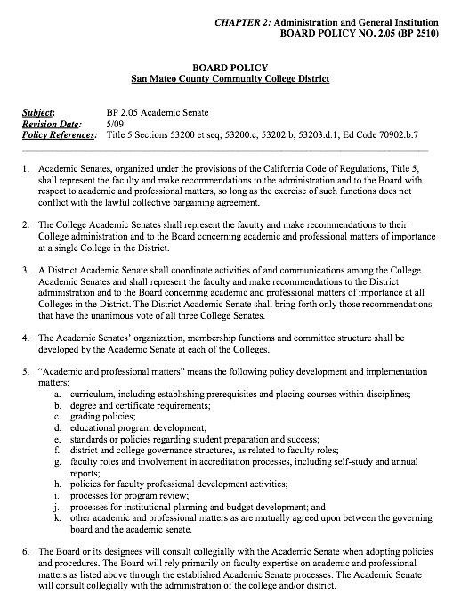

Slide 9
Title 5 §53203
(D) Requires procedures for responding to Academic Senate recommendations that include:
When rely primarily applies: the recommendation of the Academic Senate will normally be accepted, and only in exceptional circumstances and for compelling reasons will they not be accepted.

Slide 10
Title 5 §53203
(F) Appointment of faculty members to college committees shall be made by the Academic Senate

Slide 11
More from the Ed Code:
Section 87359 (b) | Waiver of Minimum Qualifications; Equivalency
Section 87360 (b) | Hiring Criteria
Section 87458 (a) | Administrative Retreat Rights
Section 87610.1 (a) | Tenure Evaluation Procedures *
Section 87615 (b) | Minimum Degree Requirements: Exceptions
Section 87663 (f) | Evaluation Procedures *
Section 87743.2 | Faculty Service Areas *
*Collective bargaining unit shall consult with Academic Senate

Slide 12
Senate of the whole
Article III, Section 2. The Academic Senate shall include all certificated full-time and part-time faculty employed under contract by the College loaded at three or more units per semester.

Slide 13
Governing Council
Officers | Other Representatives
President Vice President Secretary Treasurer | Curriculum Committee Chair Professional Personnel Chair College Council Representative Division Representatives

Slide 14
Brown Act
Open Meetings Laws in California
http://upload.wikimedia.org/wikipedia/commons/c/cb/3D_Judges_Gavel.jpg

Slide 15
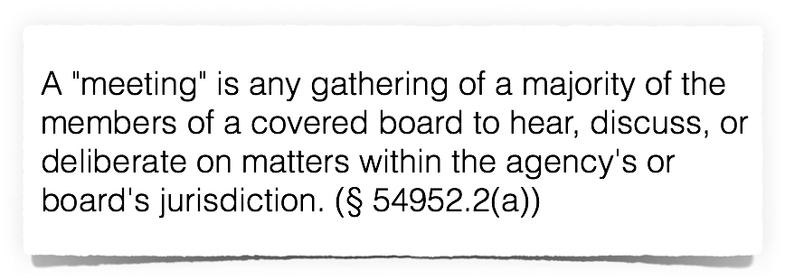
Meetings of public bodies must be "open and public," actions may not be secret, and action taken in violation of open meetings laws may be voided. (§§ 54953(a), 54953(c), 54960.1(d))

Slide 16
Requirements
Post notice and an agenda at least three days prior to meeting
Give notice at least one hour in advance of an emergency meeting
Not require a “sign-in”
Allow non-disruptive recording
Allow for public comment
Conduct only public votes
Treat documents as public “without delay”

Slide 17
Expectations
Be present at all meetings, or send a substitute
Report to your constituents and return with their feedback
Vote to represent your constituents and for the good of the college
Be a good listener, critical thinker and engaged participant

Slide 18
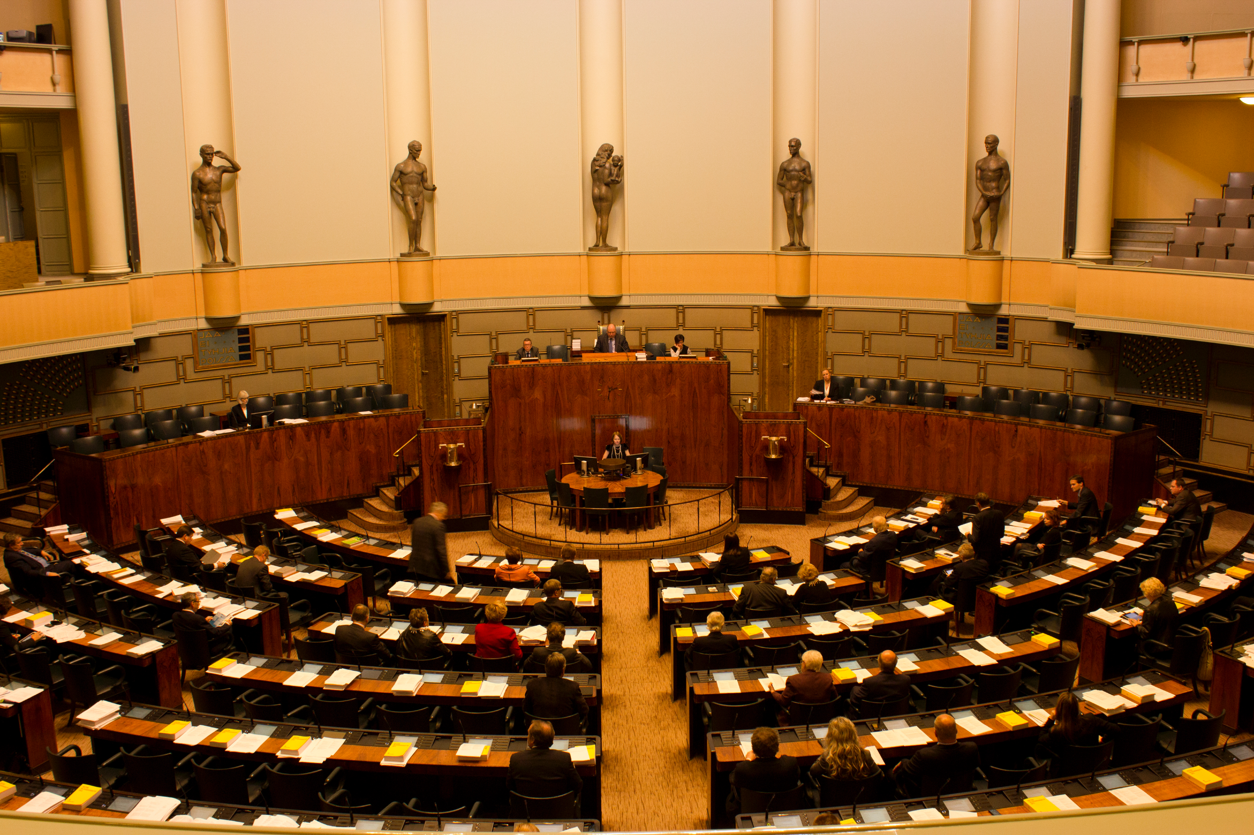
Roberts Rules of Order
Parliamentary Procedures
http://upload.wikimedia.org/wikipedia/commons/7/79/Finnish_Parliament.jpg

Slide 19
I move that we…
I second that motion.
We have a motion that states…
Collegial debate ensues…
I call for the question.
Are we ready to vote?
Voting occurs
Notes:
If there is no second, the motion is lost
Motion to table, or Motion to postpone indefinitely

