Slide 1
Course material affordability: A student panel
Textbook Affordability Subcommittee of the Academic Senate and SMCCCD Textbook Affordability Solutions Work Group
Unless otherwise indicated, Course Material Affordability: A Student Panel by Dr. Bianca Rowden-Quince, Ame Maloney, MLIS, Dr. Sarah Harmon, and Dr. Chris Smith for SMCCCD is licensed CC BY 4.0 International.

Slide 2
What is zero textbook cost (ZTC)?
S.B. 1359
“66406.9. (a) Each campus of the California Community Colleges and the California State University shall, and each campus of the University of California is requested to, do both of the following:
(1) (A) Clearly highlight, by means that may include a symbol or logo in a conspicuous place on the online campus course schedule, the courses that exclusively use digital course materials that are free of charge to students and may have a low-cost option for print versions.
(B) The course materials described in subparagraph (A) may include open educational resources, institutionally licensed campus library materials that all students enrolled in the course have access to use, and other properly licensed and adopted materials. Each campus of the California State University, each participating campus of the University of California, and each community college district shall ensure that these materials comply with the federal Americans with Disabilities Act of 1990 (42 U.S.C. Sec. 12101 et seq.) and the federal Copyright Act of 1976 (Public Law 94-553).
(2) Clearly communicate to students that the course materials used for the courses identified pursuant to paragraph (1) are free of charge and therefore not required to be purchased.

Slide 3
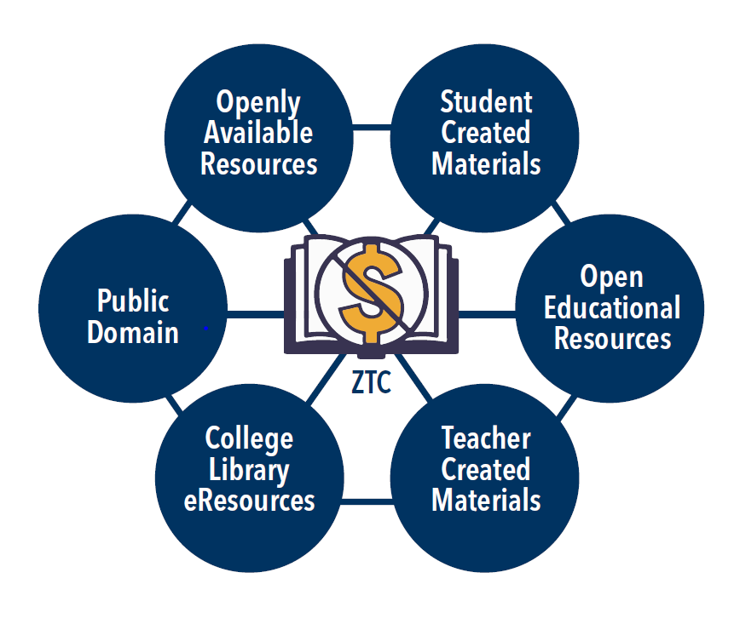
What is ZTC?
Notes:
OEW Virtual Petting Zoo

Slide 4
What is OER?
“Open educational resources” are high-quality teaching, learning, and research resources that reside in the public domain or have been released under an intellectual property license, such as a Creative Commons license, that permits their free use and repurposing by others, and may include other resources that are legally available and free of cost to students.
–Hewlett Organization OER

Slide 6
What are students saying about OER/ZTC?
–The availability of ZTC resources in my Skyline College concurrent/ dual-enrollment courses has been very convenient in that I can access all my materials online. On top of these free courses provided through my high school district, my peers and I can conduct our learning without having to pay additional fees. - Skyline
–Required course books are sometimes more costly than the class. - CSM
–I had no idea that these types of courses existed until taking this survey. It's been over a decade since I was las enrolled in SMCCD and a lot has changed for the better. I will be looking for more of these courses in the future for sure! - CSM
–Zero textbook cost helps a lot! I would not be able to sign up for all the classes I have this year if I had to buy expensive books for each. I also like that I can print just the chapter I need instead of carrying all these books around. - Cañada
Notes:
ZTC/OER
Saves students money now
Ensures student access to materials for day 1 of class
Readily available online
Remain available long after semester ends
Protects student privacy and data

Slide 7
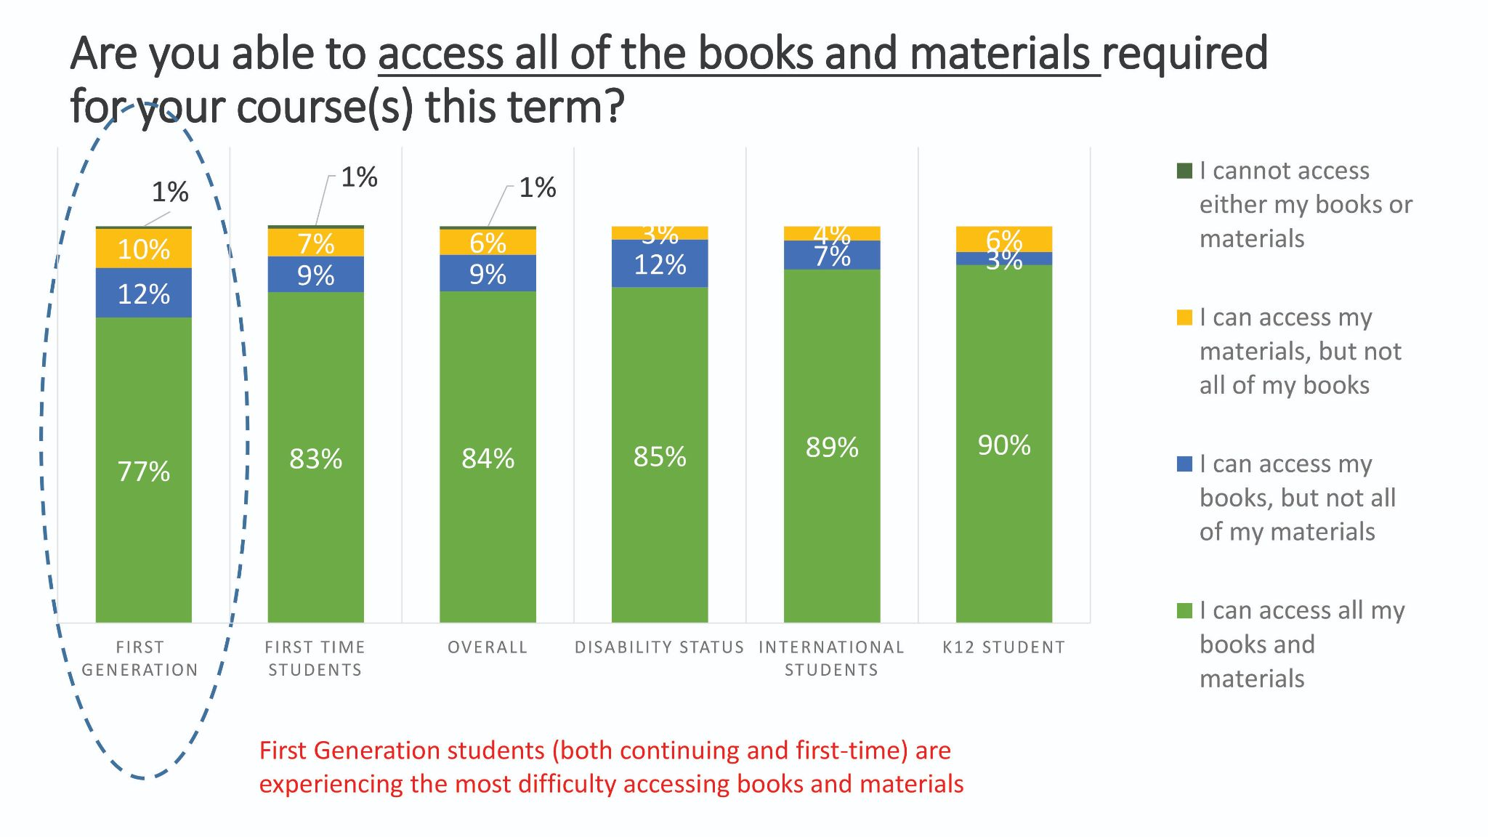
Cañada Fall 2020 Student Engagement Survey
Graphic and data from Cañada PRIE

Slide 8
Why ZTC/OER for SMCCCD faculty?
Customization: Faculty members can customize their class instruction for their students using. David Wiley, adjunct faculty at BYU, argues compellingly in "iterating toward openness" that OER can facilitate more meaningful, more inclusive pedagogical practices.
Increasing support for "plug and play" resources: For instructors who have little time to adapt resources, OER projects like OpenStax and the Open Learning Initiative (Carnegie Mellon) are increasingly making "packaged" resources available. Packaged resources include textbooks with accompanying ancillary resources (slides, clicker exercises, learning materials) and entire courses and course modules.
Student-driven, multimodal learning: OER are one way of engaging students more deeply in the educational process, moving beyond lecture and text. Open education gives instructors the tools to involve students in the creation of learning materials.
Lifelong learning: Because OER are open, they allow students to return to course content again and again—before and after courses.

Slide 9
Student Panel
Cañada: Ben Lam
CSM: Alex Loos Josephine Lock
Skyline: Gloria Carbajal Chris Wardell

Slide 10
How are you accessing your online classes?

Slide 11
What barriers to accessing digital content did you have?

Slide 12
What is your comfort level and experience with OER? With paid digital platforms?

Slide 13
What types of OER have you used in class? What worked, and what didn’t work?

Slide 14
Were the materials integrated into your Canvas course? Or did you have to download/view them from elsewhere?

Slide 15
Was it easy to use the OER materials? If not, what were some challenges?

Slide 16
If you had to spend money on a required homework platform, what do you consider to be a ‘fair’ cost?

Slide 17
What would you like to say to the faculty at large about OER and course material costs?

Slide 18
Thank you!
Textbook Affordability Subcommittee of the Academic Senate:
Sarah Harmon, Academic Senate OER Liaison and OER/ZTC Coordinator
Nick DeMello, Distance Education Coordinator
Diana Tedone-Goldstone, Librarian
Valeria Estrada, ASLT Division Representative
Ramki Kalyanaraman, Science and Technology Division Representative
Allison Hughes, Instructional Technologist
Jai Kumar, Bookstore Manager
David Reed, Dean of Academic Services and Learning Technologies
https://www.canadacollege.edu/academicsenate/textbook_affordability_subcommittee.php
Big thank you to the SMCCCD Textbook Affordability Solutions Work Group:
Ame Maloney, Skyline OER Liaison
Bianca Rowden-Quince, Skyline Instructional Designer
Chris Smith, CSM OER Liaison
Sarah Harmon, Cañada OER Liaison
https://www.smccd.edu/ztc

Slide 19
Questions? Comments?

