Slide 1

EAPC: SEAP Metric 4 Progress
April 22, 2025
Ron Andrade

Slide 2
Student Equity & Achievement Plan:
Metric 4
Interest Area Success Teams & Special Programs: Hispanic students will receive intentional, targeted support to help them stay on the path throughout their entire time at Cañada college. Retention specialists will actively case manage our Hispanic students to ensure they are making progress towards completion of their program of study. These interventions will be further resourced through the implementation of the College's Developing Hispanic Serving Institutions grant that the College was awarded in Fall 2022 to specifically address the persistence and retention of Hispanic students through to completion by way of strategic case management.
Sample Text in Franklin Gothic Book
Border is in Yellow. Copy picture and right-click -> replace picture

Slide 3
Who is the College Retention & Engagement Workgroup (CREW)?
Diego Payan- Art, Design and Performance Interest Area & Undecided
John Omar- Business & Human Behavior & Culture Interest Areas
Autumn McMahon- CWA and Umoja
Claudia Alejandra Vazquez Ibarra- Promise
Diego Zevallos- EOPS
Diana Ezpinoza-Osuna - ESL
Maribel Zarate- Dual Enrollment
Jackie Gonzalez- Science & Health Interest Area
Juan Vera- Veterans/Academic Probation
DeVon Lamar Scott - DRC
Maria Huning – TRIO
Yesenia Haro- Middle College
Kathy Kohut/Catherine Dominion – International
Miriam Mosqueda – NextUp/Project Change
Nadya Sigona- Puente & Early Alert Counselor
Rance Bobo - MESA
Sample Text in Franklin Gothic Book
Border is in Yellow. Copy picture and right-click -> replace picture

Slide 4
Student Demographics
Interest Areas and Special Programs are each serving approximately the same total number of students.
~20% are identified as Hispanic and Male (n=377 Interest Areas, n=436 Special Programs)
Key differences
  Interest Areas: 33% of Hispanic males are FT & 31% less than part-time
  Special Programs: 42% of Hispanic males are FT & 23% less than part-time

Slide 5
What have we been up to? Essential Practices
Counseling
First Year
Experience
Graduation/
Transfer Support
Career/
Major Exploration
Academic Notice/
Early Alert
CRER 401:
College Success
Welcome Week
Workshops by counselors and program staff
Kick Off, messaging, Canvas, check-ins with CREW Members
CRER 110:
Transfer center workshops
Scholarship Support
Alumni panels
Field Trips
Job search resources
CRER 137
Career Center Job Fair & Internship Fair
Retention Specialist led workshops
Speaker series
Retention Support – share resources, create a success plan, make referrals
Probation workshops
Tutoring referrals
Other student services
College Retention & Engagement Workgroup
Notes:
Mahitha

Slide 6
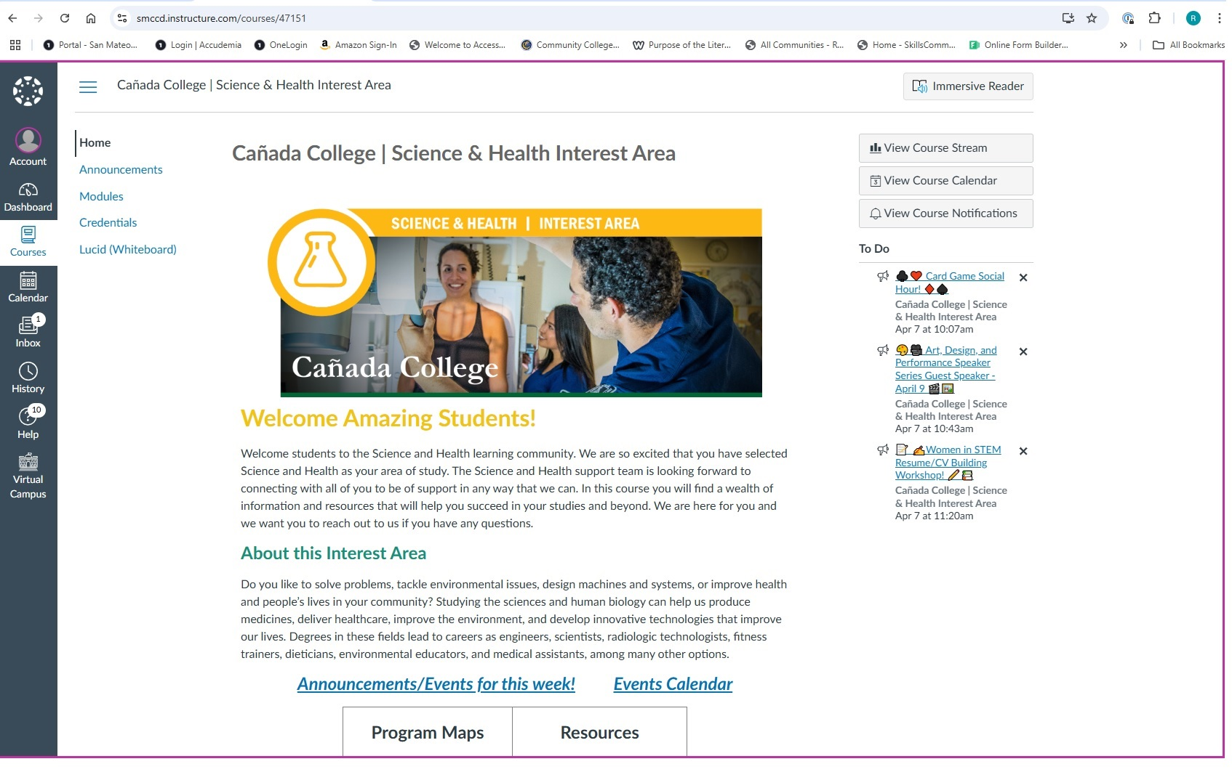
What have we been up to? Canvas as a communication tool
Sample Text in Franklin Gothic Book
Border is in Yellow. Copy picture and right-click -> replace picture

Slide 7
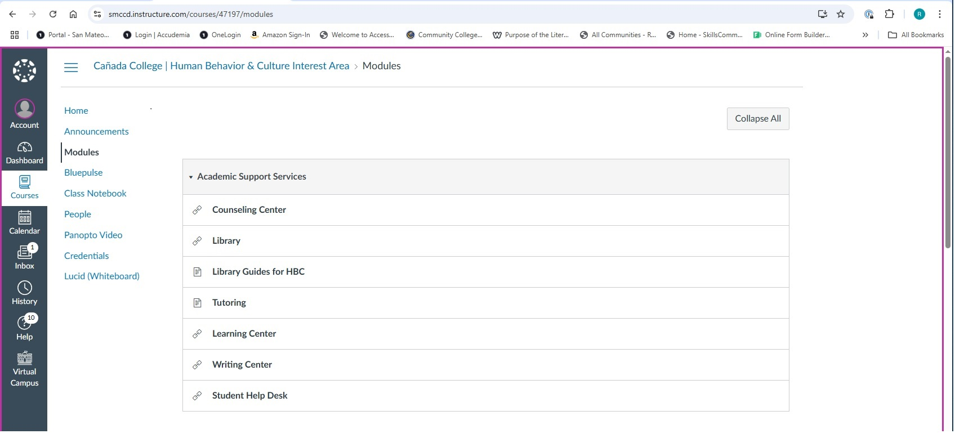
What have we been up to? Information Access
Sample Text in Franklin Gothic Book
Border is in Yellow. Copy picture and right-click -> replace picture

Slide 8
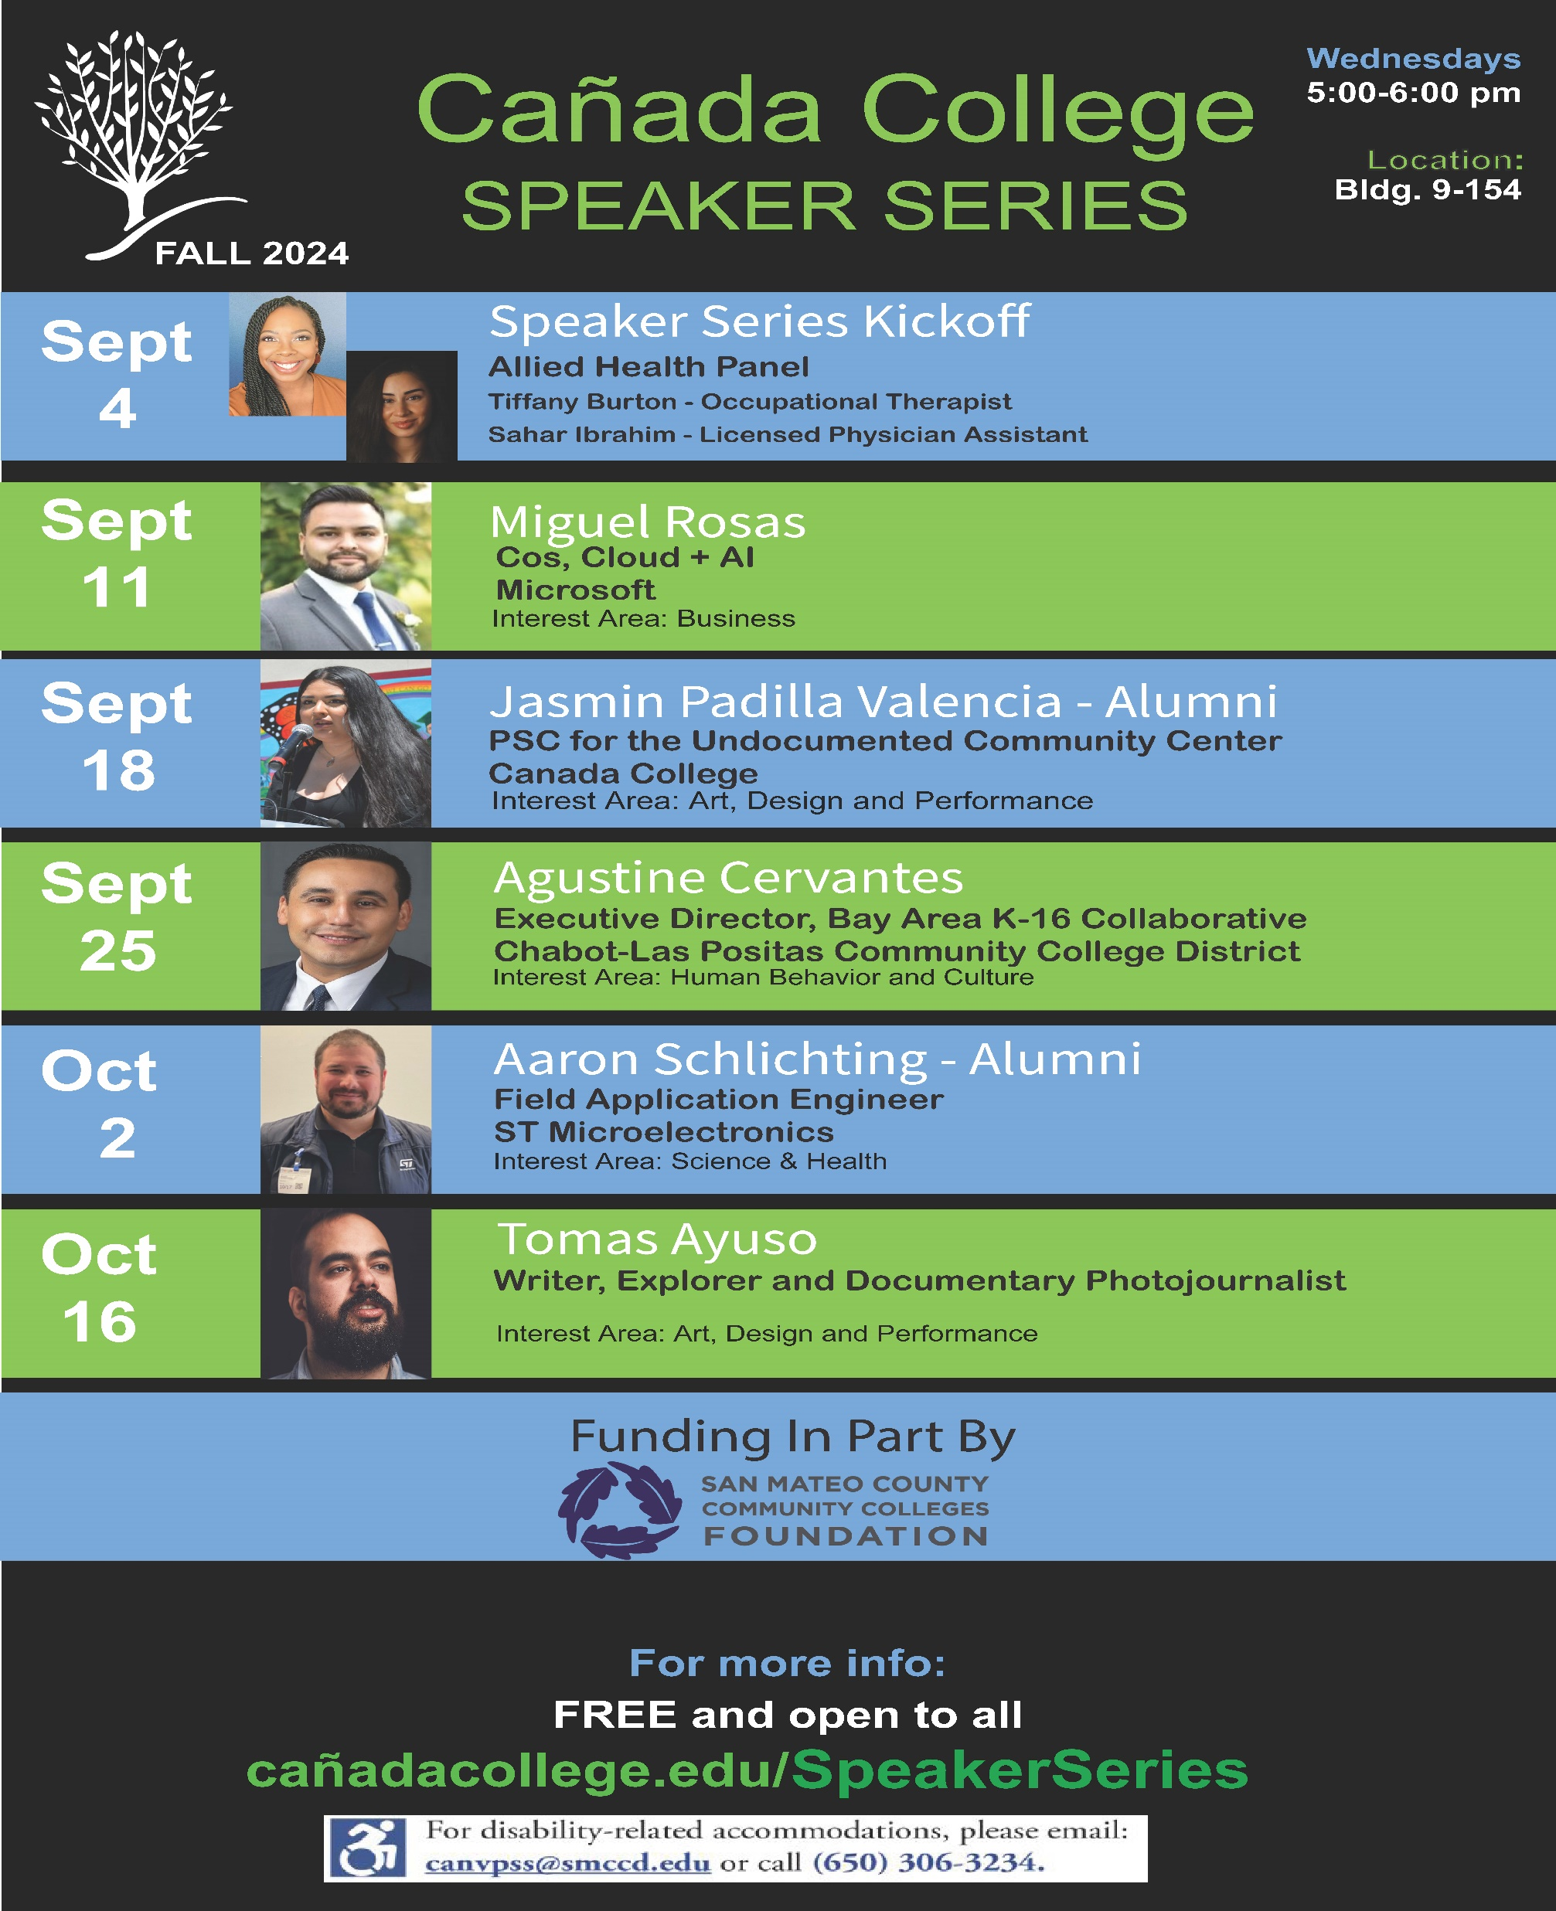
What have we been up to? Knowledgeable Speakers
Sample Text in Franklin Gothic Book
Border is in Yellow. Copy picture and right-click -> replace picture

Slide 9
What have we been up to? Data Tracking, Monitoring and Sharing
POS in Most Recent Term Enrolled at SMCCCD | First Math Attempt at SMCCCD | Most Recent Math Course Passed at SMCCCD | Currently Enrolled in a Math Course at SMCCCD | Notes | Call notes
BIOLSTM-ASTC: Biology (Associate Degree-Transfer) | 202403: MATH-251 (Grade C) | 202403: MATH-251 (Grade C) |  | Stud has only taken calc 1, has not taken any CS courses | Called/No answer- Followed up with email 4/9
ENGR-3AS: Engineering (Associate Degree) | 202308: MATH-225 (Grade B-) | 202308: MATH-225 (Grade B-) |  | Needs to take Math 251- Calc 1 - Has only one course towards the major ENG 100 - GPA 1.7 | Spoke with std. He mentioned he is planning on taking Calc 1 and one other class in Fall. I advised std to meet with a counselor to update SEP
COMSCI-3ASTC: Computer Science (Associate Degree-Transfer) | 202303: MATH-200 (Grade B+) | 202303: MATH-200 (Grade B+) |  | CS major but took Math 200 (stats) email to see if they will change major | Phone number not working- Followed up with an email
BIOLSTM-ASTC: Biology (Associate Degree-Transfer) | 202408: MATH-200 (Grade B) | 202408: MATH-200 (Grade B) |  | Taking MATH 200 but is listed as a Biology major | Called student- Student is changing major to child development
COMSCI-3ASTC: Computer Science (Associate Degree-Transfer) | 202503: MATH-145 (Grade Blank) |  | 202503: MATH-145 | Check-In-Taking wrong manth class (MATH 145) but listed as CS major (former ESL std) | Called student- Student said counselor told him he could choose any math course. Student made an app to meet with me and will also meet with a counselor.

Slide 10
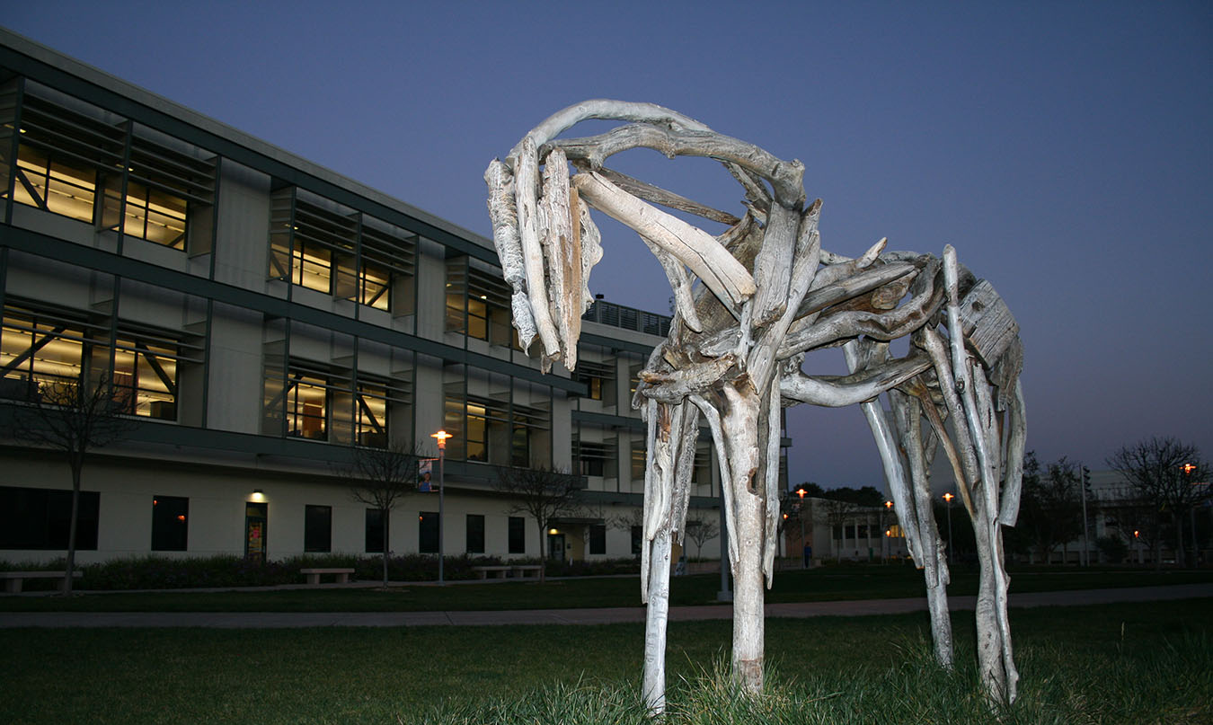
Thank you!

