Slide 1

Cañada College Student Equity Plan: Creating Pathways for Student Success

Slide 2

Course Schedule Optimized for Equity
Career Exploration & Job Placement
First Year Experience
Success Teams Aligned with Interest Areas
Redesigning Academic Support
Equity & Online Education
Early College Experiences

Slide 3
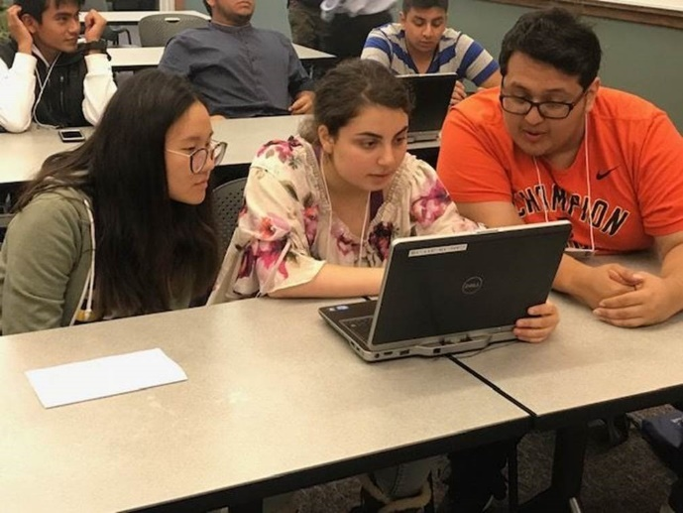
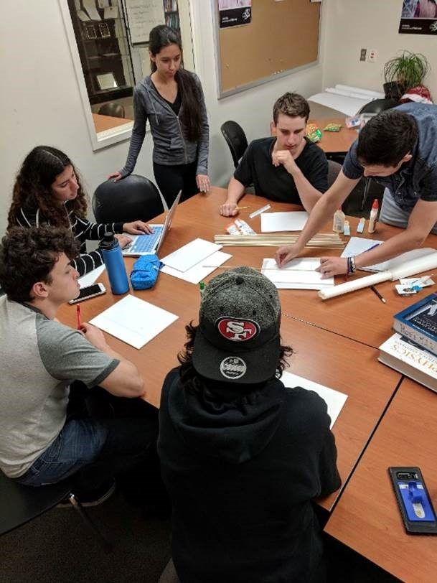
Embedded tutors for AB 705 –
impacted courses (Math 200, English 105)
              Scale Peer Mentor Program to align
              with Success Teams
              Replicate CUNY ASAP program
              within the Promise Program

Slide 4

What does it mean for
Cañada College to be a Hispanic Serving Institution (HSI)?

