Slide 1

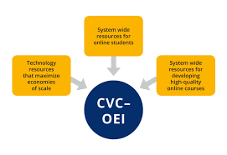
Improving Online CTE Pathways Grant Program

Slide 2
Programs to be launched or expanded under this Grant:
Online Business Academy
Cloud Computing
Data Analysis
Cybersecurity
User Interface/User Experience (UI/UX)
Paralegal
Satellite campus in Menlo Park (location of several classes in our CTE Programs)

Slide 3
Areas of work for the Grant:
Marketing
The goal of our marketing campaign is to increase enrollment at Cañada College in our CTE Programs, as well as increase awareness of our CTE Programs in the communities we serve.

Slide 4
Areas of work for the Grant:
Marketing
● 496,970 Impressions
● 53,080 Clicks and Views
● 623 Website Visits with Action (clicked a link, emailed)
● 71 Calls to the college

Slide 5
Areas of work for the Grant:
Quality Online Teaching and Learning (QOTL):
15 faculty members are currently participating in the Spring 2020 QOTL Work
Group
Three of our first four QOTL Coaches completed the Peer Online Course Review (POCR) training course in
the Fall - this is an important step towards our goal of joining the CVC course exchange (ExCEL)

Slide 6
Areas of work for the Grant:
Instructional Design Assistance
Instructure (parent company of Canvas) has been contracted to assist with optimizing online CTE curriculum in Canvas
Templates designed through this process will be assets for us to use in the future

