Slide 1
Graduation Survey Results Institutional Learning Outcomes Report
A report from the Office of Planning, Research & Institutional Effectiveness
To the Planning & Budgeting Council
September 18, 2019

Slide 2
Respondents
92 out of 602 graduates
15% response rate
9% margin of error for a 95% confidence level

Slide 3
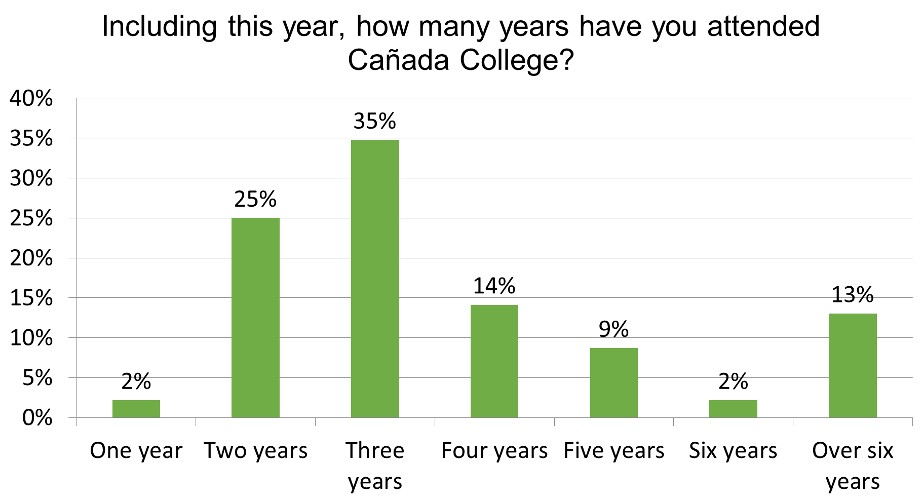

Slide 6
Average Age of Graduates: 30

