Slide 1

Success, Equity, and Social Justice
District Strategic Plan

Slide 2

District Strategic Plan Update
District Strategic Plan Steering Committee
Name | Title
Aaron McVean (Chair) | Vice Chancellor, Educational Services and Planning
Dave Mandelkern Tom Nuris | Trustees
Jamillah Moore | President (Cañada)
Jeramy Wallace | District Academic Senate President (CSM)
Golda Margate | CSEA Representative (Skyline)
Jordan Chavez (2019-20) Jade Shonette (2020-21) | Student Trustees
Karen Engel | Dean of PRIE (Cañada)
Hilary Goodkind | Dean of PRIE (CSM)
Ingrid Vargas | Dean of PRIE (Skyline)

Slide 3
District Strategic Plan Update
Date | Activity | Location
 | 2019
October 15th | First meeting of the DSP Steering Committee | District
November 13th | DSPSC #2: District Mission and College Strategic Plans | District
December 9th | DSPSC #3: Environmental Scan and SWOT Analysis | District
 | 2020
January 28th | DSPSC #4: Strategic Goals and Districtwide Strategies Review | CSM
February 18th | DSPSC #4.5: Strategic Goals and Districtwide Strategies Review cont. | District
 | COVID-19
October 7th | DSPSC #5: District Strategic Plan Metrics Review | Zoom
October 14th | Board Study Session: First Review | Zoom
November | College Planning Council and Senate Presentations | Zoom
December | DSPSC #6: Final Review | Zoom
 | 2021
January | Board Adoption | Zoom

Slide 4

San Mateo County Educational Attainment
Data source: US Census Quick Facts for San Mateo County https://www.census.gov/quickfacts/sanmateocountycalifornia

Slide 5
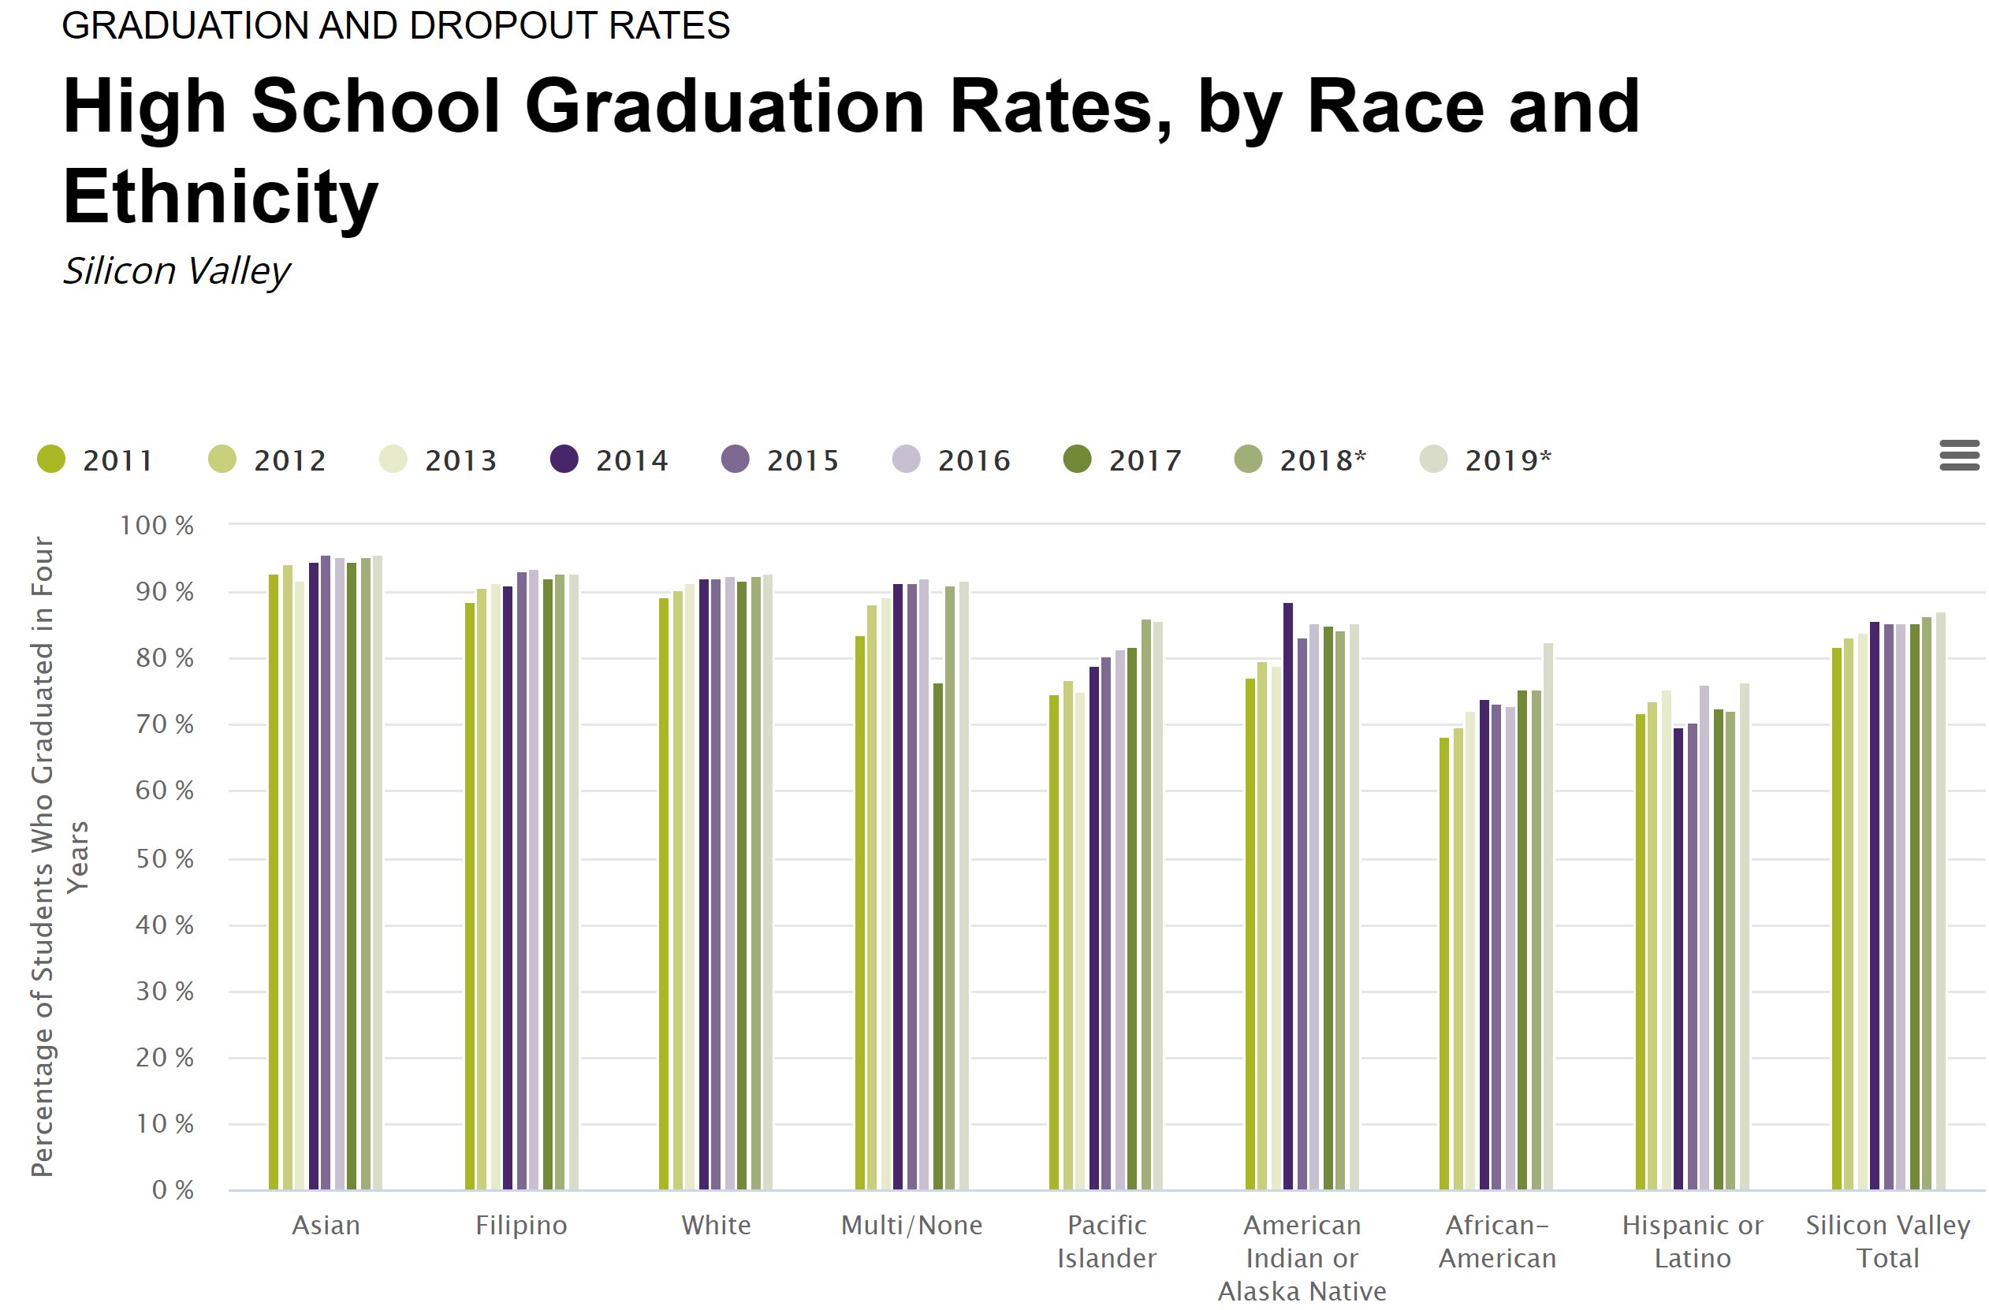
*Due to changes in the California Department of Education methodology for 2017 and subsequent years, caution should be used in comparing cohort outcome data to prior years.
Graduation rates are four-year derived rates. Multi/None includes students of two or more races, and those who did not report their race. All racial/ethnic groups aside from Hispanic or Latino are non-Hispanic. Data source: California Department of Education. Analysis by Silicon Valley Institute for Regional Studies

Slide 6
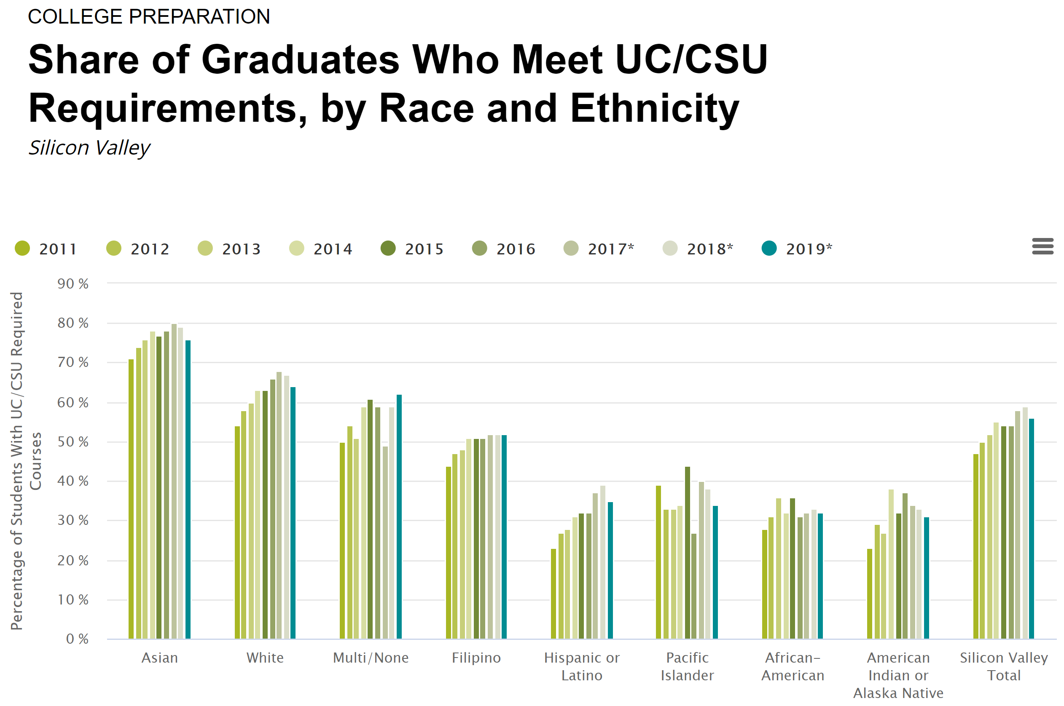
*Due to changes in the California Department of Education methodology for 2017 and subsequent years, caution should be used in comparing cohort outcome data to prior years.
Multi/None includes students of two or more races, and those who did not report their race. All racial/ethnic groups aside from Hispanic or Latino are non-Hispanic.
Data source: California Department of Education. Analysis by Silicon Valley Institute for Regional Studies

Slide 7
SMCCCD and San Mateo County Race/Ethnicity Distribution

Slide 8
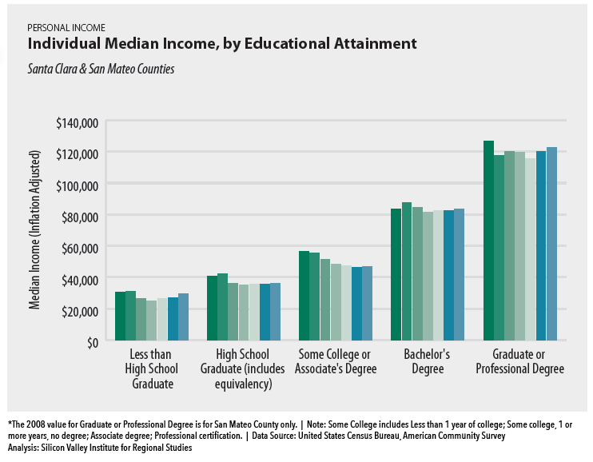
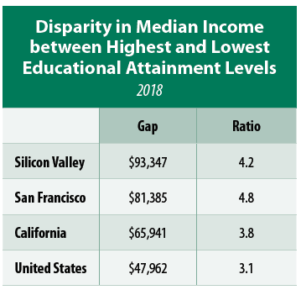
In 2018, the median individual income was nearly $123,000 for Silicon Valley residents with a bachelor’s degree or higher, and $29,500 for those without a high school diploma.
Data for 2008, 2010, 2012, 2014, 2016 and 2018.

Slide 9
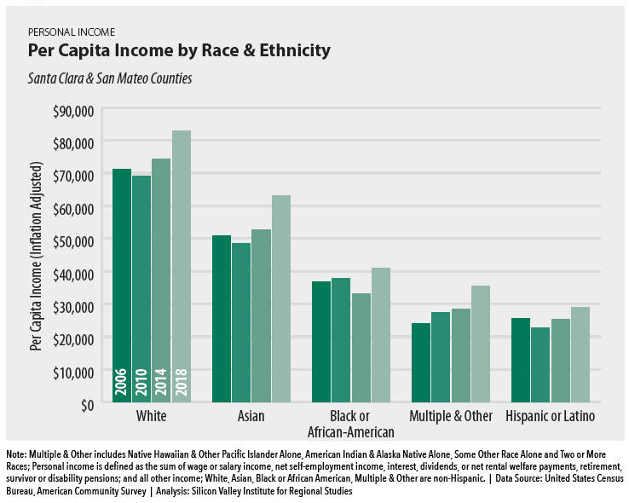
In 2018, per capita income was $82,810 for White residents and $28,960 for Hispanic or Latino residents.

Slide 10
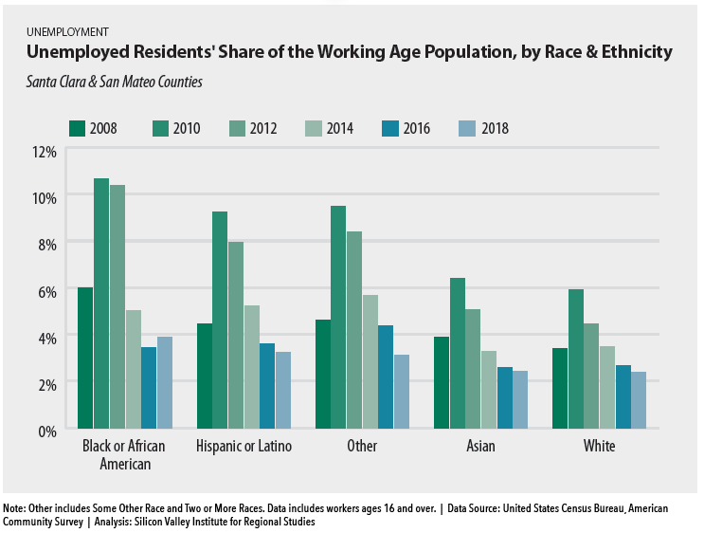

Slide 11

District Strategic Plan Goals and Strategies

Slide 12
Strategic Plan Goals and Strategies
Districtwide Strategies
Measure the impact of new and existing Districtwide efforts to increase success and reduce equity gaps for disproportionately impacted student groups.
Continually explore and implement interventions that benefit students and help them to achieve their specific educational goals.
Provide clear and distinct Guided Pathways for all students to accelerate program completion and successful transitions to the workforce or transfer to a University.
Support the Colleges by providing resources for innovative teaching and learning that is designed to increase student success.
Fully implement and optimize the Salesforce CRM and associated products in order to integrate technology systems for better communication to students, staff, and faculty.
Support the implementation of the District’s sustainability initiatives to address its program goals as part of the District’s response to climate change.

Slide 13
Strategic Goal #1: DEVELOP AND STRENGTHEN EDUCATIONAL OFFERINGS, INTERVENTIONS, AND SUPPORT PROGRAMS THAT INCREASE STUDENT ACCESS, SUCCESS, AND COMPLETION
Districtwide Strategies
Encourage the development of methodologies that increase the number of students who utilize support services that enable them to stay in school and succeed.
Create on-line and web-based options for students to access advising and counseling services, interactive scheduling, and educational plans.
Strengthen the alignment of career education programs with projected workforce needs.
Provide professional development resources for faculty, staff, and administration to ensure program effectiveness and excellence in teaching and learning.
Establish a dedicated budget for new program development in order to increase access, success, and completion, and eliminate equity gaps.
Use emerging practices to accelerate student progression of ESL sequences into transfer-level work.
Evaluate the implementation of revised placement processes for English, and math, ensuring students are successful in transfer-level coursework.
Systematically evaluate the effectiveness of academic and student support programs in all areas and develop, strengthen, or eliminate programs based on that evaluation.

Slide 14
Strategic Goal #2: ESTABLISH AND EXPAND RELATIONSHIPS WITH SCHOOL DISTRICTS, 4-YEAR COLLEGE PARTNERS, COMMUNITY-BASED ORGANIZATIONS AND EMPLOYERS TO INCREASE HIGHER EDUCATION ATTAINMENT AND ECONOMIC MOBILITY IN SAN MATEO COUNTY
Districtwide Strategies
Increase collaboration, interaction, and alignment with high school partners to increase successful transitions from local high schools to ensure higher education is accessible for all San Mateo high school students.
Continue to expand and support Middle College and Early College opportunities.
Make concurrent enrollment opportunities and processes more efficient and accessible for secondary schools and their students.
Expand dual enrollment opportunities and processes that are more efficient and accessible for secondary schools and their students.
Create faculty-to-faculty collaboration as part of high school partnerships for Dual Enrollment and Guided Pathways to better align curricula and to create seamless transitions from secondary to postsecondary education.

Slide 15
Strategic Goal #2: ESTABLISH AND EXPAND RELATIONSHIPS WITH SCHOOL DISTRICTS, 4-YEAR COLLEGE PARTNERS, COMMUNITY-BASED ORGANIZATIONS AND EMPLOYERS TO INCREASE HIGHER EDUCATION ATTAINMENT AND ECONOMIC MOBILITY IN SAN MATEO COUNTY
Districtwide Strategies
Work with feeder high schools to streamline processes for sharing transcript information to facilitate placement of more students into the appropriate transfer-level credit courses.
Create an active campus environment that creates a sense of belonging and engagement for students.
Increase and articulate Guided Pathways, programs, and services to improve career development and job placement to help students meet their stated goals.
Increase/expand partnerships with four-year colleges and universities to increase seamless curriculum alignment and direct program transfer, as well as develop opportunities to complete four-year degrees in San Mateo County.
Share data and information, especially about student success, with community partners.

Slide 16
Strategic Goal #3: PROMOTE INNOVATION AND EXCELLENCE IN INSTRUCTION TO SUPPORT STUDENT LEARNING AND SUCCESS
Districtwide Strategies
Expand program delivery options, including accelerated completion options, for all students including online students, e.g., College for Working Adults; short-term classes; intersession classes; cohort classes; and continuing, corporate and community education.
Promote strategic development of online education to increase the development and delivery of quality, fully online certificate and degree programs.
Support professional development for faculty and staff to incorporate advances in teaching, learning, and effective use of technology.
Increase technology use in the classroom and develop the overall District technology infrastructure to support innovative practices in teaching and learning.
Integrate technological systems to ensure a seamless and efficient experience for students, faculty, and staff.
Ensure student and academic support services are accessible to all students in the online environment.
Support innovation and excellence by increasing the availability of data and information to inform the effectiveness of programs and interventions designed to increase student success, equity, and achievement.

Slide 17
Strategic Goal #4: ENSURE NECESSARY RESOURCES ARE AVAILABLE TO IMPLEMENT THIS STRATEGIC PLAN THROUGH SOUND FISCAL PLANNING AND MANAGEMENT OF ALLOCATIONS. PROTECT COMMUNITY-SUPPORTED STATUS AND UNDERTAKE THE DEVELOPMENT OF ALTERNATIVE SOURCES OF REVENUE THAT SUPPORT EDUCATIONAL PROGRAMS BEYOND THAT WHICH IS AVAILABLE FROM COMMUNITY AND STATE ALLOCATIONS.
Districtwide Strategies
Protect and solidify District funding, predominately in the form of property taxes, through interaction and advocacy with key county and state legislators and the State Chancellor’s Office. To ensure this is achieved, build coalitions among other community-supported districts and statewide associations.
Increase actions across the District to provide alternative revenue sources to support programs that increase student success, equity, and achievement.
Expand the development, management, and grant funding strategy and infrastructure for the Districts and its Colleges.
Increase philanthropic development efforts in order to provide resources that can be used to support programs and efforts that increase student success, equity, and achievement.
Increase Community, Continuing and Corporate Education (CCCE) training and services to San Mateo County residents, families and public and private sector organizations through increased lifelong learning and professional certifications for adults, expanded academic and fitness programming for youth, and customized workforce training for public and private-sector organizations.
Increase credit-based enrollments through new credit/non-credit hybrid programming.
Contribute to the economic development of San Mateo County through collaborative partnerships with industry and workforce/economic development agencies.
Review allocations and evaluate the investment of resources in order to align resource allocation with District goals and districtwide strategies that increase student success, equity, and achievement.

Slide 18



Thank You!

