Slide 1
Student Equity and Achievement Program (SEAP) Plan, 2022-2025
SEAP Plan Writing Group: Alex Claxton, Karen Engel, Alison Field, Max Hartman, Mary Ho, Manuel Alejandro Pérez, Ludmila Prisecar, and David Reed
Notes:
Link to Google doc: presentation feedback notes

Slide 2
EMP Goal #2: Equity-Minded and Antiracist College Culture
Cañada College transforms its culture to be equity-minded and antiracist.
Our teaching, learning, and services create a sense of belonging among all community members so they are able to recognize that their unique selves are valued, express themselves fully, and thrive.
Our educational practices reflect the fundamental importance of individualized learning experiences, the shared building of knowledge, and promoting social justice at Cañada College.

Slide 3
Overview: Student Equity and Achievement (SEA) Program
What is it?
State Chancellor’s Office Program established in 2018
Student Equity + Basic Skills + Student Services and Support
Cañada receives SEAP funds each year
SEA Program Plan is submitted every 3 years
Aligns with Guided Pathways and Vision for Success Goals
What is it not?
The SEA Program Plan is not everything we want to do/accomplish when it comes to equity (and antiracism).
Notes:
Share one-pager.

Slide 4
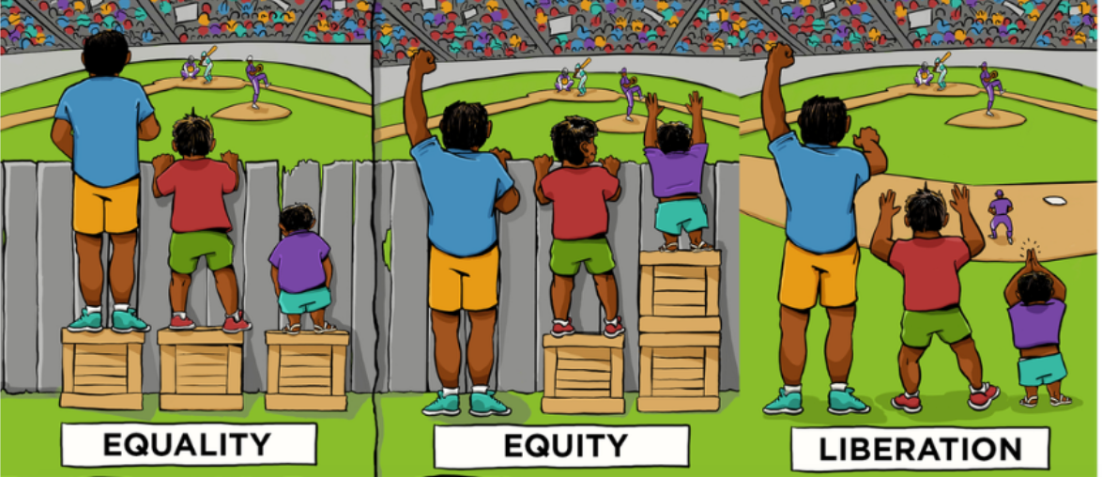
Current Planning Cycle: SEAP Plan, 2022-2025
Who: ACES & SEAP Writing Group
Timeline: Due Nov. 30.
What’s new / different from last time?
Last plan: 23 pages; this plan: 2500 characters per entry
USC Center for Urban Education (CUE) review:
Race-conscious
Engage instructional faculty / focus on classroom
Focus on equity assets
Notes:
The large take away was that our activity metric was race neutral, the descriptions are not race-specific and the plan needs to align its activities with the executive summary

Slide 5
CUE Review Recommendations: Equity Assets
Structures
Programs
Policies
Personnel
Capacity-Building: General
Capacity-Building: Equity
Culturally Relevant Curriculum
Clearly delineate different types of activities and goals (e.g capacity-building, programs, etc...), rather than discussing numerous types of activities under the same goal. (CUE Review)
Notes:
SEAP: “process/policy/practice/culture”
Link to Equity Planning Roadmap (Google jamboard)
Structures: creating anew or reintegrating how units, offices, and roles on campus work towards improving student success and outcomes. Implementing a technological system to support students, faculty or staff.
Programs: Specific activity proposed to address student equity.
Policies: Developing new or revising existing guidelines and rules that govern the operation of the institution/daily routine.
Personnel: Hiring new staff/faculty/administrators to coordinate proposed equity activities or to support the equity effort in some capacity.
Capacity-Building: General: Professional development focused on providing training to staff, faculty, and administrators.

Slide 6
SEAP Metrics:
For each Metric & DI student group in the plan:
Target Outcomes by year
Structural Impediments
Proposed changes: “process/policy/practice/culture”
Target audience & Support needed

Slide 7
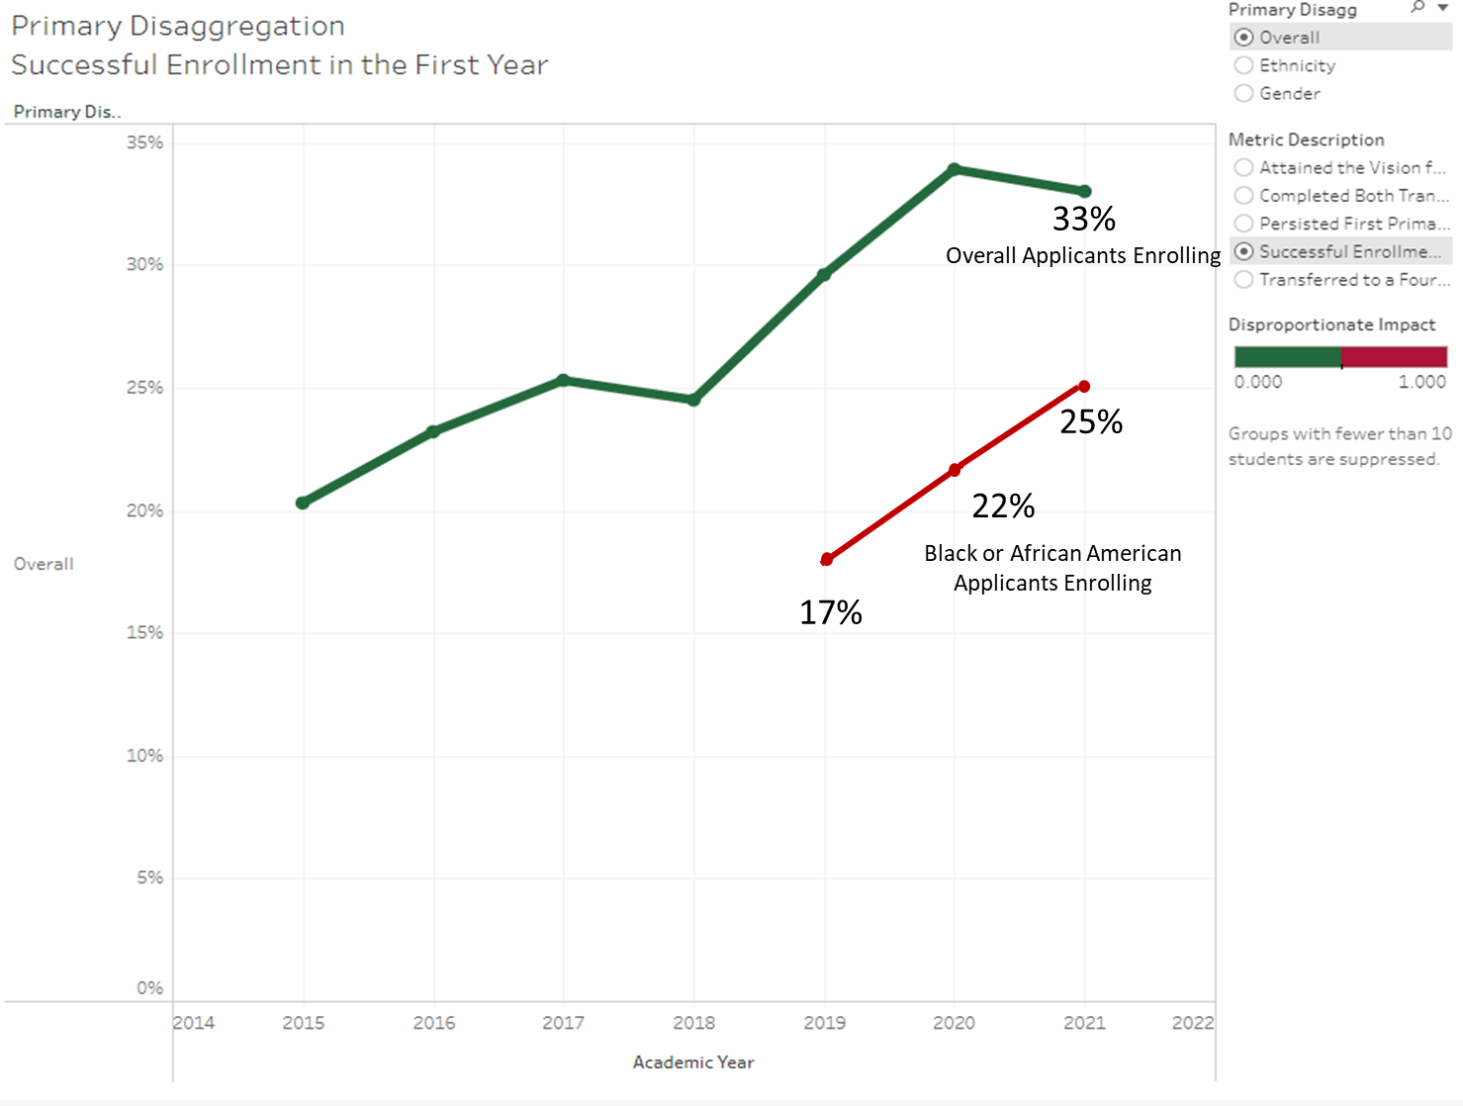
Metric 1: Successful Enrollment in the first year
(Leads: Mary Ho & Manuel Alejandro Pérez)
Definition:
Among all applicants who indicated an intent to enroll in the selected college in the selected year as a non-special admit student for the first time, the proportion of cohort students who enrolled in the same community college in the selected year.

Slide 8
Metric 1(Enrollment): Structural Impediments
What is the college’s current process/policy/practice/culture that impedes equitable outcomes for this population?
No interventions and programs that directly support Black/African American students except Umoja.
Lack of qualitative data to understand our and Black/African American student experience.
Financial barriers to enrollment (enrollment fees, cost of living, other basic needs, etc.)

Slide 9
Metric 1 (Enrollment): Recommendations for Planning & Action
What equity-minded process/policy/practice/culture would facilitate a shift to equitable outcomes for this population?
Implement regular qualitative and quantitative tools to capture the Black experience for students, faculty, staff, and administration at Cañada.
Increase support and institutionalization of UMOJA program deliverables, strategies, and structure.
Institutionalization of strategic plans for college outreach and recruitment of Black/African American students.
Implementation of affinity groups for Black-African American faculty, staff, and administration.
Implementation of Senate Bill 893 to address financial barriers by reducing and eliminating enrollment fees.

Slide 10
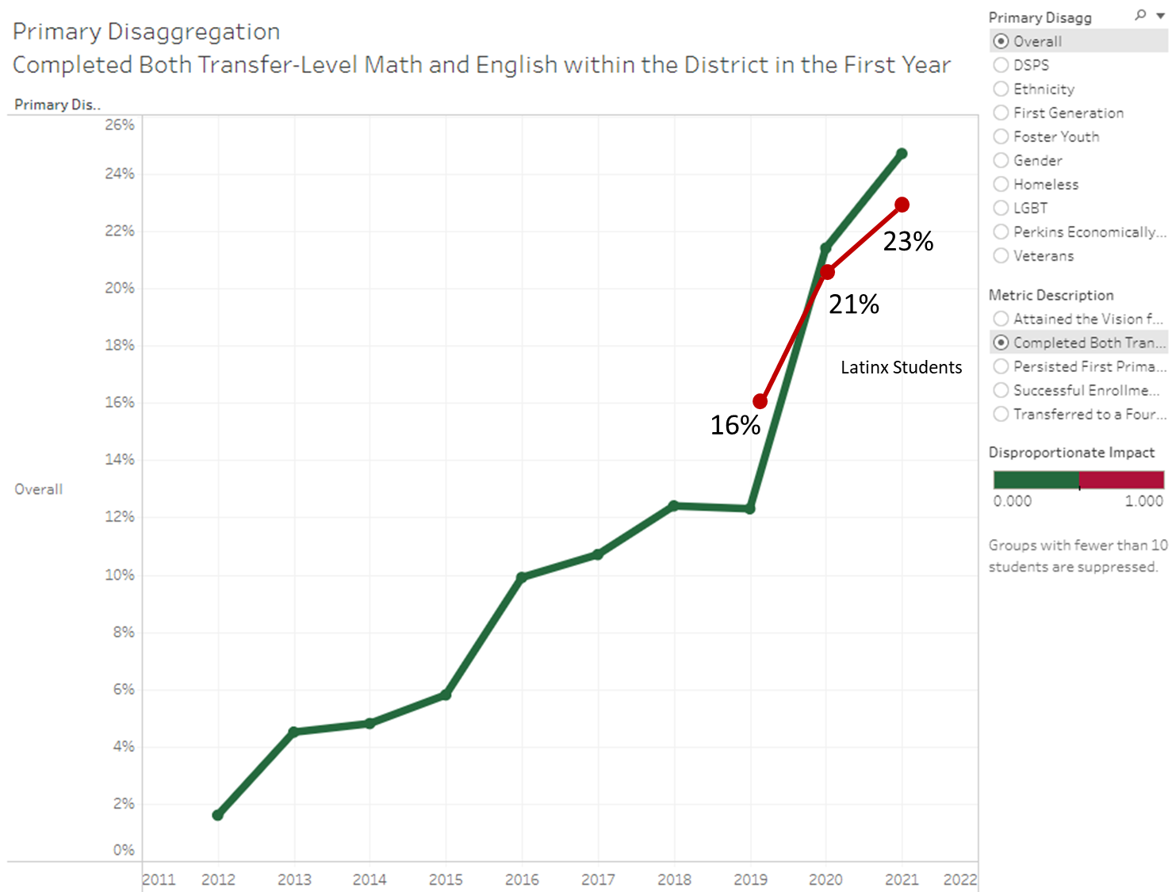
Metric 2: Completed Transfer-Level Math and English
(Lead: Karen Engel)
Definition:
Among students in the cohort, the proportion who completed both transfer-level math and English in their first academic year of credit enrollment within the district.

Slide 11
Metric 2 (Math & English): Structural Impediments
What is the college’s current process/policy/practice/culture that impedes equitable outcomes for this population?
Enrollment:
Many first-time, Latinx degree and transfer-seeking students are not enrolling in transfer-level math or English at all during their first year
Many Latinx students attend part-time and some take very few units at a time (6 or fewer)
English 105 (5 units) is offered in 2-day blocks (rather than 3-day blocks or hybrid modalities) and so may conflict with other courses
Other factors?
Completion:
These courses are challenging, especially for English language learners
Faculty teaching the co-requisite courses would like more institutional support
How do we know which of our supplemental instruction methods are effective for Latinx students?

Slide 12
Metric 2 (Math & English):
Recommendations for Planning & Action
What equity-minded process/policy/practice/culture would facilitate a shift to equitable outcomes for this population?
Establish guidance for first-time students placed into co-requisite math and English to take one course at a time (but to start in their first term)
Adjust ADT degree program maps to recommend taking one per term (most ADT’s maps recommend taking both during the first term)
Schedule Math 200/800 and English 105 to minimize creating conflicts with each other as well as other in-demand courses (GEs, etc) - MWF v. MW patterns or Hybrid
Scale a variety of just-in-time academic supports: embedded tutors, instructional aides, workshops, additional support in the Writing Center and STEM Center in all (or most) sections of both the regular and co-requisite courses
Provide additional, institutional resources and support for faculty teaching co-requisite courses

Slide 13
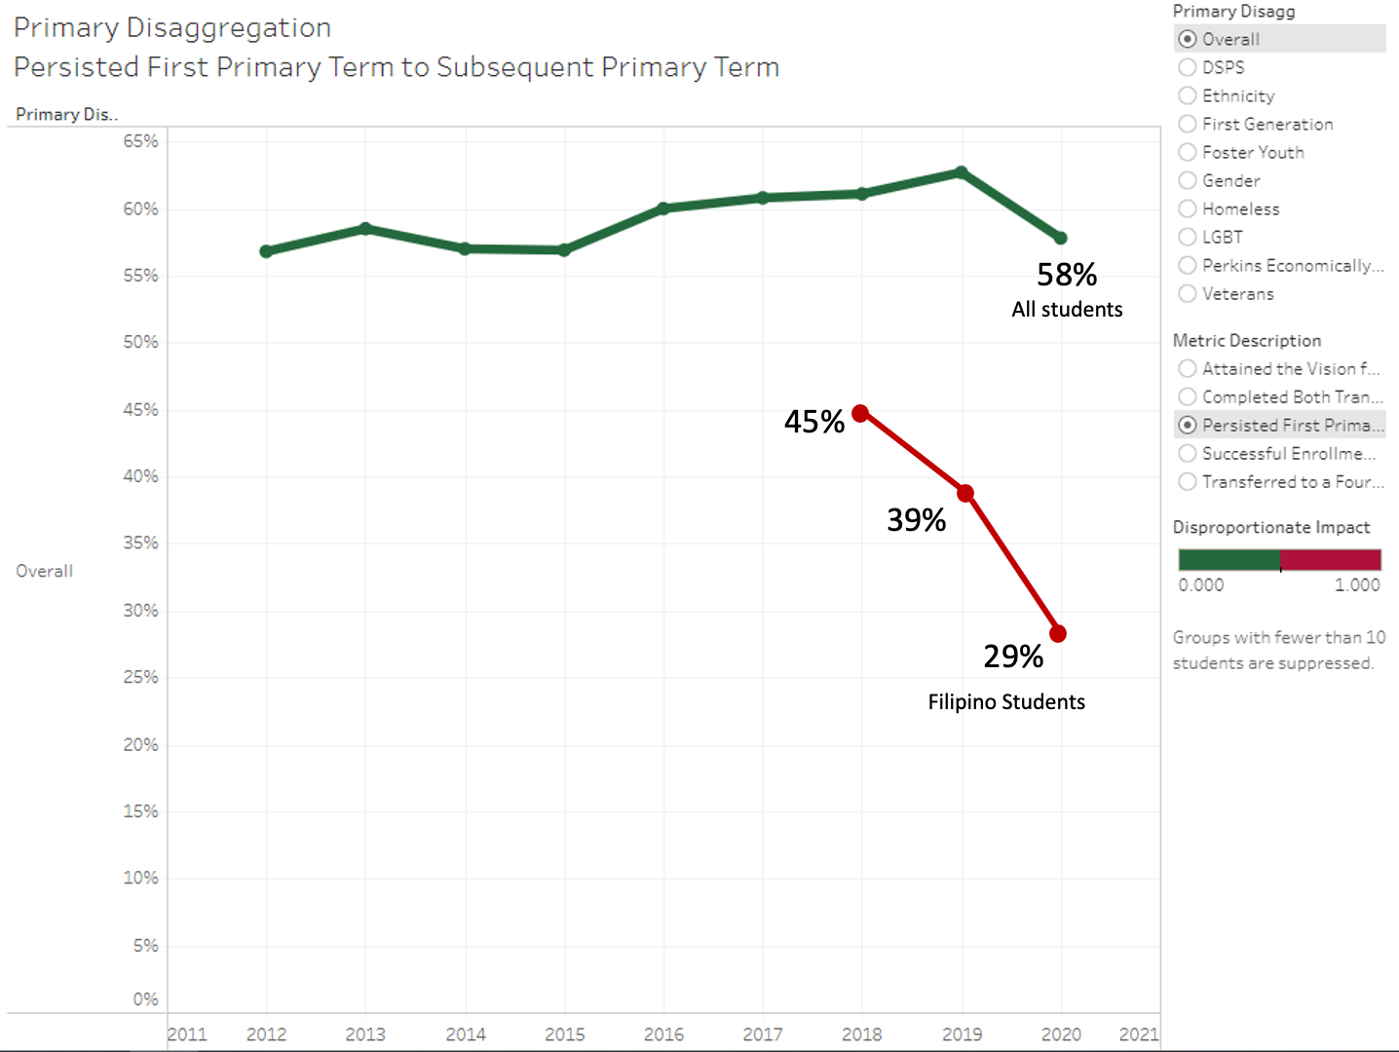
Metric 3: Persistence
(Leads: Alison Field & Manuel Alejandro Pérez)
Definition:
Among students in the cohort, the proportion who persisted from their first primary term of enrollment to the subsequent primary term.
Notes:
Other sources of data: quantitative information collected as part of Career Ladders Focus Groups.

Slide 14
Metric 3 (Persistence): Structural Impediments
What is the college’s current process/policy/practice/culture that impedes equitable outcomes for this population?
Filipino students:
lack sufficient opportunities for community-building;
are underrepresented in cultural programming;
lack mentors & role models;
lack access to affinity spaces / groups;
lack cohort-type program & support;
lack equity-minded, culturally relevant, curriculum;
experience incidents of bias (stereotyping & microaggressions)
Notes:
Also: limited data & schedule limitations

Slide 15
Metric 3 (Persistence): Recommendations for Planning & Action
What equity-minded process/policy/practice/culture would facilitate a shift to equitable outcomes for this population?
Cultural Center programming & affinity group / space development.
Hire and train a diverse team of student ambassadors or mentors to support the Cultural Center.
Consider adoption of a cohort program (Kababayan program @ Skyline).
Professional learning: equity-minded and culturally relevant curriculum development.
Professional learning: implicit bias and microaggressions.

Slide 16
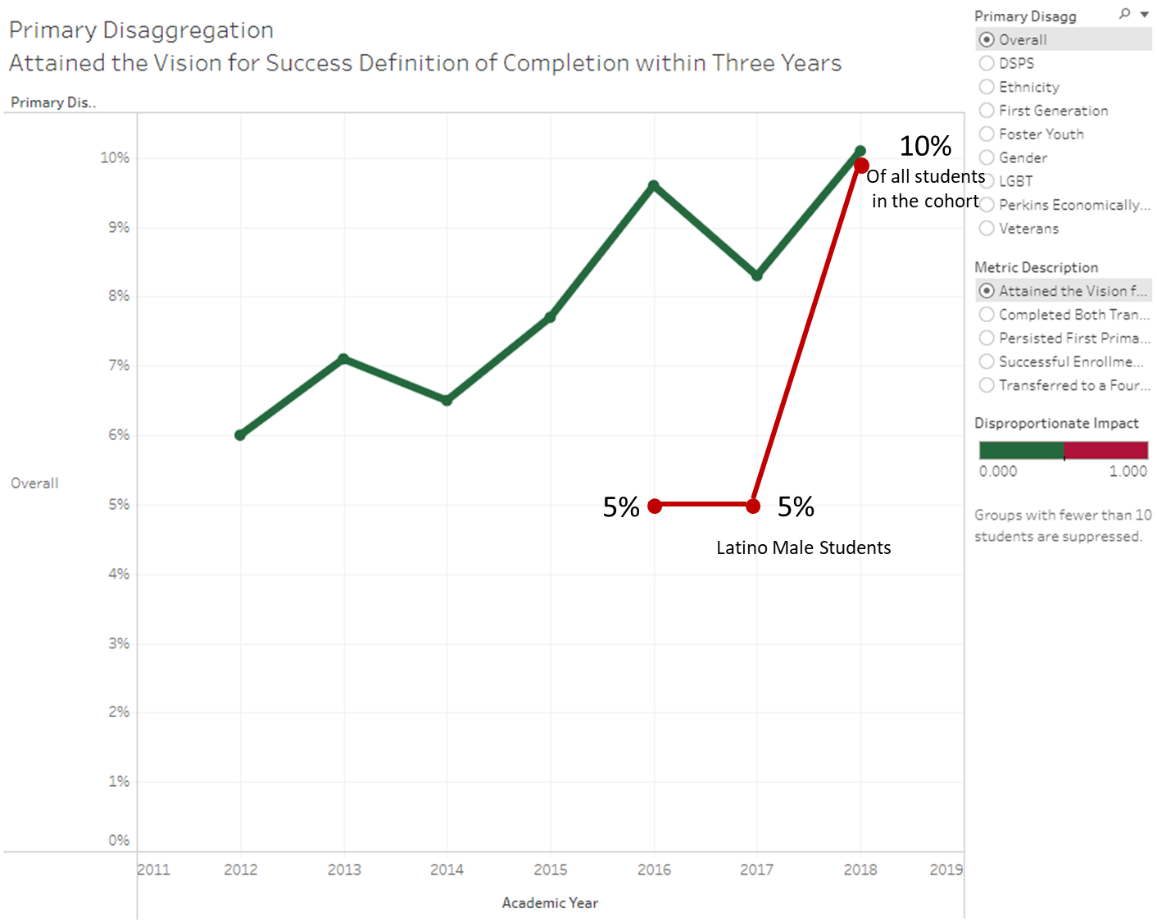
Metric 4: Completion
(Lead: Alex Claxton)
Definition:
Among students in the cohort, the unduplicated count of students who earned one or more of the following: Chancellor's Office approved certificate, associate degree, and/or CCC baccalaureate degree, and had an enrollment in the selected year in the district that they earned the award within 3, 4, or 6 years.

Slide 17
Metric 4 (Completion): Structural Impediments
What is the college’s current process/policy/practice/culture that impedes equitable outcomes for this population?
Schedule of Courses, Schedule Conflicts, Single Section Courses
Access to the physical campus and resources to access courses online
CE Award options
Some College, No Degree

Slide 18
Metric 4 (Completion): Recommendations for Planning & Action
What equity-minded process/policy/practice/culture would facilitate a shift to equitable outcomes for this population?
Student First Scheduling and cross division collaborations
Direct transit line to East Palo Alto, Redwood City satellite location, and expanded technology loan program
Expanded CE offerings based on labor market needs
Clearer path for students to complete their degrees

Slide 19
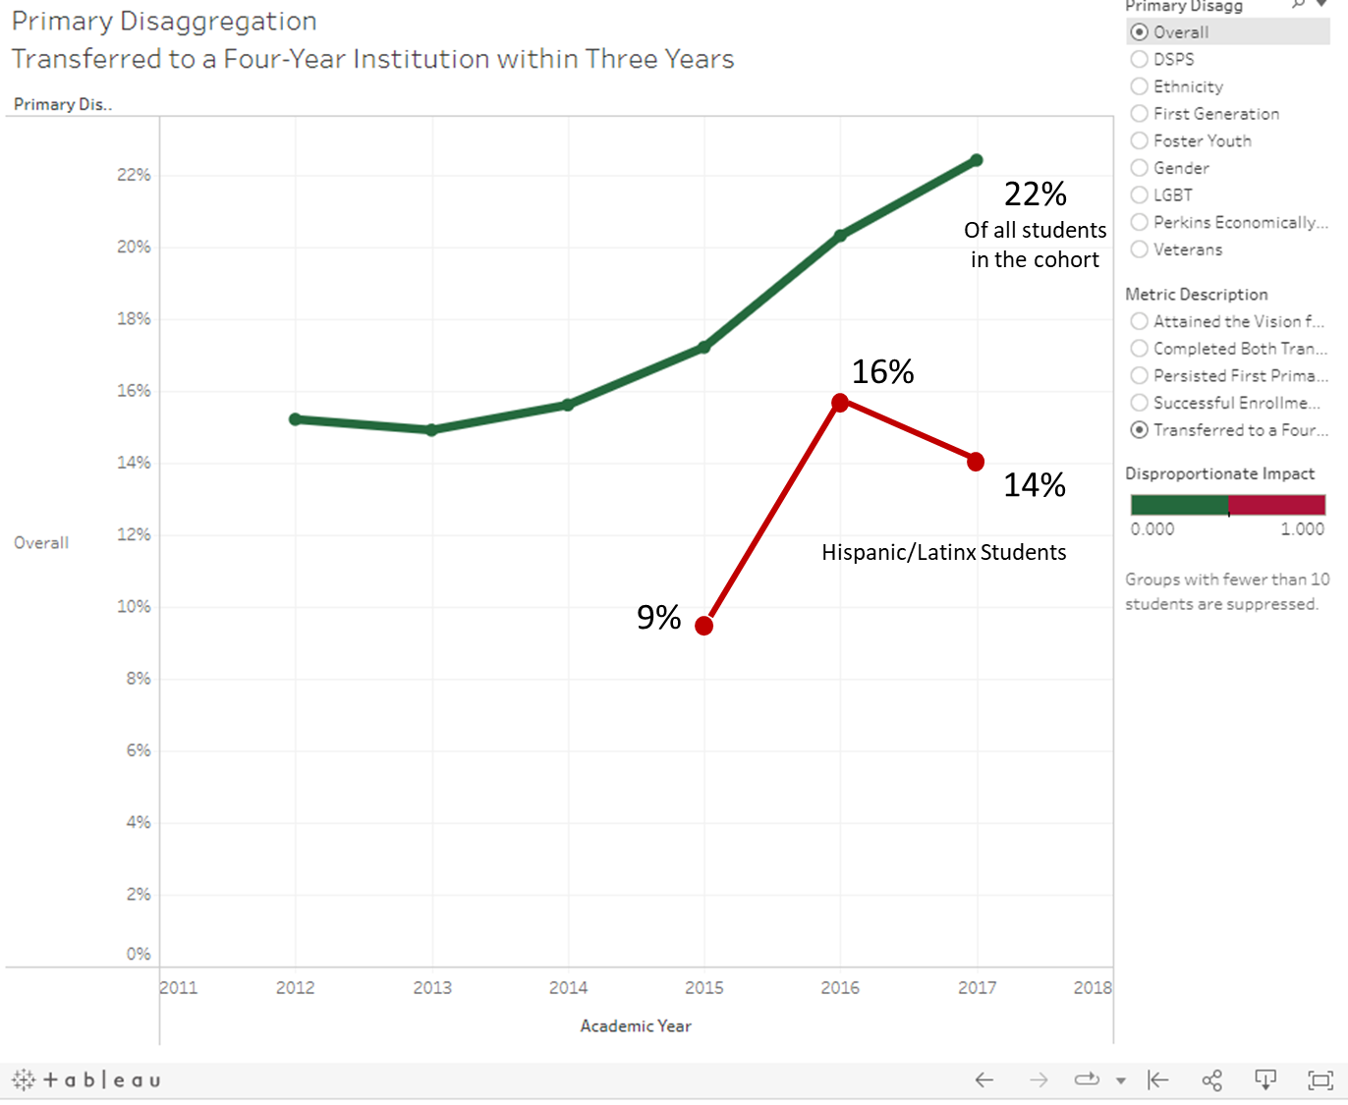
Metric 5: Transfer
(Leads: Mary Ho & Max Hartman)
Definition:
Among students in the cohort who earned 12 or more units at any time and at any college and who exited the community college system in the selected year, the number of cohort students who enrolled in any four-year postsecondary institution in the subsequent year or 4 years after for 3 year cohort, 5 years after for 4 year cohort and 7 years after for 6 year cohort.

Slide 20
Metric 5 (Transfer): Structural Impediments
What is the college’s current process/policy/practice/culture that impedes equitable outcomes for this population?
Because of our high cost of living many of our students need to work one or more jobs just to afford to live in our community. Likewise, many of these students are enrolled part time, thus extending the time it takes to complete their transfer goals.
SSSP dollars that have been rolled into SEAP are funding salary and benefits for personnel connected to matriculation that limit our opportunity to use SEAP dollars to fund additional transfer interventions for Latinx students that may be able to reduce some financial burdens to allow students to concentrate on their studies.
Minimal building of transfer practices and interventions using race-conscious data and need-base data. Elevate transferring as a culture at our college, particularly for our disportionately impacted student populations. The silo-ing of special programs, learning communities and transfer services. Offering evening hour transfer support services.
Notes:
SSSP: Student Success & Support Program

Slide 21
Metric 5 (Transfer): Recommendations for Planning & Action
What equity-minded process/policy/practice/culture would facilitate a shift to equitable outcomes for this population?
CRM: Develop an integrated system of support aligned to transfer milestones centering equity practices for Latinx and low-income students (Transfer Plan)
Ensure the COLTS-U Transfer Station in 9-106 develop high-touch support for Latinx and low-income (Transfer Plan)
Develop and grow additional “warm-hand off” university relationships that center our status as an Hispanic Serving Institution (HSI) in our transfer practices (Transfer Plan)
Expand Promise and develop Part Time Promise Program

Slide 22
Feedback/Discussion
Critical Question:
Are we being race-conscious?
Notes:
Link to Google doc: presentation feedback notes

Slide 23
Wrap-up:
Next Steps:

