Slide 1
Concurrent Enrollment
canadacollege.edu/concurrent

Slide 2
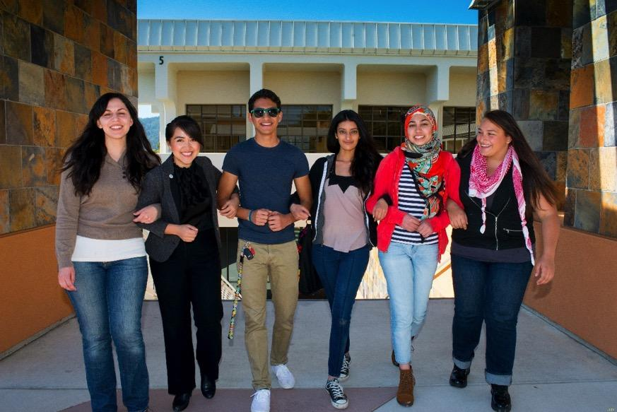
Concurrent Enrollment Program
Get an early start on your college experience while still enrolled in high school.
All high school students from grade 9-12 or homeschooled can take advantage of this program.
Video: https://www.canadacollege.edu/highschoolstudents/

Slide 3
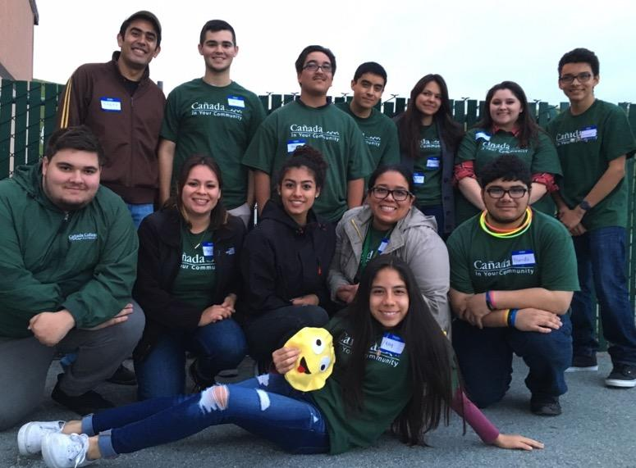
Benefits
A head start on your college degree while earning your high school diploma
Transition to college in a flexible, supportive and academically enriched environment
A refreshing Challenge
FREE Tuition!!!!!

Slide 4
Complete College Services
All of the services and facilities of the College are available to concurrent enrollment students, including:
Quick link to all student services
The College library which is part of the Peninsula Library System
College counseling and advising which includes Educational Counseling, Career Services and Transfer Services
The Learning Center offers free tutoring and mentoring in math and reading, self-paced courses and computer and language labs.

Slide 5
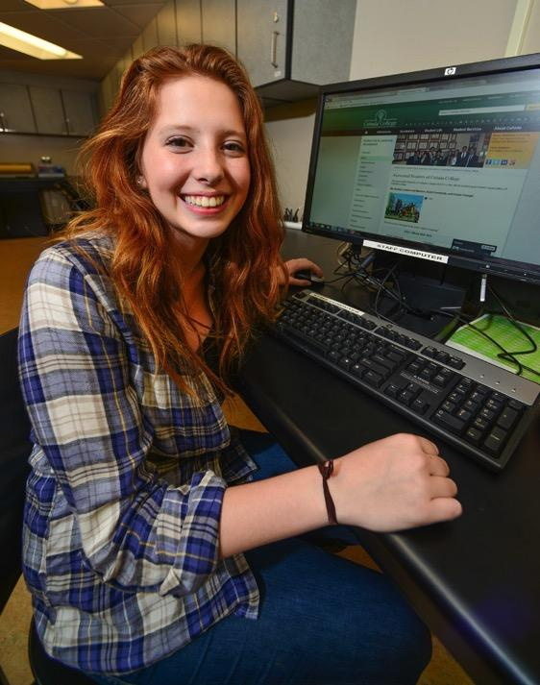
How to Apply
Concurrent Enrollment Form
Apply for Cañada College
Review college class schedule or meet with High School counselor to select your college courses
If enrolling to an English or Math class or any that required a prerequisite class, you must make an appointment to see a cañada counselor.
Submit your course request for concurrent enrollment via WEBSmart student portal

Slide 6
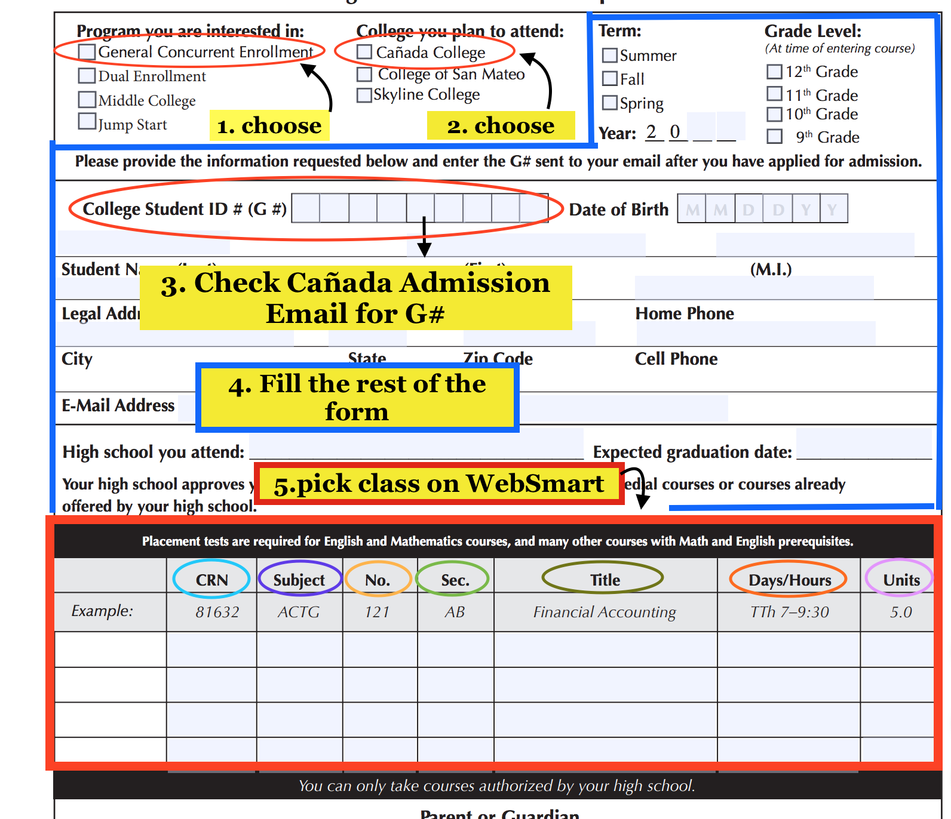
Steps to Complete the Form
Choose “General Concurrent Enrollment”Concurrent Enrollment Form
Choose “Cañada College”
Check Cañada Admission email for your student ID number (G# )
Fill in the whole form as well
To fill in the box go to WebSchedule

Slide 7
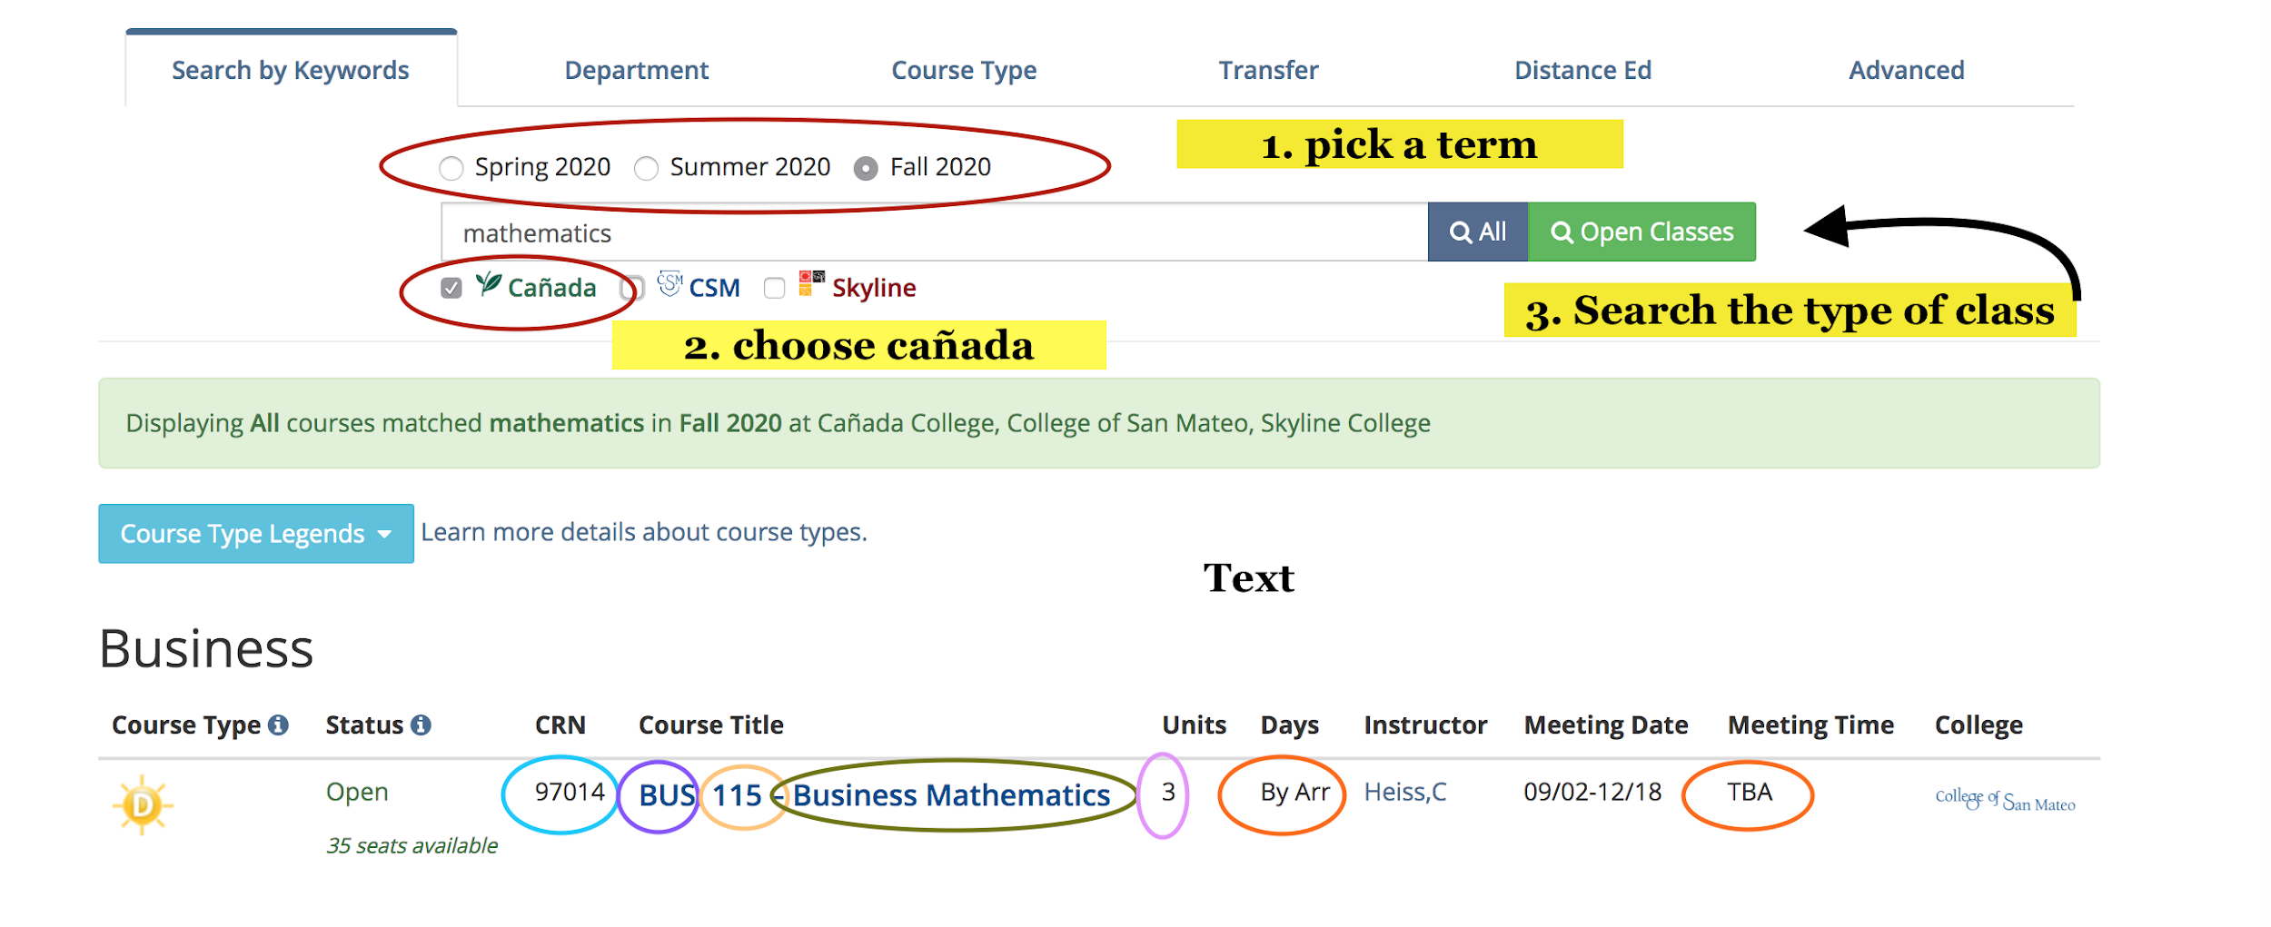
Choosing a Class via WebSchedule
WebSchedule
Pick a term
Choose the term you want to join cañada
Search the subject you want to take the class of
Pick the class you need
Fill out the box section of the form

Slide 8
Any Questions?
Vivien Huynh (Admissions & Records Assistant III)
Student Services - Admissions and Records
huynhv@smccd.edu
(650) 306-3395
Mayra Arellano (College Recruiter)
President's Office - Marketing and Outreach
arellanom@smccd.edu
(650) 306-3166

