Slide 1
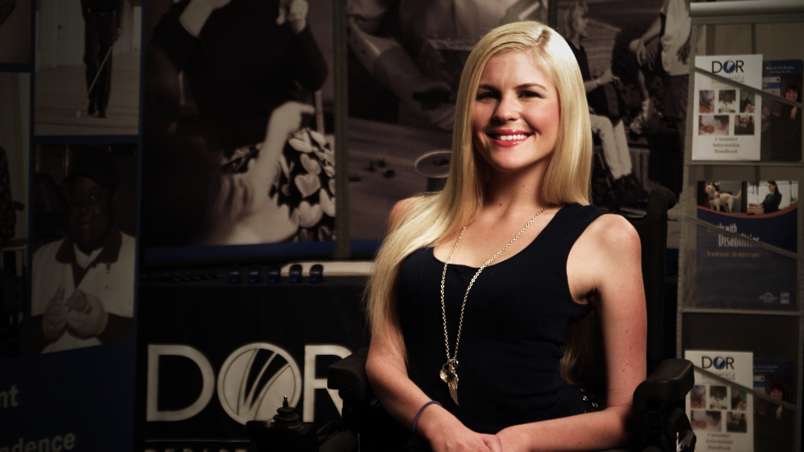

Employment, Independence, and Equality
DOR GENERAL SERVICES

Slide 2

ON A MISSION
The California Department of Rehabilitation (DOR) works in partnership with consumers and other stakeholders to provide services and advocacy in pursuit of employment, independent living and equality for Californians with disabilities.

Slide 3
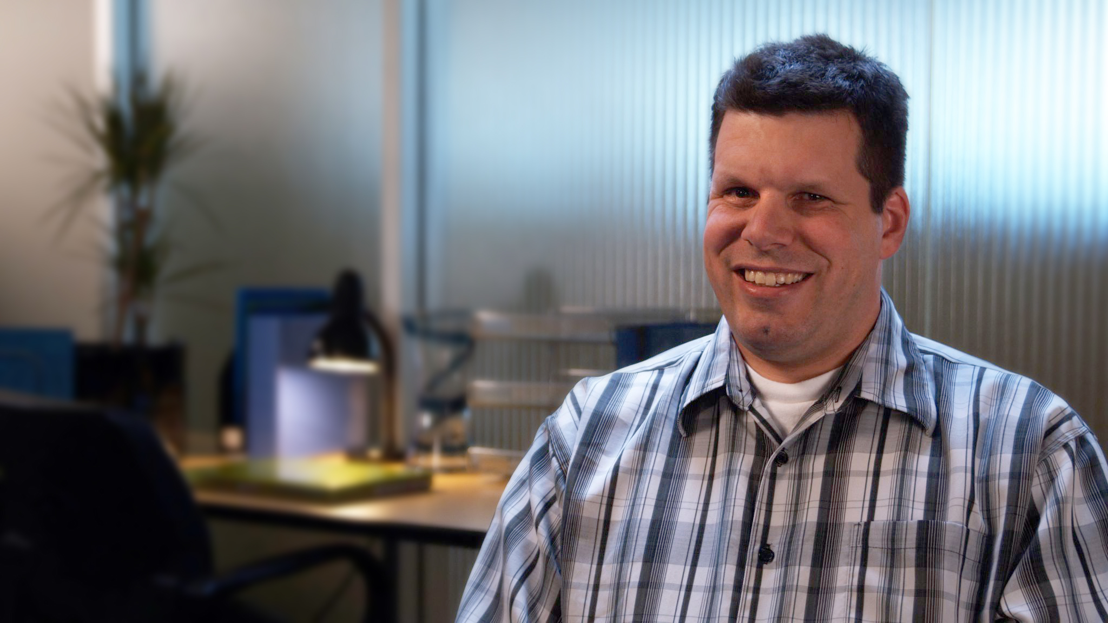
At DOR, it is our fundamental belief that individuals with disabilities can be fully integrated and highly productive community members, employees and colleagues.

Slide 4
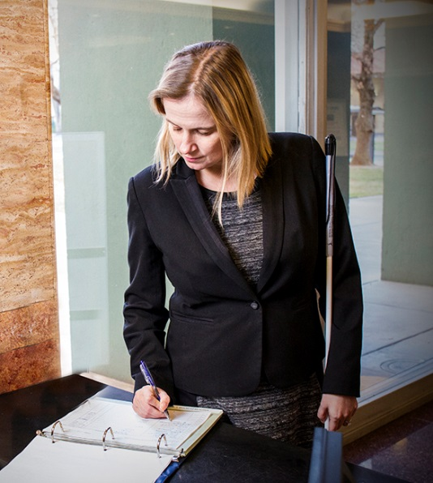
ELIGIBILITY
To be eligible for services, an individual must:
Have a physical or mental disability/Impairment
Require and would like support with vocational rehabilitation including training (education) and/or services to prepare for, secure, retain, or regain employment
Notes:
Have a physical or mental impairment that substantially impedes his or her ability to secure employment
Require vocational rehabilitation services to prepare for, secure, retain, or regain employment consistent with the applicant’s unique strengths, resources, priorities, concerns, abilities, capabilities, interests, and informed choice

Slide 5

Program participants are expected to be available, responsible, active and dedicated contributors to their own success.

Slide 6
CUSTOMIZED SERVICE DELIVERY
We tailor our services to each person individually to ensure a greater chance for success.
Notes:
We tailor our services to each person individually to ensure a greater chance for success. A vocational rehabilitation team works closely with each job seeker to establish the best combination of services and resources necessary to prepare for, find, and retain employment.

Slide 7
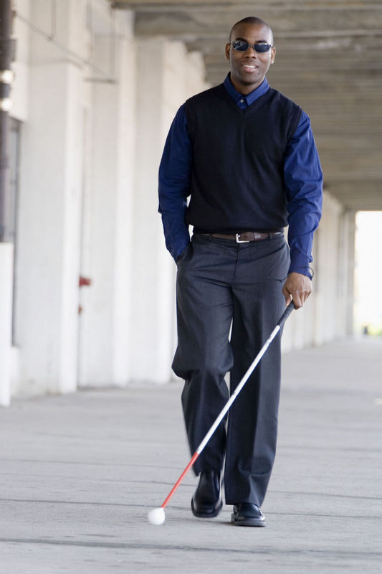
-Career assessment and counseling
-Support for training/education (DOR can help you pay for school including tuition and books and supplies)
-Job search and interview skills
-Assistive technology
SERVICES
To apply for services, contact the Menlo Park DOR office at 650-688-6380
Notes:
Benefits Planning
Career assessment and counseling
Job search and interview skills
Independent living skills
Career education and training
Assistive technology

Slide 8

For more information and to apply for services please contact:
California Department of Rehabilitation
Menlo Park Office 650-688-6380

