Slide 1
DRC Services and Learning Disability Support
March 3^{rd,} 2016
Jenna French, M.S.
Learning Disability Specialist / DRC Counselor
frenchj@smccd.edu Ext 3368

Slide 2

Jenna French – My Story
Diagnosis in 2nd Grade with Dyslexia
Self Esteem
High School Experience
UCSC – Took while to ask for accommodations
MS Rehabilitation Counseling
What did I do to help me be successful?
What did professors do to help me be successful?

Slide 3
The most important thing to take away today…..
What is the best thing a professor can do for a student with a disability?

Slide 4

ASK THE STUDENT

Slide 5

DRC Role
DRC role is to provide accommodations and assistance to students with disabilities that facilitate their achieving their educational goals.
We are committed to ensuring that students receive equal access to all programs and services.
To that end, we seek to balance the student’s right to access with our obligation to protect the integrity of our college’s programs and services.

Slide 6
TYPES OF DISABILITIES
Developmental Disabilities
  ADHD
  Autism Spectrum Disorder
  Learning Disabilities
Psychological Disabilities
  Anxiety
  Depression
  Bi Polar
  Schizophrenia
  Personality Disorders
Acquired Disabilities
  Traumatic Brain Injury
  Temporary Disabilities
Legal Blindness or Visual Impairment
Deaf and Hard of Hearing
Physical Disabilities
  Back Impairments
  Paraplegia
  Quadriplegia
Chronic Health Conditions
  Addison's
  HIV
  MS
  Fibromyalgia
  Diabetes
  Cerebral Palsy
  Gastrointestinal Disorders
  Migraine Headaches
  Sickle Cell Anemia

Slide 7
DRC Student Data
 | 2012 – 2013 Student Count | 2012 – 2013 Student Count (%) | 2013 – 2014 Student Count | 2013 – 2014 Student Count (%) | 2014 – 2015 Student Count | 2014 – 2015 Student Count (%)
Total | 218 | 100% | 252 | 100% | 315 | 100%
Acquired Brain Injury | 6 | 2.75% | 10 | 3.97% | 6 | 1.90%
Developmental Delayed Learner | 4 | 1.83% | 6 | 2.38% | 5 | 1.59%
Hearing Impaired | 6 | 2.75% | 5 | 1.98% | 8 | 2.54%
Learning Disabled | 29 | 13.30% | 28 | 11.11% | 34 | 10.79%
Mobility Impaired | 21 | 9.63% | 25 | 9.92% | 26 | 8.25%
Other Disability (ADHD, Autism) | 94 | 43.12% | 114 | 45.24% | 152 | 48.25%
Psychologist Disability | 49 | 22.48% | 55 | 21.83% | 75 | 23.81%
Speech/Language Impairment | 2 | 0.92% | 4 | 1.59% | 4 | 1.27%
Visual Impairment | 7 | 3.21% | 5 | 1.98% | 5 | 1.59%

Slide 8
Myths of Psychological Disabilities
Ewwww Stigma…..
Myth: Mental health problems don't affect many people.
  Fact: Mental health problems are actually very common. In 2014, about: One in five American adults experienced a mental health condition
Myth: People with mental health problems are violent and unpredictable.
  Fact: The vast majority of people with mental health problems are no more likely to be violent than anyone else.
  Most people with mental illness are not violent and only 3%-5% of violent acts can be attributed to individuals living with a serious mental illness.
Myth: People with mental health needs, even those who are managing their mental illness, cannot tolerate the stress of being a student.
  Fact: People with mental health problems are just as productive as other students.

Slide 9
VIDEO
http://teachingcommons.cdl.edu/access/materials/GloriaA_Story.shtml

Slide 10

How to register with DRC
Schedule an appointment with a DRC Counselor to discuss your accommodation needs.
Bring with you any documentation related to your disability, doctor's information, or IEP/Triennial that you may have.
Have your request for services evaluated and reasonable accommodations arranged.
Students can register anytime during the semester.

Slide 11
Language – Person First
Words with Dignity Words to Avoid
Person with a disability ← Handicapped/crippled/the disabled; physically/ mentally challenged
Person who has multiple sclerosis or cerebral palsy ← Afflicted by MS, victim of CP
Person with epilepsy or seizure disorder ← Epileptic, Seizures, Epileptic fits,
Person who has muscular dystrophy ← Stricken by MD
Person who is blind ← The blind
Person who uses a wheelchair ← Restricted/confined to a wheelchair; wheelchair bound (The chair enables mobility. Without the chair the person may be confined to bed.)

Slide 12
What is an Accommodation?
An academic adjustment that allows a student with a disability the opportunity for equal participation in College coursework.
Determined on an individual basis
Supported by appropriate medical documentation
Doesn’t compromise academic standards
Spoon Example

Slide 13
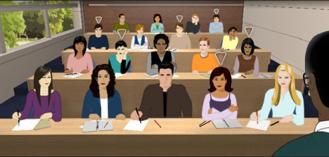
Classroom Accommodations
Notetaking
Audio Record Lectures
Materials in ALT format
Breaks in Class
Move/Stretch
Interpreters
Furniture

Slide 14
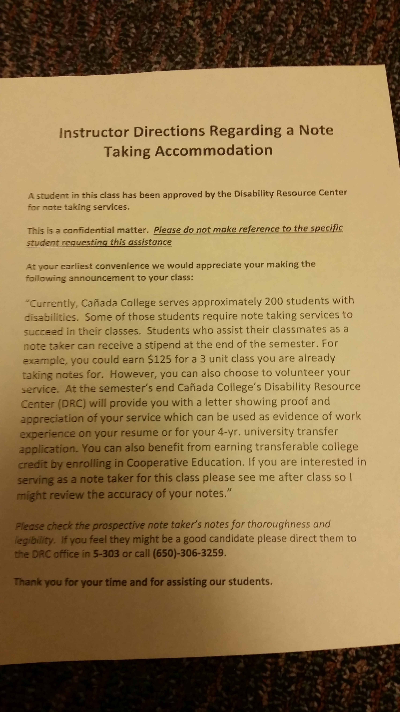
Notetaking
WE NEED YOUR HELP!
  Read the Yellow Form
Review the notetaker notes, we only want the best
Send them to our office to do the paperwork
If no one volunteers, please let us know

Slide 15

Audio record lectures
Student will bring device
Smartpen
How does it work?

Slide 16
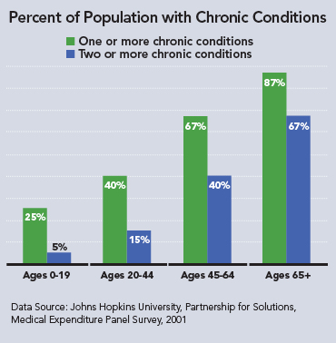

Exacerbated Symptoms
Students have Chronic Health Conditions
Flexibility around late assignments and deadlines
Flexibility on attendance and participation
Professor and student work together on this
Each case is handle individually

Slide 17
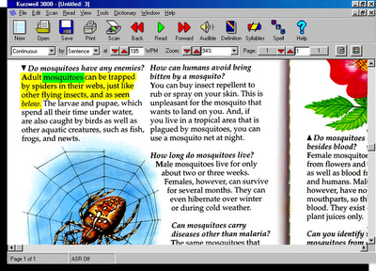
Alternative Media
Kurzweil
  Able to have text read orally to them, with visuals
  Can have writing read back to them
Need the textbooks early
  To convert for students
Clean copy of text
Any articles in class

Slide 18
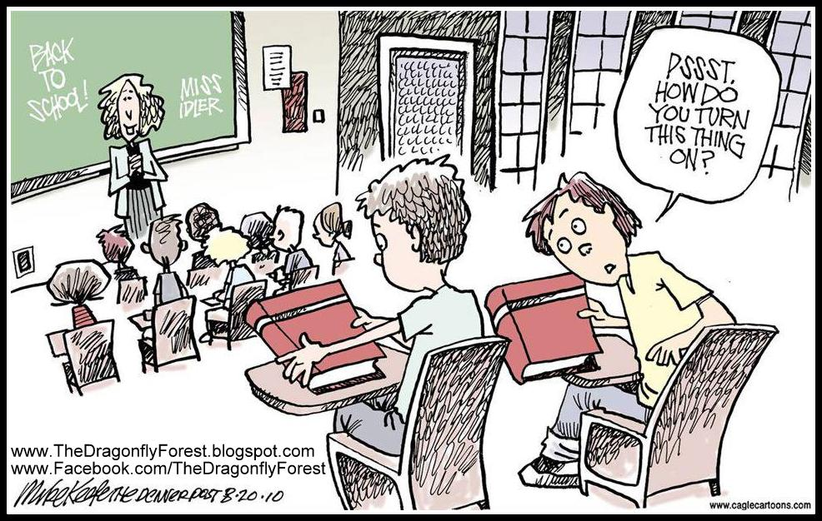
Other Classroom Accommodations
Interpreters
Real Time captioning
Breaks in Class
Move Around
Furniture

Slide 19

Testing Accommodations
Kurzweil
Breaks
Low distraction
Calculator
Spelling
Extra time
Computer

Slide 20
Testing Accommodations - Process
How do students take the exam in the DRC?
  BLUE FORM
Professors
  Pop quizzes
  The student should turn in the blue form
  Going over the quiz right after the exam, not always good
  Please send us the test 48-72 hours before the exam
  Cheating
  Testing process – we take this very seriously

Slide 21
What is the DRC accommodation letter?
The student will get the accommodation letter from the counselor each semester.
The student will then give the letter to each of their professors.
The student does not need to share what their disability is with the professor. The letter is all the professor needs to know, that they are registered with the DRC and what their accommodations are.
Professor please be available for the student to speak with you in private about their accommodations.
If a professor has any questions about the letter, there is always DRC staff contact information on the letter.

Slide 22
As a faculty member, am I required to provide the accommodations the DRC authorized?
Yes, you are.
The Rehabilitation Act of 1973 in Section 504 protects students with disabilities. This law requires that qualified students with disabilities get equal access to an education and not be discriminated against in their pursuit of this education.
Authorized accommodations are done by a qualified DRC professional in accordance to students’ documented, verified disability and the educational limitations it imposes.

Slide 23

What if a professor disagrees with an approved accommodation?
Professors who have questions, comments, concerns or suggestions on classroom accommodations authorized by DRC are encouraged to contact the DRC professional who wrote the accommodation memo.

Slide 24
Faculty Rights and Responsibilities
Faculty rights:
  To set academic standards
  To evaluate the student based on the standards of the class and to grade accordingly
  To advise the student to contact DRC if the student requests an accommodation and the instructor has not received written notification from the DRC office
Faculty responsibilities:
  To work with DRC to provide for accommodations in a fair and timely way (GET A LETTER)
  To adjust instruction without fundamentally altering the program
  To provide handouts in a timely way for alternate media provision
  To select textbooks in a timely way so that e-text can be ordered from the publisher
  To respect and maintain a student's right to confidentiality about his/her disability by not announcing or discussing the student's disability in the presence of other students or staff
  To contact the DRC office if there is disagreement about the accommodation
  To work with DRC to ensure that instructional videos/DVDs are captioned
  To post materials on school websites in an accessible format for students
  To ensure that test accommodations do not impact lecture time or other course meeting requirements

Slide 25

Professors Role
Get the accommodation letter from the student
Allow the student to speak to you in private or during office hours about their accommodations.
Fill out the DRC Blue form when the student has exam accommodations.
Professor should not ask the students, “What is your disability?” Instead ask, “What else can I do to help accommodate you? How else can help you learn this material?”
Professor do not need to get any proof of the students disability.
If a professor has any concerns about the accommodations written on the letter, they are welcomed to contact the DRC.
Extra time on exams vs. assignments

Slide 26
Students Rights and Responsibilities
Students with disabilities have the right:
  To participate voluntarily in DRC
  To participate in other courses, programs, or activities offered by the college
  To be evaluated based on ability, not disability
  To appeal a decision regarding accommodations through the academic accommodation grievance process.
Students with disabilities have the responsibility:
  To provide professional documentation of disability to the college
  To request accommodations in a timely way
  To follow procedures for obtaining accommodations
  To work cooperatively with DRC to determine and implement accommodations
  To maintain the academic and conduct standards of the college

Slide 27
DRC Rights and Responsibilities
DRC has the right:
  To request and receive current documentation that supports the need for accommodations
  To deny a request for accommodations if the documentation demonstrates that the request is not warranted or if the individual fails to provide appropriate documentation
DRC has the responsibility:
  To assist faculty in providing or arranging accommodations and/or auxiliary aids
  To hold student information confidential except where permitted or required by law
  To communicate to students, faculty, and staff the process to request accommodations
  To verify the student's disabilities and authorize accommodations based on educational limitations caused by the disability
  To direct faculty to resources available for the development of accessible web sites and/or posting of instructional materials in accessible formats.

Slide 28


Confidentiality
Under the laws affecting higher education, students have the right to confidentiality.
Under no circumstances should a student's disability situation be discussed in front of the class or in the presence of other students.
Information on a student's disability should not be shared with other faculty or staff.
In order to receive accommodations, students must disclose to you that they have a disability and have a need for academic accommodations authorized through DRC.
However, students are not required to disclose specific information on their disability to a faculty member since this information has already been obtained through DRC.

Slide 29

Do faculty members have the right to access diagnostic information regarding a student’s disability?
Faculty do not have the right to access the student’s diagnostic information. Cañada College follows the rules of confidentiality that are described in Section 503 of the Rehabilitation Act(1973) and Federal Education Right to Privacy Act (FERPA).

Slide 30

WE WANT YOU TO REFER STUDENTS
Very likely that an instructor will have at least one student with a disability in each class
Other students, particularly those with learning disabilities, may not know that they have a disability.
There may also be students in your class who have disabilities but who choose not to disclose that information to anyone at the college.

Slide 31
How to refer a student to the DRC?
Private meeting
Do not ask the student directly if they have a disability.
Instead gather information about a few resources on campus, in addition to DRC, such as the Learning Center, Career Center, Counseling Center, Transfer Center, Bookstore, EOPS/CARE/CalWorks/Former Foster Youth, Health Center, Psychological Services, International Students, TRiO SSS, Veterans Services etc.. You might say, "I want to share some information on campus services that you might find helpful."
When you mention the DRC, you could ask the student, "Are you aware of the DRC office? The DRC provides a number of services for students with a variety of disabilities.”
The student might then say, “Oh ya I had an IEP” or “Ya, I went to the resource room.” If you hear this tell them that they should then contact the DRC. They might qualify for the same type of supports that they did in highschool.

Slide 32
How to refer a student to the DRC?
Ultimately it is up to the student to decide whether or not to disclose a disability and pursue DRC services.
You may advise your student to go to the DRC office, where he or she may or may not initiate the process of becoming a DRC student.
Do not force a student to walk over the to DRC. Some students will benefit from being walked over, which is certainly acceptable as long as it is what the student wishes. Please keep in mind that students with disabilities are not required to utilize DRC services.
Please do not ask the student to provide you any disability related documentation. The DRC office will take care of getting the appropriate paperwork from the student.
Examples of what to say
“There is the DRC, this service is for students with disabilities to get academic accommodations. Any student who had an IEP/504 plan or attended the resource room might qualify for these services. Example of some accommodations are extra time on exams, and notetaking support. They also provide Learning Disability testing for students who are interested in being tested.”

Slide 33
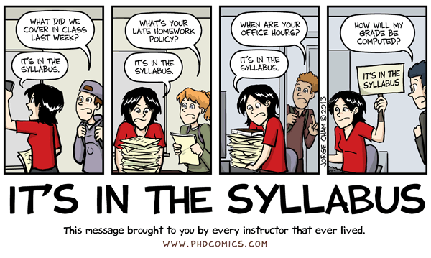
Syllabus – Add a disability statement
All faculty will want to put a statement about accommodations in their syllabus or first day handout to inform students about their right. You can use a statement like this:
“Any student who feels he or she may need an accommodation based on the impact of a disability should contact the DRC by calling 650-306-3259, or visit 5- 303 to coordinate reasonable accommodations for students with documented disabilities.”

Slide 34

What if the student is hesitated to go to the DRC?
Again, ultimately it is up to the student to decide whether or not to disclose a disability and pursue DRC services.
There are many reasons why a student might not want to register with the DRC. They will register when they are ready to.
We accept student anytime during the semester.

Slide 35
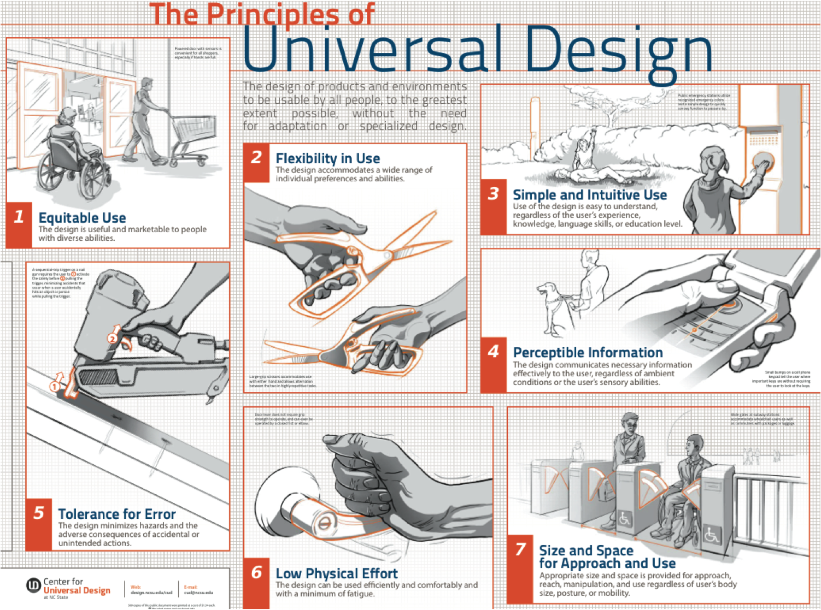
Universal Design
VIDEO http://www.washington.edu/doit/videos/index.php?vid=13

Slide 36
Universal Design
Class Climate
  Be Approachable in an inclusive manner
  Avoid segregating or stigmatizing any student
Delivery of information
  Summarize major points
  Write key terms and concepts on the board and in handouts
  Provide scaffolding tools (e.g., outlines, class notes, summaries, and copies of projected materials) in both printed form and a text-based electronic format.
  At the beginning of class, consider projecting one to two questions that students should be able to answer by the end of the session.
  Speak content presented visually.
  Make visual aids large (e.g., use large, bold fonts on uncluttered overhead displays; use a computer to enlarge microscope images).
Information Resources and Technology
  Select materials early.
  Provide materials in accessible formats. Select or create materials that are universally

Slide 37

Universal Design
Caption Videos
  Helpful for more than just student with disabilities
Feedback and Assessment
  Clear expectation
  Multiple ways for student to demonstrate knowledge
  Provide sample questions
  Study Guides
  Review outlines or 1st draft if possible

Slide 38

Emergency Situations - Prep
1. Inform all students/employees of the nearest exit to use in case of an emergency. Faculty can print this information in the course syllabus and announce it on the first day of class.
2. Encourage students/employees who may need assistance in an emergency to identify themselves and to make an evacuation plan.
3. Develop a “buddy system” by recruiting at least two volunteers to assist each person with a disability requesting evacuation assistance.

Slide 39
Guidelines for Evacuating Persons with Disabilities
Always ask someone with a disability how you can help before giving assistance.
Do not grasp a visually impaired person’s arm; ask if he or she would like to hold on to your arm to exit. Warn the person about steps. Be specific in your verbal instructions (i.e. “ to the right” rather than “this way”). Keep guide dogs with owners whenever possible.
Get the attention of a person with a hearing disability by touch and eye contact. Use facial expressions, gestures and body movements to help in communicating your message. Offer visual instructions to advise of the safest route or direction by pointing towards exits or evacuation maps.
If people with mobility impairments cannot exit, assist them in moving to the nearest stairway exit to await rescue personnel.
Attempt a rescue evacuation only if you have had rescue training or the person is in immediate danger and cannot wait for professional assistance. Evacuating a disabled or injured person yourself is the last resort. Consider your options and the risks of injuring yourself and others in an evacuation attempt. Do not make an emergency situation worse.

Slide 40
What is a Learning Disability?
A learning disability is a persistent condition of presumed neurological dysfunction that continues despite instruction in standard classroom situations.
A person with a learning disability has a significant processing deficit in one or more areas such as memory, verbal skills, non-verbal reasoning/visual-spatial skills or processing speed.
Someone with a learning disability has a history of struggling in major subjects like reading, writing, math, or listening.
A learning disability is not difficulty with a challenging subject like higher level science or math.
It is not a psychological issue like anxiety in test-taking. It is not an attention or focusing issue like ADHD which is a different neurological diagnosis.
At the California Community Colleges we assess for eligibility for services/accommodations. We are not providing a diagnosis or testing because someone is curious in how they learn.

Slide 41
Signs a student might have an LD
Learning difference in the way a person takes in, understands, remembers, and/or expresses information
Difficulties with reading, writing, and/or math
Repeating courses
Mentions they had an IEP/504 plan in high school (could be a different type of disability)
Mentions any of characteristics on the “What are Learning Disabilities” Handout

Slide 42
Learning Disability Testing
To Request Testing a Student Must:
  Be enrolled in at least one course
  Make an intake appointment with the learning disability specialist by calling 650-306-3259.
How does LD Testing help the student?
  Find out if they have a learning disability
  Discover their abilities and strengths
  Determine their limitations and accommodations
  Learn Study Strategies specific for the student learning
Does the student get after testing?
  All the testing documentation, this can be brought to the 4 year college
  This documentation can be brought to other community college
Testing Process
  1 hour Interview
  Two 3 hour testing
  1 hour results – set up accommodations

Slide 43
Reasons to Refer a Student for LD Testing
Reasons to refer someone for LD assessment:
The student studies 2-3 hours per every hour they spend in the classroom, but the evaluations of their learning (tests, papers, etc.) do not reflect this amount of study.
Significant discrepancies between any of the following: the student’s test scores, homework, written work, verbally expressed understanding of course concepts, or any other evaluative process.
Significant discrepancy in achievement from one type of course to another, such as receiving passing grades in math and sciences while receiving failing grades in English and social sciences.

Slide 44
The most important thing to take away today…..
What is the best thing a professor can do for a student with a disability?

Slide 45
ASK THE STUDENT

Slide 46
Recap –
TOP POINTS FOR FACULTY TO KNOW
How to Refer students to our office – see website
Aware of the most common accommodations
Fill out the blue forms with students
Read from the yellow form when a student needs a note taker
Pick classroom materials – early
Set up Emergency procedures for students who request it
Person First language
Allow the student to speak to you in private or during office hours
Send the DRC exams at least 48 hours in advance, 72 if the student needs Kurzweil
If a professor has any concerns, they are welcomed to contact the DRC
Ask the student what you can do to help them

Slide 47

Any Questions?

