Slide 1


Kurzweil 3000 Module I: The Basics
1. What is Kurzweil 3000? 3. The Kurzweil Universal Library
2. Accessing Kurzweil 3000

Slide 2


What is Kurzweil 3000?
Kurzweil 3000 is a software program that uses text-to-speech technology to enhance the student reading experience
Being able to read with more than one sense can help students with:
STAYING FOCUSED WHILE READING
READING COMPREHENSION
READING RETENTION

Slide 3
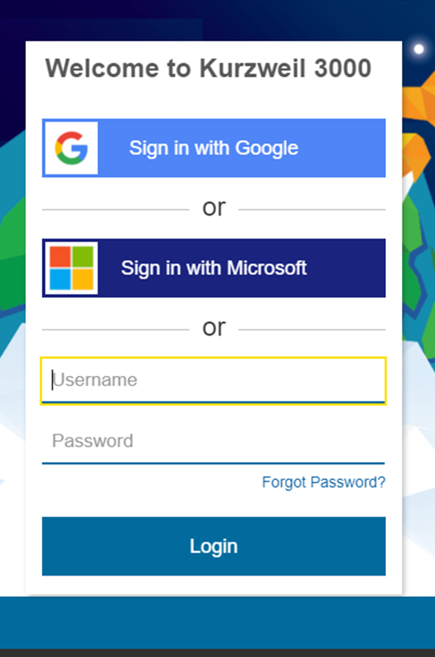
Accessing Kurzweil 3000
Kurzweil can be accessed from any smartphone, tablet, or computer with an internet connection, at kurzweil3000.com
The DRC Alt-Media staff will create a username and password for approved Kurzweil users
Note! Contact the DRC Alt-Media staff if you need assistance with logging in

Slide 4
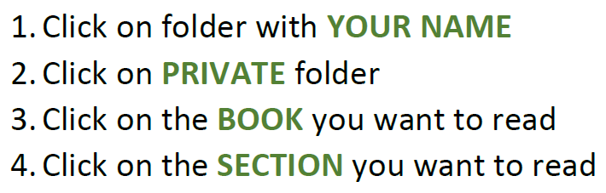
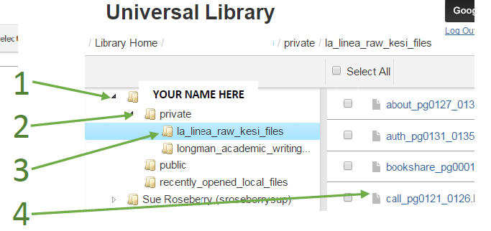
The Kurzweil Universal Library
Logging into Kurzweil will direct you to the Universal Library – the document cloud where your textbooks will be uploaded
Your uploaded books will be listed by title in your private folder
Each book will be separated into 10 page files, and each file will be labeled by section and page range

Slide 5


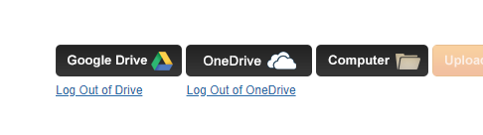


Also in the Universal Library
Did you know that Kurzweil can read documents other than textbook files?
There are icons in the Universal Library that you can click on to easily open documents saved on:
Google Drive
Microsoft One Drive
Your Computer

