Slide 1


Kurzweil 3000 Module II: Reading
1. Basic Reading Controls 3. Customize Document View
2. Using Page Controls 4. Customize Audio Options

Slide 2
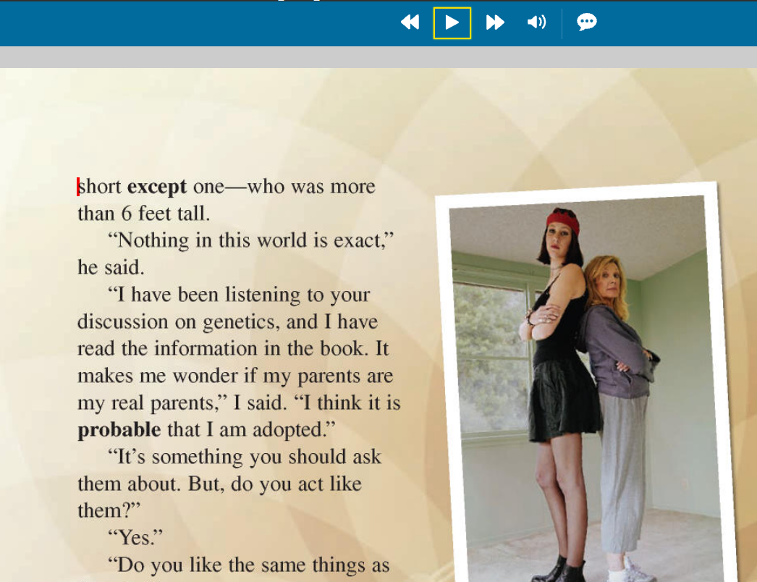
Basic Reading Controls
When you open a document in Kurzweil, a red cursor will appear at the beginning of the text
Click the Read icon to start audio playback
Click the same icon to pause playback
If you wish to read a different part of the page, move your cursor to the desired area, and click the Read icon again

Slide 3
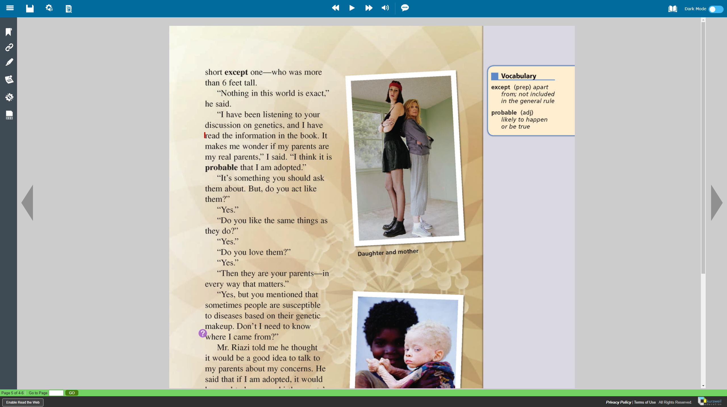
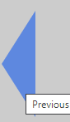

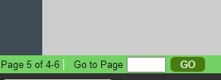
Using Page Controls
On either side of the window, there are arrows that allow you to navigate to the previous or next page
In the lower left corner of the window, you can enter a specific page number to go to

Slide 4
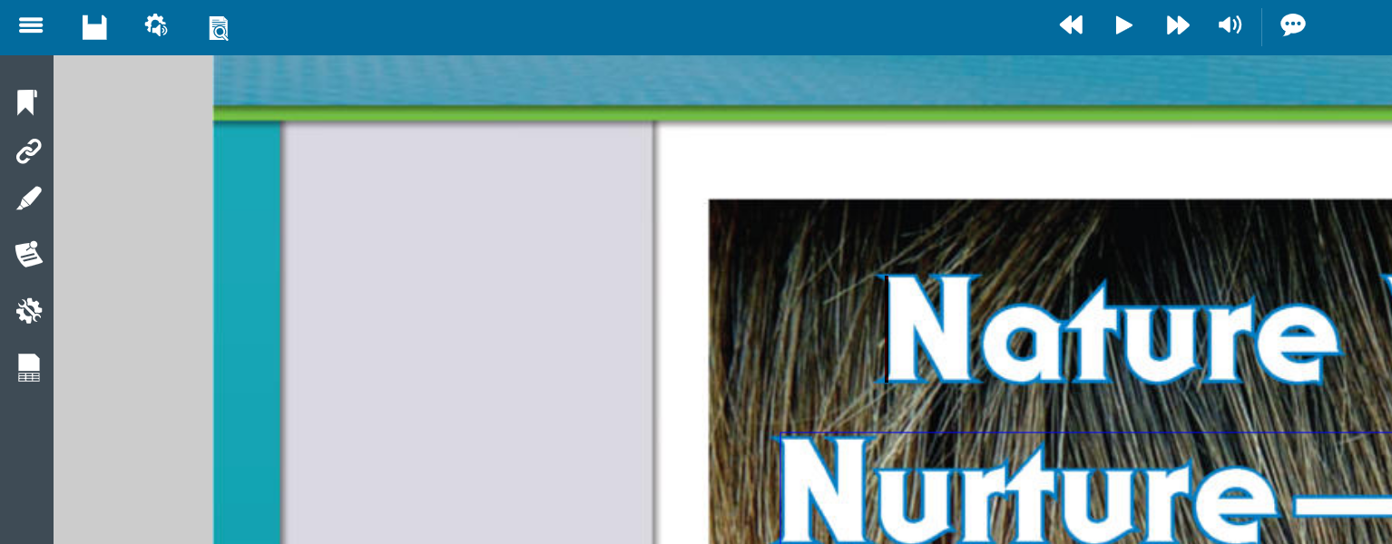
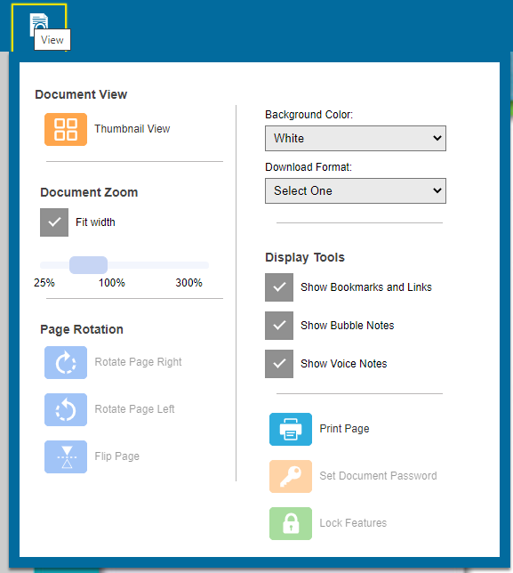
Customize Document View
Clicking on the Document View icon will allow you to adjust the zoom of the text on your screen
Make sure to use a zoom value that allows you to read without straining your eyes
Tip: Adjusting the background color may be helpful for students with light sensitivity

Slide 5
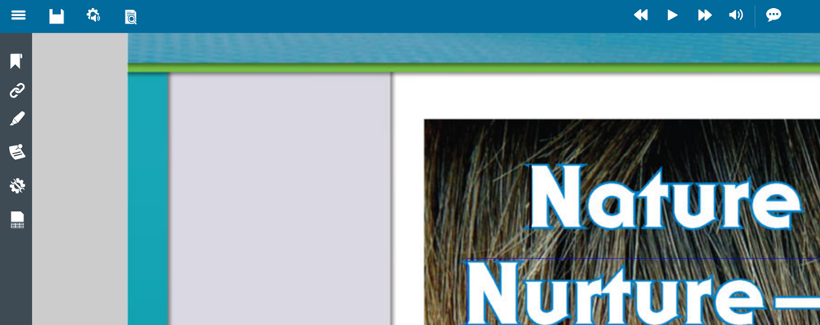
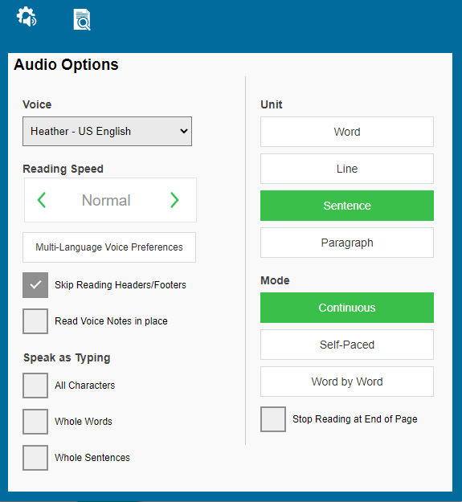
Customize Audio Options
Clicking on the Audio Options icon will allow you to select different reading voices and speeds
Select a voice and speed that you can comfortably follow along with
The other settings in this window are standard and should not be adjusted

