Slide 1


Kurzweil 3000 Module III: Study Tools
1. Reference Section 3. Highlighting
2. Annotating 4. Extracting Notes & Highlights

Slide 2
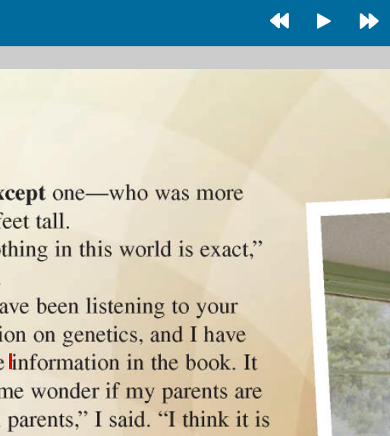

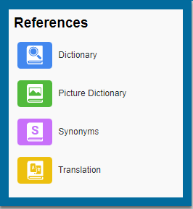
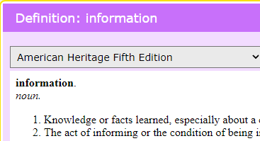
Reference Section
The References icon in the upper right corner of the window houses a dictionary, picture dictionary, thesaurus, and language translator
With the red cursor blinking at the beginning of the desired word, click the References icon, and make a selection
The requested information will pop up in a smaller window on your page

Slide 3
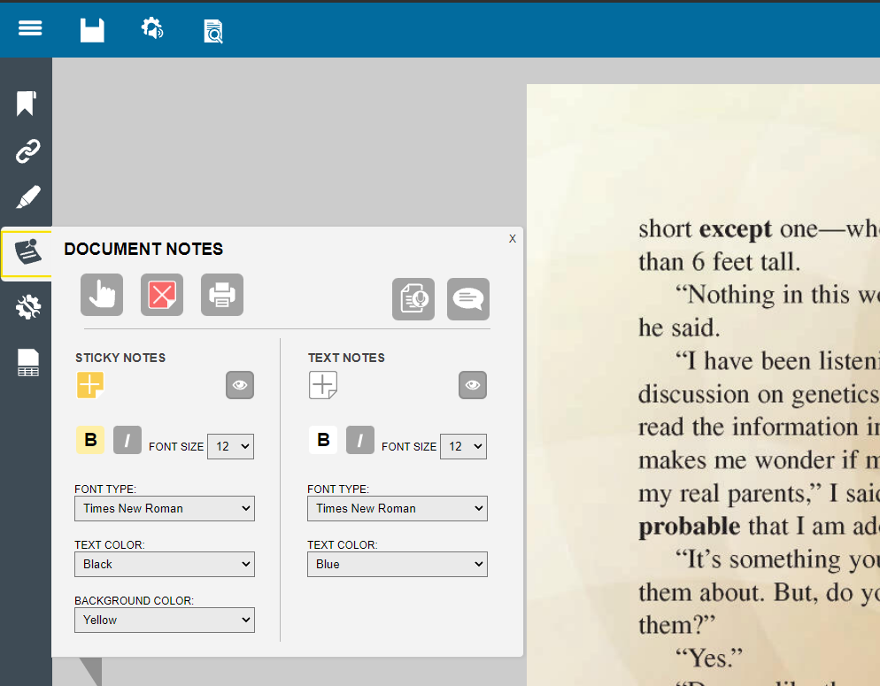
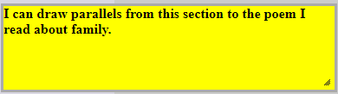
Adding Document Notes
Click the Document Notes icon to expand the window
Click the + icon to put your cursor into ‘Add Note’ mode
Click anywhere on the page to place and type in your note
Go back into the Document Notes icon and click the pointing icon to exit ‘Add Note’ mode

Slide 4
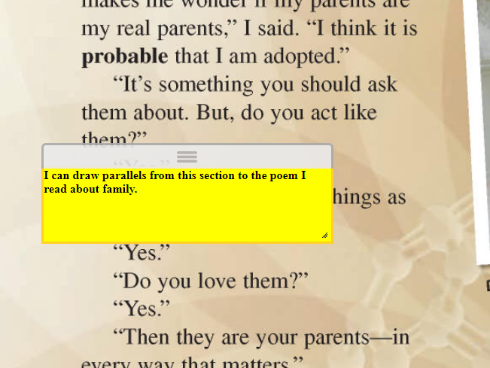
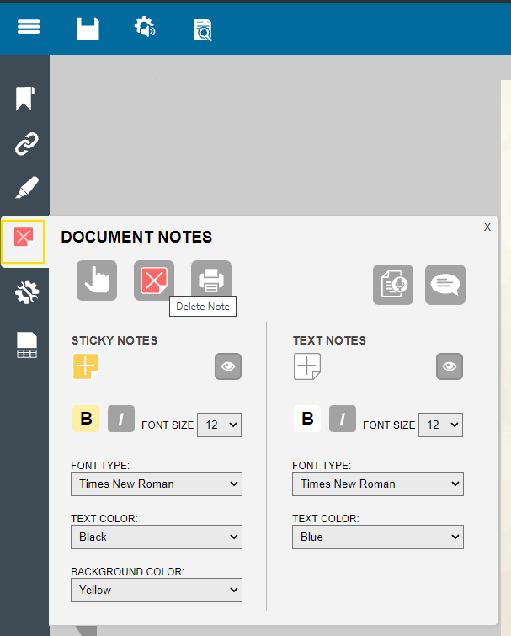
Managing Document Notes
To move a note, simply click on the note, and drag it to the desired place
To delete a note, click on the Delete Note icon in the Document Notes window, and then click on the note you want to remove
After deleting notes, go back into the Document Notes icon and click the pointing icon to exit ‘Delete Note’ mode

Slide 5
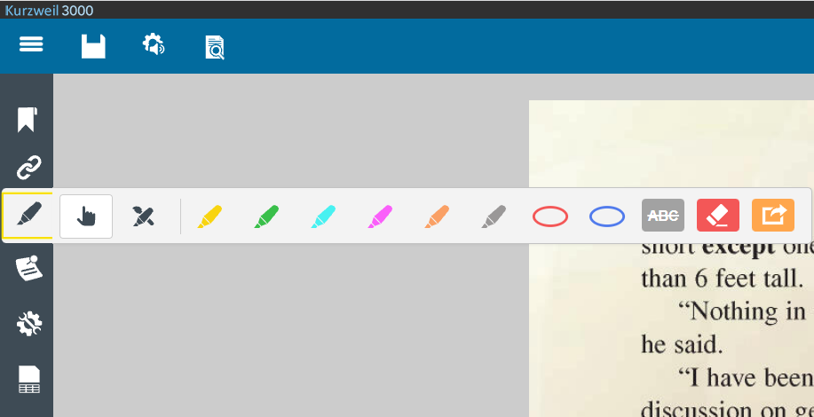
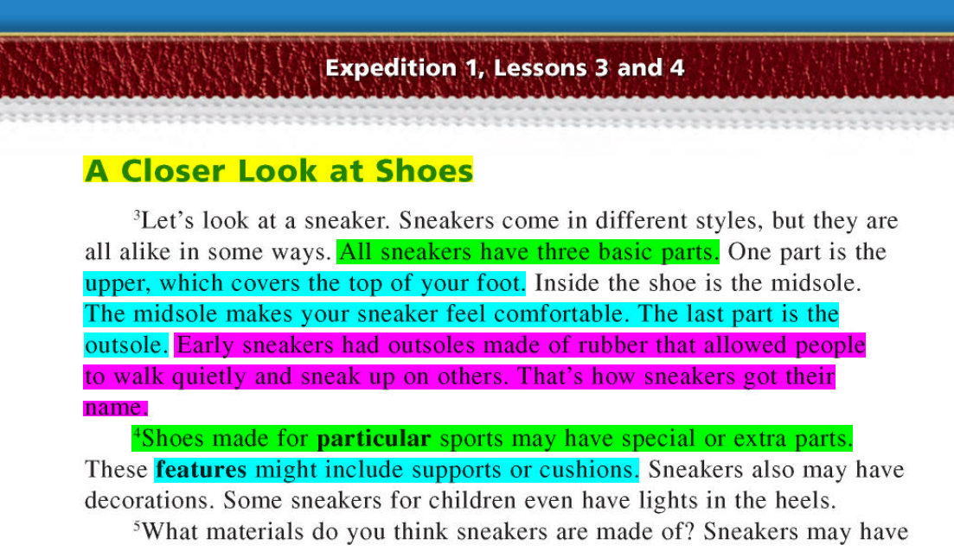
Highlighting
You can highlight parts of your readings by clicking on the Highlight icon.
Select a highlight color, and then click and drag the desired text
Click on the Eraser icon, and then click and drag text that is mistakenly highlighted
Go back into the Highlight icon, and select the pointing icon to exit ‘highlight’ mode

Slide 6
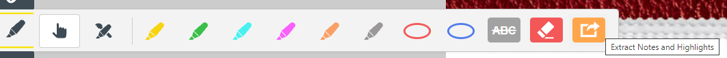
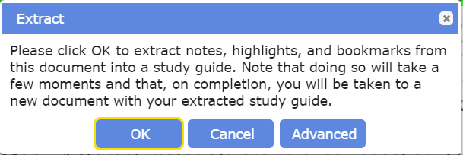
Extracting Notes and Highlights
In Kurzweil, you can create a separate document containing only your added notes, and the text you’ve highlighted
Click the Extract Notes and Highlights icon, and then click ‘OK’ in the Extract window that pops up
You will have the ability to edit and save the extracted document, or have Kurzweil read it aloud

Slide 7
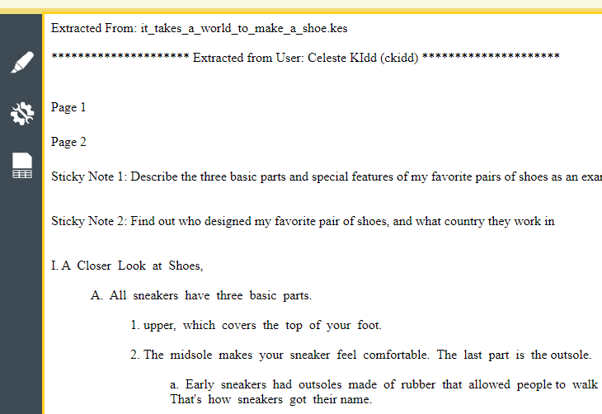
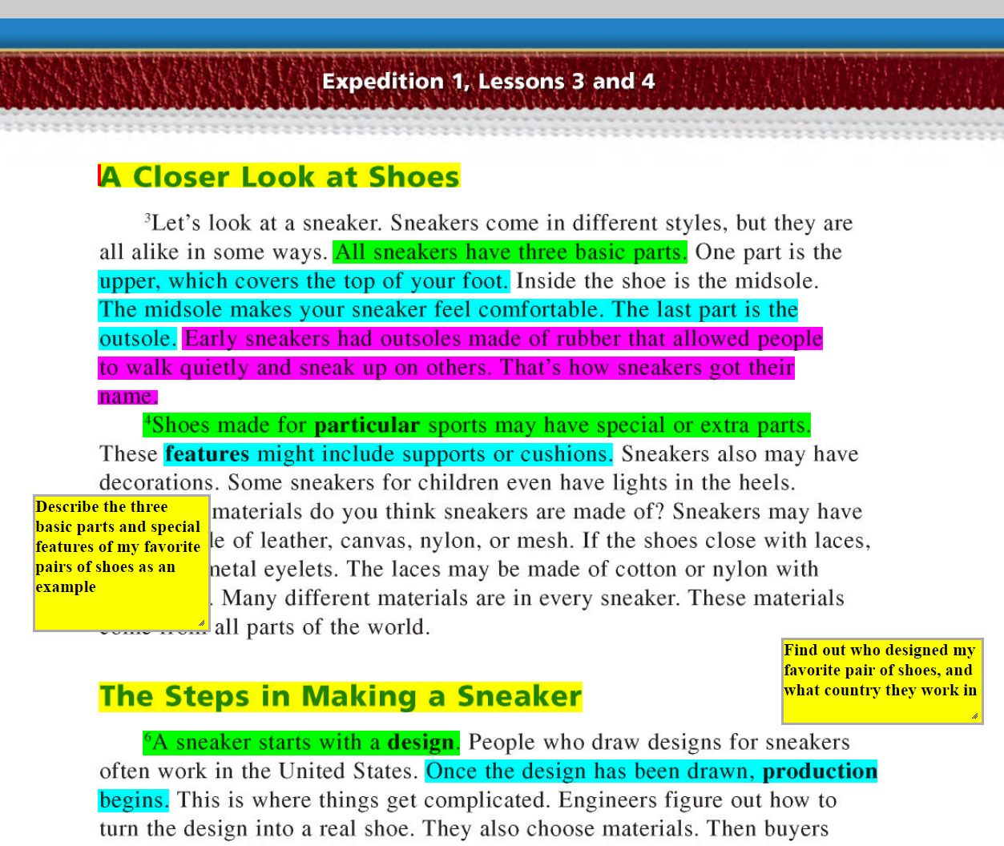
Example of Extracted Document
Highlighted & Annotated Text
Extracted Document

