Slide 1


Kurzweil 3000
Module IV: Read The Web
1. How to Access Read the Web 3. Read the Web Tips
2. Using Read the Web

Slide 2



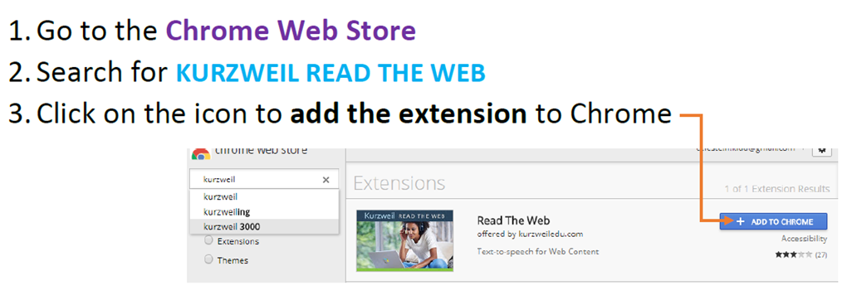
How to Access Read the Web
Kurzweil Read the Web is an extension found in Google Chrome that lets you use Kurzweil for internet content (including Canvas)
Make sure you are signed into your student email account before you add Read the Web
Follow these instructions to get started

Slide 3

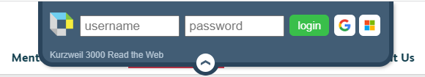
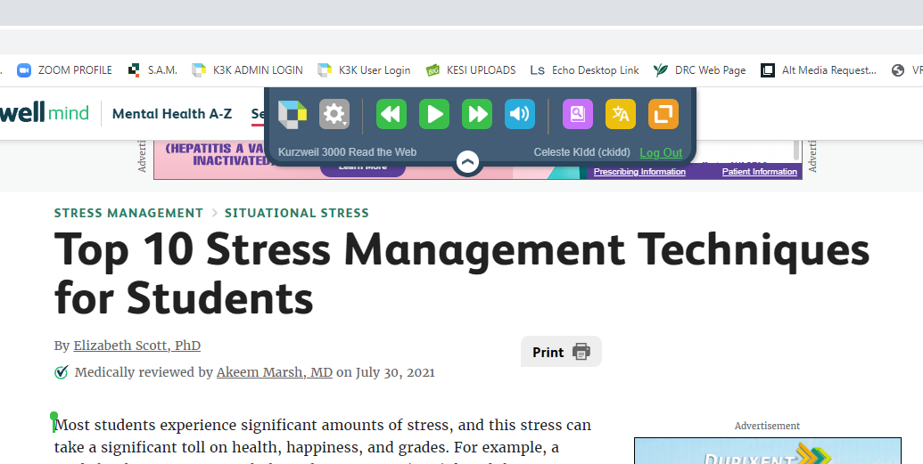
Using Read the Web
In Google Chrome, go to the desired web page
Locate and click on the Read the Web icon in the upper right corner of your window (to the right of your URL bar)
Use your Kurzweil username and password to log in
Place your cursor on the desired text, and click the Read icon to begin reading
Read the Web icon
Read icon

Slide 4
Read the Web Tips
The following Kurzweil features are available in Read the Web
  Customize Audio Options
  Dictionary
  Language Translator
  Screenshot page to read in Kurzweil
    *allows you to use other Kurzweil study tools, such as highlight, annotate, and extract
Dictionary
Screenshot
Audio Options
Translator

