Slide 1


Livescribe Echo Smartpen
Module I: The Basics
1. What is a Smartpen? 3. Smartpen Software
2. Smartpen Hardware 4. The Livescribe Notebook

Slide 2

What is a Smartpen?
The smartpen is a note taking device that allows students to record class lectures, while taking written notes in an interactive notebook
Students are able to listen to lectures more intently, ask questions, and organize their notes, without the fear of missing important information
The DRC Alt Media staff will help approved smartpen students get set up

Slide 3
Smartpen Hardware
Cap
Ball Point Tip
Infrared Camera
Speaker
Microphone
Power Button
Micro USB Port
Headphone Jack
Display
Charging/Syncing Cable

Slide 4
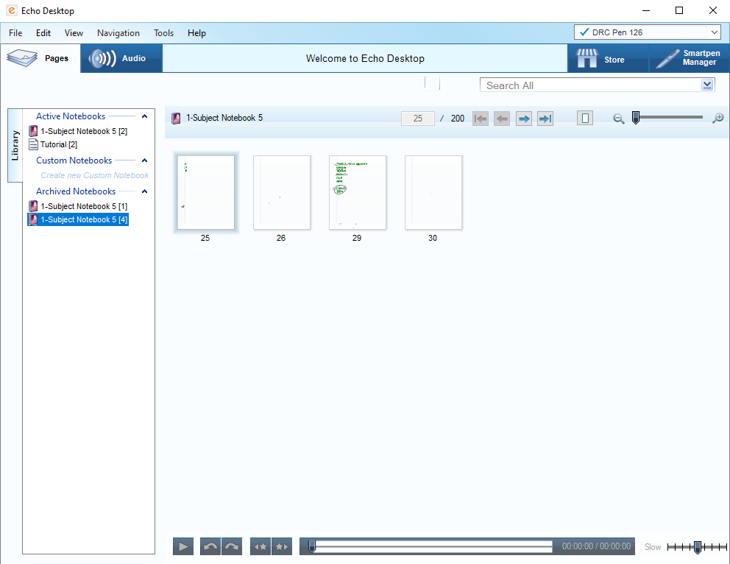
Smartpen Software
Echo Desktop, the software that accompanies the Smartpen, allows users to
Transfer notes and lectures from your pen to your computer
Review and organize notes and lectures
Free storage space on your pen by using the ‘Archive Notebook’ feature
Create copies of your notes that can be saved, emailed, and accessed from any device that supports Adobe and is connected to the internet
The Alt-Media staff is happy to assist Smartpen users with the installation of this software

Slide 5
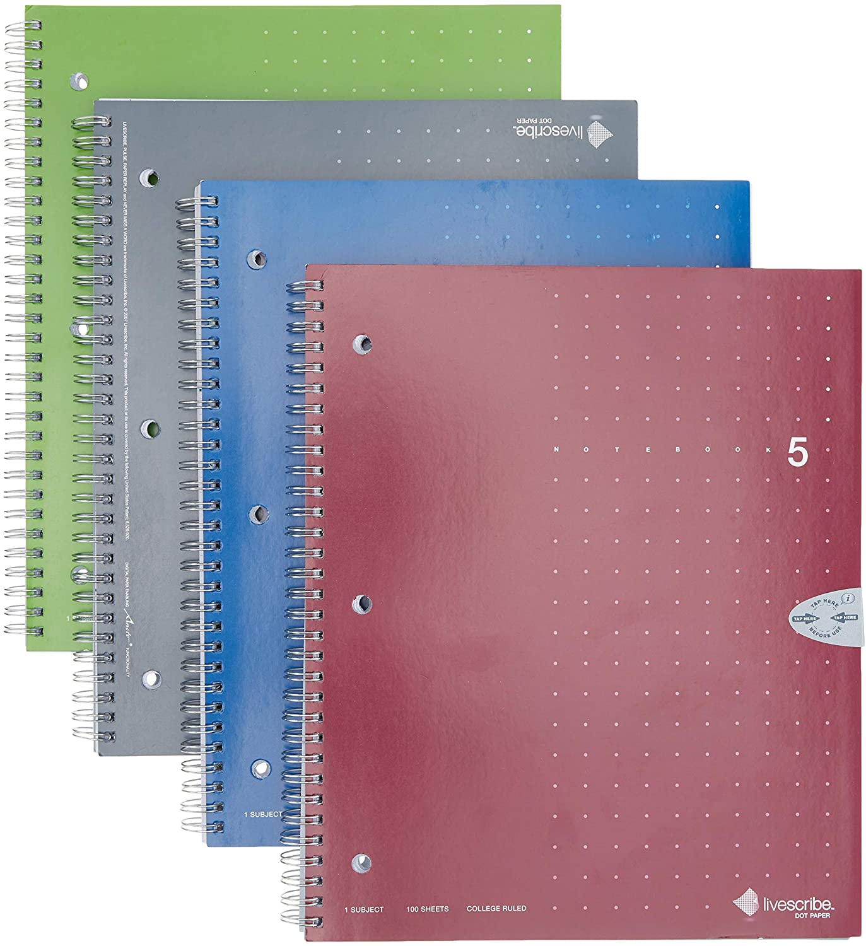
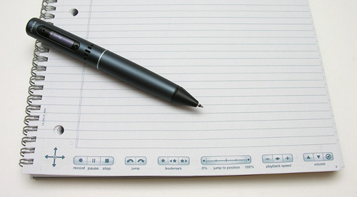
The Livescribe Notebook
The Livescribe Notebook is specialized for use with the Smartpen
The pen and notebook work together to create electronically scanned copies of written notes
The icons in the Livescribe notebook allow pen configuration, audio recording, and audio playback, with just a tap of the pen

