Slide 1


Livescribe Echo Smartpen
Module III: Using Echo Desktop
1. Install Echo Desktop 3. Archive Notes
2. Upload and Review Notes 4. Create Adobe Pencast

Slide 2
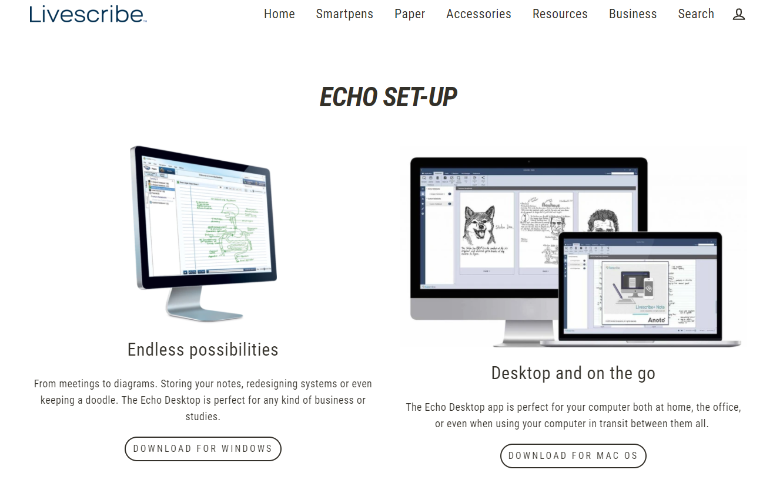
Install Echo Desktop
To install Echo Desktop, you must have a computer with a hard drive
Copy and paste this link in your browser to begin download process: https://us.livescribe.com/pages/echo-set-up
Click the download link that corresponds with your operating system, and follow the installation instructions
The Alt-Media staff is happy to assist students with this process

Slide 3
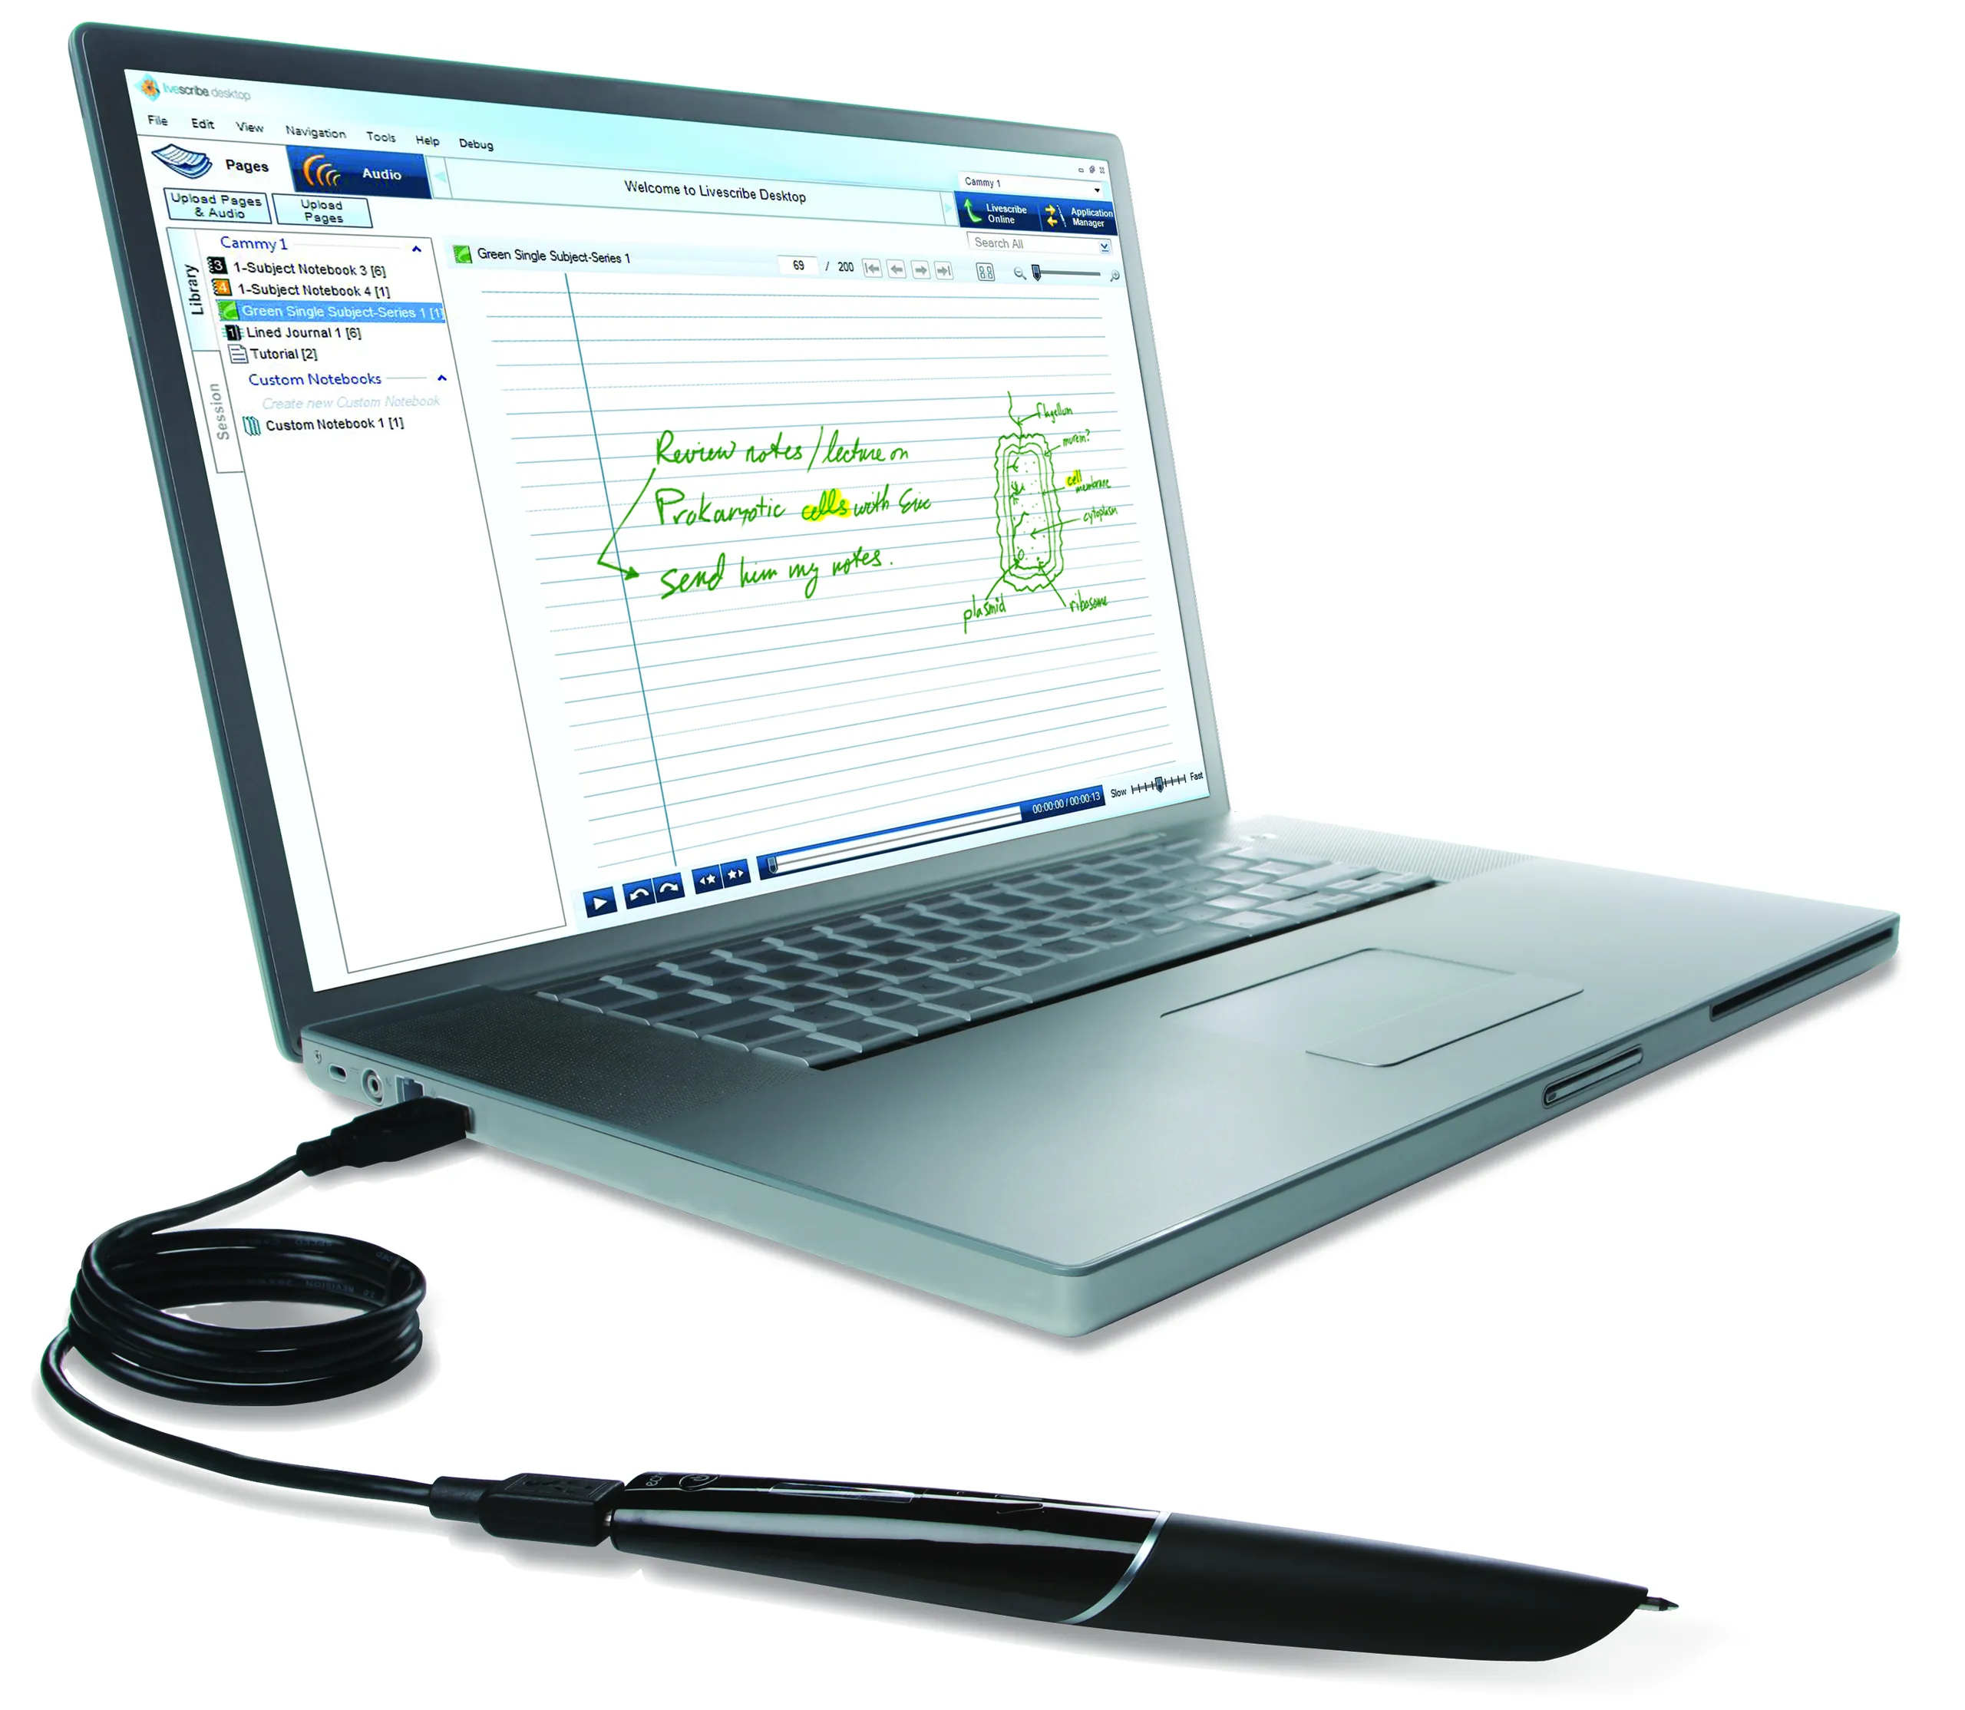
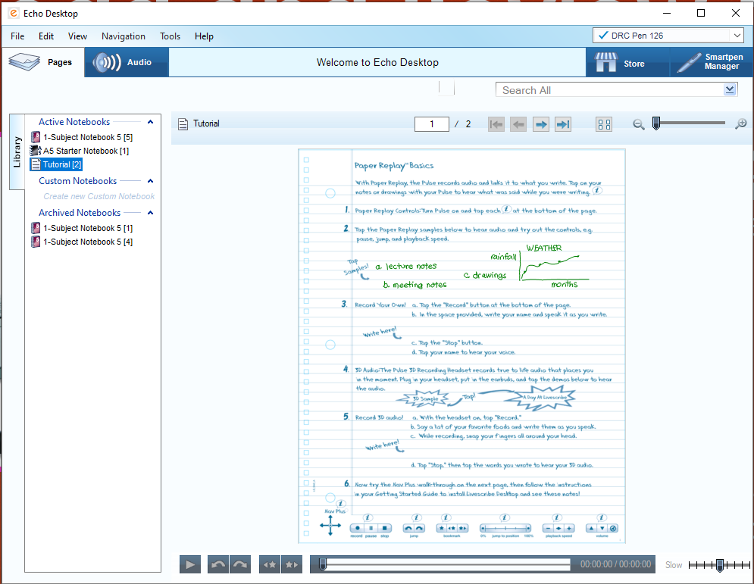
Upload and Review Notes
To upload your notes, use the Micro-USB chord to connect your pen to your computer
The upload is automatic and usually takes less than a minute
Click on the Notebook icon, and then double-click on the page you want to review
Clicking on the text will start audio playback

Slide 4
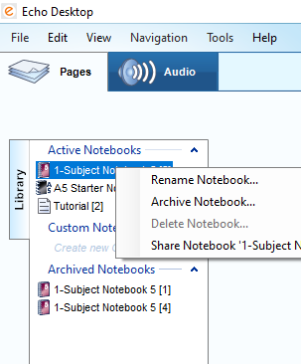
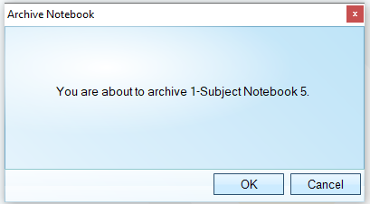
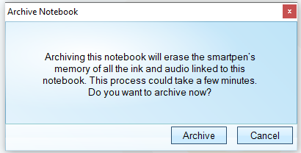
Archive Notes
Archiving is a process to free up space in your Smartpen when the memory is near full
The notes and audio will be erased from your pen, but will remain in the Echo Desktop until manually deleted
With your pen connected to the computer, right-click on the icon of the desired notebook, and select ‘Archive’ from the menu
Confirm, and the selected notebook will move from the Active Notebooks section to the Archived Notebooks section

Slide 5
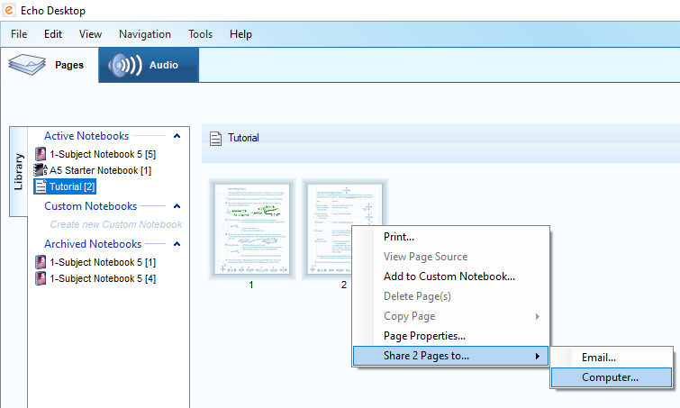
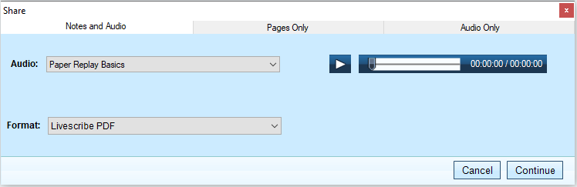
Create Adobe Pencast
Convert pages into Audio Pencasts to access them outside of the Echo Desktop
Select one or multiple pages to be converted
Right-click, and select the ‘Share Pages to…’ option
In the next window, make sure the ‘Notes and Audio’ option is selected, and click Continue
continued

Slide 6
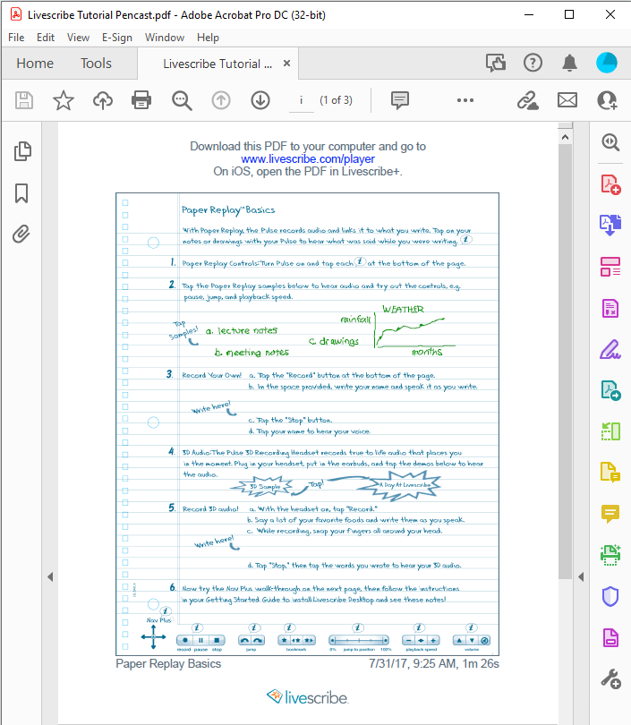
Create Adobe Pencast (continued)
Clicking continue will prompt you to assign a folder and name to your file, and save it
Open your saved Pencast, and click the Livescribe Player link to listen to the audio
Your notes and audio can now be accessed on any device that supports Adobe and is connected to the internet!

