Slide 1

Educational Master Planning
Task Force Meeting #4
September 29, 2021

Slide 2
Agenda
AGENDA ITEM | DISCUSSION LEADER(s) | TYPE OF ITEM | TIME
Welcome Verify meeting notes from previous meeting | David Eck Roslind Young | Welcome | 5 minutes
Hearing from Áse Power Consult | Nancy Morisette, APC | Information | 15 minutes
Debriefing the SCUP Training | Roslind Young | Discussion | 10 minutes
Reviewing our Mission, Vision and Values Statements | David Eck | Discussion Group Work | 25 minutes
Evaluating our Existing Mission, Vision, Values Statements | Karen Engel | Group Work Discussion | 25 minutes
Reflection and preparing for Flex Day | Karen Engel | Discussion of Next Steps | 10 minutes
Meeting Closure

Slide 3
Áse Power Consult
Feedback from faculty, staff and student “listening sessions” regarding our college mission, vision and values statements

Slide 4
Debriefing our SCUP Training
What was helpful?
Revisiting our proposed planning process and timeline – does it still make sense?
Other feedback/recommendations?

Slide 5
Educational Master Planning Process & Timeline
PBC names EMP Task Force Members
EMP Task Force evaluates 2017-22 EMP
SCUP Training in Strategic Planning
Mission, Vision, Values Update
EMP TF considers “Internal Scan”
EMP TF considers “External Scan”
College Councils provide input on challenges and opportunities
Town Hall
Winter 2021
Spring 2021
September 2021
October 2021
EMP Retreat: Set goals and new strategies
Campus constituents provide input on draft EMP
PBC considers draft EMP
PBC adopts new EMP for 2022-27
October 2021
November 2021
December 2021
February 2022
February 2022
March 2022
April 2022
May 2022

Slide 6
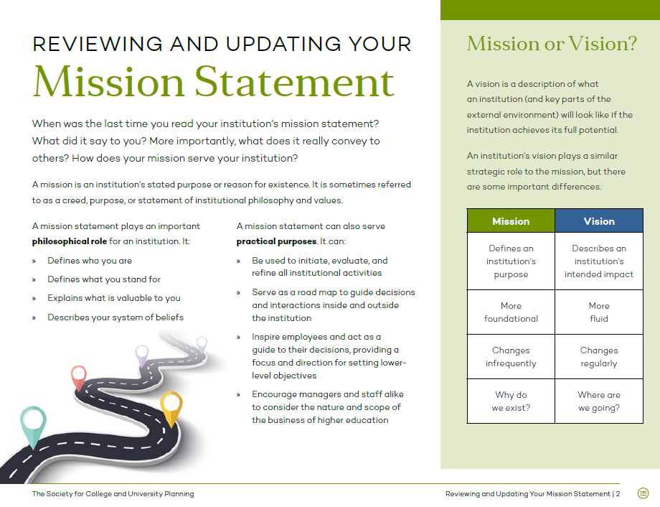

Slide 7
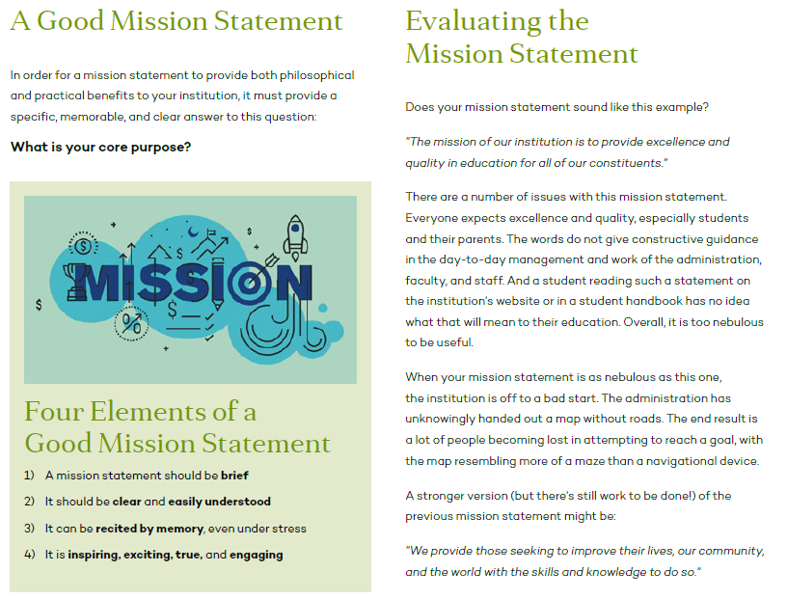

Slide 8
Mission Statements
Our College provides our community with a learning-centered environment, ensuring that all students have equitable opportunities to achieve their transfer, career education, and lifelong learning educational goals. The College cultivates in its students the ability to think critically and creatively, communicate effectively, reason quantitatively, and understand and appreciate different points of view within a diverse community.
To empower and transform a global community of learners.
Our College is committed to addressing the broad educational needs of the local and world community. We foster success and ensure equitable opportunities for all our students, while celebrating the diversity of our campus.

Slide 9
Vision Statements
Our College is committed to being a preeminent institution of learning, renowned for its quality of academic life, its diverse culture and practice of personal support and development, extraordinary student success, and its dynamic, innovative programs that prepare students for the university, the modern workplace, and the global community.
Our College inspires a global and diverse community of learners to achieve intellectual, cultural, social, economic and personal fulfillment.

Slide 10
Cañada Values:
Transforming Lives
High Academic Standards
Diverse and Inclusive Environment
Student Success in Achieving Educational Goals
Community, Education, and Industry Partnerships
Communication and Collaboration
Engaging Student Life
Accountability
Sustainability
Transparency

Slide 11
Skyline Values Statement:
Education is the foundation of our democratic society.
Thus:
Social Justice: We are committed to a comprehensive diversity framework that promotes social justice throughout all policies, procedures, and practices of the College.
Campus Climate: We value a campus-wide climate that reflects a ‘students first philosophy' with mutual respect between all constituencies and appreciation for diversity. Both instruction and student services are dedicated to providing every student with an avenue to success.
Open Access: We are committed to the availability of quality educational programs and services for every member of our community regardless of level of preparedness, socioeconomic status, gender, gender expression, sexual orientation, cultural, religious, or ethnic background, or disability status. We are committed to providing students with open access to programs and responsive student services both in person and online that enable them to advance steadily toward their goals.
Student Success and Equity: We value students’ success in achieving their goals, on time, and strengthening their voices as they transform their lives through their educational experience. We aim to identify and address equity gaps through evidence-based research to ensure that each student has the opportunity to succeed.
Academic Excellence: We value excellence in all aspects of our mission as a comprehensive community college offering preparation for transfer to a baccalaureate institution, workforce and economic development through career technical education programs and certificates, Associate of Arts and Associate of Science degrees, a Baccalaureate Degree, basic skills development, and lifelong learning. We are committed to academic rigor and quality with relevant, recent, and evolving curricula and well-equipped programs that include new and emerging areas of study. We are dedicated to an educational climate that values creativity, innovation and freedom of intellectual exploration, discovery, thought, and exchange of ideas.
Community Partnership: We value a deep engagement with the community we serve through collaborating with local school districts, industry, non-profits, government and the arts. Valuing our role as an academic and cultural center, we are dedicated to meeting the needs of the labor market and community.
Participatory Governance: We value just, fair, inclusive, and well understood, transparent governance processes based upon open and honest communication.
Sustainability: We value an institutional culture that is committed to environmental sustainability and justice. We are committed to the tenet of sustainability, “To meet present needs without compromising the ability of future generations to meet their needs.”

Slide 12
CSM Values Statement:
Equity
As a Hispanic Serving Institution, we are committed to creating a socially just campus climate wherein everybody is welcome and celebrated, and wherein everybody is an integral part of the campus. We believe that all students are entitled to a safe learning environment that celebrates their intersectional identities, fosters their agency, and develops their capacity for self-advocacy.
Academics
CSM takes great pride in its commitment to academic excellence. Our goal is to facilitate engaged, informed leadership and successful, satisfying careers for our students. We see our campus as a vibrant hub of intellectual rigor and relevance. As such, we embrace mindful learning, information literacy, and independent thinking to ensure a dynamic, innovative workforce and transfer population.
Community
Consistent with our commitment to equity, CSM strives for a vibrant, inclusive and safe college community. In support of this, we must recruit and retain a diverse faculty and staff and foster professional development informed by critical pedagogy and aligned with our college mission. Together, we aim to create an environment that fosters collegiality and empowers our students to reach their full potential inside and outside the classroom.
Governance
Because the college’s success is intricately linked to the collective wisdom and values of its students, faculty, staff, and administrators, we strive for an inclusive, collaborative, and transparent decision-making process and governance. To this end, we strive to ensure that communication is multidirectional and incorporates feedback from the entire campus community.

Slide 13
Poll
Do we need to update our mission statement?
Do we need to update our values statement?
Do we need to update our values statement?

Slide 14
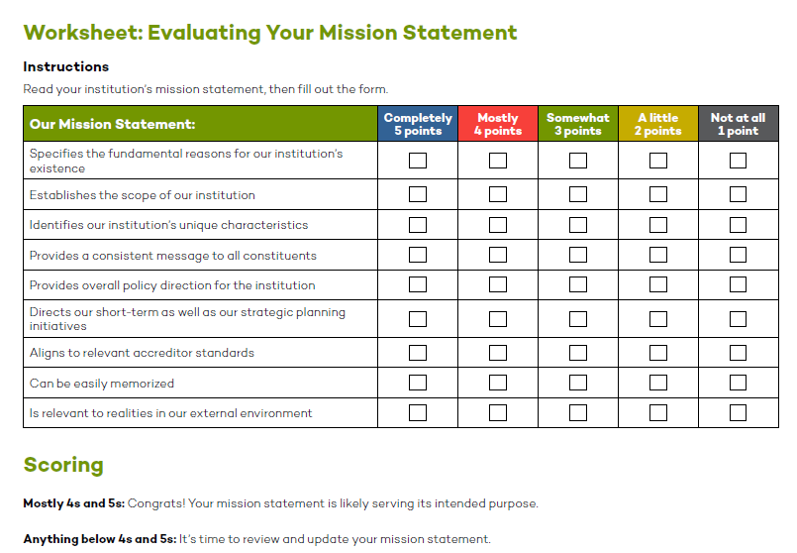
Poll

Slide 15
Reflection
Whom do we serve?
What is the scope of our services?
What effect does our institution have on constituents?
How will we know we are succeeding?
How large is our target audience? (boundaries)
What is the scope of our services?
What effect does our institution have on constituents?
How will we know we are succeeding?

Slide 16
Homework for October 6

