Slide 1

Educational Master Plan
Task Force Kick-off
April 14, 2021
Prepared by PBC Co-Chairs and the Office of Planning, Research & Institutional Effectiveness

Slide 2
Agenda
AGENDA ITEM | DISCUSSION LEADER | TIME
Welcome & Introductions | Tri-Chairs | 10 minutes
Task Force Purpose & Member Responsibilities | Jeanne Stalker, Classified Senate President | 15 minutes
The College Integrated Planning and Budgeting Cycle | Karen Engel, Dean of PRIE | 5 minutes
The Schedule External Scan Internal Scan | Diana Tedone-Goldstone, Academic Senate President | 15 minutes
Planning in an Era of Change Resources and Trends SWOT Planning with Uncertainty | Tri-Chairs | 15 minutes
Review of Our Current EMP Introduce Evaluate next time | Karen Engel, Dean of PRIE | 15 minutes
Looking Ahead Discussion Q&A | Tri-Chairs | 5 minutes

Slide 3
Task Force Membership: Welcome & Introductions
Tri Chairs:
Academic Senate President: Diana Tedone Goldstone
Classified Senate President: Jeanne Stalker
Dean of PRIE, Accreditation Liaison Officer: Karen Engel
Faculty Representatives:
HSS Division rep – Alicia Aguirre
BDW Division rep – Sarita Santos
STEM Division rep - TBD
KAD Division rep - TBD
Counseling Division rep - TBD
Request involvement of:
  Online Ed. Coordinators
  CIETL Coordinator: TBD
  Faculty Equity Coordinator – Rebekah Taveau
  Interest Area Faculty Coordinators
  Learning Assessment Coordinator: Jessica Kaven
Classified Staff Representatives
Outreach & Welcome Center rep: Joshua Forman Ortiz
Student Success Team Retention Specialist(s) rep: Nimsi Garcia
Transfer Services rep: Mary Ho
Instructional Division rep: Roslind Young
Instructional Technologist: Allison Hughes
Student Representative(s): TBD
Community member: TBD
----
PRIE Team: Alex, Milena and Isaac
Cabinet members invited to participate throughout the process

Slide 4
Purpose of the Task Force
The PBC Educational Master Plan Task Force will oversee, participate in, and lead the campus in a one-year strategic planning process dedicated to developing a new, 5-year Educational Master Plan.
As the College’s Accreditation Oversight Committee, the PBC appoints this Task Force to serve on its behalf to ensure that the EMP development process and resulting Plan support the College’s excellent accreditation standing and maintain its ability to meet and exceed all of the Standards set by Accrediting Commission for Community and Junior Colleges of the Western Association of Schools and Colleges.

Slide 5

Purpose of an EMP
To offer the essential data and foundation upon which the instructional program and student support service needs can be addressed and met in the future.

Slide 6

Purpose of an EMP
Assist in the creation or update of other important College plans. These include plans for technology, facilities (capital expenditures), personnel, finance, budget, and others.

Slide 7

Purpose of an EMP
Be a flexible document, to be reviewed annually as the economy fluctuates, students' needs change, and new educational trends develop. Inherent in this logic is the fact that institutional change takes time.

Slide 8
Task Force Members: Responsibilities
Serve from March 2021 – April 2022
Attend at least one training (TBD)
Attend meetings 2xs/month for approximately 2 hours per meeting
Review materials before and after meetings
Help organize and lead campus-wide forums (4-8) to engage the entire campus community in the EMP planning process
Ensure regular, clear communication between the constituency each member represents and the work of the Task Force
Support regular reporting on progress to the PBC and larger campus community
ADD Participate in:
  One day of a Summer Leadership Retreat
  A 2-day EMP Retreat in late January

Slide 9
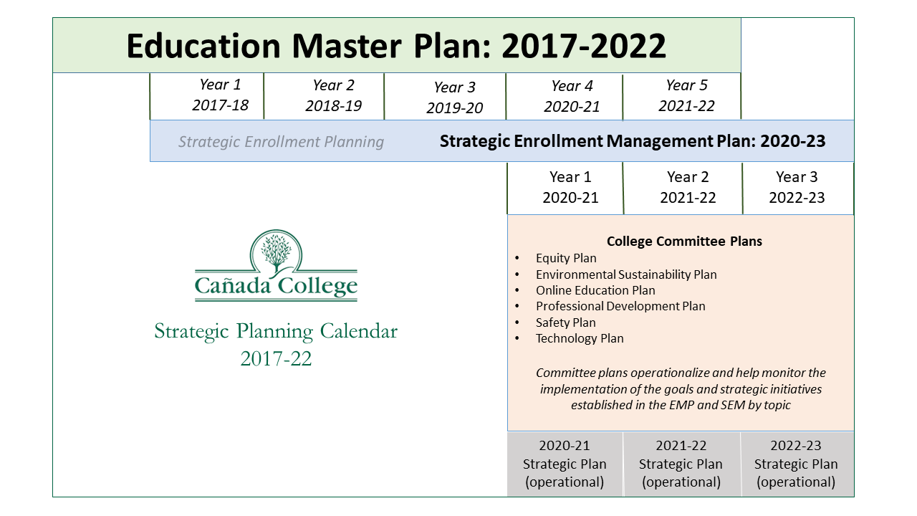

Slide 10
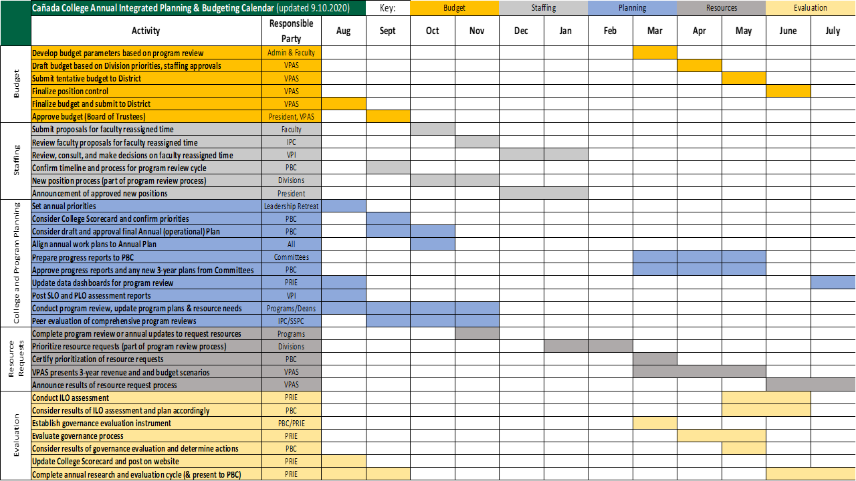

Slide 11
The Schedule - proposed
Information is posted on our EMP website: https://canadacollege.edu/emp/meetings.php
Date | Topic
April 14, 2021 | EMP Task Force Kick-off Meeting
April 28, 2021 | Evaluation of the 2017-22 Educational Master Plan
Early June | Strategic Planning TRAINING
 | Summer Break
August 9-10, 2021 (pending) | College Leadership Retreat
August 13, 2021 | College Flex Day
September 1, 2021 | Environmental Scan - part 1
September 15, 2021 | Environmental Scan - part 2
September, 2021 - date TBD | College Town Hall on the future of higher education
September 29, 2021 | Internal Scan - part 1
October 6, 2021 | College Mission, Vision and Values
October 13, 2021 - Flex Day | College-wide forum on the EMP
October 20, 2021 | Internal Scan - part 2
November 3, 3021 | Refining Challenges and Opportunities
November 17, 2021 | Strategic Planning Retreat Preparation
 | Winter Break
January, 2021 (dates TBD) | Educational Master Planning Retreat (2 days)
Winter-Spring 2021 | Develop draft of EMP and solicit feedback
April - May 2021 | PBC to adopt new EMP for 2022-27

Slide 12

Planning in an Era of Change

Slide 13
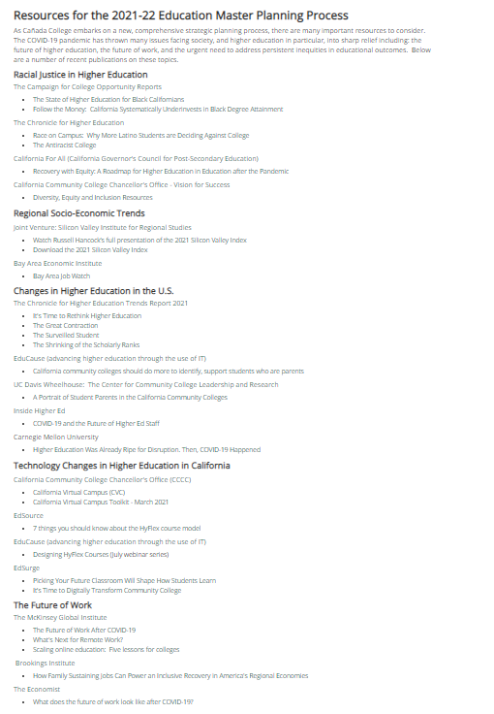
Planning in an Era of Change
Information shared here: https://canadacollege.edu/emp/emp-data.php
Assessing our Strengths, Weaknesses, Opportunities & Threats (SWOT) – consultant help
Facing uncertainty

Slide 14

Review of Our Current EMP

Slide 15
Looking Ahead
Next Steps
Preparing for our Next Meeting

