Slide 1

Educational Master Planning Task Force
March 2, 2022 Meeting Materials
Office of Planning, Research & Institutional Effectiveness

Slide 2
Topics
SCUP Review: Goals and Strategies Refreshing our understanding of what makes a good goal statement and strategic initiative statement
Brief Overview of District Goals and Strategies Our EMP should align
Evaluation of our 2017-22 EMP Revisit what we thought should be “carried forward” from last time
Drafting Goal Statements
Report Out on Goal Statements Consider Longer List of Strategies
Prepping for the March 11 Retreat

Slide 3
SCUP: Goals, Strategies and Tactics
Goal: | A broad, general statement of intended outcomes or results
Strategy: | A plan of action created to achieve a goal or a vision or to address a strategic issue
Tactic: | A specific action an institution takes to carry out a strategy

Slide 4
SCUP: Goals, Strategies and Tactics
Goal: | A broad, general statement of intended outcomes or results
Strategy: | A plan of action created to achieve a goal or a vision or to address a strategic issue
Tactic: | A specific action an institution takes to carry out a strategy
This gets addressed on an annual basis. Each year, we develop tactics during our Summer Leadership Retreat. These form the basis for our Annual (operational) Plan.

Slide 5
Goals and Strategies
Goal: | A broad, general statement of intended outcomes or results
Strategy: | A plan of action created to achieve a goal or a vision or to address a strategic issue

Slide 6
Goals and Strategies
Goal: | A broad, general statement of intended outcomes or results
Strategy: | A plan of action created to achieve a goal or a vision or to address a strategic issue
Goals are WHAT
Strategies and tactics are HOW

Slide 7
Writing GOAL Statements:
Return to Strategic Issues
The easiest and most beneficial way to determine your goals is to return to your strategic issues. You can ask the following for each issue:
If we resolved this strategic issue, what outcomes would we see?
What benefits would we see?

Slide 8
Writing GOAL Statements:
Phrase Goals as Results, Not Actions
Goals written as outcomes leave room for stakeholders to come up with ideas on how to contribute to the goal.
They are more inspirational.

Slide 9
Two Tips for Writing Goals that are not Strategies:
Think about phrasing your goals as “states of being” not actions.
Phrase your goals as results.

Slide 10
SMART(E) Goals
Specific: clearly define the intended outcome
Measurable: the goal can be quantified
Assignable: a person, department or committee could be given responsibility for the goal
Realistic: It can be achieve with an institution’s resources and in the amount of time indicated
Timebound: identifies when the goal will be completed
Equity-minded: addresses the college’s obligation to close equity gaps in student outcomes and address bias in college culture and climate

Slide 11
Goals from our last EMP
  Student Completion/Success
Provide educational and student services programs that highlight inclusivity, diversity, and equity in their mission to help students meet their unique educational goals and minimize logistical and financial barriers to success.
  Community Connections
Build and strengthen collaborative relationships and partnerships that support the needs of, reflect, and enrich our diverse and vibrant local community.
  Organizational Development
Focus institutional resources on the structures, processes, and practices that invest in a diverse student population and prioritize and promote equitable, inclusive, and transformative learning.

Slide 12
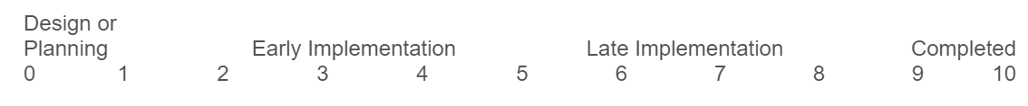
Qualitative & Quantitative Feedback on the 2017-22 EMP:
EMP Feedback Response Rates:
4-5 (out of 12) Task Force members provided numeric responses per the scale below
1-2 (out of 12) Task Force members provided written comments
-----------------------------
SCALE USED TO EVALUATE THE STATUS OF EACH GOAL & STRATEGIC INITIATIVE:

Slide 13
EMP Goal #1:
Student Completion/Success
To provide educational and student services programs that help students meet their unique academic goals; minimize logistical and financial barriers to success; and highlight inclusivity, diversity and equity.
Average Score from Evaluation:
5
EVALUATION COMMENTS:
The college continues to provide services and programs to support student goals and reduce barriers, but there is more work to do!

Slide 14
EMP Goal #2:
Community Connections
To build and strengthen collaborative relationships and partnerships that support the needs of, reflect and enrich our diverse and vibrant local community.
Average Score from Evaluation:
5.7
EVALUATION COMMENTS:
I'm not sure of all the community relationships that we have, but I know work is being done! Thinking bout our annual Presidents lunch as a community connection/fundraising event/opportunity.

Slide 15
EMP Goal #3:
Organizational Development
To invest institutional resources on the structures, processes and practices that focus on a diverse student and staff population, promote excellence, equity, inclusion and transformative learning.
Average Score from Evaluation:
3.3
EVALUATION COMMENTS:
We are moving towards more intentionally updating our Equity Plan, we have a long way to go to increase the diversity of our employees, particularly faculty.

Slide 16
San Mateo County Community College District Goals (updated 2021)
District Goal #1 | Develop and Strengthen Educational Offerings, Interventions, and Support Programs that Increase Student Access, Success and Completion
District Goal #2 | Establish and Expand Relationships With School Districts, 4-year College Partners, And Community-based Organizations to Increase Higher Education Attainment and Economic Mobility In San Mateo County
District Foal #3 | Promote Innovation and Excellence in Instruction to Support Student Learning and Success
District Goal #4 | Ensure Necessary Resources are Available to Implement This Strategic Plan Through Sound Fiscal Planning And Management Of Allocations and Protection of Community-supported Status

Slide 17
Other goals we have set
Accreditation
  Institution Set Standards and Quality Focus Essay
Cañada College
Strategic Enrollment Management Plan
State Chancellor’s Office
  Vision for Success
  Student Equity & Achievement Plan
  Guided Pathways Scale of Adoption
  Strong Workforce

Slide 18
 | Vision for Success (also our ACCJC Goals) | Student Equity & Achievement Program (SEAP) | Strategic Enrollment Management
Successful Enrollment |  | Increase the number of student who enroll at Cañada within 1 Year of application | Create and publicize clear degree and certificate programs that remove barriers to completion in two years.
 |  |  | Align marketing, messaging and outreach with our programs, schedule, and supportive services and programs
Momentum | Decrease the number of units accumulated by Cañada College students earning associate degrees, from an average of approximately 93 total units to an average of 85 total units by 2021-22. | Increase the persistence of students enrolled in the fall and returned in the spring to the same college | Create and manage a course schedule focused on student completion in two years.
 |  | Increase the Number of First Time students at Cañada completing transfer level math and English by end of following term | Align and sustain pro-active student support services with programs of study to ensure effective and timely student enrollment, retention, persistence and completion.
Success | Increase by at least 20 percent the number of Cañada College students who acquire associate degrees, credentials, certificates, or specific job skill sets that prepare them for in-demand jobs by 2021-22 (adjusted for enrollment fluctuations). | Increase the Award Counts (Number of students receiving any type of degree or certificate in a given academic year)
 | Increase by 35 percent the number of Cañada College students transferring to a UC or CSU by 2021-22 (adjusted for enrollment fluctuations). | Increase the number of students transferred to a Four-Year Institution
Employment | Increase the percent of exiting career education students at Cañada College who report being employed in their field of study, from 65% to 72% by 2021-22.
Equity | Reduce equity gaps across all of the above measures through faster improvements among traditionally underrepresented student groups, with the goal of cutting achievement gaps by 40 percent by 2021-22 and fully closing those achievement gaps for good by 2026-27. | Close achievement gaps in all of the above metrics

Slide 19
Break Out Discussions: Goal Statements

Slide 20
Report Out: Goal Statements

Slide 21
Next Steps and Prep for EMP Retreat
Moving from goals to strategies
Review of existing strategies
Retreat format and desired outcomes

Slide 22
Extra Slides

Slide 23
SEAP Metric | SEAP Definition | Baseline 2017-18 | 2018-19 | 2019-20 | 2020-21 | SEAP Goal 2021-22 | GOAL % Increase | % Change Since the Baseline | Disproportionately Impacted Student Groups in 2017-18 | Disproportionately Impacted Student Groups in 2018-19* | Disproportionately Impacted Student Groups in 2019-20 | Disproportionately Impacted Student Groups in 2020-21
Access: Successful Enrollment** | Enrolled at Cañada Within 1 Year of application | 1,572 | 1,479 | 1,470 | 1,152 | 1,700 | 8% | -27% | Due to compromised CCCApply data, this is not available | Due to compromised CCCApply data, this is not available | Data is still compromised. Male Unreported gender American Indian/Alaskan Native Asian Uneported Race/Ethnicity Male Asian Female Asian Male Unknown Race/Ethnicity & Gender White Male Ages 20-24 Ages 25-29 Ages 30-34 Ages 35-30 Homeless Youth LGBTQ | Data is still compromised. Male Unreported Gender American Indian/Alaskan Native Asian White Non-Hispanic Unknown Race ethnicity Female Unknown Race Ethnicity Male American Indian/Alaskan Native Male Asian Male White Non-Hispanic Male Unknown Race ethnicity Unknown Gender White Non-Hispanic Unknown Gender Unknown Race Ethnicity Ed. Goal: Improve Basic Skills Ed. Goal: Undecided First Time Age 20-24 Age 25-29 Homeless Youth Unreported First Generation Status
Persistence: Fall to Spring | Persistence of students enrolled in the fall and returned in the spring to the same college (excludes high school students) | 3,406 | 3,244 | 3,101 | 2,885 | 3,800 | 12% | -15% | College-wide persistence rate: 57.1% Asian Filipino White Non-Hispanic Filipina Female Asian Female Asian Male White Female Ages 25-29 | College-wide persistence rate: 57.1% Asian Filipino Multiraces Filipina Female Filipino Male Asian Female Asian Male MultiRace Male Ages 25-29 Veterans | College-wide persistence rate: 55.3% Asian Black Non-Hispanic Filipino Multiraces Filipina Female Filipino Male Asian Female Asian Male Black or Af Am Female MultiRace Male Ages 25-29 Foster Youth LGBTQ | College-wide persistence rate: 52.8% Asian Black non-Hispanic Filipino Female Asian Female Black Non-Hispanic Female Filipino Male Black Non-Hispanic Male Filipino Ed. Goal: 4 year students taking courses Ed. Goal: Job skill/New career Ed. Goal: HS diploma Ed. Goal: Career plans Ed. Goal: Basic Skills Ed. Goal: Maintain certificate/License Ed. Goal: Update job skills Ed. Goal: Undecided Associate's degree holder Bachelor's degree holder Non-Low Income Non-International Disabled Age 25-29 Not First Gen Veteran Non-LGBTQ
Transfer to a four-year institution** | Number of students transferred to a Four-Year Institution | 341 | 474 | NA |  | 443 | 30% |  | NA | None | NA
Completion of transfer level math and English | First Time students at Cañada completing transfer level math and English by end of following term | 161 | 204 | 208 | 162 | 200 | 38% | 1% | College-wide progression rate: 19% Age (20-24) Age (30-34) Age (40-54) | College-wide progression rate: 22% None | College-wide progression rate: 20% None | College-wide progression rate: 23%
Earned credit certificate over 18 units, associate degree, CCC bachelor’s degree | Award Counts (Number of students receiving any type of degree or certificate in a given academic year) | 563 | 528 | 513 | 498 | 672 | 19% | -12% | Unknown race/ethnicity (AD-T) Unknown race/ethnicity (any degree or certicificate) Low Income (AD-T) Low Income (any degree or certicificate Students under the age of 20 | Students under the age of 20 | Students under the age of 20 | Ed. Goal: Educational Development Ed. Goal: Undecided Age under 20 Non-Disabled
The % in parenthesis after each student sub-population s the annual the disproportionate impact for that group
**NOTE: This data is from the SMCCCD data warehouse as of November 2020 with the exception of the Transfer data which comes from the National Student Clearinghouse
**In Cañada's 2021 Transfer Plan, a 2016 student cohort was analyzed to examine equity gaps in transfer outcomes using a chi-square test method. That found that Students over 23 years, Hispanic/Latinx, Low Income, and First generation students (and those with an unknown First Gen status) were disproportionately under-represented in the transferring cohort. The CCCCO SEAP methodology asks for the college to look at the total number of students transferring in a given year. For this purpose, we use a PPG-1 (percentage point gap, less the group in question) method which yields a different result.

Slide 24
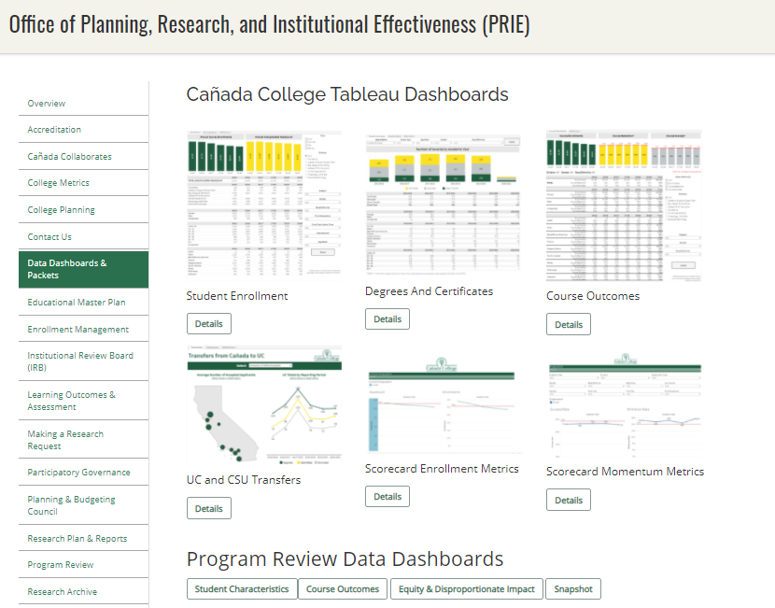
We track our progress via our newly adopted College Scorecard as well as our
Data Dashboards

Slide 25
District Goals
Key New Districtwide Strategies
District Goal #1 | Develop and Strengthen Educational Offerings, Interventions, and Support Programs that Increase Student Access, Success and Completion | Support the work of the District Anti-Racism Council … Increase enrollment of San Mateo County residents through coordinated efforts, including the implementation of the Free Community College initiative.
District Goal #2 | Establish and Expand Relationships With School Districts, 4-year College Partners, And Community-based Organizations to Increase Higher Education Attainment and Economic Mobility In San Mateo County | Continue to expand and support Middle College and Early College opportunities. Expand dual enrollment opportunities and make processes more efficient and accessible for secondary schools and their students.
District Foal #3 | Promote Innovation and Excellence in Instruction to Support Student Learning and Success | Expand program delivery options, including accelerated completion options, for all students including online students, e.g., College for Working Adults; short-term classes; intersession classes; cohort classes; and continuing, corporate and community education. Promote strategic development of online education to increase the development and delivery of quality, fully online certificate and degree programs. Ensure instruction is delivered in multiple modalities, including in-person, hybrid, and hyflex, to increase access to higher education and meet the needs of different student populations.
District Goal #4 | Ensure Necessary Resources are Available to Implement This Strategic Plan Through Sound Fiscal Planning And Management Of Allocations and Protection of Community-supported Status | Free Community College: Strategies of this plan include the accelerated expansion of Dual Enrollment, the Promise Scholars Program (PSP), and Open Educational Resources (OER) for Zero Textbook Cost (ZTC) degree programs, all within a Guided Pathways framework.

