Slide 1

External Scan
Prepared for the Educational Master Planning Task Force
December 1, 2021
Office of Planning, Research & Institutional Effectiveness

Slide 2
Elements of the External Scan
Community Perceptions Questionnaire
SMCCCD Environmental Scan (separate document)
U.S. Census data and mapping

Slide 3
Community Perceptions Questionnaire
Fall 2021

Slide 4
Distribution and follow up
QUESTIONNAIRE DETAILS:
  sent in English and Spanish
  distributed to approximately 71 community organizations, 26 high schools, and 81 churches and religious organizations
RESPONSES:
  received 223 responses
  about 40% of responses in Spanish
  68 respondents indicated a willingness to speak with us further about their feedback
  currently conducting 1:1 phone calls and focus groups

Slide 5
Demographics of Respondents
The respondents are not a representative sample of a larger group
Disaggregating responses by anything other than language is not possible due to a high percentage of blanks for various questions
English speaking respondents are more likely to be older than the Spanish speaking respondents and twice as likely to be Hispanic/Latinx than White.
Spanish speaking respondents were more likely than English speakers to NOT provide any demographic information and much more likely to be Hispanic/Latinx than any other race or ethnicity

Slide 6
Neighborhood where respondent lives | % of total respondents
NO RESIDENCE LOCATION PROVIDED | 34.1%
Redwood City | 29.6%
East Palo Alto | 10.8%
I do not live in San Mateo County | 9.0%
Other San Mateo County city (not on this list) | 7.6%
Menlo Park | 4.0%
North Fair Oaks | 1.8%
San Carlos | 1.8%
Atherton | 0.4%
Belle Haven | 0.4%
La Honda | 0.4%

Slide 10
The degree to which respondents are familiar with the college has a positive correlation (.24) with their opinion of the college:
the more familiar, the more positive the overall perception of Cañada.

Slide 14
Preliminary, anecdotal feedback from 1:1 interviews
Overall, Cañada’s brand is positive
The Middle College and Promise Program are well known and well regarded
Events that showcase student work should be highlighted
There is a real desire for more community access and engagement with the campus.
The campus is a community asset which should be leveraged for more hours of the day and on weekends. It should never be or feel empty and unused. Summer camps and programs should increase.
Neighborhood support (and resistance) for student housing.

Slide 15
Environmental Scan

Slide 16
High cost of living
Older, already educated residents move in
Low and moderate income families forced out
Silicon Valley industries generate high wages for some
Traffic and commute patterns worsen
School age population declining
Work-school imbalance due to
low-wage/high-cost environment

Slide 17
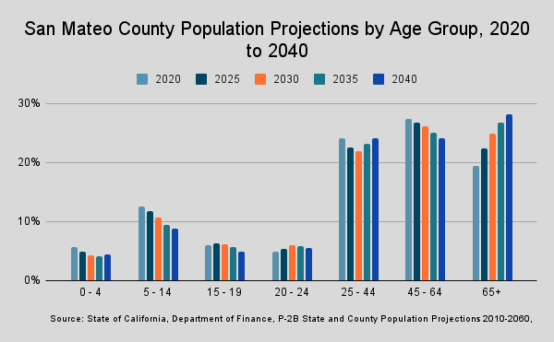

Slide 20
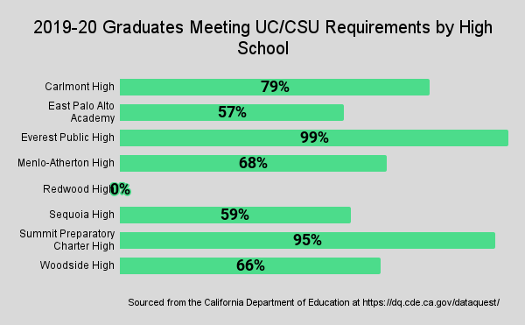

Slide 21
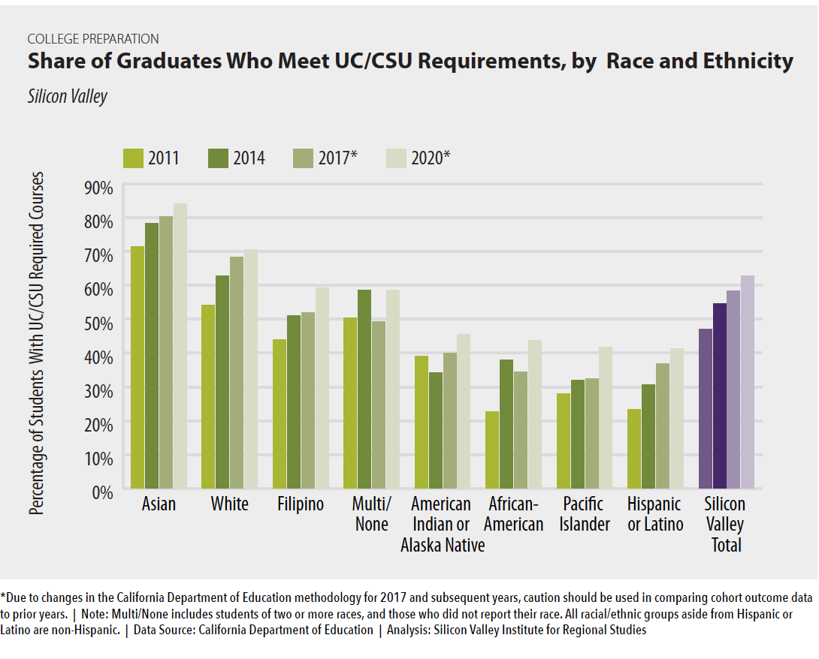

Slide 22
Sources: Burning Glass/Labor Insight/EMSI and the US Census 2019 American Community Survey

Slide 23
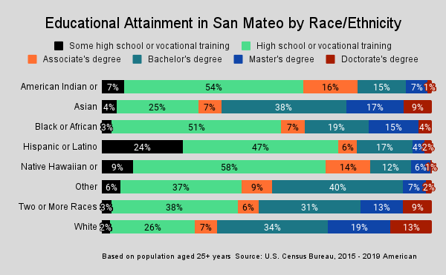

Slide 24
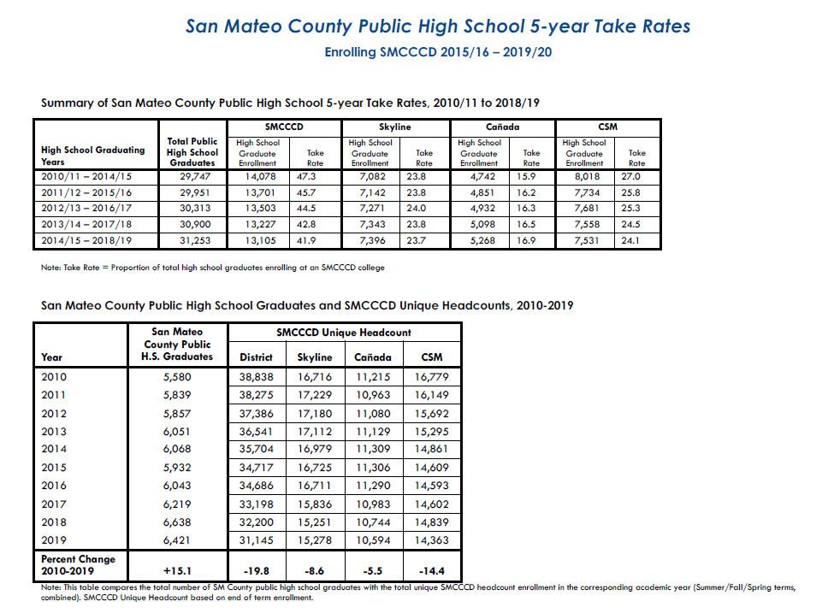

Slide 25


Slide 26
Breakout Group Discussion Questions
Socio-economic and demographic shifts in our region are dramatically changing who our potential students are and what they might need. How can Cañada adapt?
  What shifts or modifications to existing college programs might help?
  What kind of new programs or strategies might help Cañada?
Are there ways of leveraging the transfer center plan to better support as many types of students as possible?
We can’t be all things to all people, but what are the 1-2 things we could do well?
  What things should Cañada prioritize the most?
  What kind of strategic partnerships should Cañada develop or further develop (such as with high schools or our sister colleges)?

