Slide 1

Internal Scan Part I
Prepared for the Educational Master Planning Task Force
October 20, 2021
Office of Planning, Research & Institutional Effectiveness

Slide 2
Part I Topics Part II Topics
Enrollment Trends
Student Momentum
Student Completion
What can explain these trends?
How can they inform our strengths, challenges and opportunities?

Slide 3
Enrollment Trends

Slide 4
Cañada College

Slide 5
California: all community colleges

Slide 6

One Full-time Equivalent Student (FTES) = 4+ students enrolled in 6 units or less
# of students needed to equal one full-time student
Units taken per academic year

Slide 7
Students enrolled at CAN are taking fewer units:
From 2017-21, more and more are SKY & CSM students
# of students needed to equal one full-time student

Slide 8
COVID: exacerbating long-term enrollment trends at Cañada

Slide 9
Cañada is losing FTES faster than CSM and SKY

Slide 10
Compared to 38 of its peers, Cañada has the lowest % of full time equivalent students
Source: IPEDS Report Data
Notes:
IPEDS Report Data College Headcount: 2019-20 FTE: 2019-20 Ratio Canada College 9575 2382 25% Skyline College 14900 4394 29% College of San Mateo 12649 4120 33% Allan Hancock College 16609 6654 40% College of the Canyons 32974 12473 38% Chabot College 19951 7966 40% Cıtrus College 18592 9611 52% Cıty College of San Francısco 35153 13833 39% Cosummes Rıver College 21511 9172 43% Cuesta College 15810 6214 39% De Anza College 28029 13982 50% College of the Dessert 15367 7764 51% Diablo Valley College 29307 12876 44% Glendale Community College 18781 11602 62% Golden West College 18515 7556 41% Grossmont College 23927 10076 42% Irvine Valley College 18862 8494 45% Reedley College 19189 6736 35% Los Angeles Pierce College 28007 11819 42% Los Angeles Trade Technical College 21565 7286 34% Los Angeles Valley College 26867 9476 35% Los Angeles City College 26967 9476 35% Merced College 15302 7469 49% Moorpark College 20631 9487 46% Mt. San Jacinto Community College 21606 10057 47% Orange Coast College 26295 12663 48% Saddleback College 33140 12621 38% San Diego City College 22977 7357 32% San Diego Miramar College 23038 7066 31% San Joaquin Delta 26150 15238 58% Santa Barbara City College 20624 10254 50% Santa Rosa Junior College 27223 10801 40% College of the Sequias 16379 8581 52% Sierra College 25731 11966 47% San Bernandino Valley College 20297 9178 45% Southwestern College 26197 12541 48% Ventura College 18487 7669 41% Victor Valley 17862 8365 47% Norco College 17543 6319 36% Averege of 38 similar CCCs 22185 9453 43% Total 843014 359212 43%

Slide 11
Cañada’s funding is tied to FTES
 | 2021-22 Site Allocations | 2020-21 FTES | 2020-21 Headcount
Cañada | 24% | 21.5% | 25%
College of San Mateo | 37% | 37.8% | 34%
Skyline College | 39% | 40.7% | 41%

Slide 12
During the pandemic, our home campus students are taking fewer units here at Cañada
Note: Home campus is defined as the college where a student has their program of study – the college from which they are seeking a degree or certificate or transfer.

Slide 13
During the pandemic, more students “swirled” but this trend may have peaked

Slide 14
The share of students enrolled at who are seeking a degree or certificate from Cañada is declining
Total: 6,223
Total: 6,048
Total: 4,334
Home campus is defined by the college from which the student is seeking a degree or certificate.

Slide 17
Access for Low Income Students

Slide 18
Student demographics by home campus as of Fall 2021

Slide 21
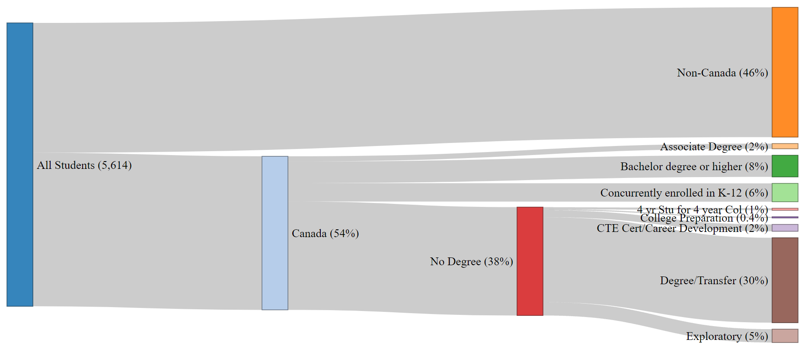
Fall 2021 CAN Enrolled Students by Home Campus,
Education Level & Education Goal
Notes:
file:///C:/Users/engelk/OneDrive%20-%20San%20Mateo%20County%20Community%20College%20District/Enrollment%20Management/FA19FA20%20Sankey.html

Slide 22
The pandemic’s impact on enrollment has impacted some groups of students more than others…
Student Group | Overall 2-year change: -7% in headcount | Overall 5-year change: -20% in headcount
First generation students | -22% | -9%
Male students | -24% | -17%
Ages 20-24 | -40% | -28%
Low income, BIPOC students | -44% | -50%
ESL students | -52% | -70%
Disabled students | -62% | -31%
Ages less than 20 | +76%
Overall 2-year drop in students:
-7%
Notes:
Headcount Full Time Equivalent Students # of Sections Enrollment per Section (after census) 2-year change -7% -15% -3% -13% 5-year change -12% -21% -2% -16% 10-year change -22% -42% -16% -27% 20-year change (2001-2021) -10% -28% -32% -3%
Overall – enrollment of concurrently enrolled high school students is down 6%
Data source: San Mateo County Community College District Data Warehouse.

Slide 23
Enrollment Trend Summary
Cañada’s enrollment continues to decline (COVID exacerbating pre-COVID trends)
Cañada’s share of Full Time Equivalent Students (FTES) is declining faster than at SKY and CSM which impacts funding
Fewer students are enrolling after applying
Fewer students are seeking a degree, certificate or transfer from Cañada
A greater share of Cañada’s headcount (and enrollments) are coming from SKY and CSM home campus students over time

Slide 24
Student Momentum Trends

Slide 25
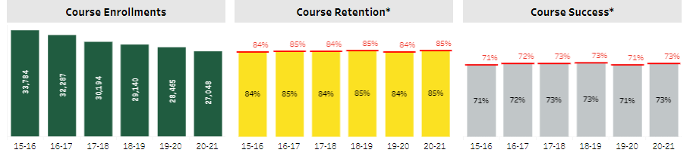

Slide 26
Disproportionate Impact in Course Success
*
*
*
*
*
*
*
*
*
*
* Denotes statistically significant disproportionate impact (DI greater than the margin of error). This is the equity gap.

Slide 27
Overall, BIPOC students see disproportionately lower course success rates
*
*
*
*
*
*
*
*
*
*
*
*
*
* Denotes statistically significant disproportionate impact (DI greater than the margin of error). This is the equity gap.

Slide 28
Course success rates by modality

Slide 29
In online courses, BIPOC students fair disproportionately worse
*
*
*
*
*
*
* Denotes statistically significant disproportionate impact (DI greater than the margin of error). This is the equity gap.

Slide 30
Fall 2019 AB 705 Outcomes at Cañada College:
Summary of Findings
More students accessed transfer-level Math and English courses (Access)
More students passed transfer-level Math and English courses (Success & Throughput)
Equity gaps in access to and success in transfer-level Math and English courses between Latinx and White students decreased or were completely mitigated (Equity)

Slide 31
Equity in Access in Transfer-level English Courses
AB 705 mitigated the equity gap between Latinx and White students in access to transfer-level English courses from 35% in Fall 2016 to 0% in Fall 2019.

Slide 32
Equity in Access in Transfer-level Math Courses
All first-time students enrolled in math courses in Cañada College in Fall 2019.
Consistently more white students than Latinx students have been placed in transfer-level courses (disproportionate impact in access).
New placement under AB 705 increases the odds of Latinx students enrolling in transfer-level math courses
New placement under AB 705 leads to significant decrease in the access gap from 30% points in Fall 2016 to 10% in Fall 2019.
gap

Slide 33
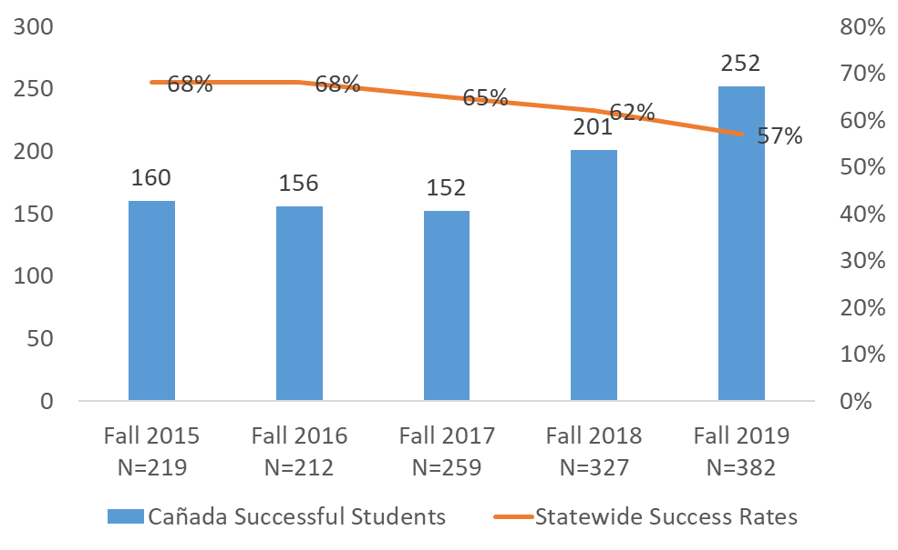
Course Success Trend in Transfer-Level English Courses
Cañada success rates in transfer-level English courses are similar to statewide trends.
Finding 1:
AB 705 led to a 5% point decrease in the transfer-level English course success rates between fall 2018 and fall 2019.
Finding 2:
The number of students who passed transfer-level English courses increased by 27% from 201 in fall 2018 to 255 in fall 2019 at Cañada.

Slide 34
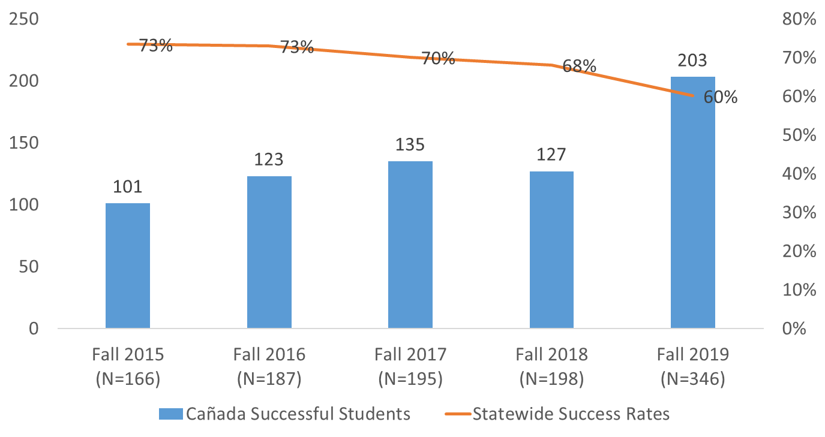
Course Success Trend in Transfer-level Math Courses
Transfer-level courses:
Math 200
Math 200 + 800
Math 225
Math 225 + 825
Math 241
Math 241 +841
Math 215
Math 130
Math 222

Slide 35
Persistence Rate of Cañada Home Campus Students from Fall to the following Spring Term
*
*
*
* Denotes the persistence rate for this group which statistically disproportionately lower than that expected given the persistence rates for all other students.
Notes:
Home campus students
Fall Term Fall Spring % Retained in Spring
Fall 2019 3949 2560 64.8%
Fall 2020 3405 2345 68.9%

Slide 36
Persistence Rate of Cañada Home Campus Students from Fall to the following Spring Term
Persistence Rate Overall:
Fall 19 to Spring 20: 65%
Fall 20 to Spring 21: 69%
*
*
*
*
*
*
*
*
* Denotes the persistence rate for this group which statistically disproportionately lower than that expected given the persistence rates for all other students.

Slide 37
Persistence Rates of CAN Primary Campus Students Over Time

Slide 38
Impact of Special Programs
 | Persistence
 | Special Program | No Special Program
Full Time | 95% | 79%
Part Time | 83% | 52%
Low Income | 95% | 71%
Asian | 100% | 67%
Black - Non-Hispanic | 100% | 25%
Filipino | 100% | 100%
Hispanic | 91% | 61%
Multiraces | 100% | 67%
Pacific Islander | 100%
Unknown | 100% | 75%
White Non-Hispanic | 100% | 71%
 | % of Units Taken Completed Successfully
 | Special Program | No Special Program
Full Time | 55% | 53%
Part Time | 52% | 47%
Low Income | 55% | 45%
Asian | 54% | 60%
Black - Non-Hispanic | 100% | 43%
Filipino | 61% | 86%
Hispanic | 51% | 44%
Multiraces | 58% | 48%
Pacific Islander | 100%
Unknown | 76% | 61%
White Non-Hispanic | 61% | 56%
Notes:
55% of FT students are in a special program

Slide 39
Student Momentum Summary
BIPOC students continue to be negatively disproportionately impacted in terms of their course success rates at Cañada
This trend is more pronounced in online courses, even as the college is improving its overall online course success rate
Cañada’s implementation of AB 705 is yielding significant gains for students and is closing access and throughput gaps
While overall persistence rates are improving, Black non-Hispanic students continue to persist at disproportionately lower rates
Special Programs help with persistence and, to some degree, with course success

Slide 40
Student Completion Trends

Slide 41
Current College Mission
Cañada College provides our community with a learning-centered environment, ensuring that all students have equitable opportunities to achieve their transfer, career education, and lifelong learning educational goals. The College cultivates in its students the ability to think critically and creatively, communicate effectively, reason quantitatively, and understand and appreciate different points of view within a diverse community.

Slide 42
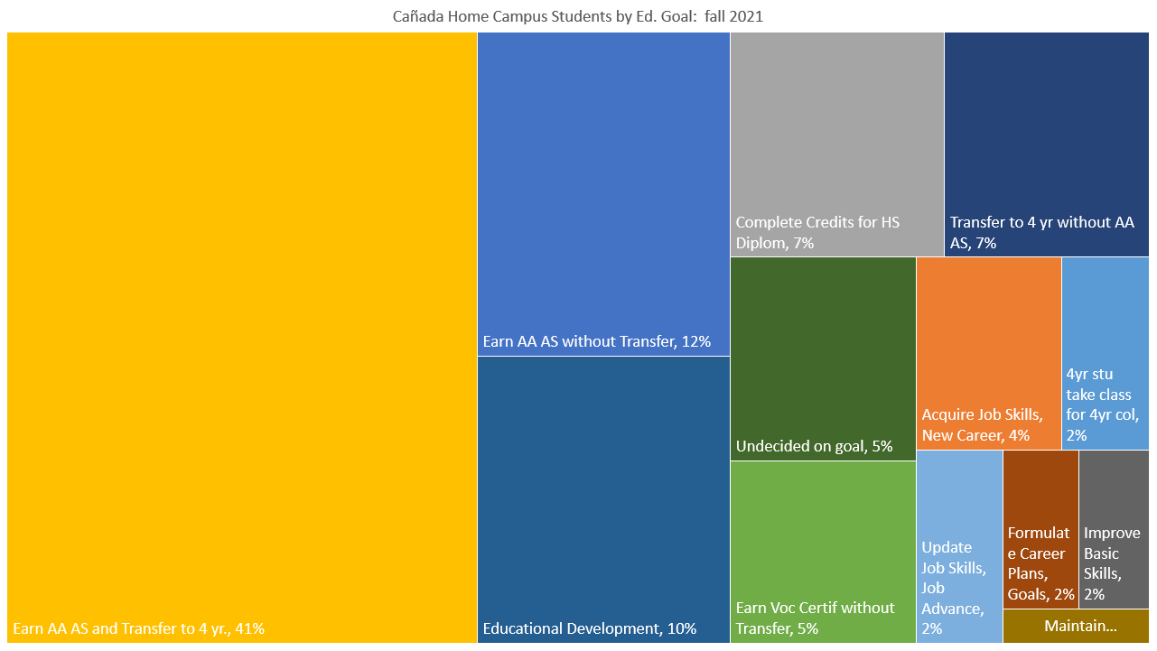

Slide 43
53% have a degree goal

Slide 44
Cañada College 2-Year Degree Attainment
‡ The 2019-20 and 2020-21 academic years were impacted by the COVID-19 pandemic and may not be representative of a typical academic year.
Notes:
Percent of degree earners who completed an award in the given time

Slide 45
Degree Earners: under-represented groups
Of the students seeking a two-year degree from Cañada, the following two student groups are disproportionately under-represented:
Student Group | Equity Gap | # of additional degree earners needed to close the gap*
Students Ages 18-22 | -5% | 48
Non Low Income Students | -4% | 57
* Degree Earners in 2020-21 were compared to all Degree Seekers enrolled in 2020-21. No other groups are disproportionately under-represented.

Slide 46
48% have a transfer goal

Slide 47
Cañada College Transfer Rate as of 2020-21
Notes:
Fall first time student cohort 2015

Slide 48
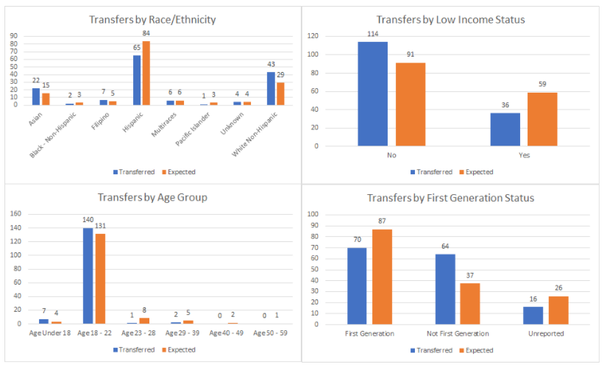
When comparing the subset of students (a cohort that first enrolled in Fall 2015) who transferred within four years of starting to the overall cohort some subgroups are less likely to transfer than others. All of our older students (23+) were less likely to transfer than their younger counterparts. Additionally our Hispanic students were less likely to have transferred than their peers. Low income and first generation student groups were also less likely to transfer than their peers. There was no difference in transfer across gender. Source: Cañada College Transfer Services Plan: 2021-24.

Slide 49
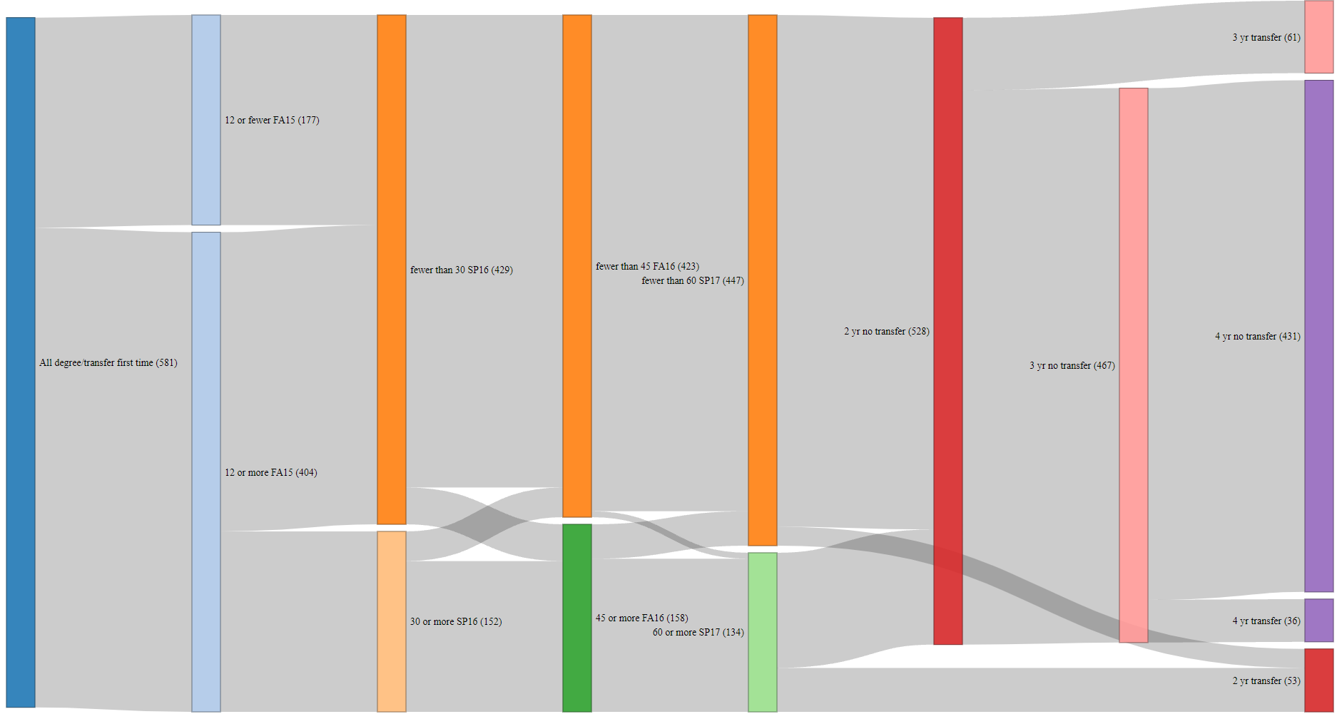

Slide 50
Job Relation to Field of Study (CTEOS)
Notes:
These are the only years we have, new data comes out at a lag

Slide 51
Summary of Student Completion
Cañada is not fulfilling its mission of “ensuring that all students have equitable opportunities to achieve their transfer, career education, and lifelong learning educational goals.”
Hispanic, low income and first generation college students are less likely to transfer than we would expect

