Slide 1
Internal Scan Part III
Prepared for the Educational Master Planning Task Force
November 17, 2021
Office of Planning, Research & Institutional Effectiveness

Slide 2
Topics
Supporting part time students
Student preferences and concerns
Can students get the classes they need?
What are we optimizing for?

Slide 3
Supporting Part Time Students

Slide 4
There are 3 part-time students for every one full-time student at CAN
Overall CAN primary campus students by units attempted per term

Slide 5
Part-time students are not necessarily less successful
Overall course success rates Fall 2016 by unit load

Slide 6
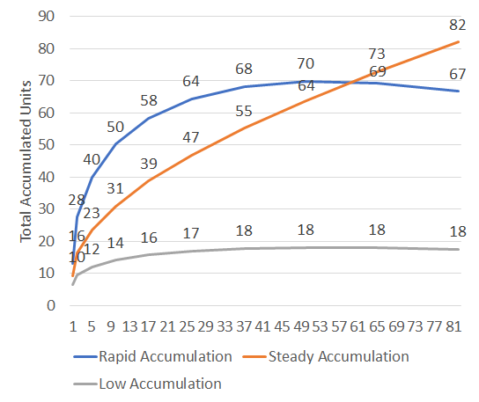
Unit Accumulation Groups for Cañada’s Fall 2016 First-Time Cohort
Rapid Accumulation
32% of the cohort
Accumulating over 10 units per term
2-3 years to completion
Steady Accumulation
12% of the cohort
Accumulating 7-9 units per term
3-4 years to completion
Low Accumulation
56% of the cohort
Accumulating 0-5 units per term
5+ years to completion

Slide 7
The cohorts start out similarly
Notes:
This really could be a remedial math and English issue….since this is a Fall 2016 cohort

Slide 8
Sustaining course success is key

Slide 9
Special Programs’ Unit Requirements
Special Program | Full Time Requirement?
Promise Scholars Program | YES
EOPS | YES
TRIO SSS | NO
International | YES
Athletics | YES
College for Working Adults | NO
Umoja | NO
Puente | NO

Slide 10
Director of Student Support
Special Programs
Promise
EOPS
ESL
TRIO SSS
CWA
ECE
International
Puente
ESO Adelante
Athletics
Arts, Design & Performance
Retention Specialist
Business
Retention Specialist
Human Behavior & Culture
Retention Specialist
Science & Health
Retention Specialist
Student Support
Community of Practice
to align services and create consistency
Peer Mentor
Peer Mentor
Peer Mentor
Peer Mentor
Peer Mentor
Peer Mentor

Slide 11
Student Preferences and Concerns

Slide 12
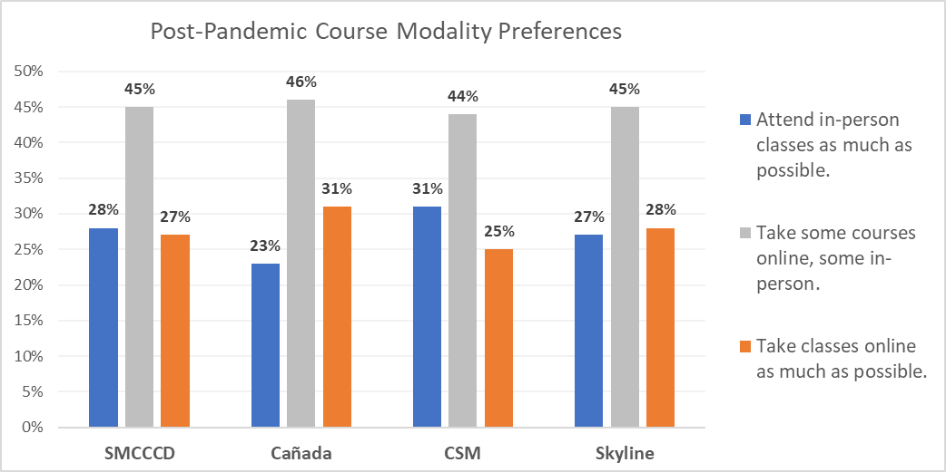
Students’ post-COVID course modality preferences are split between on-line and in person
Q: In the future, once the pandemic is behind us, which most accurately describes your preference for how to attend college?
Source: Email survey sent to all students enrolled at SMCCCD in May, 2021.
Notes:
Differences between Canada and CSM are statistically significant (p<.05)

Slide 13
Districtwide student preferences for instructional modalities – post pandemic
Source: April-May 2021 survey of enrolled students (via email)
Notes:
So

Slide 14
Top reasons students gave for stopping out during the pandemic:
Prioritizing working for pay
Preferring not to enroll in online classes
Taking classes at another college (online)
Prioritizing the care of children and other family members

Slide 15
Top 3 things our colleges could do to support the return of stopped out students:
More scheduling options: getting the courses they want when they want them
Financial support
Help choosing courses and programs

Slide 16
2 of every 3 students are working for pay
Source: NACCC survey of all non-K12 students enrolled at CAN in Spring 2021 (not just home campus students.

Slide 17
Part-time students more likely to work full time
Source: NACCC survey of all non-K12 students enrolled at CAN in Spring 2021 (not just home campus students.

Slide 18
Part-time students far less likely to access services
All students
Of those using these services…
Source: NACCC survey of all non-K12 students enrolled at CAN in Spring 2021 (not just home campus students).

Slide 19
Can students get the classes they need when and where they need them?

Slide 20
Pre-pandemic class schedule
35
Most classes in Fall 2019 occurred between 9:00 a.m. and 1:00 p.m.
The campus is under-utilized for much of the day.
30
25
20
15
10
Monday
Tuesday
5
Wednesday
Thursday
Friday
0
12:00 1:00
Lunch
7:00
Dinner
8:00
9:00
10:00
11:00
2:00
3:00
4:00
5:00
6:00
8:00
9:00
10:00
Source: Fall 2019 Enrollment Data
Notes:
Per Steinberg & Hart analysis, Facilities Master Planning consultants for SMCCCD 2021-22

Slide 21
General Education Courses Offered by time block

Slide 22
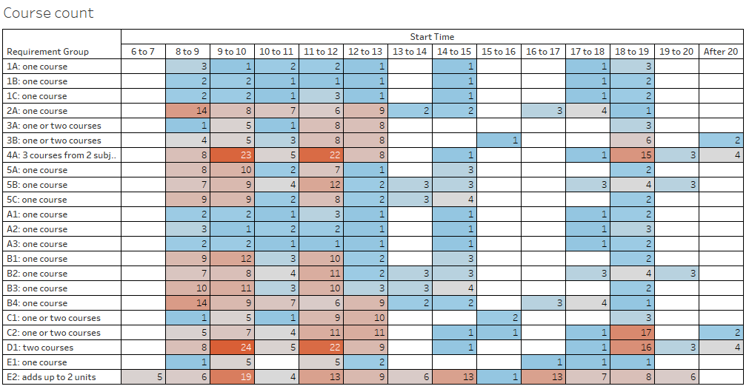
Data is for the 2018-19 and 2019-20 academic years

Slide 23
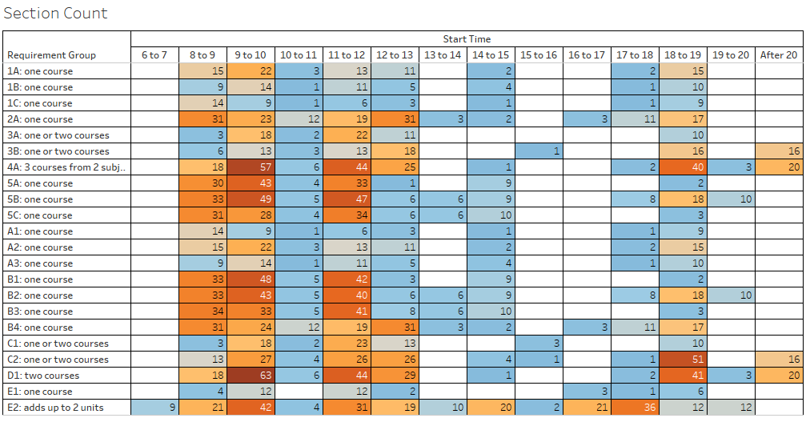
Data is for the 2018-19 and 2019-20 academic years

Slide 24
Fa18 | MWF |  |  | MW
Time | 3 Unit | 4 Unit | 5 Unit | 3 Unit | 4 Unit | 5 Unit
8:00 |  |  | Block 1
8:05
8:10 | Block 1 | Block 1 |  | Block 1 Count: 3 | Block 1 Count: 12 (6 off block) | Block 1 Count: 15 (14 off block)
8:15
8:20
8:25
8:30
8:35
8:40
8:45
8:50
8:55
9:00
9:05
9:10 | Block 2
9:15
9:20
9:25
9:30
9:35 |  |  | Block 2
9:40
9:45 |  | Block 2 |  | Block 2 Count: 22
9:50
9:55
10:00
10:05
10:10 | Block 3 |  |  |  | Block 2 Count: 2 (2 off block)
10:15
10:20
10:25
10:30
10:35
10:40
10:45
10:50
10:55
11:00
11:05
11:10 | Block 4 | Block 3 | Block 3 | Block 3 Count: 19 |  | Block 2 Count: 5 (2 off block)
11:15
11:20
11:25
11:30
11:35
11:40
11:45
11:50
11:55
12:00
12:05
12:10 | Block 5 |  |  |  | Block 3
12:15
12:20
12:25
12:30
12:35
12:40
12:45 |  | Block 4 | Block 4 | Block 4 Count: 10
12:50
12:55
13:00
13:05
13:10 | Block 6
13:15
13:20
13:25
13:30
13:35
13:40
13:45
13:50
13:55
14:00
14:05

Slide 25
Cañada home campus student enrollments: then and now

Slide 26
Cañada’s course sections tend to low enrollments

Slide 27
20% of courses saw 67% of enrollments in 2020-21

Slide 28
71% of courses are offered only 1-2 times per year

Slide 29
What are we optimizing for?
Making sure students can complete GE patterns and/or degree programs in a timely way?
Full time students may have more time and may be less impacted by limited offerings
Part time students have smaller windows of availability. If courses are always offered in the morning, or in person, or both, they may not be able to take them.

Slide 30
How do we help students get the courses they need?
Ensuring at least one, on-line option of most of all of our core required courses is offered somewhere in the District?
Same for GEs?
Create co-horted time blocks?
College for Working Adults (nights, online, weekends option) – with a strong sense of community
Morning blocks with better scheduling to allow more than one class to be taken per day
Build a sense of community around Interest Areas, pathways, at certain times?

Slide 31
Breakout Discussion Questions
What does “intentional scheduling” look like?
What does that mean for services and community?
How do we optimize the course schedule for student completion?
What kind of information should we share with Deans and faculty to help them plan their course schedules?
What kind of process would help adjust drafted class schedules?
What are the best ways we could collect more information from students about preferred scheduling options?

Slide 32
Appendix

Slide 33
We've noticed you have not re-enrolled at the San Mateo County Community Colleges (Cañada, CSM, or Skyline) during the COVID pandemic. Could you please share your reasons for not returning?
 | # of survey respondents
I had to prioritize my job/work | 196
I prefer not to enroll in online classes | 190
Other | 172
I am attending college elsewhere | 135
I needed to prioritize my care for children/family | 101
I am taking a break from school for now | 95
I needed to focus on my mental health/wellness | 81
I could not (and cannot) afford to attend right now | 81
I moved out of the area | 80
I needed to focus on my physical health/wellness | 55
I do not have a quite place to study | 47
I did not feel supported while I was enrolled | 40
My Wifi and internet access are unreliable | 29
I could not find a program | 27
Students were able to select as many or as few items as they liked. Five main themes of the “Other” responses were: They had completed course requirements/graduated/transferred, they were waiting to be in person, college processes had created an impediment to their re-enrolling, various life reasons, and a lack of classes that they were interested in.
Notes:
Source: SMCCCD PRIE Districtwide survey of students who had been enrolled at any point in 2019-20 but who had not re-enrolled at any point during the pandemic (through spring 2021)

Slide 34
If you had both face-to-face and online/virtual options for all of the classes you might want to take, what are the three biggest obstacles to your re-enrolling at the SMCCCD Colleges next fall?
 | # of survey respondents
I need to prioritize my job/work | 134
I moved out of the area | 100
Other | 86
The course(s) I need are not offered at the time(s) I need them | 79
I need to focus on my mental health/wellness | 66
I cannot find a program of study that interests me | 64
I need to prioritize my care for children/family | 55
I need to focus on my physical health/wellness | 52
I cannot afford to attend college right now | 51
Students were able to select up to three options, of those who indicated No or Not Sure to re-enrolling. The main themes for those that selected other were transferred/graduated/completed course requirements, they have switched schools, or they prefer in person instruction.

Slide 35
What are the top 3 things the San Mateo Colleges could do to support your return to college in the future?
 | # of survey respondents
More scheduling options: getting the courses I want when I want them | 328
Financial Support | 323
Help choosing courses programs etc. | 203
Personal counseling | 152
Help with registering for courses | 146
Other | 130
Transportation to/from campus | 88
Support with technology | 86
Support with accessing food and/or housing | 82
Support with childcare | 51
Students were able to select up to three options. Of those who selected Other, over half indicated None/Not applicable, a minority indicated a return to in person instruction, and finally more diverse course offerings.

