Slide 1

Internal Scan
Prepared for and presented to the Educational Master Planning Task Force
in 3 parts during the Fall of 2021
by the
Office of Planning, Research & Institutional Effectiveness

Slide 2
Part I Topics Part II Topics
Enrollment Trends
Student Momentum
Student Completion
What can explain these trends?
How can they inform our strengths, challenges and opportunities?

Slide 3
Enrollment Trends

Slide 4
Cañada College

Slide 5
California: all community colleges

Slide 6

One Full-time Equivalent Student (FTES) = 4+ students enrolled in 6 units or less
# of students needed to equal one full-time student
Units taken per academic year

Slide 7
Students enrolled at CAN are taking fewer units:
From 2017-21, more and more are SKY & CSM students
# of students needed to equal one full-time student

Slide 8
COVID: exacerbating long-term enrollment trends at Cañada

Slide 9
Cañada is losing FTES faster than CSM and SKY

Slide 10
Compared to 38 of its peers, Cañada has the lowest % of full time equivalent students
Source: IPEDS Report Data
Notes:
IPEDS Report Data College Headcount: 2019-20 FTE: 2019-20 Ratio Canada College 9575 2382 25% Skyline College 14900 4394 29% College of San Mateo 12649 4120 33% Allan Hancock College 16609 6654 40% College of the Canyons 32974 12473 38% Chabot College 19951 7966 40% Cıtrus College 18592 9611 52% Cıty College of San Francısco 35153 13833 39% Cosummes Rıver College 21511 9172 43% Cuesta College 15810 6214 39% De Anza College 28029 13982 50% College of the Dessert 15367 7764 51% Diablo Valley College 29307 12876 44% Glendale Community College 18781 11602 62% Golden West College 18515 7556 41% Grossmont College 23927 10076 42% Irvine Valley College 18862 8494 45% Reedley College 19189 6736 35% Los Angeles Pierce College 28007 11819 42% Los Angeles Trade Technical College 21565 7286 34% Los Angeles Valley College 26867 9476 35% Los Angeles City College 26967 9476 35% Merced College 15302 7469 49% Moorpark College 20631 9487 46% Mt. San Jacinto Community College 21606 10057 47% Orange Coast College 26295 12663 48% Saddleback College 33140 12621 38% San Diego City College 22977 7357 32% San Diego Miramar College 23038 7066 31% San Joaquin Delta 26150 15238 58% Santa Barbara City College 20624 10254 50% Santa Rosa Junior College 27223 10801 40% College of the Sequias 16379 8581 52% Sierra College 25731 11966 47% San Bernandino Valley College 20297 9178 45% Southwestern College 26197 12541 48% Ventura College 18487 7669 41% Victor Valley 17862 8365 47% Norco College 17543 6319 36% Averege of 38 similar CCCs 22185 9453 43% Total 843014 359212 43%

Slide 11
Cañada’s funding is tied to FTES
 | 2021-22 Site Allocations | 2020-21 FTES | 2020-21 Headcount
Cañada | 24% | 21.5% | 25%
College of San Mateo | 37% | 37.8% | 34%
Skyline College | 39% | 40.7% | 41%

Slide 12
During the pandemic, our home campus students are taking fewer units here at Cañada
Note: Home campus is defined as the college where a student has their program of study – the college from which they are seeking a degree or certificate or transfer.

Slide 13
During the pandemic, more students “swirled” but this trend may have peaked

Slide 14
The share of students enrolled at who are seeking a degree or certificate from Cañada is declining
Total: 6,223
Total: 6,048
Total: 4,334
Home campus is defined by the college from which the student is seeking a degree or certificate.

Slide 17
Access for Low Income Students

Slide 18
Student demographics by home campus as of Fall 2021

Slide 21
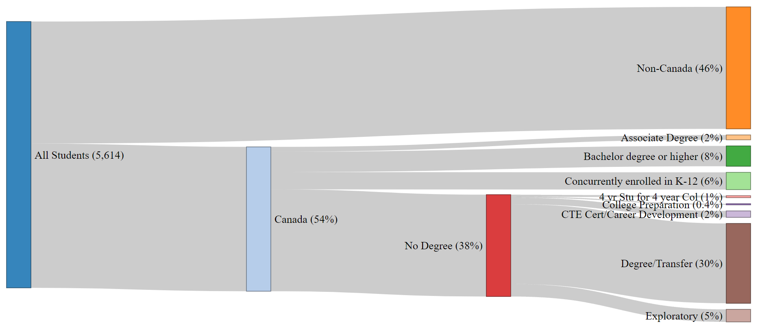
Fall 2021 CAN Enrolled Students by Home Campus,
Education Level & Education Goal
Notes:
file:///C:/Users/engelk/OneDrive%20-%20San%20Mateo%20County%20Community%20College%20District/Enrollment%20Management/FA19FA20%20Sankey.html

Slide 22
The pandemic’s impact on enrollment has impacted some groups of students more than others…
Student Group | Overall 2-year change: -7% in headcount | Overall 5-year change: -20% in headcount
First generation students | -22% | -9%
Male students | -24% | -17%
Ages 20-24 | -40% | -28%
Low income, BIPOC students | -44% | -50%
ESL students | -52% | -70%
Disabled students | -62% | -31%
Ages less than 20 | +76%
Overall 2-year drop in students:
-7%
Notes:
Headcount Full Time Equivalent Students # of Sections Enrollment per Section (after census) 2-year change -7% -15% -3% -13% 5-year change -12% -21% -2% -16% 10-year change -22% -42% -16% -27% 20-year change (2001-2021) -10% -28% -32% -3%
Overall – enrollment of concurrently enrolled high school students is down 6%
Data source: San Mateo County Community College District Data Warehouse.

Slide 23
Enrollment Trend Summary
Cañada’s enrollment continues to decline (COVID exacerbating pre-COVID trends)
Cañada’s share of Full Time Equivalent Students (FTES) is declining faster than at SKY and CSM which impacts funding
Fewer students are enrolling after applying
Fewer students are seeking a degree, certificate or transfer from Cañada
A greater share of Cañada’s headcount (and enrollments) are coming from SKY and CSM home campus students over time

Slide 24
Student Momentum Trends

Slide 25
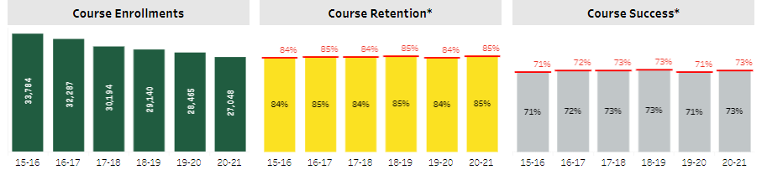

Slide 26
Disproportionate Impact in Course Success
*
*
*
*
*
*
*
*
*
*
* Denotes statistically significant disproportionate impact (DI greater than the margin of error). This is the equity gap.

Slide 27
Overall, BIPOC students see disproportionately lower course success rates
*
*
*
*
*
*
*
*
*
*
*
*
*
* Denotes statistically significant disproportionate impact (DI greater than the margin of error). This is the equity gap.

Slide 28
Course success rates by modality

Slide 29
In online courses, BIPOC students fair disproportionately worse
*
*
*
*
*
*
* Denotes statistically significant disproportionate impact (DI greater than the margin of error). This is the equity gap.

Slide 30
Fall 2019 AB 705 Outcomes at Cañada College:
Summary of Findings
More students accessed transfer-level Math and English courses (Access)
More students passed transfer-level Math and English courses (Success & Throughput)
Equity gaps in access to and success in transfer-level Math and English courses between Latinx and White students decreased or were completely mitigated (Equity)

Slide 31
Equity in Access in Transfer-level English Courses
AB 705 mitigated the equity gap between Latinx and White students in access to transfer-level English courses from 35% in Fall 2016 to 0% in Fall 2019.

Slide 32
Equity in Access in Transfer-level Math Courses
All first-time students enrolled in math courses in Cañada College in Fall 2019.
Consistently more white students than Latinx students have been placed in transfer-level courses (disproportionate impact in access).
New placement under AB 705 increases the odds of Latinx students enrolling in transfer-level math courses
New placement under AB 705 leads to significant decrease in the access gap from 30% points in Fall 2016 to 10% in Fall 2019.
gap

Slide 33
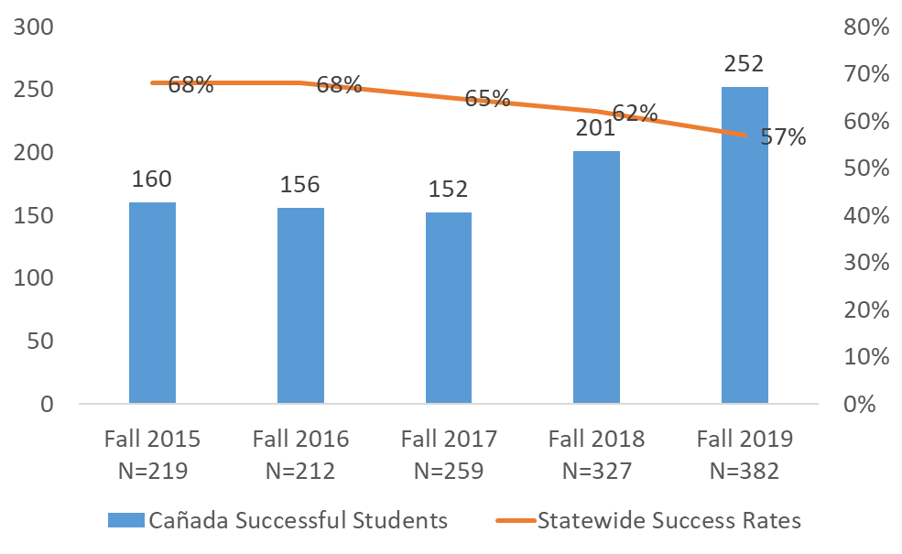
Course Success Trend in Transfer-Level English Courses
Cañada success rates in transfer-level English courses are similar to statewide trends.
Finding 1:
AB 705 led to a 5% point decrease in the transfer-level English course success rates between fall 2018 and fall 2019.
Finding 2:
The number of students who passed transfer-level English courses increased by 27% from 201 in fall 2018 to 255 in fall 2019 at Cañada.

Slide 34
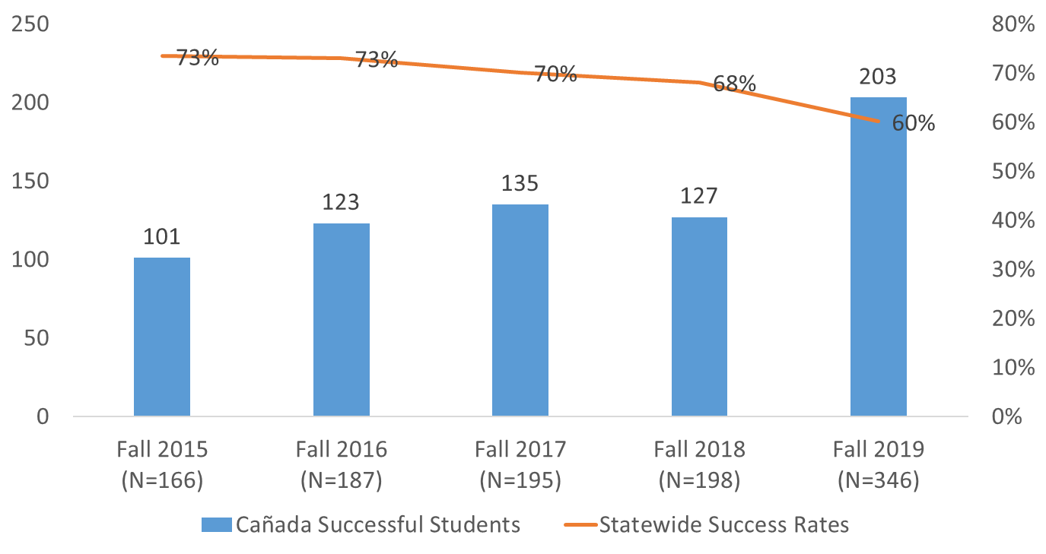
Course Success Trend in Transfer-level Math Courses
Transfer-level courses:
Math 200
Math 200 + 800
Math 225
Math 225 + 825
Math 241
Math 241 +841
Math 215
Math 130
Math 222

Slide 35
Persistence Rate of Cañada Home Campus Students from Fall to the following Spring Term
*
*
*
* Denotes the persistence rate for this group which statistically disproportionately lower than that expected given the persistence rates for all other students.
Notes:
Home campus students
Fall Term Fall Spring % Retained in Spring
Fall 2019 3949 2560 64.8%
Fall 2020 3405 2345 68.9%

Slide 36
Persistence Rate of Cañada Home Campus Students from Fall to the following Spring Term
Persistence Rate Overall:
Fall 19 to Spring 20: 65%
Fall 20 to Spring 21: 69%
*
*
*
*
*
*
*
*
* Denotes the persistence rate for this group which statistically disproportionately lower than that expected given the persistence rates for all other students.

Slide 37
Persistence Rates of CAN Primary Campus Students Over Time

Slide 38
Impact of Special Programs
 | Persistence
 | Special Program | No Special Program
Full Time | 95% | 79%
Part Time | 83% | 52%
Low Income | 95% | 71%
Asian | 100% | 67%
Black - Non-Hispanic | 100% | 25%
Filipino | 100% | 100%
Hispanic | 91% | 61%
Multiraces | 100% | 67%
Pacific Islander | 100%
Unknown | 100% | 75%
White Non-Hispanic | 100% | 71%
 | % of Units Taken Completed Successfully
 | Special Program | No Special Program
Full Time | 55% | 53%
Part Time | 52% | 47%
Low Income | 55% | 45%
Asian | 54% | 60%
Black - Non-Hispanic | 100% | 43%
Filipino | 61% | 86%
Hispanic | 51% | 44%
Multiraces | 58% | 48%
Pacific Islander | 100%
Unknown | 76% | 61%
White Non-Hispanic | 61% | 56%
Notes:
55% of FT students are in a special program

Slide 39
Student Momentum Summary
BIPOC students continue to be negatively disproportionately impacted in terms of their course success rates at Cañada
This trend is more pronounced in online courses, even as the college is improving its overall online course success rate
Cañada’s implementation of AB 705 is yielding significant gains for students and is closing access and throughput gaps
While overall persistence rates are improving, Black non-Hispanic students continue to persist at disproportionately lower rates
Special Programs help with persistence and, to some degree, with course success

Slide 40
Student Completion Trends

Slide 41
Current College Mission
Cañada College provides our community with a learning-centered environment, ensuring that all students have equitable opportunities to achieve their transfer, career education, and lifelong learning educational goals. The College cultivates in its students the ability to think critically and creatively, communicate effectively, reason quantitatively, and understand and appreciate different points of view within a diverse community.

Slide 42
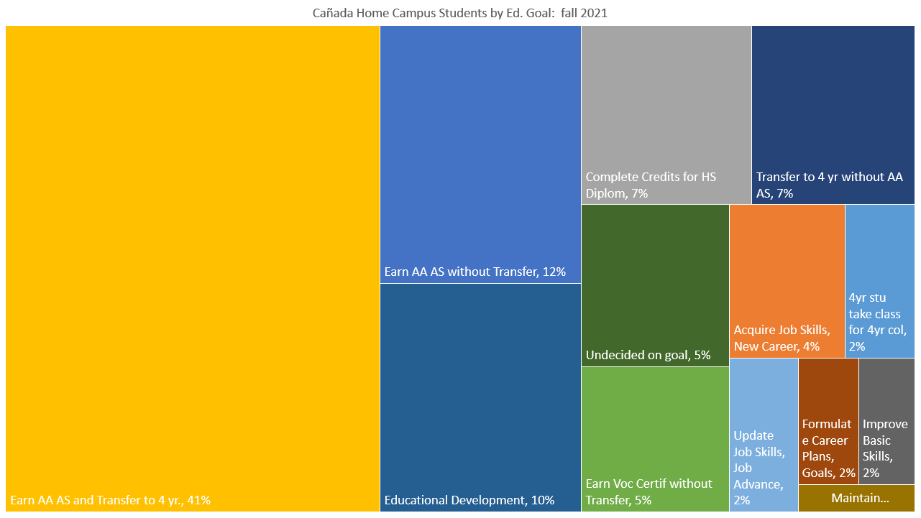

Slide 43
53% have a degree goal

Slide 44
Cañada College 2-Year Degree Attainment
‡ The 2019-20 and 2020-21 academic years were impacted by the COVID-19 pandemic and may not be representative of a typical academic year.
Notes:
Percent of degree earners who completed an award in the given time

Slide 45
Degree Earners: under-represented groups
Of the students seeking a two-year degree from Cañada, the following two student groups are disproportionately under-represented:
Student Group | Equity Gap | # of additional degree earners needed to close the gap*
Students Ages 18-22 | -5% | 48
Non Low Income Students | -4% | 57
* Degree Earners in 2020-21 were compared to all Degree Seekers enrolled in 2020-21. No other groups are disproportionately under-represented.

Slide 46
48% have a transfer goal

Slide 47
Cañada College Transfer Rate as of 2020-21
Notes:
Fall first time student cohort 2015

Slide 48
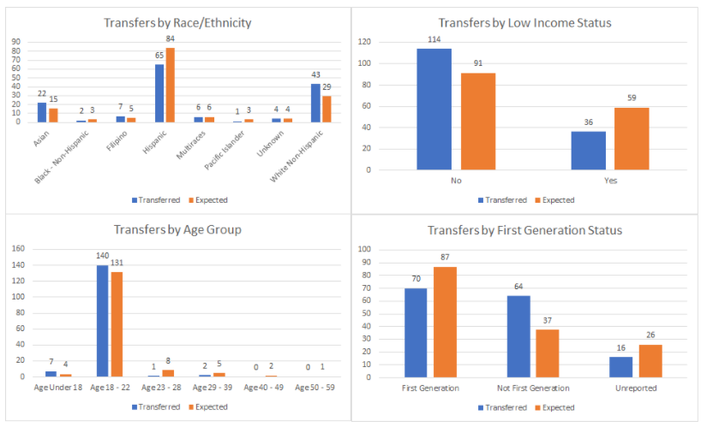
When comparing the subset of students (a cohort that first enrolled in Fall 2015) who transferred within four years of starting to the overall cohort some subgroups are less likely to transfer than others. All of our older students (23+) were less likely to transfer than their younger counterparts. Additionally our Hispanic students were less likely to have transferred than their peers. Low income and first generation student groups were also less likely to transfer than their peers. There was no difference in transfer across gender. Source: Cañada College Transfer Services Plan: 2021-24.

Slide 49
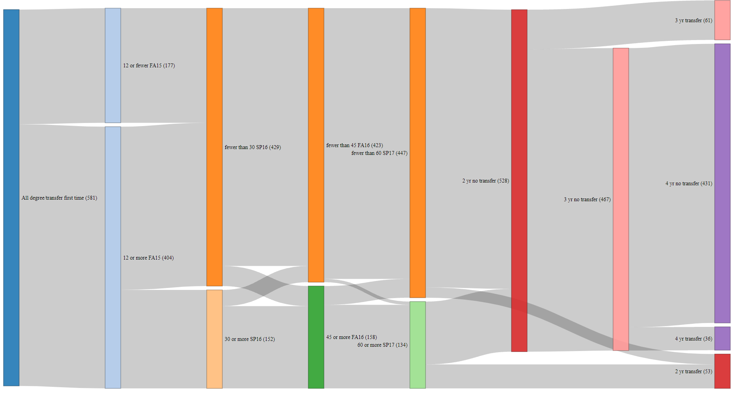

Slide 50
Job Relation to Field of Study (CTEOS)
Notes:
These are the only years we have, new data comes out at a lag

Slide 51
Summary of Student Completion
Cañada is not fulfilling its mission of “ensuring that all students have equitable opportunities to achieve their transfer, career education, and lifelong learning educational goals.”
Hispanic, low income and first generation college students are less likely to transfer than we would expect

Slide 52
Internal Scan Part II
Prepared for the Educational Master Planning Task Force
November 3, 2021
Office of Planning, Research & Institutional Effectiveness

Slide 53
Agenda
Quick review of main takeaways from Part I
What can help explain these trends?
  Understanding student journeys and changing preferences – what do our students want?
  What might be contributing to students not completing their journeys?
  How can we best address student needs given our resources/size/location?
How can these factors inform potential goals and strategies?

Slide 54
Enrollment Trend Summary
Cañada’s enrollment continues to decline (COVID exacerbating pre-COVID trends)
Cañada’s share of Full Time Equivalent Students (FTES) is declining faster than at SKY and CSM which impacts the college’s funding
Fewer students are enrolling after applying
Fewer students are seeking a degree, certificate or transfer from Cañada
A greater share of Cañada’s headcount (and enrollments) are coming from SKY and CSM home campus students over time

Slide 55
Student Momentum Summary
BIPOC students continue to be negatively disproportionately impacted in terms of their course success rates at Cañada
This trend is more pronounced in online courses, even as the college is improving its overall online course success rate
Cañada’s implementation of AB 705 is yielding gains for students and is closing access and throughput gaps, but we can do better
While overall persistence rates are improving, Black non-Hispanic students continue to persist at disproportionately lower rates
Special Programs help with persistence and, to some degree, with course success

Slide 56
Student Completion Trends

Slide 57
Current College Mission
Cañada College provides our community with a learning-centered environment, ensuring that all students have equitable opportunities to achieve their transfer, career education, and lifelong learning educational goals. The College cultivates in its students the ability to think critically and creatively, communicate effectively, reason quantitatively, and understand and appreciate different points of view within a diverse community.

Slide 58
Cañada College 2-Year Degree Attainment
‡ The 2019-20 and 2020-21 academic years were impacted by the COVID-19 pandemic and may not be representative of a typical academic year.
Notes:
Percent of degree earners who completed an award in the given time

Slide 59
Cañada College Transfer Rate as of 2020-21
Notes:
Fall first time student cohort 2015

Slide 60
When comparing the subset of students (a cohort that first enrolled in Fall 2015) who transferred within four years of starting to the overall cohort some subgroups are less likely to transfer than others. All of our older students (23+) were less likely to transfer than their younger counterparts. Additionally our Hispanic students were less likely to have transferred than their peers. Low income and first generation student groups were also less likely to transfer than their peers. There was no difference in transfer across gender. Source: Cañada College Transfer Services Plan: 2021-24.

Slide 61
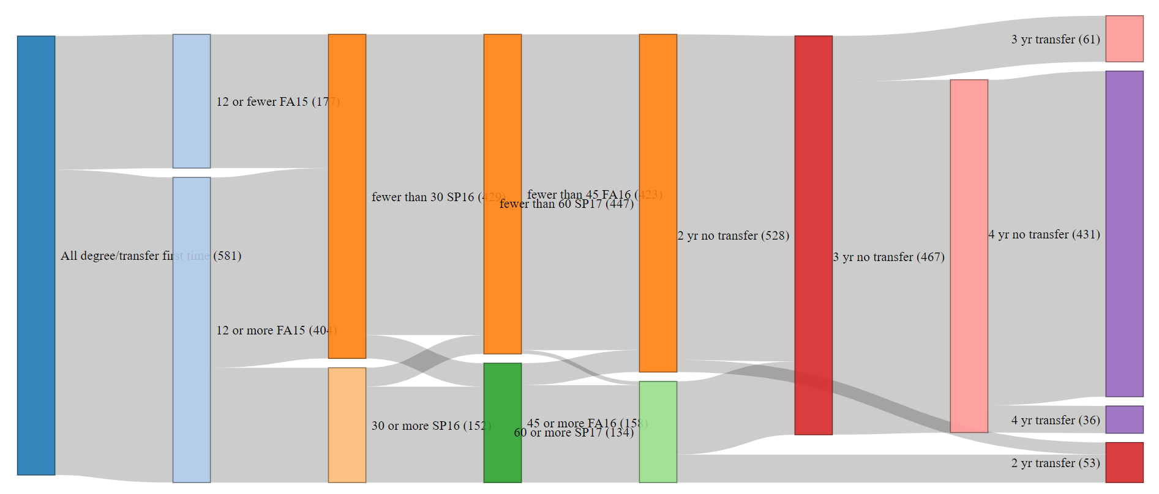
Transfer journey of Fall 2015 first-time cohort

Slide 62
Summary of Student Completion
Cañada is not fulfilling its mission of “ensuring that all students have equitable opportunities to achieve their transfer, career education, and lifelong learning educational goals.”
Hispanic, low income and first generation college students are less likely to transfer than we would expect

Slide 63


Slide 64


Slide 65
Why are these trends happening?
Internal factors
External factors
Our size?
Our location?
Our schedule?
Our choices of instructional modality?
Do students feel sufficiently connected to and supported by the campus? Even online?
It’s really expensive to live here and students work many hours
Students have other obligations beyond working that get in the way of taking more classes (family, care-giving, etc)

Slide 66

Why are these trends happening?
COVID-19 and the increase in online offerings District-wide
  Pre-pandemic, CAN could boost enrollment by putting courses online and tapping SKY and CSM students
Changing student preferences
  Desire for a mix of in-person and online modalities to help manage their work/school/life balance
  SWIRL is more possible
Economic realities: Cañada students (especially part-time students) are working longer hours for pay

Slide 67
Sometimes our challenges are also our strengths
CHALLENGES
STRENGTHS
Small size – can’t offer as many courses and programs
Location – hard to get to
We might not offer enough sections of critical courses to offer them in multiple modalities each term
Small size – intimate, friendly
Location – beautiful campus
We can change our course schedule

Slide 68
Understanding our students’ journeys and shifting preferences

Slide 69
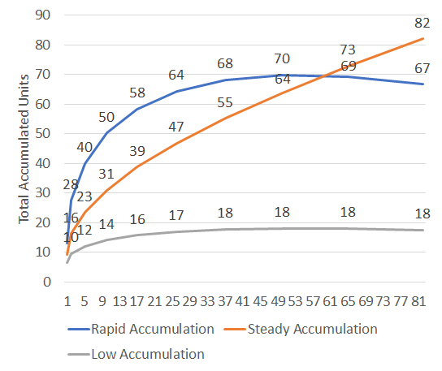
Unit Accumulation Groups in our Fall 2016 First-Time Cohort
Rapid Accumulation
  32% of the cohort
  Accumulating over 10 units per term
  2-3 years to completion
Steady Accumulation
  12% of the cohort
  Accumulating 7-9 units per term
  3-4 years to completion
Low Accumulation
  56% of the cohort
  Accumulating 0-5 units per term
  5+ years to completion

Slide 70
Unit Accumulation Group by Race/Ethnicity
 | Rapid |  | Steady |  | Low
AANAPI | 13% | 21 | 11% | 7 | 6% | 19
Hispanic | 52% | 85 | 61% | 38 | 80% | 237
White Non-Hispanic | 24% | 39 | 21% | 13 | 8% | 23
Black/Multi/Other | 12% | 19 | 6% | 4 | 6% | 17
Notes:
Students in the Rapid Accumulation were more likely to be…
White than Hispanic (11x)
Black or Multiracial than Hispanic (5x)
AANAPI than Hispanic (5x)
…than the low accumulation group

Slide 71
Unit Accumulation Group by Education Goal
Education Goal | Rapid |  | Steady |  | Low
Concurrently enrolled 4-year college student | 1% | 2 | 2% | 1 | 1% | 3
College Preparation |  |  | 3% | 2 | 1% | 2
CTE Cert/Career Development | 1% | 1 | 3% | 2 | 4% | 11
Degree/Transfer | 92% | 151 | 76% | 47 | 52% | 154
Exploratory | 6% | 10 | 16% | 10 | 43% | 126
Notes:
Students in the Rapid Accumulation Group are more likely to be…..
Degree or Transfer seeking (24x)
Ag 20 or younger when they start college (16x)
…than the Low Accumulation Group

Slide 72
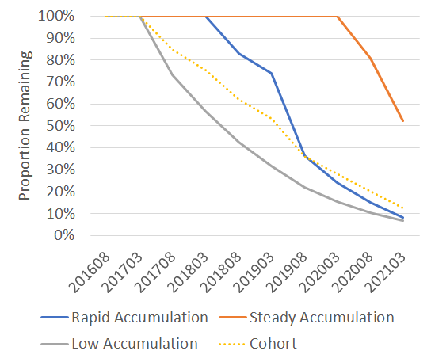
Attrition by Group
The Low Accumulation group show attrition starting in the next primary term.
The Rapid Accumulation group shows attrition after the second year.
The Steady Accumulation group doesn’t show attrition until after the 4th year
After 2 years: | 60% remain
After 3 years: | 20% remain
After 5 years: | 0% obtain a degree or transfer
After 2 years: | 14% obtain a degree or transfer 80% remain
After 3 years: | 46% obtain a degree or transfer 40% remain
After 4 years: | 56% obtain a degree or transfer 15% remain
After 5 years: | 37% obtain a degree or transfer 52% remain

Slide 73


Group Demographic Predictors
Rapid
Low
Students in the Rapid Accumulation Group are more likely to be…..
  Degree or Transfer seeking (24x)
  Ag 20 or younger when they start college (16x)
  White than Hispanic (11x)
  Black or Multiracial than Hispanic (5x)
  AANAPI than Hispanic (5x)
…than the Low Accumulation Group
Notes:
Students in the Rapid Accumulation Group are more likely to be…..
Degree or Transfer seeking (24x)
Ag 20 or younger when they start college (16x)
White than Hispanic (11x)
Black or Multiracial than Hispanic (5x)
AANAPI than Hispanic (5x)
…than the Low Accumulation Group
There are no significant demographic differences betweem the Rapid and Steady Accumulation Groups

Slide 74

Group Demographic Predictors
Steady
Low
Students in the Steady Accumulation Group are…..
  7.3 times more likely to be White than Hispanic
…than the Low Accumulation Group

Slide 75
Breakout Group Discussion

Slide 76
Breakout Group Discussion Prompts
Many degree and transfer-seeking students attempt and earn a very low number of units during their first term. How can we better understand the experience of these part-time students during their first semester?
Are there strategies we are currently pursuing as a college that could better support part-time students? (e.g., Interest Area Success Teams, expanding the College for Working Adults, others?)
What else would you like to know as we consider which strategies might be most impactful for the low unit accumulation (part-time) group? The steady accumulation (part-time) group?
What strategies might be good to help increase or maintain full-time student numbers?
Is there a different interpretation of any of the data presented in today’s slide? Other lines of inquiry you would like to pursue?

Slide 77
Internal Scan Part III
Prepared for the Educational Master Planning Task Force
November 17, 2021
Office of Planning, Research & Institutional Effectiveness

Slide 78
Topics
Supporting part time students
Student preferences and concerns
Can students get the classes they need?
What are we optimizing for?

Slide 79

Supporting Part Time Students

Slide 80
There are 3 part-time students for every one full-time student at CAN
Overall CAN primary campus students by units attempted per term

Slide 81
Part-time students are not necessarily less successful
Overall course success rates Fall 2016 by unit load

Slide 82
Unit Accumulation Groups for Cañada’s
Fall 2016 First-Time Cohort
Rapid Accumulation
  32% of the cohort
  Accumulating over 10 units per term
  2-3 years to completion
Steady Accumulation
  12% of the cohort
  Accumulating 7-9 units per term
  3-4 years to completion
Low Accumulation
  56% of the cohort
  Accumulating 0-5 units per term
  5+ years to completion

Slide 83
The cohorts start out similarly
Notes:
This really could be a remedial math and English issue….since this is a Fall 2016 cohort

Slide 84
Sustaining course success is key

Slide 85
Special Programs’ Unit Requirements
Special Program | Full Time Requirement?
Promise Scholars Program | YES
EOPS | YES
TRIO SSS | NO
International | YES
Athletics | YES
College for Working Adults | NO
Umoja | NO
Puente | NO

Slide 86
Director of Student Support
Special Programs
Promise
EOPS
ESL
TRIO SSS
CWA
ECE
International
Puente
ESO Adelante
Athletics
Arts, Design & Performance
Retention Specialist
Business
Retention Specialist
Human Behavior & Culture
Retention Specialist
Science & Health
Retention Specialist
Student Support
Community of Practice
to align services and create consistency
Peer Mentor
Peer Mentor
Peer Mentor
Peer Mentor
Peer Mentor
Peer Mentor

Slide 87

Student Preferences and Concerns

Slide 88
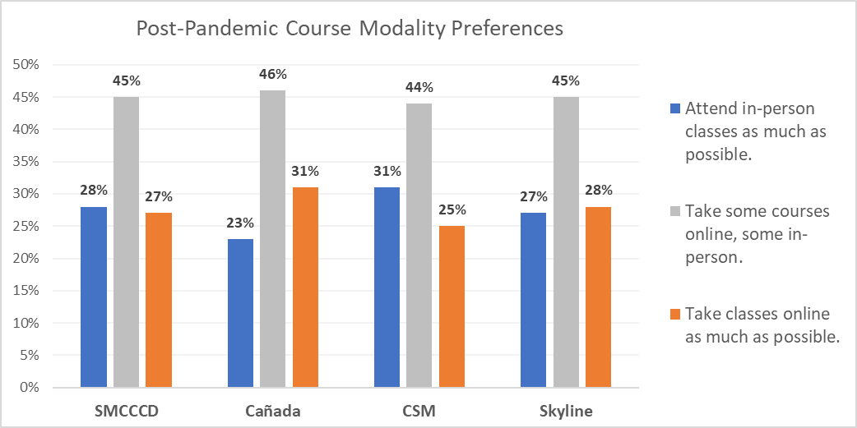
Students’ post-COVID course modality preferences are split between on-line and in person
Q: In the future, once the pandemic is behind us, which most accurately describes your preference for how to attend college?
Source: Email survey sent to all students enrolled at SMCCCD in May, 2021.
Notes:
Differences between Canada and CSM are statistically significant (p<.05)

Slide 89
Districtwide student preferences for instructional modalities – post pandemic
Source: April-May 2021 survey of enrolled students (via email)
Notes:
So

Slide 90
Top reasons students gave for stopping out during the pandemic:
Prioritizing working for pay
Preferring not to enroll in online classes
Taking classes at another college (online)
Prioritizing the care of children and other family members

Slide 91
Top 3 things our colleges could do to support the return of stopped out students:
More scheduling options: getting the courses they want when they want them
Financial support
Help choosing courses and programs

Slide 92
2 of every 3 students are working for pay
Source: NACCC survey of all non-K12 students enrolled at CAN in Spring 2021 (not just home campus students.

Slide 93
Part-time students more likely to work full time
Source: NACCC survey of all non-K12 students enrolled at CAN in Spring 2021 (not just home campus students.

Slide 94
Part-time students far less likely to access services
All students
Of those using these services…
Source: NACCC survey of all non-K12 students enrolled at CAN in Spring 2021 (not just home campus students).

Slide 95
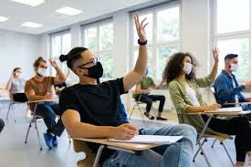
Can students get the classes they need when and where they need them?

Slide 96
Pre-pandemic class schedule
35
Most classes in Fall 2019 occurred between 9:00 a.m. and 1:00 p.m.
The campus is under-utilized for much of the day.
30
25
20
15
10
Monday
Tuesday
5
Wednesday
Thursday
Friday
0
12:00 1:00
Lunch
7:00
Dinner
8:00
9:00
10:00
11:00
2:00
3:00
4:00
5:00
6:00
8:00
9:00
10:00
Source: Fall 2019 Enrollment Data
Notes:
Per Steinberg & Hart analysis, Facilities Master Planning consultants for SMCCCD 2021-22

Slide 97
General Education Courses Offered by time block

Slide 98
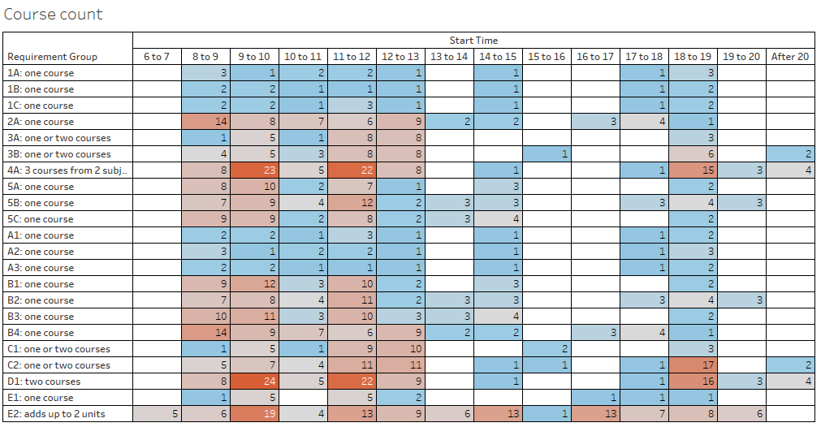
Data is for the 2018-19 and 2019-20 academic years

Slide 99
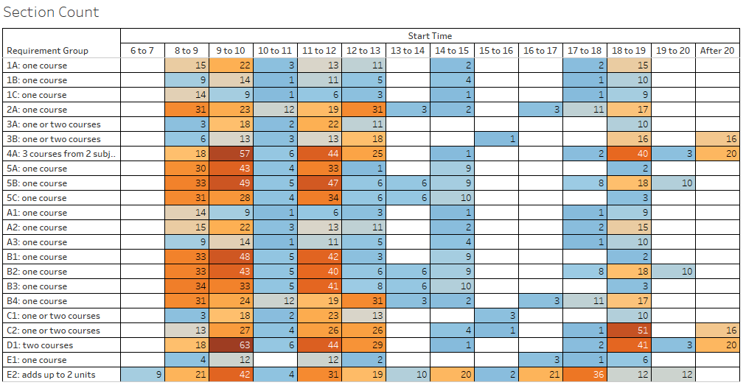
Data is for the 2018-19 and 2019-20 academic years

Slide 100
Fa18 | MWF |  |  | MW
Time | 3 Unit | 4 Unit | 5 Unit | 3 Unit | 4 Unit | 5 Unit
8:00 |  |  | Block 1
8:05
8:10 | Block 1 | Block 1 |  | Block 1 Count: 3 | Block 1 Count: 12 (6 off block) | Block 1 Count: 15 (14 off block)
8:15
8:20
8:25
8:30
8:35
8:40
8:45
8:50
8:55
9:00
9:05
9:10 | Block 2
9:15
9:20
9:25
9:30
9:35 |  |  | Block 2
9:40
9:45 |  | Block 2 |  | Block 2 Count: 22
9:50
9:55
10:00
10:05
10:10 | Block 3 |  |  |  | Block 2 Count: 2 (2 off block)
10:15
10:20
10:25
10:30
10:35
10:40
10:45
10:50
10:55
11:00
11:05
11:10 | Block 4 | Block 3 | Block 3 | Block 3 Count: 19 |  | Block 2 Count: 5 (2 off block)
11:15
11:20
11:25
11:30
11:35
11:40
11:45
11:50
11:55
12:00
12:05
12:10 | Block 5 |  |  |  | Block 3
12:15
12:20
12:25
12:30
12:35
12:40
12:45 |  | Block 4 | Block 4 | Block 4 Count: 10
12:50
12:55
13:00
13:05
13:10 | Block 6
13:15
13:20
13:25
13:30
13:35
13:40
13:45
13:50
13:55
14:00
14:05

Slide 101
Cañada home campus student enrollments: then and now

Slide 102
Cañada’s course sections tend to low enrollments

Slide 103
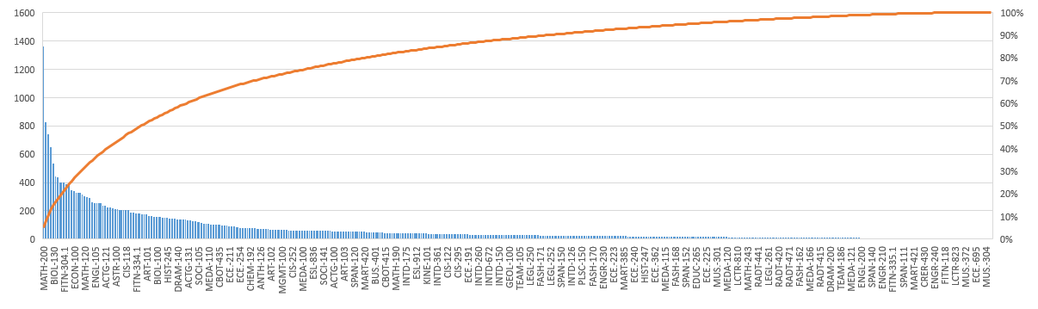
20% of courses saw 67% of enrollments in 2020-21

Slide 104
71% of courses are offered only 1-2 times per year

Slide 105
What are we optimizing for?
Making sure students can complete GE patterns and/or degree programs in a timely way?
Full time students may have more time and may be less impacted by limited offerings
Part time students have smaller windows of availability. If courses are always offered in the morning, or in person, or both, they may not be able to take them.

Slide 106
How do we help students get the courses they need?
  Ensuring at least one, on-line option of most of all of our core required courses is offered somewhere in the District?
  Same for GEs?
  Create co-horted time blocks?
    College for Working Adults (nights, online, weekends option) – with a strong sense of community
    Morning blocks with better scheduling to allow more than one class to be taken per day
    Build a sense of community around Interest Areas, pathways, at certain times?

Slide 107
Breakout Discussion Questions
What does “intentional scheduling” look like?
What does that mean for services and community?
How do we optimize the course schedule for student completion?
What kind of information should we share with Deans and faculty to help them plan their course schedules?
What kind of process would help adjust drafted class schedules?
What are the best ways we could collect more information from students about preferred scheduling options?

Slide 108
Appendix

Slide 109
We've noticed you have not re-enrolled at the San Mateo County Community Colleges (Cañada, CSM, or Skyline) during the COVID pandemic. Could you please share your reasons for not returning?
 | # of survey respondents
I had to prioritize my job/work | 196
I prefer not to enroll in online classes | 190
Other | 172
I am attending college elsewhere | 135
I needed to prioritize my care for children/family | 101
I am taking a break from school for now | 95
I needed to focus on my mental health/wellness | 81
I could not (and cannot) afford to attend right now | 81
I moved out of the area | 80
I needed to focus on my physical health/wellness | 55
I do not have a quite place to study | 47
I did not feel supported while I was enrolled | 40
My Wifi and internet access are unreliable | 29
I could not find a program | 27
Students were able to select as many or as few items as they liked. Five main themes of the “Other” responses were: They had completed course requirements/graduated/transferred, they were waiting to be in person, college processes had created an impediment to their re-enrolling, various life reasons, and a lack of classes that they were interested in.
Notes:
Source: SMCCCD PRIE Districtwide survey of students who had been enrolled at any point in 2019-20 but who had not re-enrolled at any point during the pandemic (through spring 2021)

Slide 110
If you had both face-to-face and online/virtual options for all of the classes you might want to take, what are the three biggest obstacles to your re-enrolling at the SMCCCD Colleges next fall?
 | # of survey respondents
I need to prioritize my job/work | 134
I moved out of the area | 100
Other | 86
The course(s) I need are not offered at the time(s) I need them | 79
I need to focus on my mental health/wellness | 66
I cannot find a program of study that interests me | 64
I need to prioritize my care for children/family | 55
I need to focus on my physical health/wellness | 52
I cannot afford to attend college right now | 51
Students were able to select up to three options, of those who indicated No or Not Sure to re-enrolling. The main themes for those that selected other were transferred/graduated/completed course requirements, they have switched schools, or they prefer in person instruction.

Slide 111
What are the top 3 things the San Mateo Colleges could do to support your return to college in the future?
 | # of survey respondents
More scheduling options: getting the courses I want when I want them | 328
Financial Support | 323
Help choosing courses programs etc. | 203
Personal counseling | 152
Help with registering for courses | 146
Other | 130
Transportation to/from campus | 88
Support with technology | 86
Support with accessing food and/or housing | 82
Support with childcare | 51
Students were able to select up to three options. Of those who selected Other, over half indicated None/Not applicable, a minority indicated a return to in person instruction, and finally more diverse course offerings.

