Slide 1
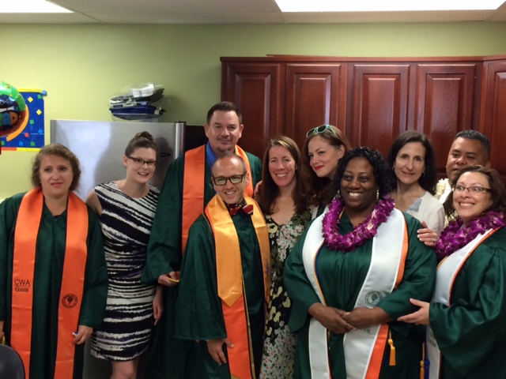
Cañada College
College for Working Adults

Slide 2
Contact Information
Cañada College
College for Working Adults
4200 Farm Hill Boulevard
Redwood City, CA 94061
(650) 306-3100
canadacwa@smccd.edu
www.canadacollege.edu/cwa
Jeri Eznekier
Project Director
Building 13, Room 106
(650) 306-3304
eznekierj@smccd.edu
Kristen Parks
Faculty Coordinator
Building 13, Room 106
(650) 381-3541
parksk@smccd.edu
Christopher Rico
CWA Counselor
Building 13, Room 106A
(650) 306-3455
ricoc@smccd.edu

Slide 3
CWA Enrollment Growth
Continued growth and demand for the program
Notes:
Some of you might remember that I was here in Dec 2011 when CWA was only 4 months old. At that time we came to this Board to show you the new innovative program we put together for working adults with the Measure G funds you provided to Cañada College.
At that time…
We offered only 2 degrees
We had only 26 students
We offered only 5 classes
You can see how much the program has grown over the past 4.5 years.
Why? Because although other colleges offer evening classes, students who work all day find it difficult to access all the courses they need for degree completion at night. As a result, if this program did not exist, these students would not otherwise be enrolled at any college at all.
Cañada is the only college on the Peninsula that offers a program designed so that evening students to earn a degree while working full time.
Having developed string partnerships with many government and non-profit agencies up and down the peninsula and in the east bay, a large number of CWA students enter the program as new Cañada students.

Slide 4
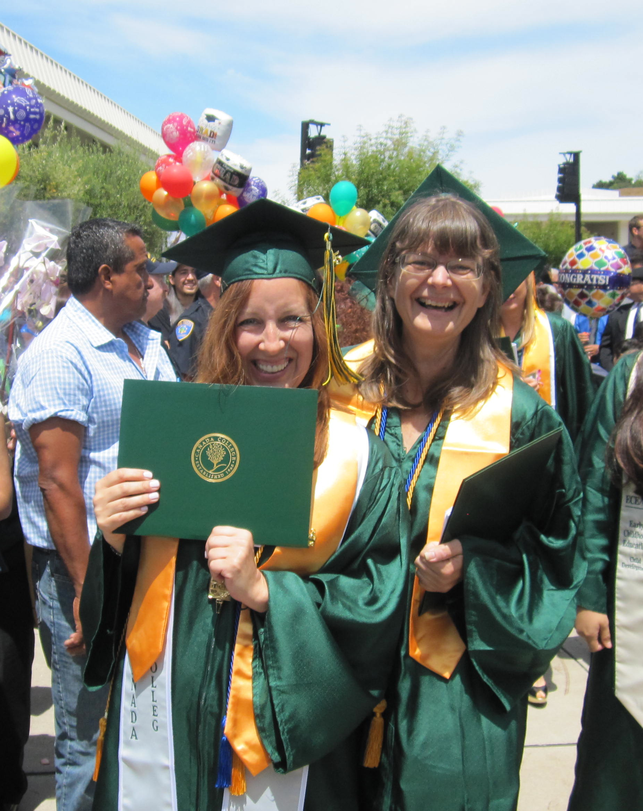




CWA Completion & Transfer
Academic Year | CWA Graduates | Degrees Awarded
2013-2014 | 11 | 21
2014-2015 | 26 | 50
2015-2016 | 43 | 86
Total | 80 | 157
Over 80% of CWA grads transfer to a four-year college or university!
Notes:
The CWA program also has a successful record of degree completion. At Cañada College course completion and transfer rates for Hispanic students are significantly below average. However, Hispanic students in the CWA program achieve better than average success and retention. Finally, the CWA transfer pathway makes it possible for nontraditional age groups to attain their transfer goals. Data show that Cañada College students in the 40-49 year old range experience disproportionate impact in transfer. Approximately half of CWA students are over the age of 40. Of the 176 AA degrees awarded in 2013-2014 and 2014-2015 in Psychology, Arts and Humanities and Social and Behavioral Sciences, 52 were earned by CWA students. Susana Benavidez just accepted to Stanford!

Slide 5
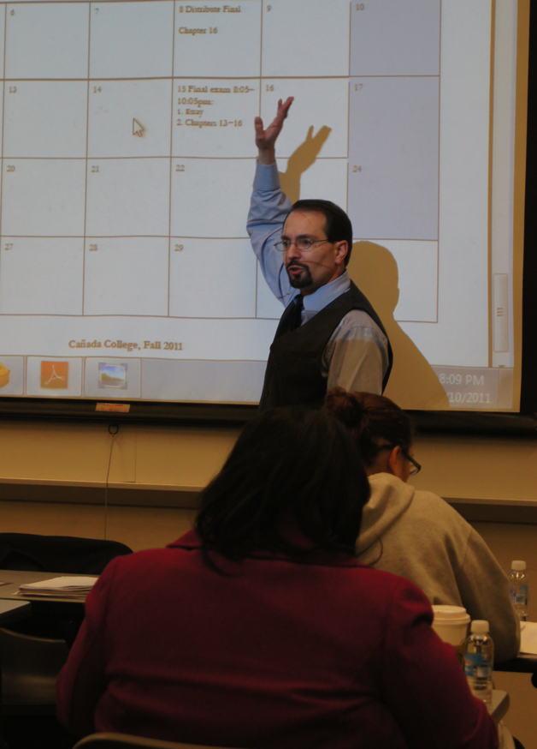
CWA Program Overview
Earn Three Associates Degrees
  Interdisciplinary Studies:
  Social & Behavioral Sciences
  2. Psychology
  3. Interdisciplinary Studies:
  Arts & Humanities
  4. Economics
Notes:
CWA degree path meets requirements for transfer to CSU (CSU general education requirements)
CWA degree path meets the IGETC curriculum (Lower division general education requirements)
Language Other than English Required for transfer to UC
Fast, reliable internet connection is critical to your success
Cañada College Learning Center and Library have free internet access:
Monday-Thursday: 8am-7pm
Friday: 8am-2pm
Saturday: 10am-2pm
Intersegmental General Education Transfer Curriculum = series of courses that community colleges students may complete to satisfy the lower division breadth/ general education requirement at both UC and the CSU
IGETC is not an admissions requirement. Completing it is not required, nor does it guarantee admission to the campus or program of choice. However, completing the lower-division breadth/general education requirements - through IGETC or the campus-specific requirements (depending upon the program) — may improve your chances for admission

Slide 6
CWA Program Overview
Designated curriculum
  Fulfills three degree requirements
  Fulfills all General Education Requirements
  Fulfills CSU transfer requirements
Class schedule for busy adults
  Guaranteed enrollment in all CWA classes
  Thursday evenings and eight Saturdays per term
  Hybrid classes to reduce classroom time
    Two hours classroom/one hour online component

Slide 7
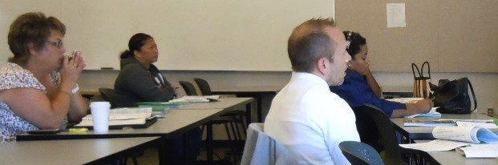
Participation in CWA has it’s advantages…
Predetermined curriculum
Priority registration
Dedicated counseling support
Learning community
Consistent schedule from semester to semester

Slide 8
Careers
Interdisciplinary-Social Behavior Science
Social Worker
Teaching/Education
Law/Government Jobs
Healthcare Administration
Marketing/Media/Communications
Psychology
Counseling
Personal/Family Counseling
Elementary/Secondary/Post Secondary
Criminal Justice-Correctional/Probation Officer
Social and Community Service
Court Arbitration/Mediation
Interdisciplinary-Arts & Humanities
Elementary/Secondary Education
Advertising
Event Coordinator
Travel Agent
Museum Worker/Curator
Economics
General Business
Accounting/Financial Analyst/CPA
Project Management
Human Resources/Compensation
Investment Advisor

Slide 9
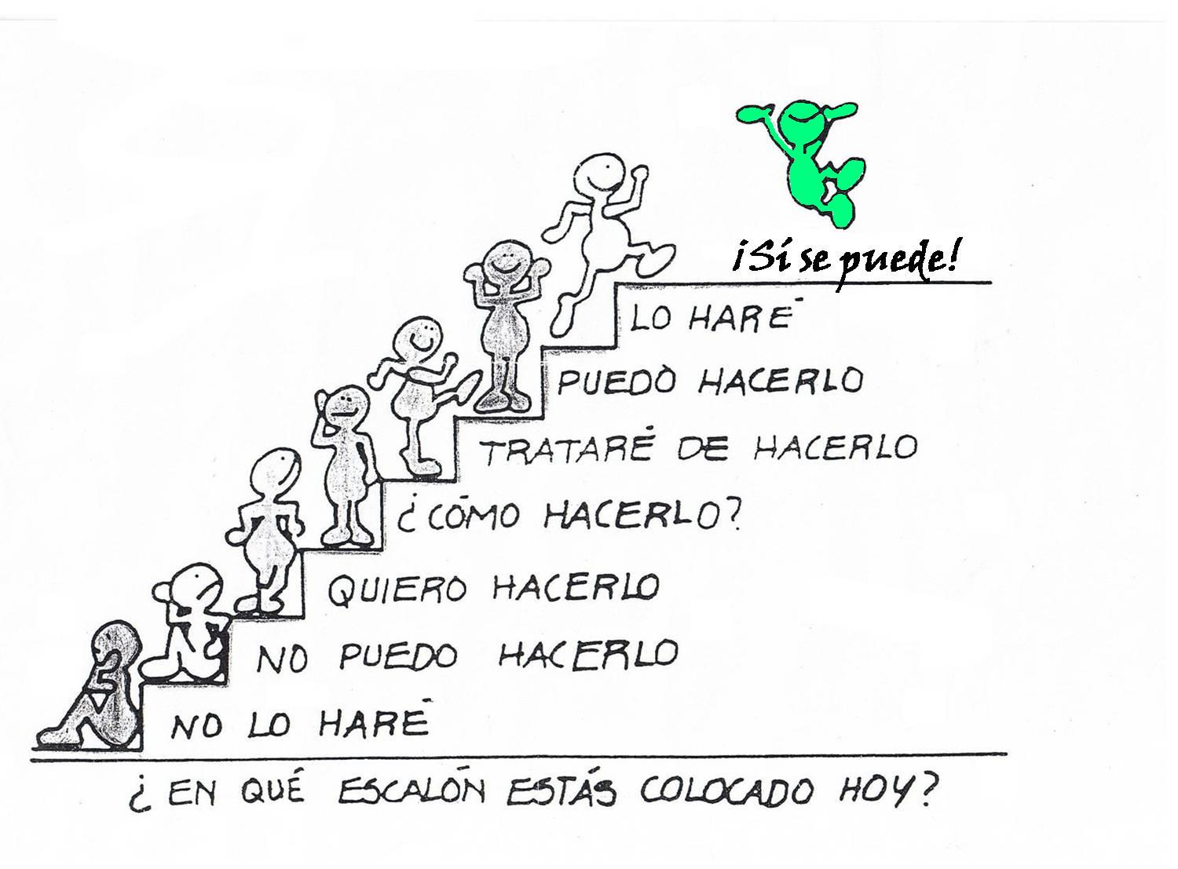
Motivation

