Slide 1
Cañada College Counseling

Slide 2
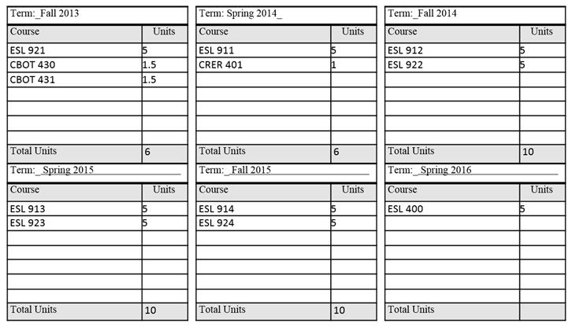

Student Educational Plan
Begin taking CWA classes while completing ESL 400. NOTE: ESL 400 is not a guaranteed class or part of CWA. You will enroll into that separately. Early registration for ESL 400 encouraged.
Apply for CWA program in Level 4 of ESL classes to begin CWA classes the following semester.

Slide 3
Associate Degree
Requirements are the core units and the Associate Degree General Education Requirements, which demonstrate your ability to think and to communicate effectively, and cover mathematics, arts, humanity and science. You can see these requirements on page 78 and 79 of the college catalog.
Associate General Education Requirements
Core
Courses
60 Degree applicable units

Slide 4
Student Educational Plan
SEP
To schedule an appointment to see a counselor, please contact the Welcome Desk 650-306-3452

