Slide 1
Training and Professional Development
The ESL Department and
Learning Center

Slide 2
Training & Professional Development
Mission of The ESL Program
Work of SLAMmers
ESL Pathway (Awards and Certificate)
Off-Campus ESL Sites
Upcoming Events

Slide 3
Mission of the ESL Program
ESL Department On-Campus
The ESL Department provides English as a Second Language instruction and classes to non-native speakers of English in order to prepare students for entry into occupational programs or university transfer courses. The Mission of the ESL Department at Cañada College is to prepare students from around the world to reach their academic, vocational and personal goals.
Community Based English Tutoring (CBET) Program Off-Campus
The CBET program is housed under the ESL Department at Canada College. The program offers beginning level of English as a Second Language (ESL) classes and computer skill classes. The Community Based classes serve as a bridge to on-campus academic and career programs. Upon completing the program, students receive the English for the Workforce EFW Award. This program has been made possible in part by a grant from Silicon Valley Community Foundation.

Slide 4
Work of SLAMmers
ESL Student Learning Assistant Mentors (SLAMmers) have two important parts to their work.
One part of the work of ESL SLAMmers is to work closely with the ESL faculty members to support off-campus, low-level ESL students academically to learn the curriculum in the courses.
The other part of the work of ESL SLAMmers is to mentor the ESL students in off-campus classes by providing role models of successful college students.
The ESL SLAMmer project is funded by a grant from a private foundation.

Slide 5
English for The Workforce EFW Award
Off-Campus
ESL 800
(5 units)
LEVEL 1
ESL921
(5units)
ESL911
(5 units)
CBOT 415/417/
430
EFW Award
LEVEL 2
ESL922
(5 units)
ESL912 (5 units)
CBOT 415/417/
430
EFW Award
ESL 921 Grammar &Writing 1
ESL 911 Read & Listen/Speak1
CBOT 415 or CBOT 417
CBOT 430
Awards are presented to students at the ESL Department Recognition Ceremony in May.
Students transition to campus to continue ESL Levels 2, 3, and 4.

Slide 6
Academic Command of English ACE Award
Jan/Aug
Word Jam Math Jam ESL 805 ESL 836
LEVEL 3
ESL913
(5units)
ESL923
(5 units)
Math Jam Math 811
LEVEL 4
ESL914
(5 units)
ESL924
(5 units)
Math 110 CRER
ACE Award
ESL 924 Grammar &Writing 4
ESL 914 Reading and Listening/Speaking 4
ACE Awards are presented to students at the ESL Department Recognition Ceremony in May.

Slide 7
Preparation for Academic Scholarship and Success (PASS) Certificate of Achievement
Jan/Aug
Word Jam Math Jam
CBOT
ESL 400 (5units)
LIBR 100
(1 unit)
+
selectives
English 100
PASS Certificate
+
selectives
This is a State-recognized Certificate of Achievement.
Students must complete the petition with a counselor, and turn in the petition before the deadline.
Students can participate in Commencement in May.

Slide 8
Off-Campus Sites
What cities does the program serve?
The program serves the cities of Redwood City, East Palo Alto, Half Moon Bay, and Pescadero .
When are courses offered?
We offer the courses in the evenings during the week at all locations except for two locations in Redwood City, where we offer one morning class every semester.
English for the Workforce EFW Award:
Students in the program usually study two to four semesters at our off-campus sites and then transition to campus to continue studying ESL and other courses and careers.
Who is eligible for the program?
The program is designed to serve parents and community members of South San Mateo County. In Redwood City, students at CBET sites pledge to tutor school age children once their English is proficient. All participants must be at least 18 years old and meet California residency and financial aid requirements for free tuition to enroll in the courses. Half Moon Bay, Sequoia Adult School, and East Palo Alto courses are open to any parent or community member who qualifies.

Slide 9
Locations in Redwood City
The program offers courses in the following locations in Redwood City:
Hawes Elementary School
Hoover Elementary School
Taft Elementary School
Fair Oaks Elementary School
Sequoia District Adult School
The elementary schools are managed by the Redwood City School District. The ESL Program has a partnership with Sequoia District Adult School.

Slide 10
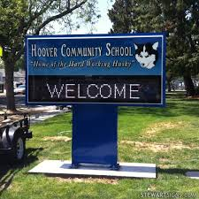
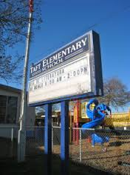
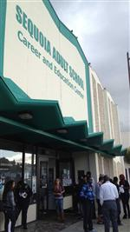
< Hoover School
^Taft School
<Sequoia Adult School

Slide 11
Courses Offered in Redwood City
Hawes School
ESL 800 (1^{st class)} Beginning Level ESL
Mon/Wed 6:30-9:00 p.m.
Professor: Julie Carey
SLAMmer: Yahosca Quezada
ESL 921 (2^{nd class)} High Beginning Grammar/Writing 1
Mon/Wed 6:30-9:00 p.m.
Professor: Alessandra Castello
SLAMmer: Vianey Alarcon
ESL 911 (3^{rd class)} High Beginning Reading/Listening and Speaking1
Not offered Spring 2016
Hoover School
ESL 800 (1^{st class)} Beginning Level ESL
Mon/Wed 6:30-9:00 p.m.
Professor: Beth Enthoven
SLAMmer: Maria Delgado
ESL 921 (2^{nd class)} High Beginning Grammar/Writing 1
Mon/Wed 6:30-9:00 p.m.
Professor: Natalia Ades
SLAMmer: Leslie Herrera
ESL 911 (3^{rd class)} High Beginning Reading/Listening and Speaking1
Mon/Wed 6:30-9:00 p.m.
Professor: Jeanne Gross
SLAMmer: Katherine Ramirez Perez

Slide 12
Courses Offered in Redwood City
Fair Oaks School
ESL 911 (3rd ^{class)} Reading and Listening/Speaking 1
Mon/Wed 9:00-11:20 a.m.
Professor: Rebekah Taveau
SLAMmer: Elizabeth Sosa-Cornelio
Sequoia District Adult School
ESL 921 (2^{nd class)} High Beginning Grammar/Writing 1
Tues/Thurs 6:30-9:00 p.m.
Not offered Spring 2016
ESL 921 (2^{nd class)} High Beginning Grammar/Writing 1
April 11-May 26
Mon/Tues/Wed/Thurs 9:00 -11:45 a.m.
Professor: Vassei, Nooshin
SLAMmer: TBD

Slide 13
Locations in East Palo Alto
The program offers one course in the following location in East Palo Alto:
Los Robles Magnet Academy partnership with Nuestra Casa
2450 Ralmar Ave. East Palo Alto, CA 94303
No classes this Spring 2016
Los Robles Magnet Academy is managed by Ravenswood School District and is in partnership with Nuestra Casa a Non Profit Organization

Slide 14
Locations in Half Moon Bay and Pescadero
The program offers courses at Cunha Intermediate Middle School located in Half Moon Bay and at Puente De La Costa Sur, located in Pescadero:
Cunha Intermediate Middle School
600 Church Street, Half Moon Bay, CA 94019
Puente De La Costa Sur
620 North Street, Pescadero, CA 94060
Cunha Intermediate Middle School is managed by Cabrillo Unified School District and is in partnership with our New La Costa Adult School and Puente De La Costa Sur.

Slide 15
Courses Offered in H.M.B. & Pescadero
Cunha Intermediate Middle School
ESL 800 (1^{st class)} Beginning Level ESL
Mon/Wed 6:30-9:00 p.m.
Professor: Ann Cartier
SLAMmer: Sydney Ramos
ESL 911 (3^{rd class)} High Beginning Reading/Listening and Speaking1
Mon/Wed 6:30-9:45 p.m.
Professor: Pelletier, Danielle
SLAMmer: None
Puente De La Costa Sur
ESL 901, Language Skills for the Workforce I
Tues/Thurs 7:10-9:00 p.m.
Professor: Gerardo Pacheco
SLAMmer: None

Slide 16
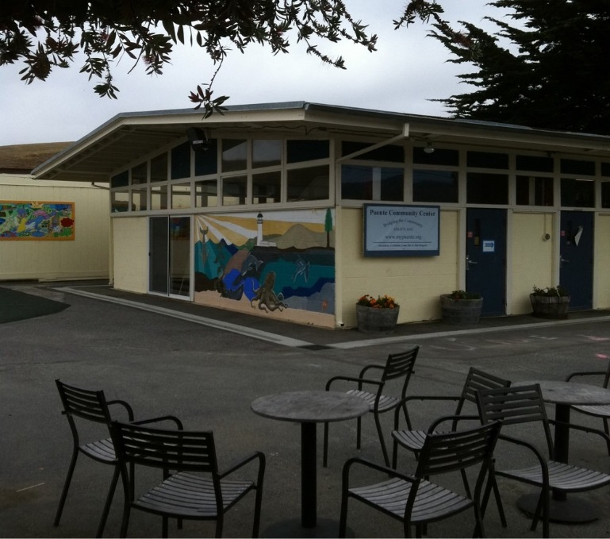
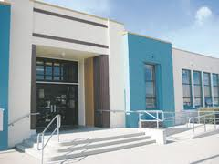
<Puente De La Costa Sur
< Cunha School

Slide 17
Rules for Sites
Classrooms: All classrooms are opened and closed by the site custodian. Classrooms must be kept exactly the way that they are when class starts. Students/Faculty cannot borrow anything from classrooms or use anything inside students(elementary students) desks. No eating or drinking in the classrooms.
Restrooms: At Hoover site students and staff must use the restrooms located at the very end of the hallway near classroom wing 700. There is a sign that is labeled, “parent restrooms.” At our other sites you are allowed to use any restrooms that are open.
Emergencies: In case of any emergency call 911. Notify Jenny Castello or Diana Espinoza immediately by calling our cell phone numbers.
Attendance Forms: At Hoover site, faculty must take attendance every time their class meets. The attendance forms must be turned in to the Family Center office located at Hoover near classroom wing 700. Attendance forms are put in a manila folder and pushed underneath the office door.
Computer Lab: ESL faculty should contact the ESL office to use the computer labs at the sites. Arrangements for this must be done ahead of time with the ESL office. There is NO eating or drinking in the computer labs.

Slide 18
Program Childcare
Our childcare staff are all employees of the Redwood City School District. We only accept children from 3 years to 10 years. The childcare is only for the students’ children and it is free.
Hawes:
Room: 2, Dina Parada and Piedad Hernandez
Hoover:
Room: 105, Sandra Calderon and Carmen Chavez
Fair Oaks:
Room: Cafeteria, Leticia
Cunha School:
Managed by La Costa Adult School who also offers ESL classes at Cunha School.
Puente De La Costa Sur:
Managed by Puente directly.

Slide 19
Upcoming Events for ESL Students
Events:
CAREERS IN Technical Education (CTE), for on-campus ESL Students
Wednesday, March 16, 2016, 8:30-11:00 am (morning sessions)
Thursday, March 17, 2016, 7:00-9:30 pm (evening sessions)
College Information and ID Event for Puente Students
Thursday, March 17, 2016, 6:00-7:00 pm
College Information and ID Event for Sequoia Adult School Students
Monday April 18, 2016, 9:00-11:00 am
ESL Recognition Ceremony, Monday
May 16, 2016, 7:00-9:00 pm in the Main Theater

Slide 20
QUESTIONS?

