Slide 1

Library Resources for Your Courses
Videos, eBooks, and articles, oh my!

Slide 2
eBooks and Audiobooks
The “eBooks” tab on our webpage provides access to our e- and audiobooks.
(Using OneSearch works, but not as well)
We provide e- and audiobooks through:
EBSCO (which has the broadest range)
Gale (which focuses on reference material)
O’Reilly (which contains textbooks and focuses on business and tech)
We can also help students access these materials through Libby, but it’s part of the Peninsula Library System and they would need a public library card.
Notes:
Chris

Slide 3
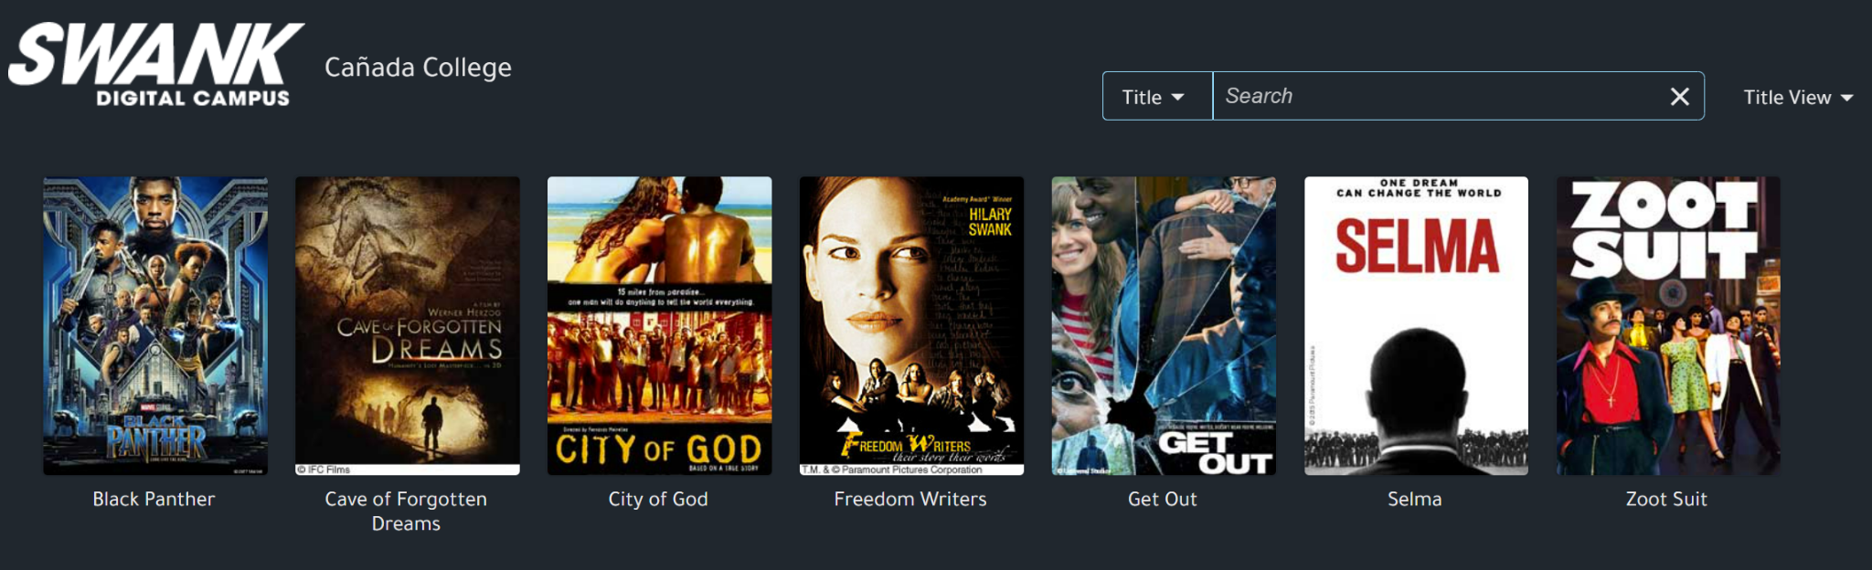
Streaming Videos
The “videos” tab on our webpage provides access to our streaming services
Films on Demand
  Great for television documentaries (HBO, PBS, Discovery+, etc.)
Kanopy
  Great for independant and international films and film/television documentaries
  Includes the Criterion Collection and Great Courses series
Swank
  This is great for Hollywood movies we can’t otherwise access
  We can license 25 titles per fiscal year – just ask!
Notes:
Chris

Slide 4
Streaming Videos
“I use Films on Demand and Kanopy with my Intermediate Spanish students, as they have to watch a movie and write about it for their final composition. I give them a list, and they choose one to watch.”
--Professor Harmon, Spanish
Notes:
Chris

Slide 5
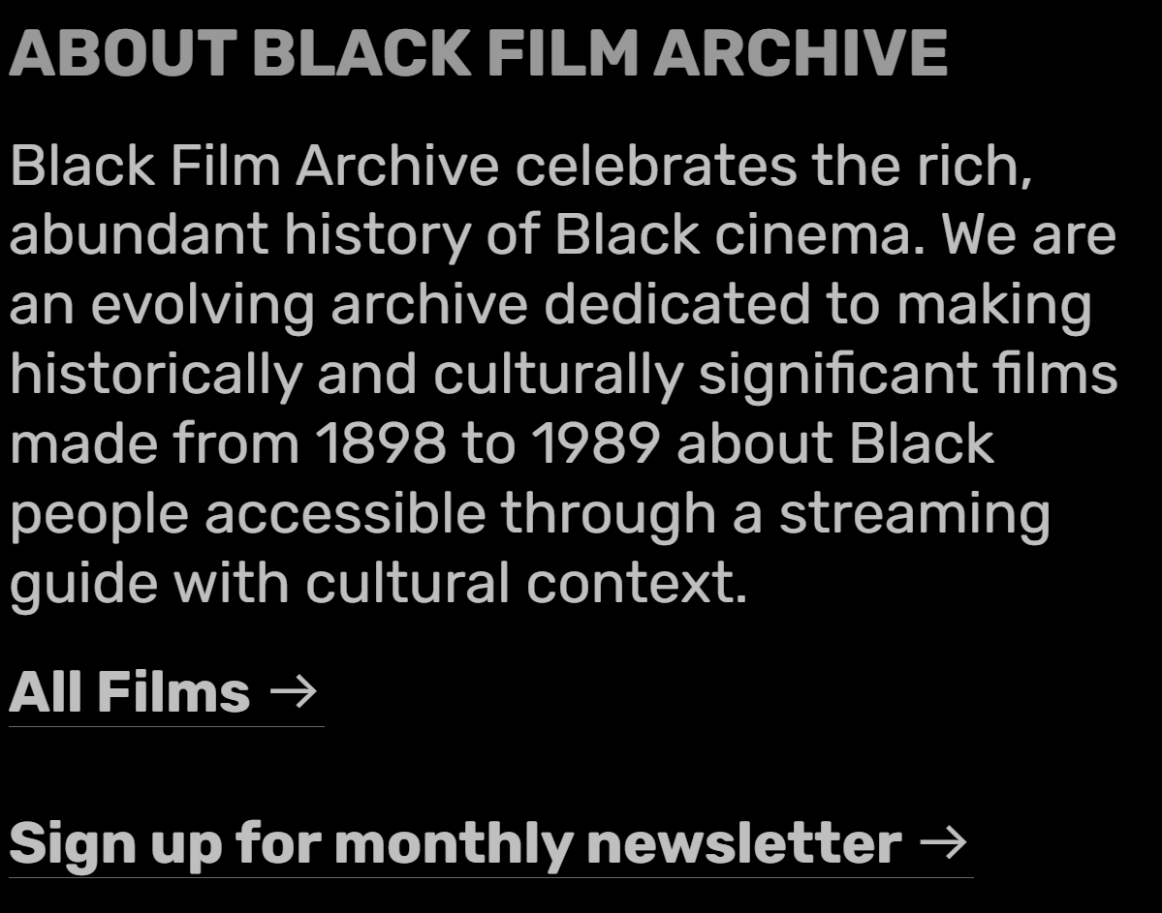
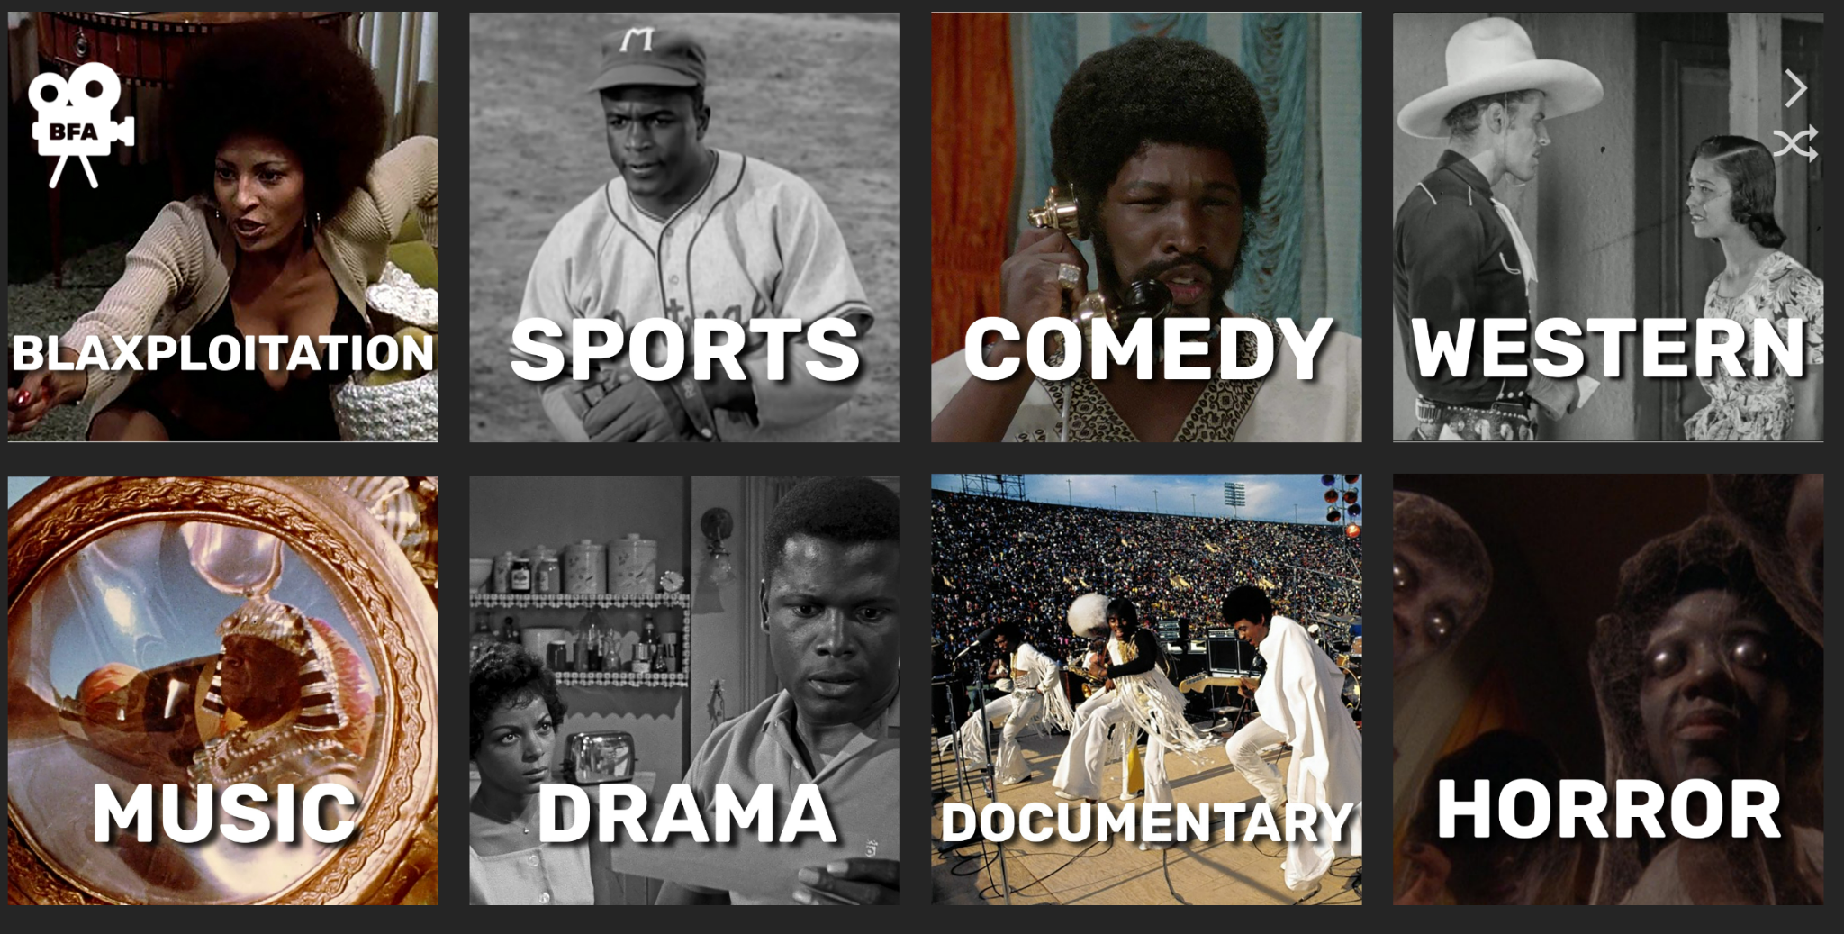
Streaming Videos
The “videos” tab on our webpage provides access to our streaming services
Ethnographic Videos Online
  Great for documentaries concerning human culture and behavior
Black Film Archive
  This is a free, publicly accessible archive of streaming Black films (currently spanning 1898 - 1989)
Notes:
Chris

Slide 6
Streaming Videos: Ted Talks
Prof Taveau (ESL 400 and ESL 914) uses Ted Talks, which can be great for students and classes.
Ted Talks are easy to find on YouTube of course. The main TED YouTube channel currently has more than 4,000 videos.
But the library offers Ted Talks through Films on Demand! Like on YouTube, it provides subtitles, transcripts, a search feature, and the ability to make and share clips. But Films on Demand also
Provides an easy, pre-set list of clips
Ensures that students have the correct video
Gives data a student will need for a Work Cited or Reference page
And doesn’t require a Google account or get into Google’s algorithms and rabbit holes
Notes:
Chris

Slide 7
Embedding Articles
“I use various library subscriptions in all of my classes, specifically articles from JSTOR and Academic Premier, for them to read. I put the Permalinks in the Canvas course shells.”
-Prof. Harmon, Spanish

Slide 8
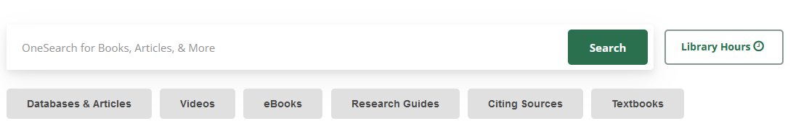
OneSearch
Like Google for library resources
Directs you to where to access these resources
Articles, eBooks, physical books, and more
Include open access resources

Slide 9
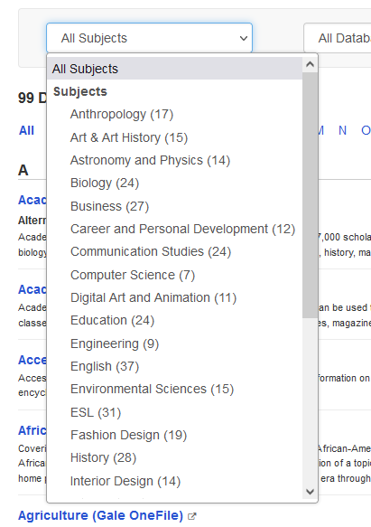
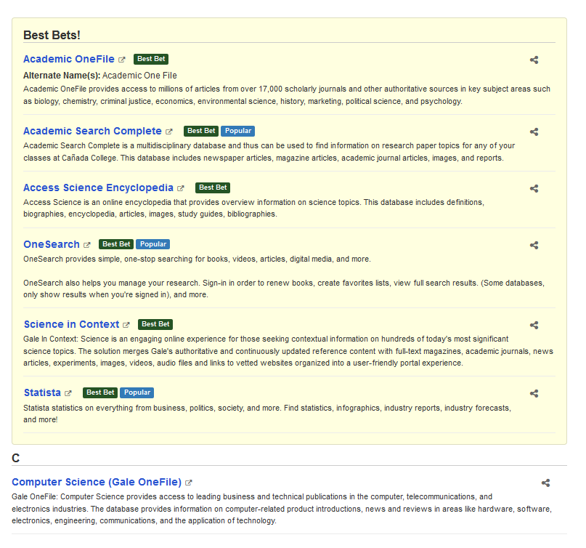
Browse Databases by Subject

Slide 10
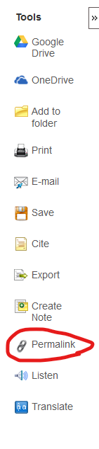
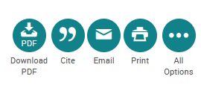

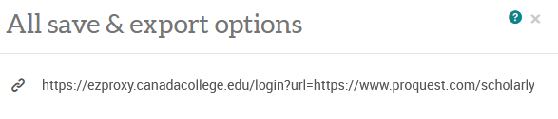
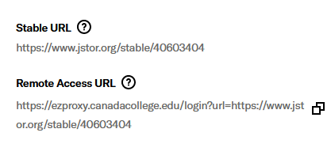
Get the Permalink
EBSCO
ProQuest
Gale
JSTOR
Notes:
Why need permalink
Licensing and fair use, these are only available to students and using the permalink makes sure we are within our licensing agreements.
Usage stats for libraries, if we know these resources are used more we can justify keeping them

Slide 11
New York Times and Wall Street Journal
From Prof. Taveau: We use the New York Times in ESL 400 and ESL 914
Free for all students and employees
Subscriptions last one year and can be renewed
Unfettered access to all articles
You can use the regular URL to share these

Slide 12
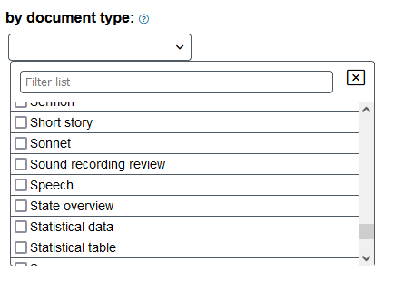
Literature Resource Center
Find short stories, poetry, plays, essays, and more!
Search by author (gender, ethnicity, nationality, literary movement, etc.), theme, title, and more.
Search by type of work.
Filter by document type.
Notes:
Diana

Slide 13
How do these relate to ZTC/Low Cost?
Free for your students!
With eBooks, to qualify as ZTC we need enough copies where access is not impeded by use.
Share the permalink!
Notes:
Diana

Slide 14
Questions about these free
(for students) resources?
Contact us!
Diana Tedone-Goldstone, Librarian
tedoned@smccd.edu
Chris Burns, Librarian
burnsc@smccd.edu

