Slide 1

Guided Pathways & SEM: Everything you ever wanted to know and more!
Presented by: Char Perlas
March 27, 2019

Slide 2
Guided Pathways & SEM Goals
Guided Pathways
SEM
Design for all students – Full-time/Part-Time, Skill Builders, Lifelong Learners, Degree/Cert/transfer seeking, varied programs: CE, Social Science, Liberal Arts, STEM
Data Driven – to inform planning, design, implementation and analysis
Coordination & Collaboration – pathway maps with integrated student supports, cross functional processes, scaling of existing pathways
Establish Comprehensive Enrollment Goals – number and types of students needed to accomplish mission
Promote Institutional Success – access, transition, persistence, and graduation (completion) through effective data driven strategic and financial planning
Strengthen Internal and External Communications – strategic marketing
Increase Campus Collaboration – among programs to accomplish mission

Slide 3
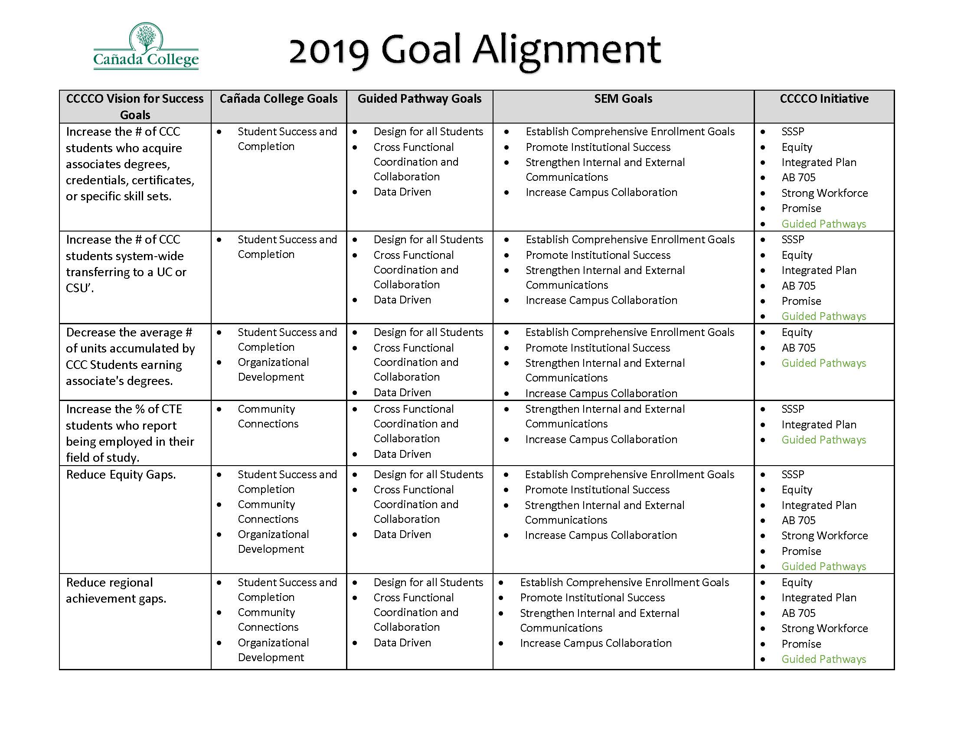

Slide 4
Highlights of GP Progress To-Date
Utilization of Student Voices data to drive Guided Pathway discussions and decisions
Compiled list of current classes specifying when each class is offered (FA, SP, SU)
Engaged in Guided Pathways Flex Day mapping activities which have produced the framework for establishing ‘meta-majors’
Identified closely associated or overlapping degrees & certificates

Slide 5
Highlights of GP Progress To-Date
Drafted guiding principles which emphasizes equity considerations as pathway maps are developed
Engaged in visioning exercises to establish pathway goals
Offered and continue to offer campus-wide Center for Innovation and Excellence in Teaching and Learning CIETL sessions relating to Guided Pathways mapping
Conducting usability study to gather additional information on the student onboarding process
Completing inquiry phase and preparing to scale (FA19)

Slide 6
Guided Pathways – QFE Action Items
Complete-ability
Increased accuracy of Student Education Plans which can inform course scheduling
Grouping degree programs into ‘Interest Areas’ or ‘Meta Majors’
Optimization of the class schedule to avoid class cancelations and conflicts
Alignment of support services with interest areas
Implementation/expansion of various high school engagement strategies: Dual Enrollment, Summer Programs, Outreach Events, etc…
Modification of the current Priority Enrollment Program (PEP) to better serve incoming students

Slide 7
Guided Pathways – QFE Action Items cont….
Expansion of cohorts via learning communities
Expansion of Support (including Job Placement and Career assistance) and Instructional Programs
Identification of job placement data tool
Streamlining the application process
Providing the needed support for FAFSA completion
Development of a First Year Experience program
Development of Bridge Programs

Slide 8
2019 Guided Pathways Self-Assessment
Areas needing input:
The college works with high schools and other feeders to motivate and prepare students to enter college-level coursework in a program of study when they enroll in college.
Advisors and students are alerted when students are at risk of falling off their program plans and have policies and supports in place to intervene in ways that help students get back on track.
Assistance is provided to students who are unlikely to be accepted into limited-access programs, such as nursing or culinary arts, to redirect them to another more viable path to credentials and a career.

Slide 9
2019 Guided Pathways Self-Assessment
Faculty/programs assess whether students are mastering learning outcomes and building skills across each program, in both arts and sciences and career/technical programs.
The college helps students document their learning for employers and universities through portfolios and other means beyond transcripts.
The college assesses effectiveness of educational practice (e.g. using CCSSE or SENSE, etc.) and uses the results to create targeted professional development.

Slide 10
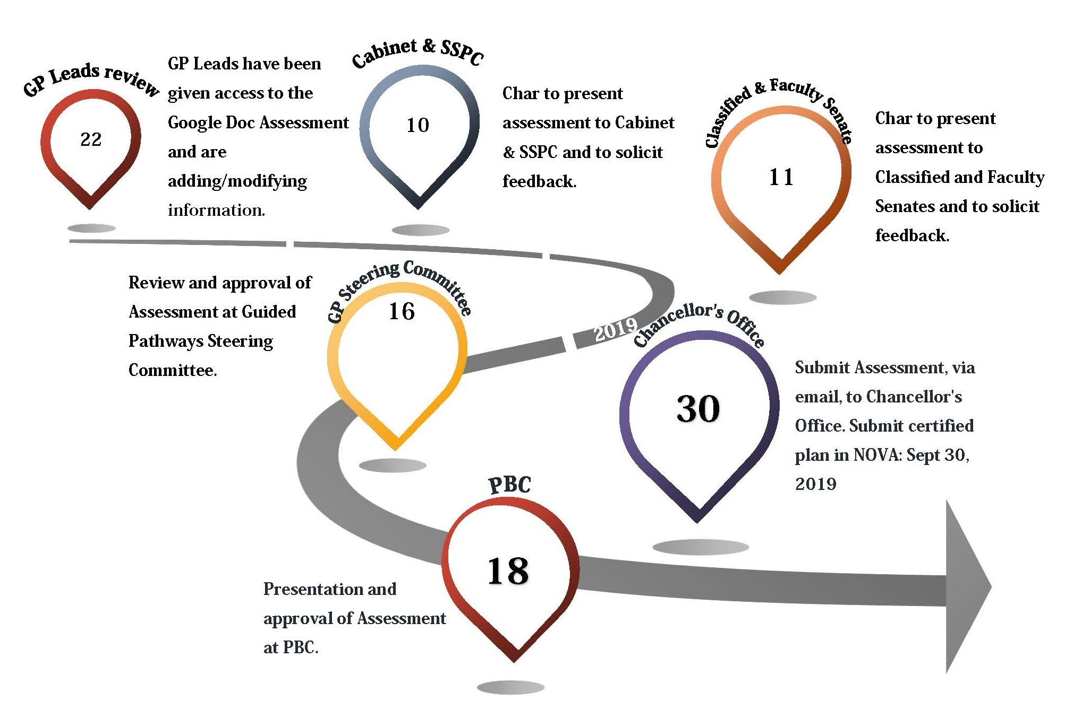

2019 GP Self-Assessment Timeline

