Slide 1

Developing Meta-Majors at Skyline College
Presented to Canada College’s Academic Senate
December 6, 2018

Slide 2
Quick Question:
What is the problem(s) that developing Meta-majors helps address?

Slide 3
Confronting Skyline’s Brutal Truths
16% of Skyline College students graduate in 3-years
Approximately 50% of students are completing in 6 years
Students are attempting approximately 100 units and completing 80 units
Approximately 50% of students persist from the first to second semester

Slide 4
What is a Meta-major?
A meta-major is a grouping of related fields of study designed to simplify the process of selecting a major.
A student facing piece.
Notes:
Jessica

Slide 5
Meta-Major Work Team Task:
To develop a proposal of Meta-majors and the degrees and certificates contained within them.

Slide 6
The Ground Work:
Degree/Certificate Sort #1:
October 12, 2016 – Skyline College Flex Day
Degree/Certificate Sort #2:
January 12, 2017 – Skyline College Flex Day
January 13, 2017 – Skyline College Flex Day
Reverse Sort & Preliminary Discussion of Design Principles:
February 10, 2017 – Joint Division Meeting
Finalization of Design Principles:
April 14, 2017 – Design Team Meeting
Preliminary Gauge of Meta-majors:
April 21, 2017 – Work Team & Design Team Meetings
Degree/Certificate Mapping #1:
May 19, 2017 – All Department Work Session (Degree & Certificate Sequencing)

Slide 7
Meta-Major Design Principles
Efficiency for Students
Focus on Student Perspective/Perception
Commonality of Community Contribution and Intellectual
Pursuit
Shared Ways of Knowing
Inclusion and Equity
Keep an Open Mind

Slide 8
Meta-Major Work Team Process:
Data Analysis & Emergent Groups
Design Principle: Efficiency for Students
The Degree/Certificate sequences generated by faculty were catalogued into a pivot table and analyzed using a social graph.
Results:
Meta-major groupings emerged based on shared courses
Four groups identified with some outliers

Slide 9
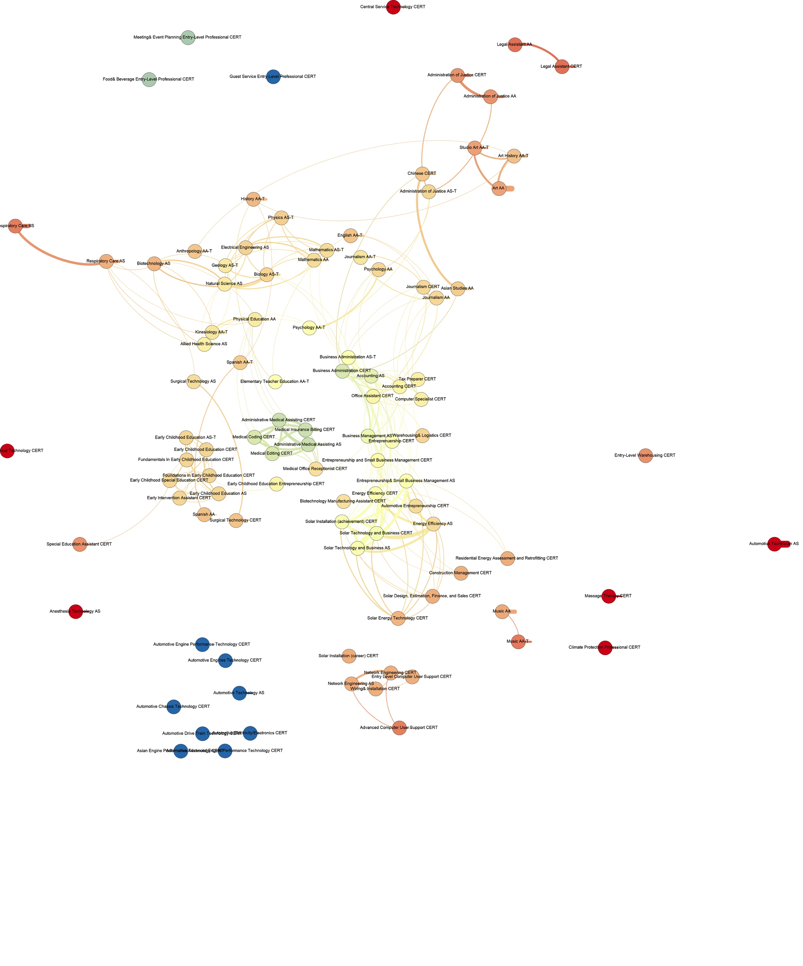

Slide 10
Meta-Major Work Team Process:
Data Analysis – Reconciling Outliers
Question:
How do we situate programs that do not share courses with other programs in ways that are obvious and intuitive for students who may be interested in those degrees?

Slide 11
Meta-Major Work Team Process:
Data Collection – Reconciling Outliers
Design Principle: Focus on Student Perspective/Perception
Process:
Polled students in Cosmetology, Massage Therapy and Automotive

Slide 12
Meta-Major Work Team Process:
Data Collection – Reconciling Outliers
Results of Student Focus Groups:
Cosmetology
Student split between classification as an Art (creativity) vs. Business
(entrepreneurship) and Science (Anatomy & Chemistry)
Massage Therapy
100% of students agree that Massage Therapy is affiliated
healthcare (many BIOL prerequisites and similar knowledge base)
Automotive
100% of students agree that AUTO is affiliated with Engineering
Sciences over Business Entrepreneurship

Slide 13
Science, Technology & Health
Biological Sciences
Technology & Engineering
Medical, Health & Wellness
Physical Sciences
Math
Kinesiology
Auto
Biology AS-T; Biotechnology AS; Biotechnology Manufacturing Assistant cert
Respiratory Care AS, BS; Surgical Technology AS, cert; Anesthesia Technology AS, cert; Allied Health Science AS; Emergency Medical Technician cert; Surgical Technology AS, cert; Central Services Technology cert; Massage Therapy cert; Medical Editing, Medical Office, Medical Coding, Medical Insurance
Kinesiology AA-T; Physical Education AA
Geology AS-T, Physics AS-T, Natural Science AS
Electrical Engineering AS; Network Engineering AS, cert; Advanced Computer User Support cert; Entry Level Computer User Support cert; Wiring & Installation cert; Energy Efficiency AS, cert; Solar Technology, and Business AS, cert; Residential Energy Efficiency cert; Solar Installation cert; Climate Protection Professional cert; Construction Management cert; Assessment and Retrofitting cert; Solar Design, Estimation, Finance, and Sales cert; Solar Energy Technology cert; Solar Installation cert, Engineering AS
Automotive Technology, Automotive Technology Technician, Automotive Technician Entry Level, Automotive Technology Advanced Engine Performance Tech, Automotive Technology Asian Engine Performance Tech, Automotive Technology Chassis Technology, Automotive Technology Drive Train Technology, Automotive Technology Electricity/Electronics, Automotive Technology Engine Performance, Automotive Technology Engines Technology
Mathematics AA, AS-T

Slide 14




Meta-Majors:
Arts, Languages, & Communication
Business, Entrepreneurship, & Management
Society & Education
Science, Technology, & Health

Slide 15
Meta-Majors (Student View)
Interest Areas in the Science, Technology & Health Meta-Major
Biological Sciences
Medical, Health & Wellness
Kinesiology
Physical Sciences
Technology & Engineering
Automotive
Math

Slide 16
Meta-Majors (Student View)
Ex: Biological Sciences
Transfer Degree:
Biology AS-T
Certificate:
Biotechnology Manufacturing Assistance Certificate
Local Degree:
Biotechnology AS

Slide 17
http://skylinecollege.edu/metamajors/

