Slide 1


Guided Pathways Steering Committee Meeting
Chase Fischerhall
Senior Director, Career Ladders Project
Sia Smith-Miyazaki
Senior Program Associate, Career Ladders Project
Jessica Hurless
Instructional Faculty, Skyline College
Cañada College
February 19, 2019

Slide 2
Meeting Agenda:
Gallery Walk (5 mins)
Norm Setting (5 mins)
Thought Questions (25 mins)
Examining the Vision (20 mins)
Next Steps (5 mins)

Slide 3
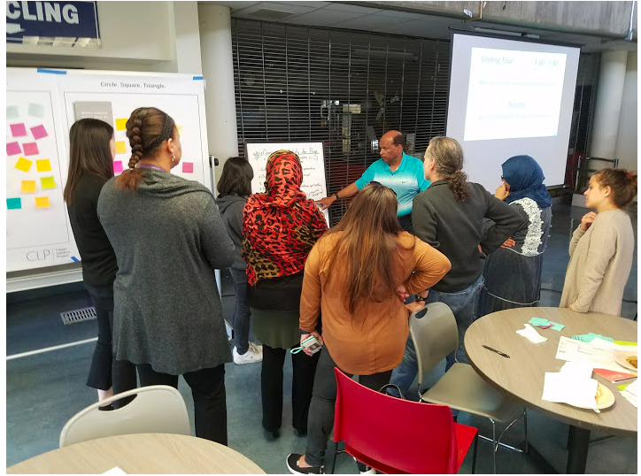
Gallery Walk
Take about 5 minutes to walk around the room and examine the flex day input and guiding principles documents.
Feel free to write down, on the post-its provided, any thoughts, reactions, or takeaway(s) you had for each poster.

Slide 4
Agreements/Norms

Slide 5
Thought Questions:
Please take a few minutes to read and respond to the questions on the worksheet.

Slide 6
Reflection Swap:
Please trade your written reflection with someone from a different work group.
Take 3 minutes to read the other person’s reflection.

Slide 7
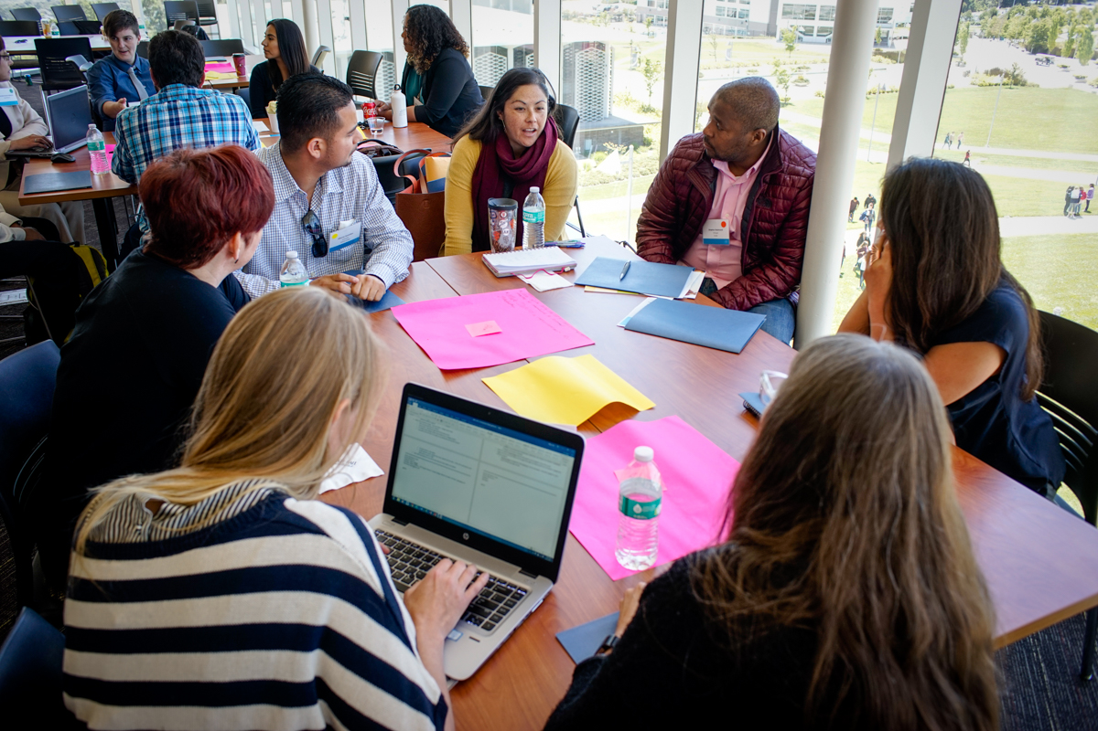
Discussion

Slide 8
Thought Questions:
What is Guided Pathways at Cañada College?
How do you define Guided Pathways?

Slide 9
Thought Questions:
What Cañada College student challenges have you identified that Guided Pathways will help minimize?

Slide 10
Thought Questions:
Two years from now, what will the Cañada College student experience look like?
In what ways will the Guided Pathways structure enhance this?

Slide 11
Planning Questions
What things could Cañada College do to make sure this effort fails?
How can we safeguard against these things?
(Structure, Process, Decision-Making, etc.)

Slide 12
Planning Questions
What is the underlying theme?
What are some common elements?

Slide 13

Homework:
Create an inventory of all the programs and/or projects happening at Cañada College.
Make sure to explain the goal(s) and resource(s) of the program/project.

