Slide 1

Guided Pathways
Key Performance Indicators
As of September 7, 2021
Prepared by the Office of Planning, Research & Institutional Effectiveness (PRIE)
For the Guided Pathways Steering Committee at Cañada College

Slide 2
Key Performance Indicators
Access: first time enrollments
Success: course success rates
Momentum: transfer level math and English completion in 1st year
Momentum: persistence
Momentum: unit completion
Completion: degree and certificate attainment

Slide 3
First Time Students at Cañada

Slide 4
Course Success Rate for First Time Students v. All Students

Slide 5
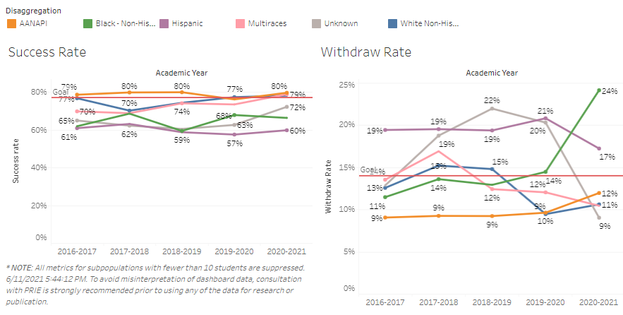
Course Success by Race/Ethnicity

Slide 6
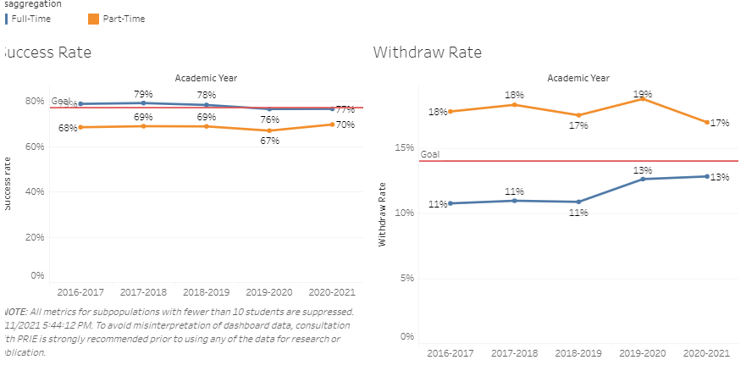
Course Success by FT/PT status

Slide 7
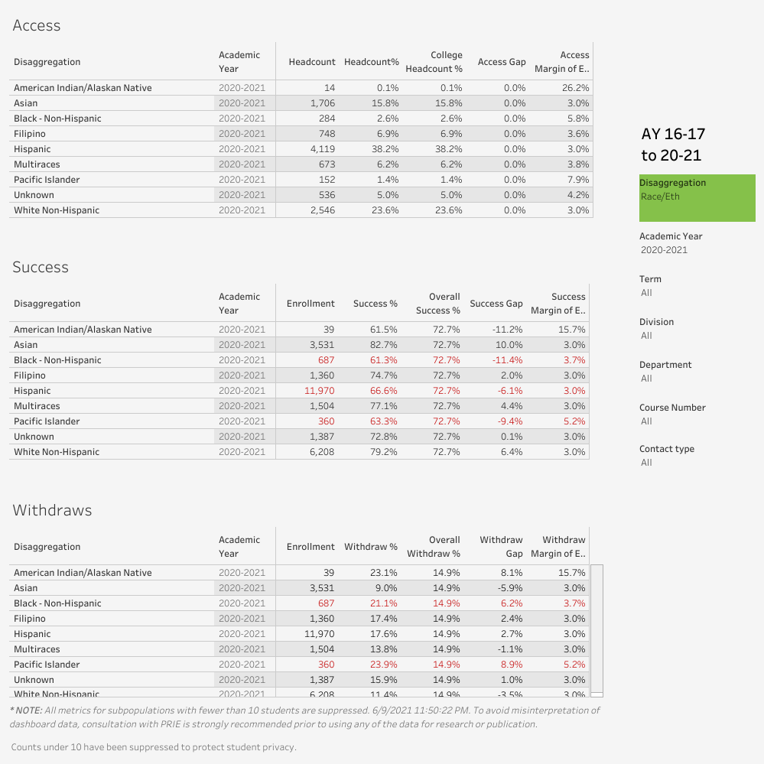

Slide 8
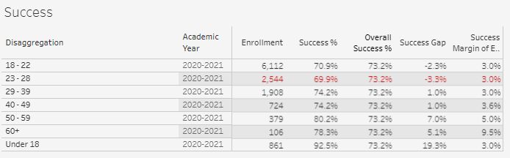
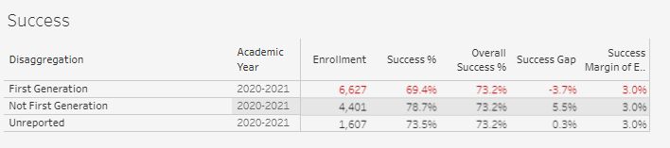

Slide 10
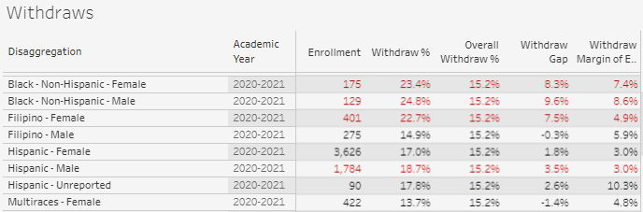

Slide 11
Completed both transfer-level math and English in the First Year

Slide 12
Completed transfer-level math in the First Year

Slide 13
Completed transfer-level English in the First Year

Slide 14
Persistence
 | Fall 2020 to Spring 2021 | Fall 2020 to Fall 2021
Overall persistence rates | 64% | 40%
Term Ethnicity Desc | SP21 | FA21
American Indian/Alaskan Native | 50% | 50%
Asian | 63% | 37%
Black - Non-Hispanic | 47% | 35%
Filipino | 56% | 39%
Hispanic | 65% | 41%
Multiraces | 69% | 42%
Pacific Islander | 63% | 38%
Unknown | 64% | 44%
White Non-Hispanic | 64% | 37%
Student Low Income | SP21 | FA21
Yes | 66% | 42%
No | 62% | 37%
Enrollment Status Desc | SP21 | FA21
Continuing Student | 66% | 41%
First-Time Student | 76% | 55%
First-Time Transfer Student | 55% | 33%
Not Applicable, Currently K-12 | 62% | 33%
Returning Student | 45% | 29%
Returning Transfer Student | 46% | 21%
‡ Spring 2020, Summer 2020, Fall 2020, and Spring 2021 were impacted by Covid 19 and may not be representative of a typical academic year

Slide 15
Students persist from fall to spring at higher rates with the support of special programs (Promise, EOPS, College for Working Adults, ESO Adelante, Puente, COLTS)
 | Persistence
 | Special Program | No Special Program
Full Time | 95% | 79%
Part Time | 83% | 52%
Low Income | 95% | 71%
Asian | 100% | 67%
Black - Non-Hispanic | 100% | 25%
Filipino | 100% | 100%
Hispanic | 91% | 61%
Multiraces | 100% | 67%
Pacific Islander | 100%
Unknown | 100% | 75%
White Non-Hispanic | 100% | 71%
Fall 2020 first time cohort

Slide 16
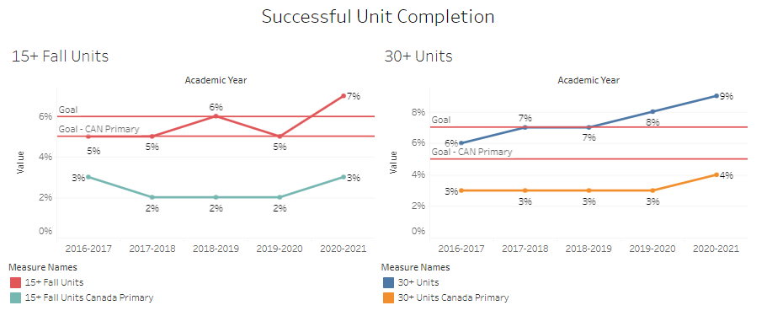
Unit completion thresholds: all students

Slide 17
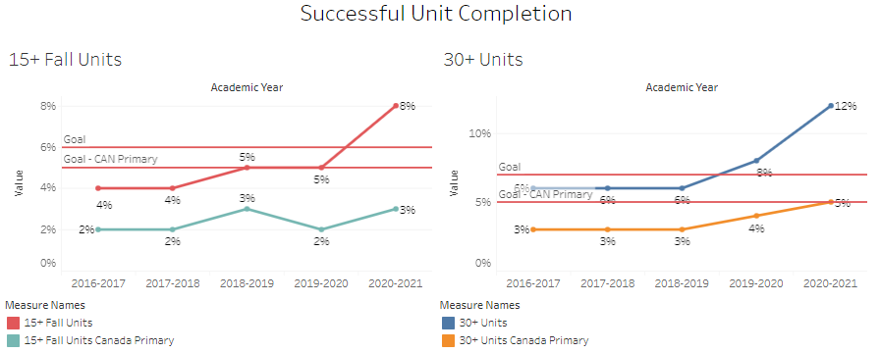
Unit completion thresholds: low income students

Slide 18
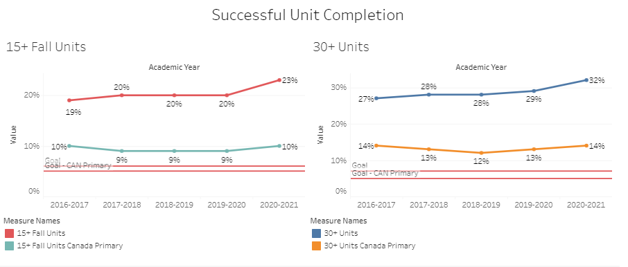
Unit completion: full time students

Slide 19
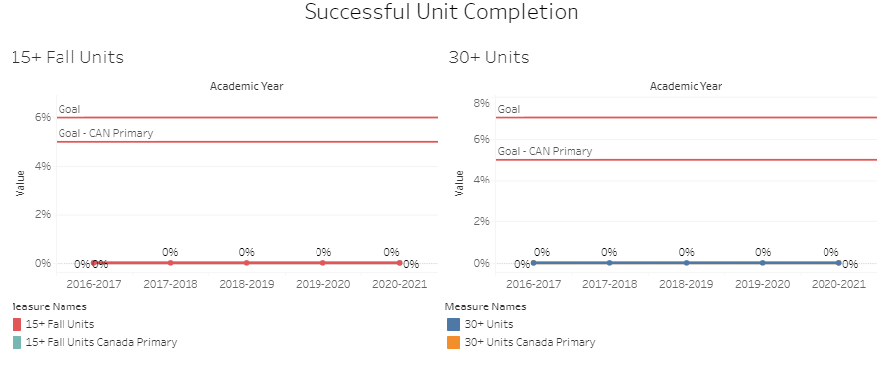
Unit completion: part time students

Slide 20
Degree completion
Notes:
This is based on unduplicated head count and cohorted based on time to complete.

Slide 21
Degree Completion by Race/Ethnicity
 | Home Campus Students 2019-2020 | % of all Associate Degree Earners 2019-2020 | Proportion (1= perfectly proportionate to enrolled home campus students)
AI/AN | 0% | 0% | 0.0
Asian | 5% | 9% | 1.9
Black/African American | 2% | 3% | 1.4
Filipino | 1% | 0% | 0.0
Hispanic/Latinx | 28% | 62% | 2.2
Pacific Islander | 1% | 0% | 0.0
White | 14% | 23% | 1.6
Multiraces | 2% | 4% | 1.6
Unknown | 7% | 0% | 0.0

Slide 22
% of First-Time students who were enrolled full-time at Cañada during the academic year

Slide 23
Resources
Cañada College PRIE dashboards:
  https://canadacollege.edu/prie/Data-Dashboards.php
Cañada College Guided Pathways (Scorecard Momentum) dashboard:
  https://canadacollege.edu/prie/dashboards/scorecard-momentum.php
Cañada College Scorecard:
  https://canadacollege.edu/prie/College%20Scorecard%20Metrics_20-21%20pending.xlsx
PRIE Analysis of Cañada’s Implementation of AB 705 to the Planning and Budgeting Council on March 3, 2021
State LaunchBoard for Guided Pathways:
  https://www.calpassplus.org/LaunchBoard/guidedpathways.aspx

