Slide 1

Interest Area Success Teams
For Guided Pathways Steering Committee
Review and Discussion
September 21, 2021

Slide 2
What is a Success Team?
A Success Team is a small group of college faculty, staff, student mentors and administrators who monitor student-level data in the Interest Area (and build and manage relationships with each student in the Interest Area) to help each student with:
  Onboarding and matriculation
  Retention and persistence
  Completion of education goals

Slide 3
 | Human Behavior and Culture | Arts, Design & Performance | Business | Science & Health
Dean | James | Hyla | Hyla | Ameer (Matt)
Lead Faculty | Denise Erickson | David Meckler | Gampi Shankar | David Monarres
Counseling Division | Gloria Darafshi | Chris Rico | Daryan Chan | Sandra Rodriguez
Retention Specialists | Diana Espinoza-Osuna | TBD | Melissa Maldonado | Gonzalo Arrizon
Learning Center (ASLT) | Peer Mentors | Peer Mentors | Peer Mentors | Peer Mentors
Data Coach | Alex Claxton | Karen Engel | Karen Engel | Milena Angelova
Manager | Director of Student Support

Slide 4
Arts, Design & Performance
Retention Specialist
Business
Retention Specialist
Human Behavior & Culture
Retention Specialist
Science & Health
Retention Specialist
TBD
Melissa
Diana
Gonzalo
Special Programs with Retention Specialists
Promise
EOPS
CWA
Other Programs
Athletics
EHD/ECE
International
Middle College
TRIO SSS
Puente
Student Support
Community of Practice
to align services and create consistency

Slide 5
Steps to full implementation in 2021-22
Create and align IA student and faculty communication plans with all Interest Area Success Teams and Special Programs to ensure clarity and consistency for students
Develop an academic year calendar of key messages and key indicators/metrics to review and monitor in order to support students effectively (and align with special program messaging)
Engage IA faculty in aligning and integrating academic support services (tutoring and mentoring) effectively with the Interest Area programs to support students
Collaborate in the design of and help implement First Year Experience Programs

Slide 6
Sample issues: communication plan
Use of Canvas Shells for each Interest Area for IA-related messaging
Content and timing of key messages to students (and faculty) during the semester
How will students’ engagement in special programs (Promise, EOPS, etc) be communicate vis-à-vis their membership and belonging in an Interest Area

Slide 7
Complete plan for aligning data for review, messaging, and activities for each IA each year
 | Goals | Data | Activities
June-July | Summer session | Receive data on students who have not registered for Fall
August | Fall semester
 | Welcome message and/or activity/event/information session |  | Collaborative workshops, Scholarships, Interpersonal Communication with Faculty, etc.
September | Early Alert, promote progress report
October | Disseminate and analyze Mid-Semester Progress Report
November | Promote registration for Spring | Receive data on students who have not registered for Spring
December | Finals
 | Follow-up with new students to see if they qualify for special programs (EOPS, Promise, ¡ESO Adelante, STEM)
January | Spring semester |  | Outreach to students on probation
 | Welcome message and/or activity/event/information session
February | Early Alert, promote progress report
March | Disseminate and analyze Mid-Semester Progress Report
April | Promote Summer and Fall registration | Receive data on students who have not registered for Summer/Fall (April & May) | Transfer information session for new students (April/May)
May | Finals
 | Follow-up with new students to see if they qualify for special programs (EOPS, Promise, ¡ESO Adelante, STEM)

Slide 8
Sample: timeline of key activities
Develop an academic semester timeline of key activities, with a focus on direct support for students within the first four weeks of the semester
Week 1 Class Visit from Success Team
Week 2-4 Retention Support Activity
Week 5-8 Academic Success Workshop/DLA

Slide 9
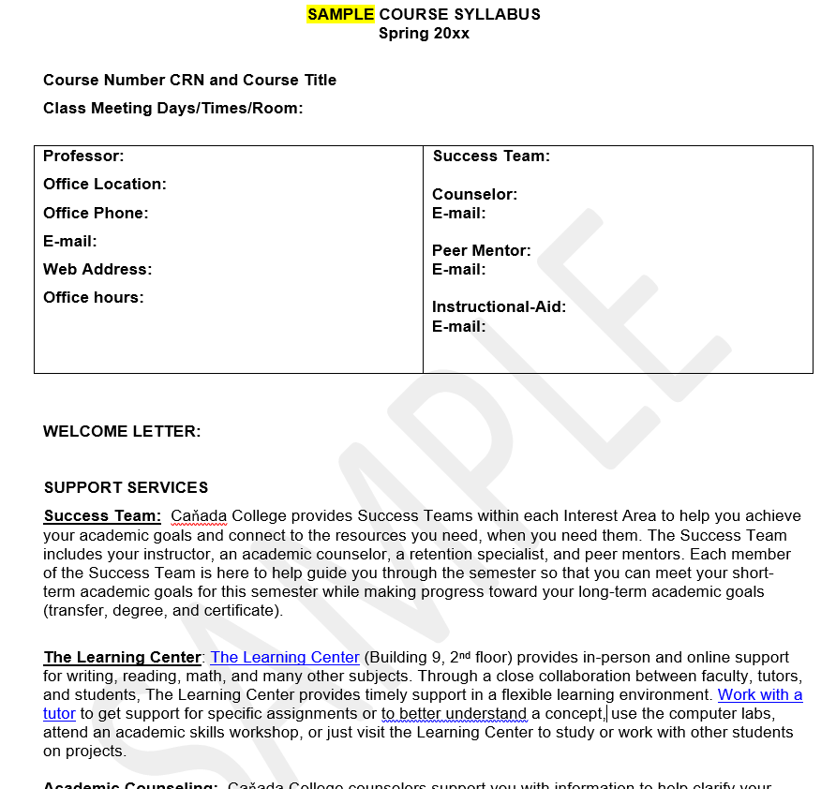
Examples: engage faculty in integrating academic support
Share information about Success Teams on course syllabi
Encourage faculty to work with the Learning Center to provide just-in-time supports (such as academic success workshops aligned with course curriculum) or use of Directed Learning Activities to support course content

Slide 10
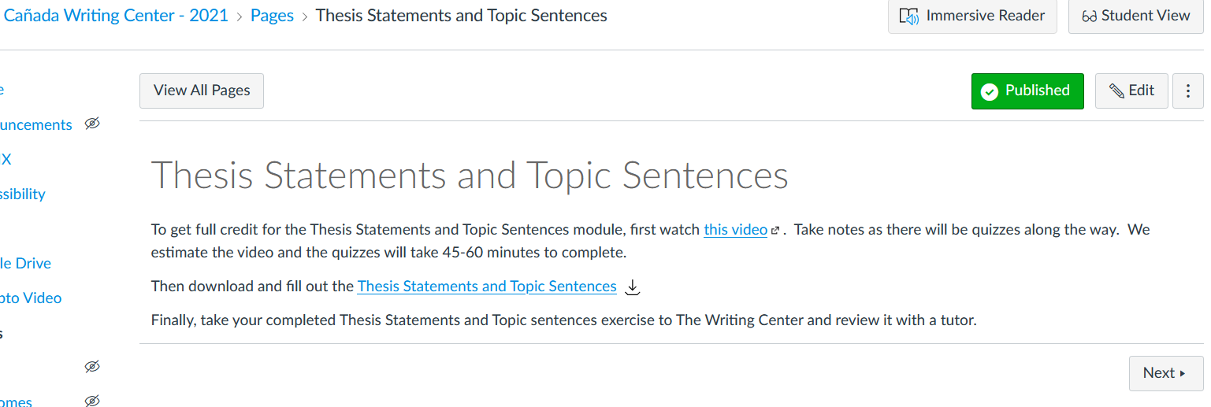
Example: Directed Learning Activity (Writing Center)

Slide 11
Success team: retention specialist
Areas of Impact: General categories of students: 1st time, Continuing, and Returning
Create channels for frequent and consistent communication to students (text, email, phone, etc.)
Daily maintenance of system for all interest area student contacts from point of application (CRM, Banner, Canvas, etc.)
Maintain regular contact with students for them to enter and stay on the Interest Area pathway
Approx. 10 - 20 hrs/week: Varying by period of semester/year (semester beginning, middle, end, and summer)
Weekly/bi-weekly Success Team and Community of Practice meetings (16 hrs/sem)
Develop initial message bundles (text, email, Canvas posts, etc.) by need or event
Establish system for regular contact with students (could be one-on-one case mgmt. and could be group sessions by milestone for continuing and returning students)
Coordination with special program retention specialists (Promise, ESL, EOPS, etc.)
Integration of Banner, CRM, & Canvas tools to help students stay on the path

Slide 12
Success team: counselor
Areas of Impact
Provide Interest Area specific educational planning for students within their Interest Area
Document and report trends in interest area educational planning to inform Program Mapper, Course Scheduled, and student engagement efforts
Develop system for regular educational planning sessions with all Interest Area students

Slide 13
Success team: faculty lead
Areas of Impact
Engage faculty effectively in implementing Early Alert and the effective integration of academic support services with academic courses and programs
Document and report trends in interest area course planning, curriculum, and instruction to inform student engagement efforts with the Success Team
Develop system to connect Success Team trends and feedback to larger Interest Area planning, including Program Mapper maintenance and updates, as well as other IA faculty engagement

Slide 14
Success team: data coach
Areas of Impact
Provide bundles of student data for Success Team members to inform the various milestones related to student engagement, completion, and overall success
Regular maintenance and reporting of data for all interest area student contacts from point of application

