Slide 1
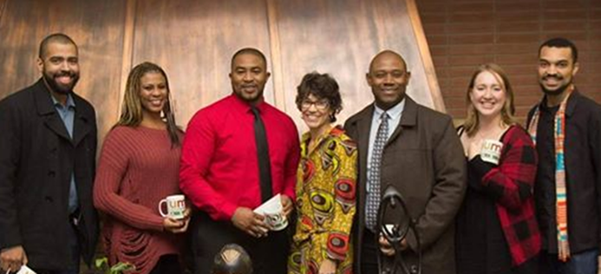

Guided Pathways
Student Success Teams
Julian West, MBA
Director
Career Ladders Project

Slide 2
COMPLETION COACHING TEAMS

Slide 3

The Foundation
Equity: Equity puts the focus on the outcomes as oppose to the process. Equity redirects resources to students most in need to produce equal outcomes. Consider students who may have specific needs or any bottleneck performers. This is why student services was created.
High Expectations: Consider what it is we are expecting from our students. Your expectations affect the level of service you provide. When we expect more of our students they expect more of themselves.
Relationships: Building relationships with students allows us to be more effective at our job. Also, consider how relationships among each other increases our ability to serve students.

Slide 4

Affinity Groups Meta-Majors
Athletes
African American Initiatives
Students with Disabilities
EOP&S
Foster Youth
Dreamers
Veterans
Kern Promise
Health Sciences
Business
Agriculture, Nutrition, and Culinary Arts
Public Safety
Industrial & Transportation
STEM
Social and Behavioral Sciences
Education
Arts, Humanities and Communication

Slide 5
Affinity Group vs. Meta-Major
Affinity Groups
More concrete foundation to build relationships with students
Targeted outreach, counseling, and service offerings
Can be utilized to expand current equity programs
May already have components in place
Meta-Majors
Ensures every student is within a completion team
Allows more robust faculty participation and curriculum alignment
Better alignment with transfer institution
More in depth knowledge of career trajectory and industry opportunities

Slide 6
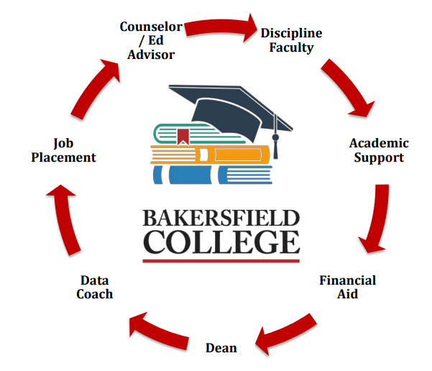



Completion Coaching Community
Counselor/Ed Advisors: Liaison and point person to students.
Dean/Director: Coordination of team meetings and outcomes
Data Coach: Finding and interpreting cohort data.
Discipline Faculty: Discipline-specific coursework, career, and tracking.
Financial Aid Expert: Tracking financial aid information.
Student Support Expert: Intrusive guidance for support in academics.

Slide 7
Key Completion Team Considerations
One-Stop-Shop: Too often we make students bounce around like pin balls in a machine. Consider cross-training and making counselors/advisors central hub for student services.
Specialization: In focusing on a specific area you develop a broader knowledge of the students you serve and the content with which you are an expert (EX: AB540 – Residency issues, Veterans – VA Benefits, STEM – Transfer requirements for various institutions).
Accountability: Students can now be accountable to a group of individuals invested in their success. Completion teams are accountable for cohort outcomes.

Slide 8
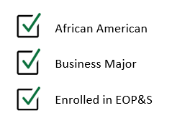





Which Team? Which Students?
AB 540
STEM Major
Promise Program

Slide 9
DATA EVOLUTION

Slide 10


Types of Data
Communication Management
Data Analytics
Program Pathways Mapper
Support Services Utilization
Early Alerts
Focus Groups
Student Success Data
Student Data Reports On-Demand

Slide 11

Data Coaching
Building Capacity
Empowering The Front Lines
Engaging Multiple Constituencies
Uncovering Institutional Blind Spots

Slide 12
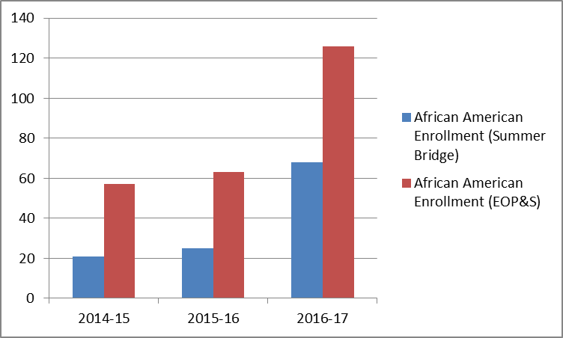
AAI Outcomes
HIGHER AMOUNT OF SUPPORT – DOUBLING AFRICAN-AMERICAN ENROLLMENT IN PROGRAMS THAT MATTER MOST

Slide 13
ENGAGING COMMUNITY PARTNERS

Slide 14
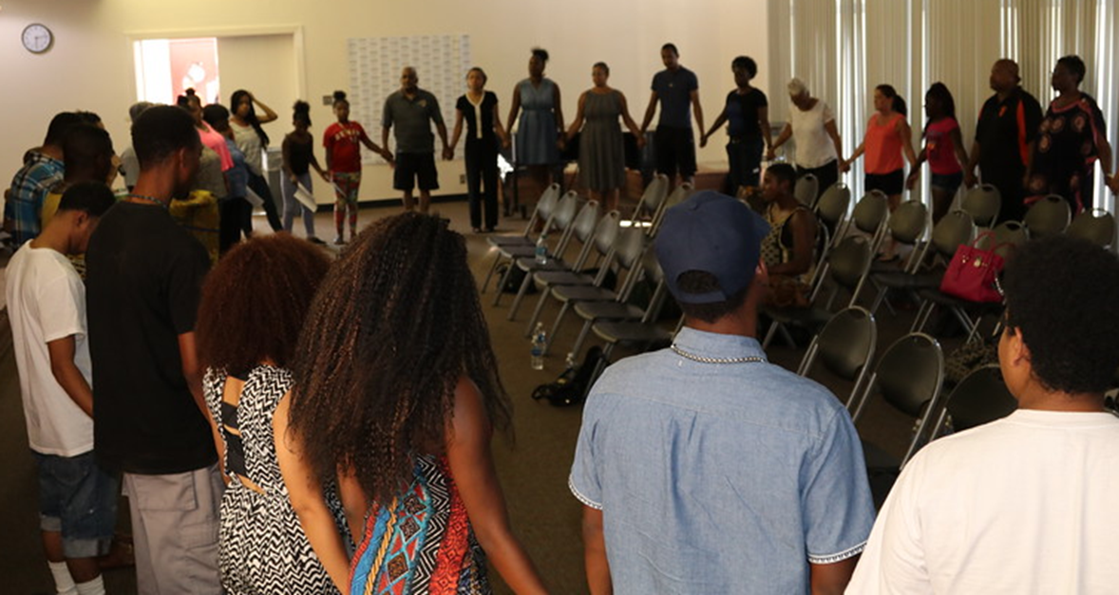
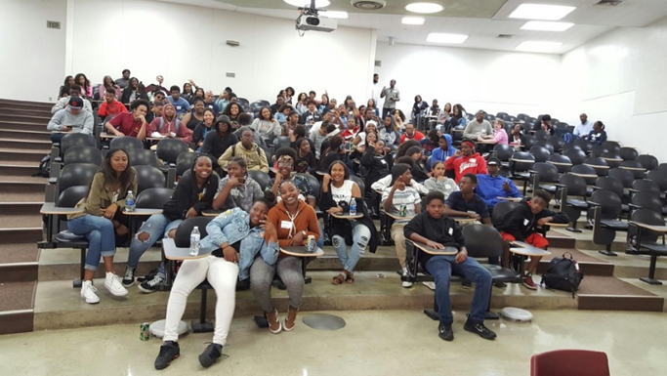
Emphasis on Community
Aligning our Agendas
Broadening our Access to Information
Creating Advocates Outside of the Institution

Slide 15
Elements of a Good Partnerships
Find people in communities who can network and make connections.
Develop a knowledge of community needs—understanding of how issues (like homelessness and K-12 schooling) play out locally.
Recognize that communities and campuses each have multiple players and perspectives.
Develop specific opportunities for community partners to make use of campus resources, such as attending classes, accessing research, and developing curriculum - not just use of the gym.

Slide 16
INTRUSIVE GUIDANCE

Slide 17

Students Want Us To Care
Strong relationships with students and educators allows for more intrusive counseling.
Collaboration with Faculty
Holistic Concern for Students
Walk and Talk with Students
Get to the ROOT Causes
Consistently Follow Up
Highlight Success and Address Failure
Go Beyond Matriculation

Slide 18
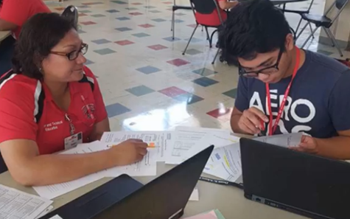
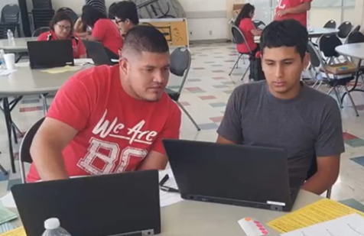
Proactive Vs Reactive
The students who need our services most do not know to come and see us; How do you seek services you do not realize you need?
Consider addressing issues with students before they do; Shift contacts from drop-ins to appointments.
Emails, Phone Calls, Text Messaging, Classroom Visits.

Slide 19
STUDENT LIFE INTEGRATION

Slide 20
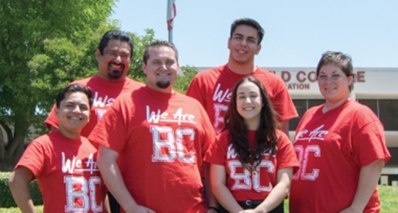
Empowering our Students to Lead
Ask not what you can do for your student organizations, but what you can do with your student organizations.

Slide 21
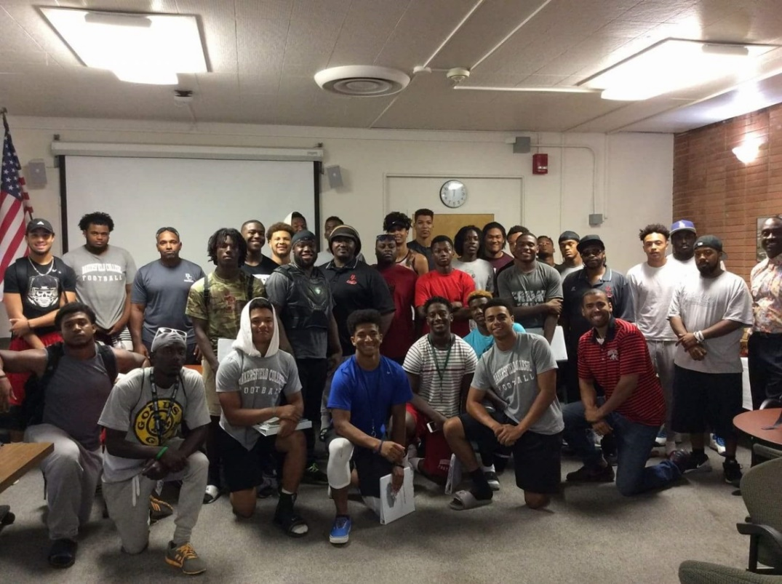
We Cannot Succeed Without Our Students
Who better to lead a push for student success than students?
Utilize the culture as an asset to add to conversations
Allow students to produce knowledge

Slide 22
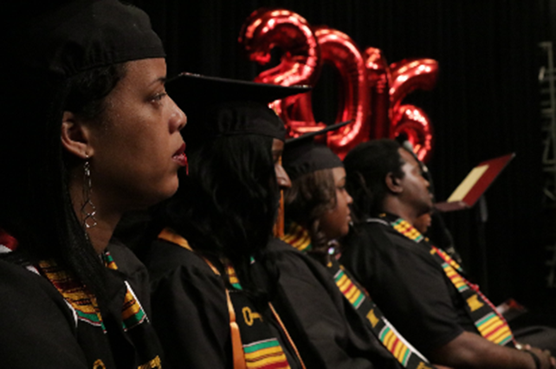
Final Thoughts
1. You cannot have equity without high expectations.
2. Culture eats strategy for breakfast.
3. If your not stretched thin your not doing Guided Pathways.
4. RELATIONSHIPS are the foundation of our work!

