Slide 1
Evening Students
Spring 2023
As of March 7, 2023

Slide 2
Spring 2023 Evening Enrollment Data
Term | Cañada College Unduplicated Headcount | Total Enrollments | Total unique sections | Evening or Saturday Sections | Enrolled in At Least One Evening And/Or Saturday Section at Cañada | All Enrollments at Cañada are Exclusively in Evening And/Or Saturday Sections | Cañada Students Who Are Active Members of the WRKADLT Cohort (Regardless of Time/Day of Enrollments)
Spring 2023 | 5833 | 10,285 | 448 | 114 | 1227 | 660 | 105
Percentages |  |  |  | 25% | 21% | 6% | 2%

Slide 3
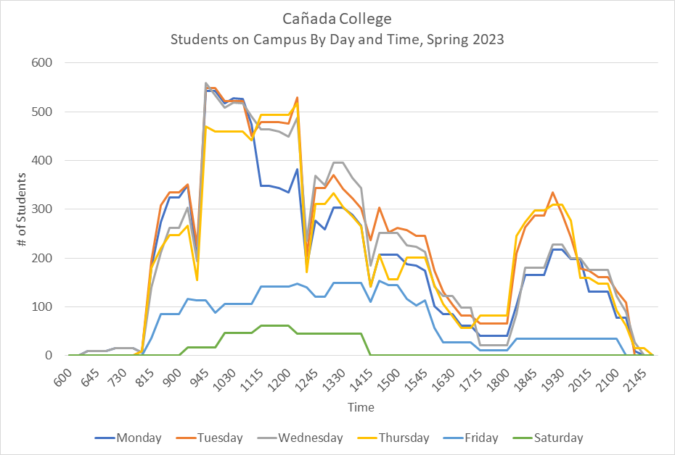

Slide 5
Classes that might be room agnostic
ACTG-100 | ESL-400
ACTG-121 | ESL-837
ACTG-131 | ESL-912
ACTG-200 | ESL-913
ART-131 | ESL-914
BUS.-100 | ESL-922
BUS.-201 | ESL-923
COMM-130 | ESL-924
CRER-137 | ETHN-108
ECE.-366 | PHIL-100
ECON-100 | PSYC-205
ENGL-100 | SOCI-205
ENGL-105 | SPAN-120
ENGL-110 | SPAN-122
ENGL-161 | SPAN-131
ENGL-162 | SPAN-132
 | SPAN-140

Slide 6
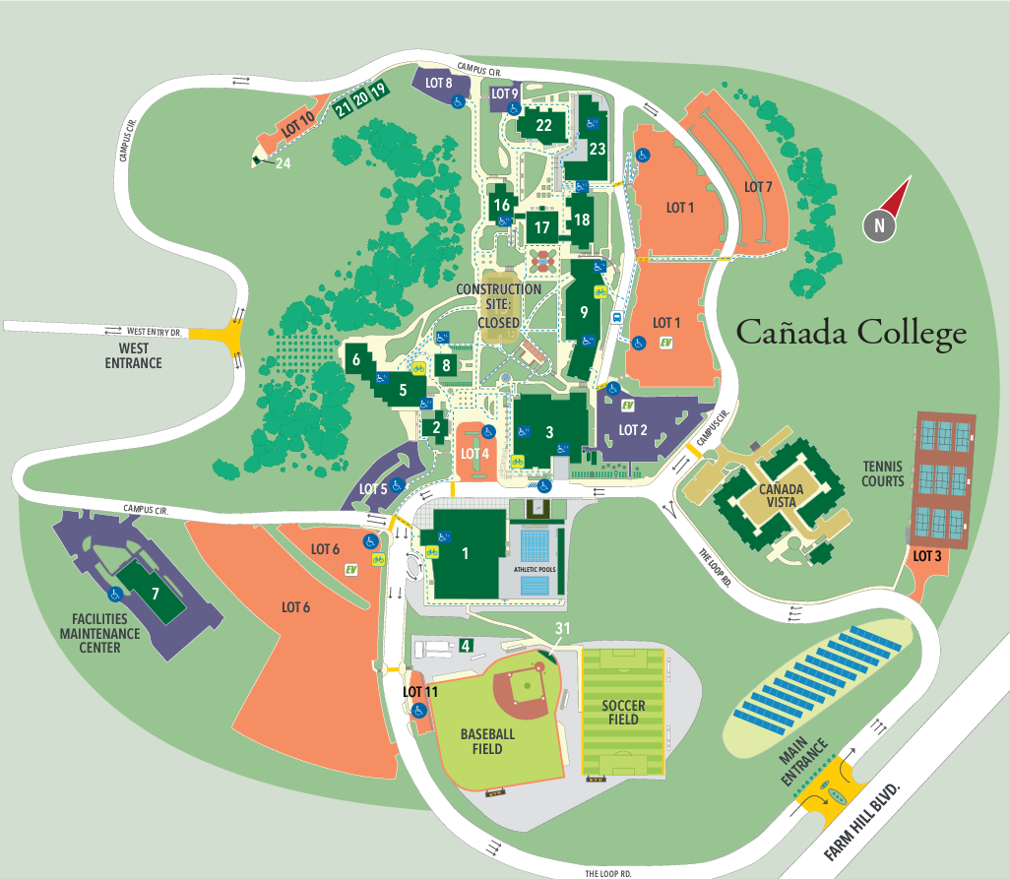
133
50
74
Monday
20
19
24
32
16
59
40

Slide 7
57
Tuesday
52
30
24
24
173
24
59
35
130
40

Slide 8
98
84
125
Wednesday
24
16
23
24
52
16
24
40
24

Slide 9
Thursday
30
72
26
38
26
92
52
16
130
40

Slide 10
Friday
24
34
30
40

Slide 11
Understanding student motivation
Survey of evening students?

