Slide 1
Guided Pathways Metrics

Slide 2
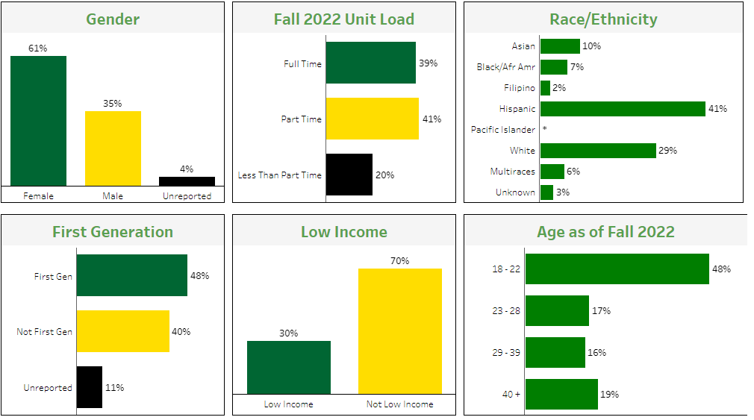
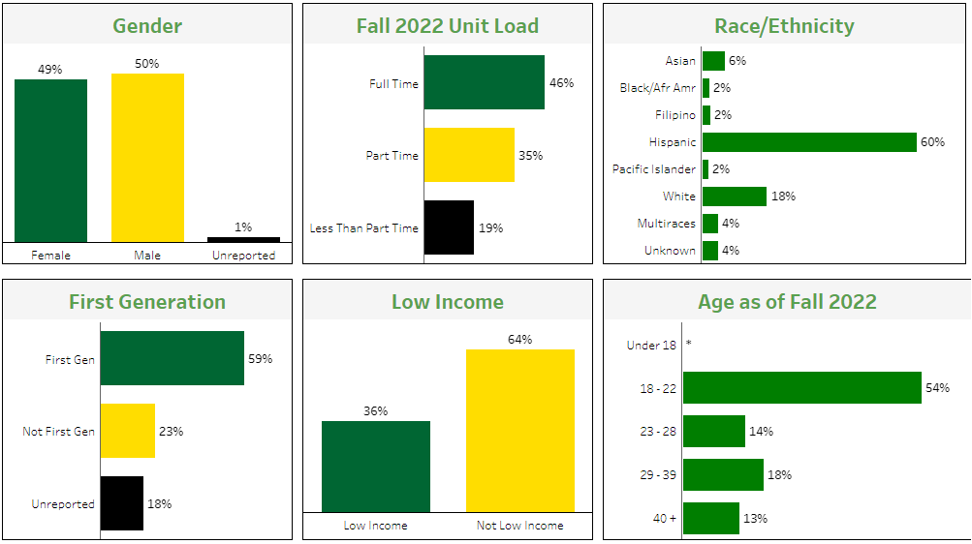
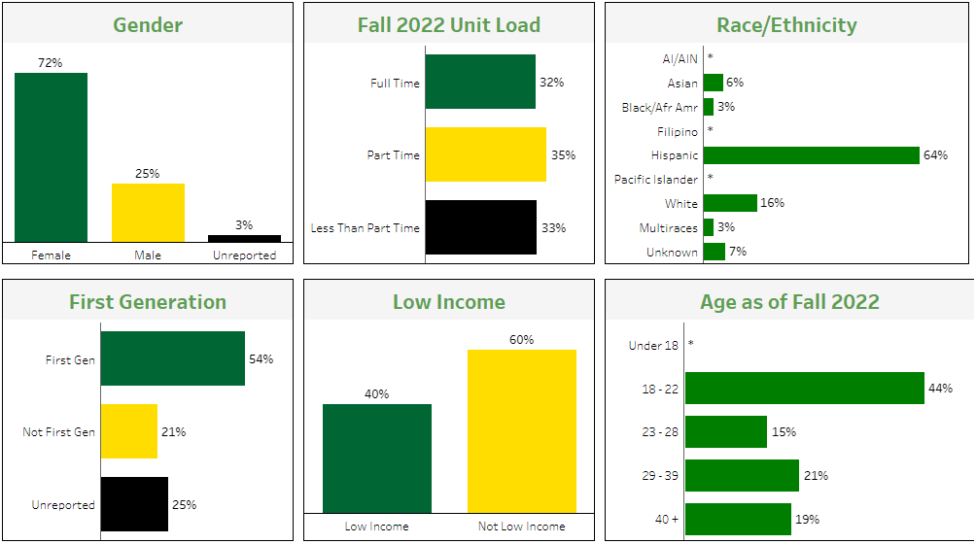
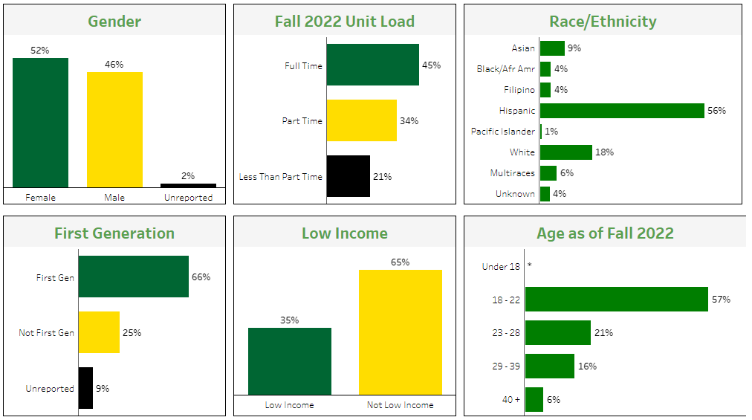
ADP
BUS
362
402
HBC
S&H
704
738

Slide 3
ADP students are the least likely to have completed transfer level English and math, while Science and Health students are the most likely

Slide 4
Having an active SEP is relatively uniform across interest areas, while persistence varies drastically

Slide 5
In each interest area approximately one fifth of students have earned over 60 units

Slide 6
533 students are attending face-to-face classes in the evening this Spring
Education Goal
Home Campus
Program of Study (Major Group) | % of all Evening, F2F Students
Undecided | 35%
PASS/PATH | 18%
CSM/SKY Program of Study | 17%
Digital Art and Animation | 5%
Business Admin/Management | 4%
Fashion Design and Merchandising | 4%

Slide 7
Challenges facing evening teachers and students (summary):
Lack of access to support services (extended hours needed)
Poorly timed public transportation (SAMTrans)
Limited food options
Poorly lit areas on campus
Limited access to practice rooms
The absence of evening IT support
The need for basic first aid, particularly in situations where a student may require non-life threatening medical attention
A need for extended hours for the bookstore to accommodate students who work until 5 pm and have evening classes.
Additionally, having a consolidated space [such as a “Hub] for all facilities available to both day and evening students could be helpful.

