Slide 1
Learning Disability Assessment
November 4th, 2016
Jenna French, M.S.
Learning Disability Specialist / DRC Counselor
frenchj@smccd.edu Ext 3368

Slide 2

Jenna French – My Story
Diagnosis in 2nd Grade with Dyslexia
Self Esteem
High School Experience
UCSC – Took while to ask for accommodations
MS Rehabilitation Counseling
What did I do to help me be successful?
What did professors do to help me be successful?

Slide 3
The most important thing to take away today…..
What is the best thing a professor can do for a student with a disability?

Slide 4

ASK THE STUDENT

Slide 5

DRC Role
DRC role is to provide accommodations and assistance to students with disabilities that facilitate their achieving their educational goals.
We are committed to ensuring that students receive equal access to all programs and services.
With our obligation to protect the integrity of our college’s programs and services.

Slide 6
TYPES OF DISABILITIES
Developmental Disabilities
  ADHD
  Autism Spectrum Disorder
  Learning Disabilities
Psychological Disabilities
  Anxiety
  Depression
  Bi Polar
  Schizophrenia
  Personality Disorders
Acquired Disabilities
  Traumatic Brain Injury
  Temporary Disabilities
Legal Blindness or Visual Impairment
Deaf and Hard of Hearing
Physical Disabilities
  Back Impairments
  Paraplegia
  Quadriplegia
Chronic Health Conditions
  Addison's
  HIV
  MS
  Fibromyalgia
  Diabetes
  Cerebral Palsy
  Gastrointestinal Disorders
  Migraine Headaches
  Sickle Cell Anemia

Slide 7
DRC Student Data
 | 2012 – 2013 Student Count | 2012 – 2013 Student Count (%) | 2013 – 2014 Student Count | 2013 – 2014 Student Count (%) | 2014 – 2015 Student Count | 2014 – 2015 Student Count (%)
Total | 218 | 100% | 252 | 100% | 315 | 100%
Acquired Brain Injury | 6 | 2.75% | 10 | 3.97% | 6 | 1.90%
Developmental Delayed Learner | 4 | 1.83% | 6 | 2.38% | 5 | 1.59%
Hearing Impaired | 6 | 2.75% | 5 | 1.98% | 8 | 2.54%
Learning Disabled | 29 | 13.30% | 28 | 11.11% | 34 | 10.79%
Mobility Impaired | 21 | 9.63% | 25 | 9.92% | 26 | 8.25%
Other Disability (ADHD, Autism) | 94 | 43.12% | 114 | 45.24% | 152 | 48.25%
Psychologist Disability | 49 | 22.48% | 55 | 21.83% | 75 | 23.81%
Speech/Language Impairment | 2 | 0.92% | 4 | 1.59% | 4 | 1.27%
Visual Impairment | 7 | 3.21% | 5 | 1.98% | 5 | 1.59%

Slide 8

How to register with DRC
Schedule an appointment with a DRC Counselor to discuss your accommodation needs.
Bring with you any documentation related to your disability, doctor's information, or IEP/Triennial that you may have.
Have your request for services evaluated and reasonable accommodations arranged.
Students can register anytime during the semester.

Slide 9
What is an Accommodation?
An academic adjustment that allows a student with a disability the opportunity for equal participation in College coursework.
Determined on an individual basis
Supported by appropriate medical documentation
Doesn’t compromise academic standards
Spoon Example

Slide 10
What is a Learning Disability?
Persistent/Chronic condition
Significant processing deficit
  Memory, verbal skills, non-verbal reasoning/visual-spatial skills or processing speed
Difficulty in major subjects like reading, writing, math, or listening.
A learning disability is not difficulty with a challenging subject like higher level science or math.
It is not a psychological condition:
  Not test anxiety
  Not ADHD

Slide 11
Signs a student might have an LD
- HANDOUT
Learning difference in the way a person takes in, understands, remembers, and/or expresses information
Difficulties with reading, writing, and/or math
Repeating courses
Mentions they had an IEP/504 plan in high school (could be a different type of disability)
Mentions any of characteristics on the “What are Learning Disabilities” Handout

Slide 12
Learning Disability Testing Process
To Request Testing a Student Must:
  Be enrolled in at least one course
  Make an intake appointment with the learning disability specialist by calling 650-306-3259.
How does LD Testing help the student?
  Find out if they have a learning disability
  Discover their abilities and strengths
  Determine their limitations and accommodations
  Learn Study Strategies specific for the student learning

Slide 13
Learning Disability Testing Process
Does the student get after testing?
  All the testing documentation, this can be brought to the 4 year college
  This documentation can be brought to other community college
Testing Process
  1 hour Interview
  Two 3 hour testing
  1 hour results – set up accommodations

Slide 14
Reasons to Refer a Student for LD Testing
2-3 hours per every hour they spend in the classroom, but the evaluations of their learning do not reflect
Significant discrepancies between any of the following:
  the student’s test scores, homework, written work, verbally expressed understanding of course concepts, or any other evaluative process.
Significant discrepancy in achievement from one type of course to another,
  passing grades in math and sciences, while receiving failing grades in English and social sciences.

Slide 15
How to refer a student to the DRC?
Do not ask the student directly if they have a disability.
Use the class schedule on page 13-14, to show contact information for: Learning Center, Career Center, Counseling Center, Transfer Center, Bookstore, EOPS/CARE/CalWorks/Former Foster Youth, Health Center, Psychological Services, International Students, TRiO SSS, Veterans Services etc.. You might say, "I want to share some information on campus services that you might find helpful."
When you mention the DRC, you could ask the student, "Are you aware of the DRC office? The DRC provides a number of services for students with a variety of disabilities.”
Notes:
Private meeting
The student might then say, “Oh ya I had an IEP” or “Ya, I went to the resource room.” If you hear this tell them that they should then contact the DRC. They might qualify for the same type of supports that they did in highschool.

Slide 16
How to refer a student to the DRC?
Ultimately it is up to the student
Do not force a student to walk over the to DRC.
Please do not ask the student to provide you any disability related documentation.
Examples of what to say:
“There is the DRC, this service is for students with disabilities to get academic accommodations. Any student who had an IEP/504 plan or attended the resource room might qualify for these services. Example of some accommodations are extra time on exams, and notetaking support. They also provide Learning Disability testing for students who are interested in being tested.”

Slide 17
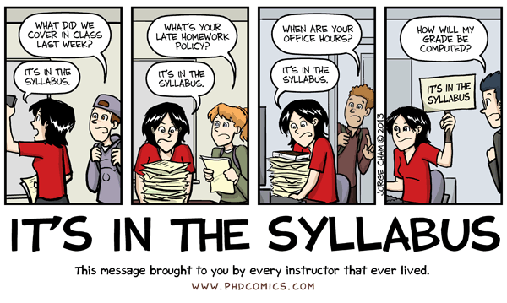
Syllabus – Add a disability statement
All faculty will want to put a statement about accommodations in their syllabus or first day handout to inform students about their right. You can use a statement like this:
“Any student who feels he or she may need an accommodation based on the impact of a disability should contact the DRC by calling 650-306-3259, or visit 5- 303 to coordinate reasonable accommodations for students with documented disabilities.”

Slide 18
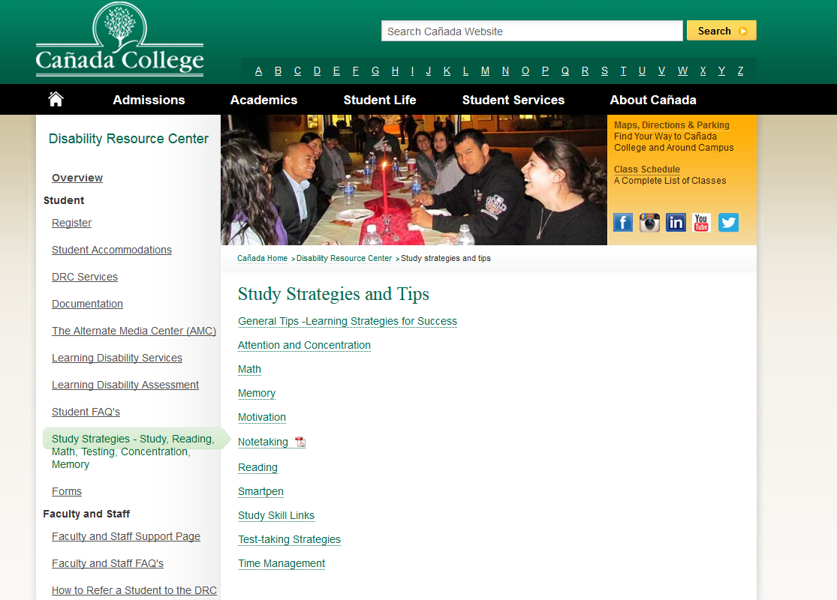
Check out our Website

Slide 19
The most important thing to take away today…..
What is the best thing a professor can do for a student with a disability?

Slide 20
ASK THE STUDENT

Slide 21

Any Questions?

