Slide 1
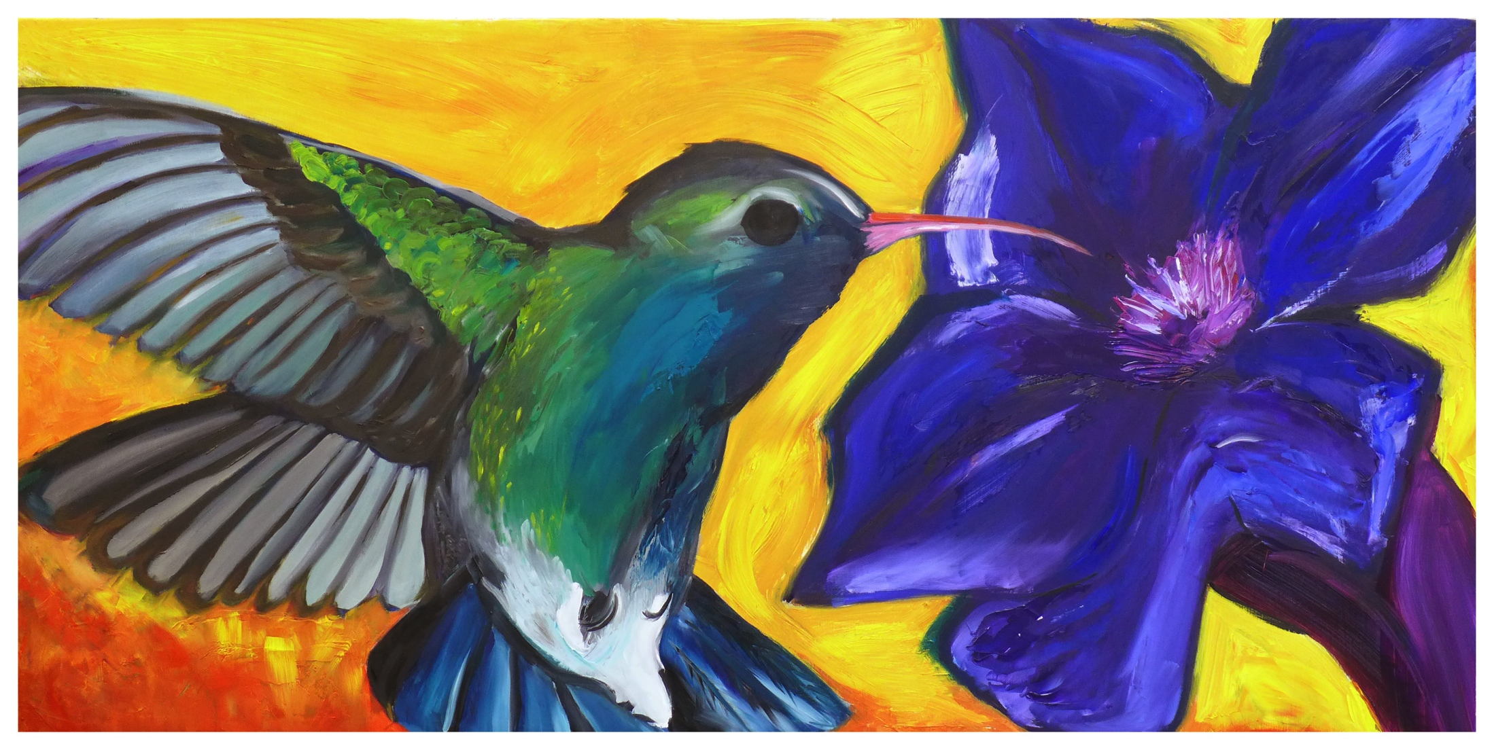
Program Review
Art and Art History

Slide 2
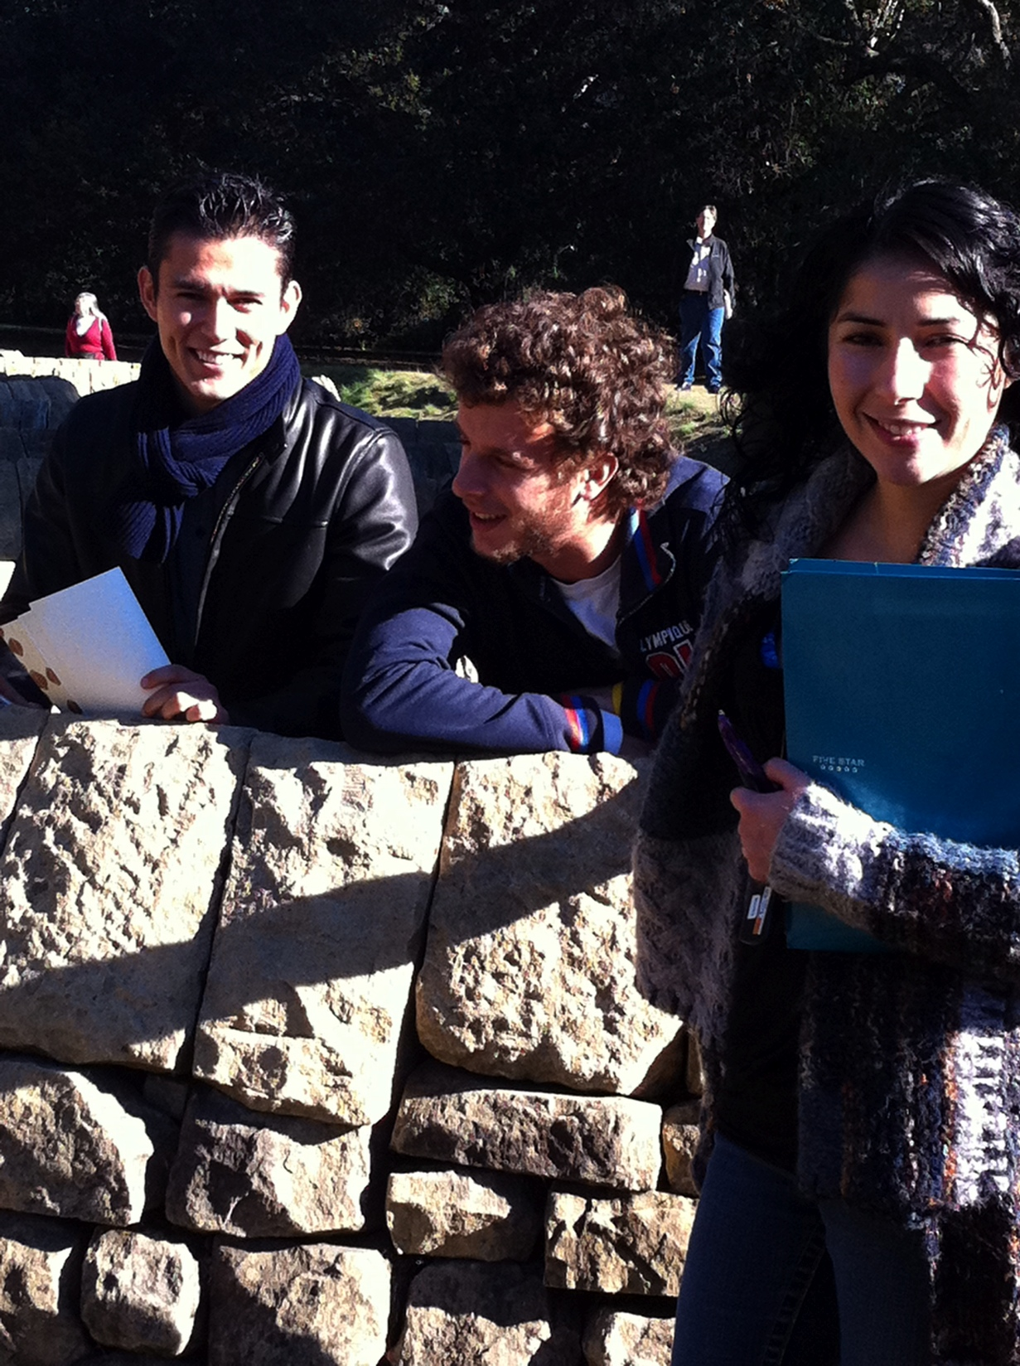
Strengths and Challenges of the
Art History Program
Strengths
Strong enrollments
Successful completion rates
Strong student satisfaction
Supports the transfer program
Success with Honors (Art History students are consistently chosen to present their research at the Bay Area Honors Consortium)
Strong support from the community, and reputation for excellence

Slide 3
Strengths of the
Art History Program
NEW Courses which support the AA, the AA-T and the Certificate:
Art 113 - Great Museums of America
Art 114 – The Art History of Paris
Art 116 – The Art of Great Britain
Art 118 – The Art of Spain
NEW courses offered for Honors Credit:
Art 102, Art 103,Art 104
NEW partnership between Art 104 and Music 115 creates a unique interdisciplinary opportunity for students

Slide 4
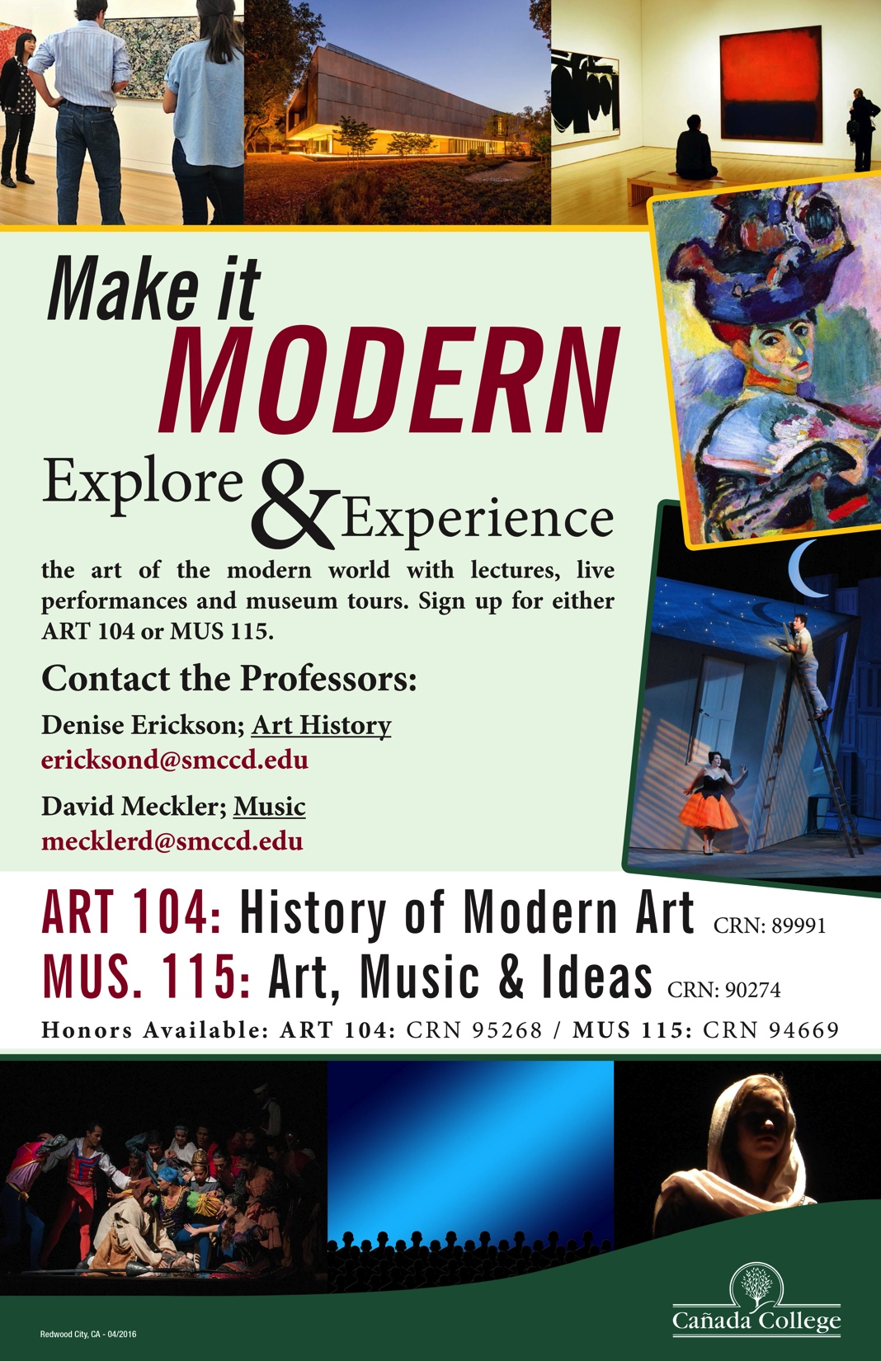
Strengths of the
Art History Program
Art History courses are included in both the NEW Social Justice and Sustainability GE Pathways
NEW partnership with the Stanford Arts Initiative provides outstanding field trip and research opportunities for our students
Current boom in Bay Area Art Museums means jobs – our NEW courses on Art Museums create a foundation for the burgeoning Museum Studies programs at local colleges and universities

Slide 5
Challenges of the Art History Program
Disappearance of 680’s (standalone courses) make Curriculum work more challenging
Repeatability rules make it challenging to serve many valuable members of our community whose goals are not transfer, basic skills, or workforce
Students coming to college have an increasingly limited knowledge of history
Students have increasingly short attention spans, which makes deep looking at images challenging
The CSU’s (not the UC’s) would like to see us cram four semesters of Art History into two semesters, turning our program into a processing plant to produce “sausage” students who are out the door in two years. This diminishes the students’ opportunity for intellectual growth in an academic setting, where they can discover critical thinking skills and an awareness of the world to be applied in their future education, and their professional and personal lives.

Slide 6
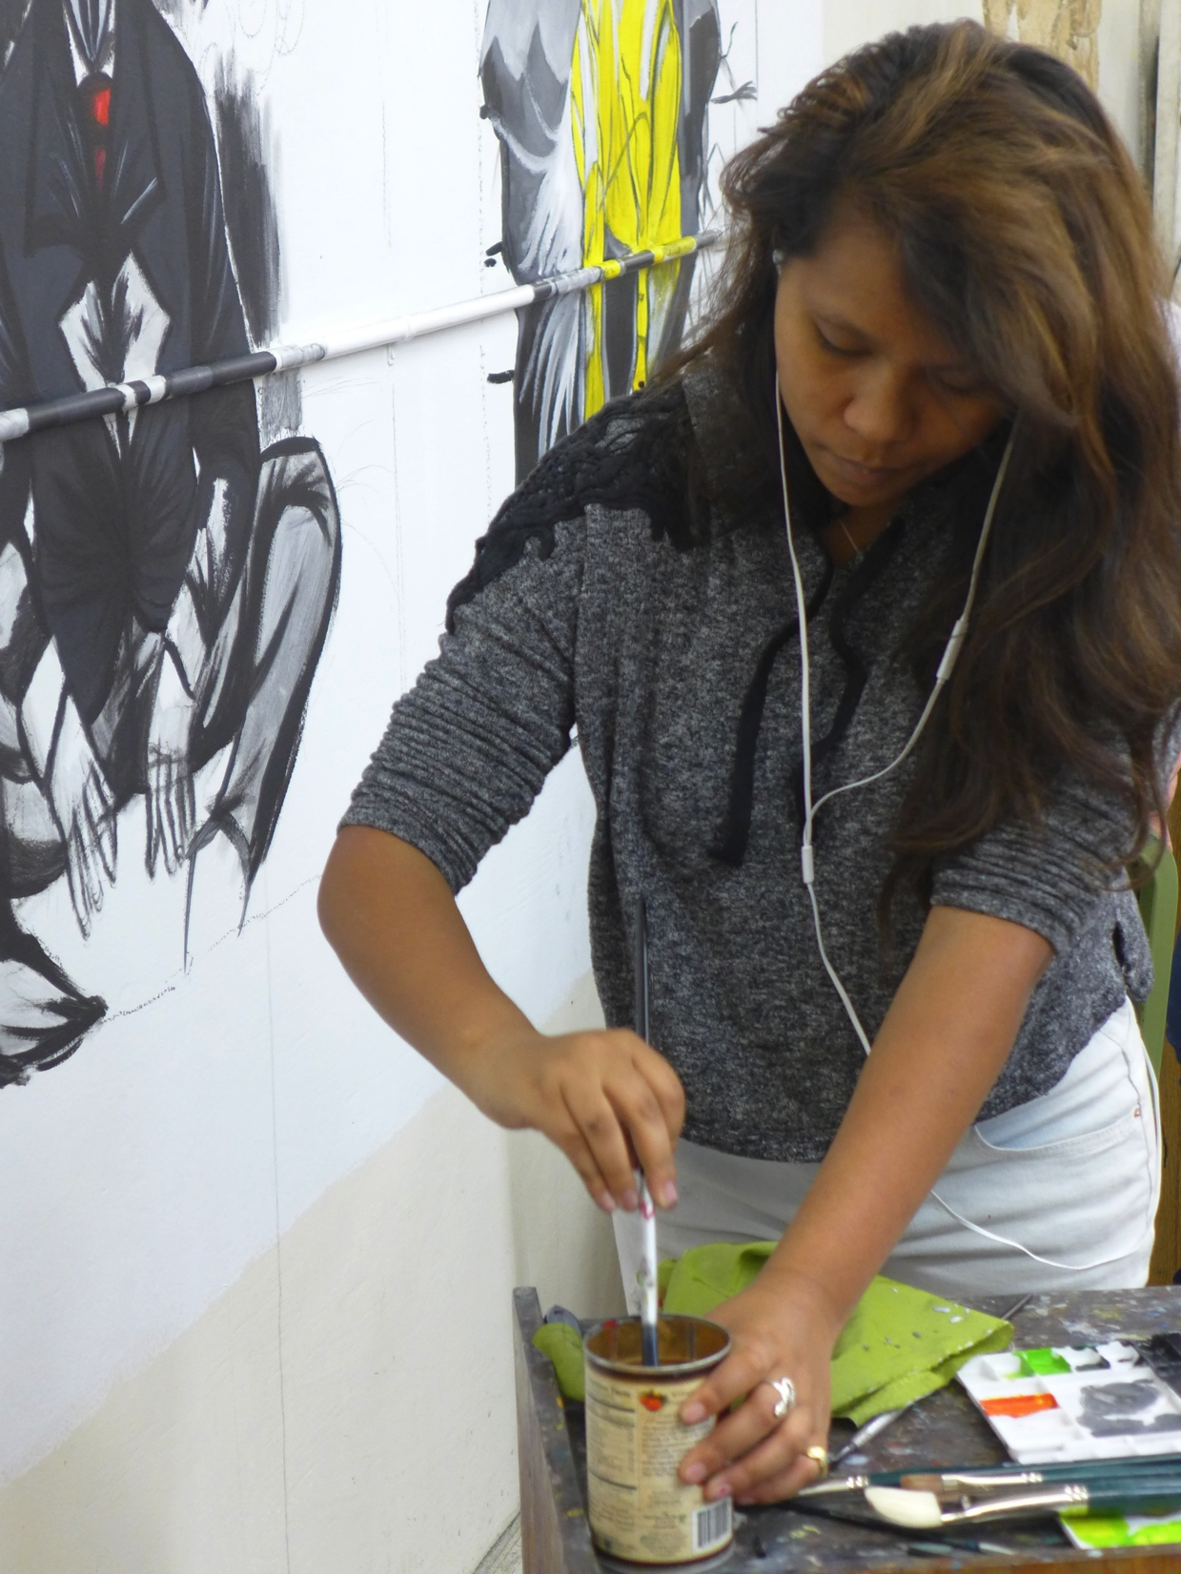
Studio Art Program Strengths
Quality instruction in Studio Art to a diverse population including
Art and Art History Majors
Students in related design arts fields needing the fine arts skills and experience we offer
Middle College students fulfilling the fine arts requirement
Students seeking an introduction into the practice of art
Students seeking to strengthen and refine their skills
New courses:
ART 306 3D Design, to complete the AA-T in Art
ART 213 LifeDrawing II, ART 231 Watercolor I, and ART 232 Watercolor II to broaden our offerings

Slide 7
Studio Art Program Strengths
The Cañada Art Gallery offers an excellent program of exhibitions by accomplished Bay Area artists. The aim is to bring art to our students who might not otherwise seek it out. The quality of the art shown is of the highest.
The Cañada Art Gallery and the Main Theatre gallery also showcase the work of students and faculty in the Art and the Multimedia Arts departments.

Slide 8
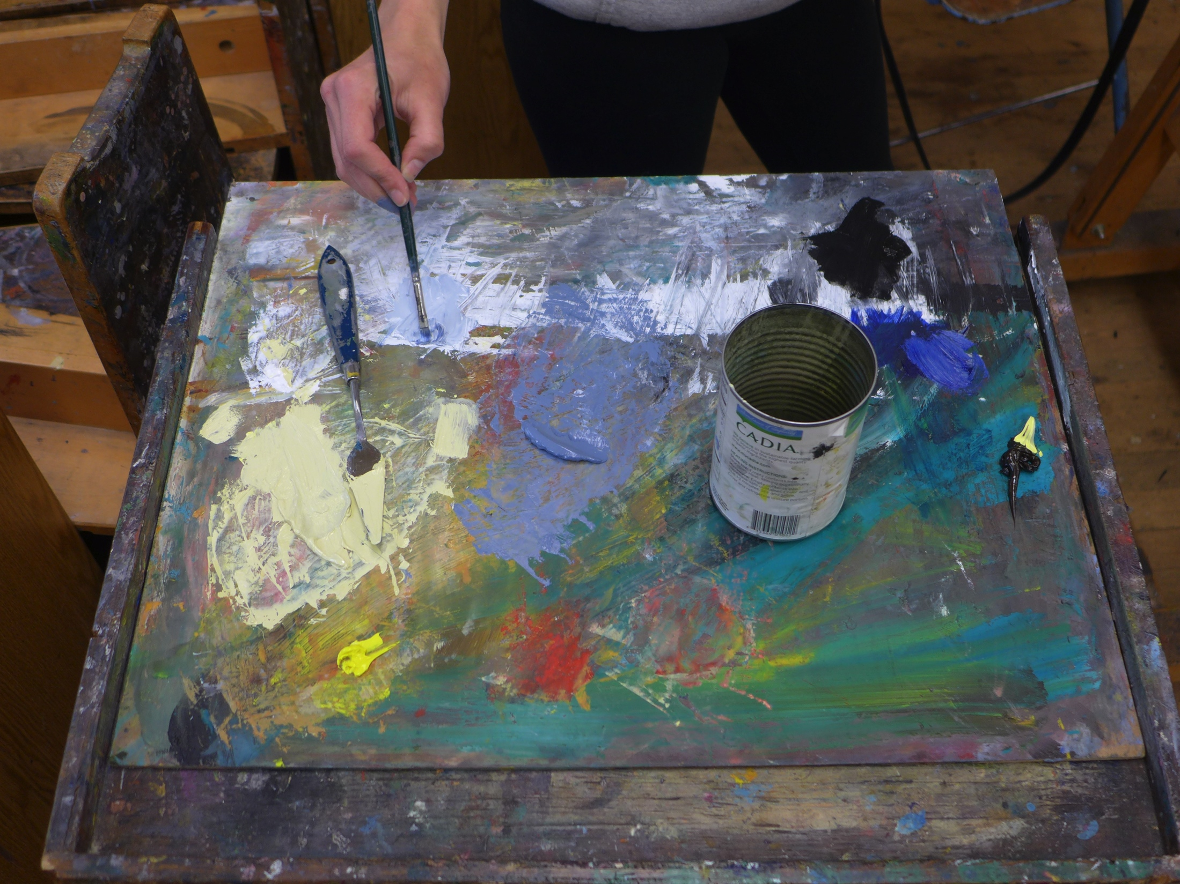
Challenges of the Studio Arts Program
Declining enrollments in Studio Arts over the last 3 years due to:
Lower enrollments college-wide during this period
Elimination of Studio Art courses being accepted for GE credit
Emphasis on moving students through the college more efficiently
Photography darkroom closed down by the District due to safety concerns with no timeline for reopening. This eliminates an important area of our program and negatively impacts our ability to offer the AA-T in Studio Art.

Slide 9
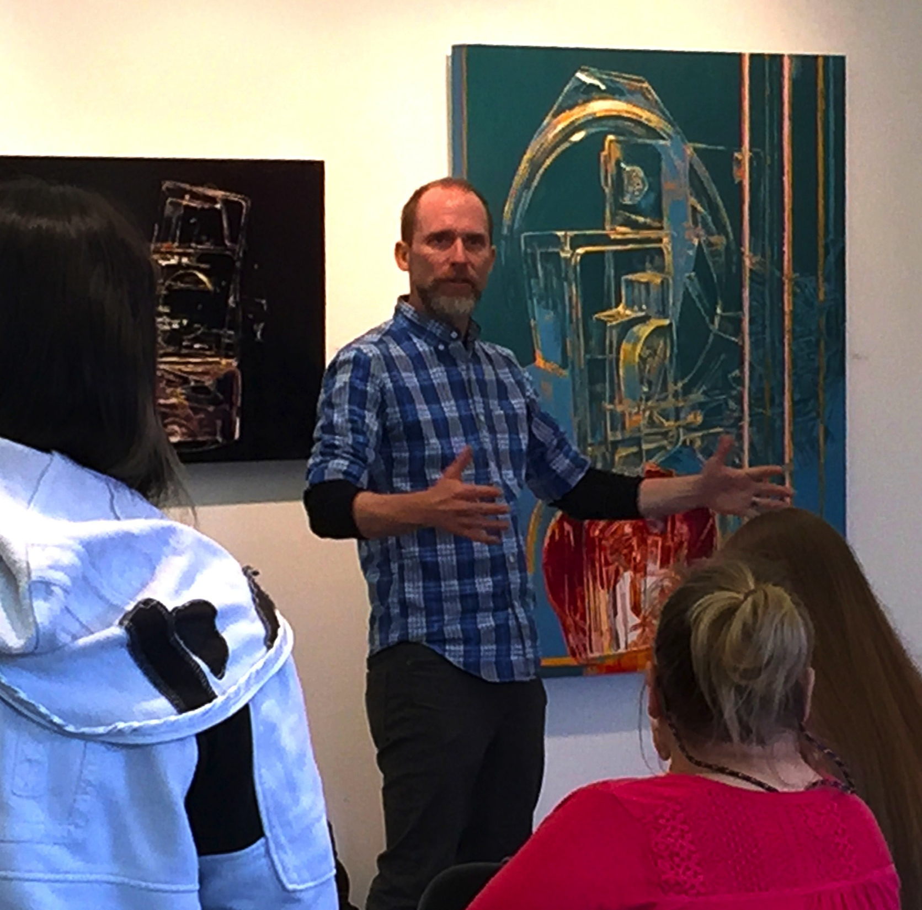
Goals of the Art Program
Participate as leaders in the Arts Task Force to mobilize college-wide support of the Art Studio and Art History programs
Persist in getting administrative support for an Arts Coordinator to facilitate and support curriculum development, planning, community outreach, and marketing (ACCOMPLISHED)
Initiate an active marketing plan to increase awareness of the presence and quality of the art program, and the excellence of the art gallery

Slide 10
Goals of the Art Program
Re-brand the Art Program by creating an Arts Honors Certificate, which raises the profile of all the arts at Cañada, and draws students from other colleges
Work with the counselors to clarify and strengthen the message to students about the value of art classes for their education and careers
Research ways to comply with state guidelines for our Art Studio classes to articulate for GE credit
Research Museum Studies programs in the Bay Area to see how we can help meet the growing demand for a museum work force
Attend the 2017 College Art Association Conference in New York to research new trends in pedagogy and scholarship
Improve the space and facilities of the photography and art studio classes to improve instruction

